Slide 1
A generative model towards
high-quality text-to-speech synthesis
using normalizing flow
Group
Yulou Liu
Fengshuo Yang
Yixun Zhu

Slide 2
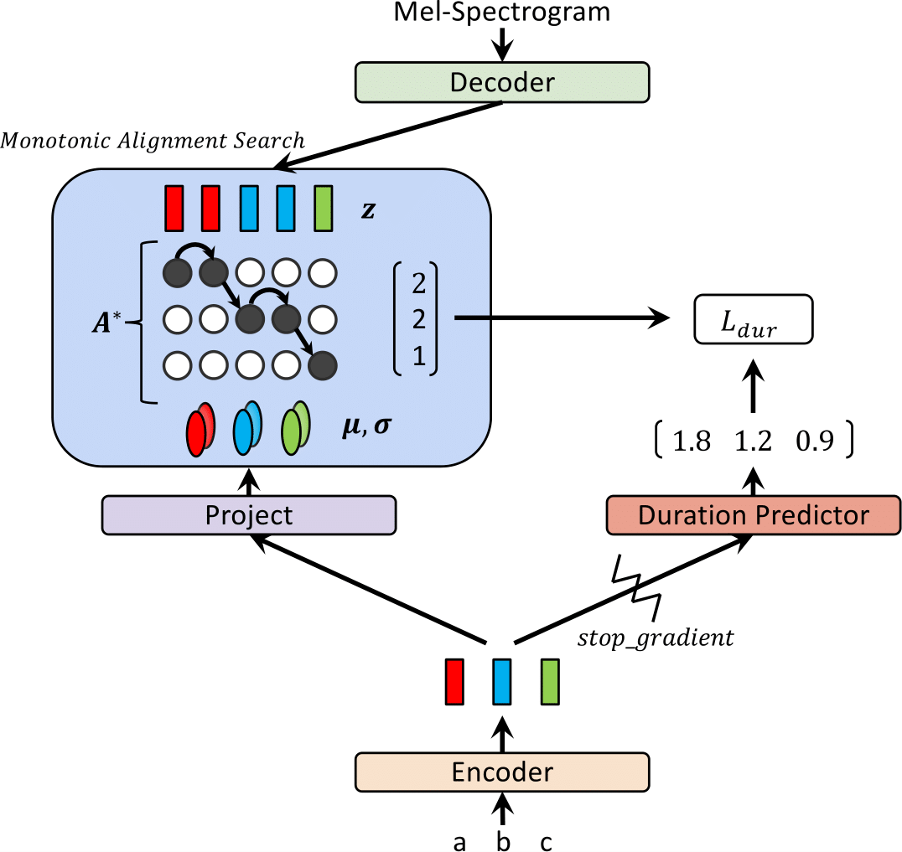
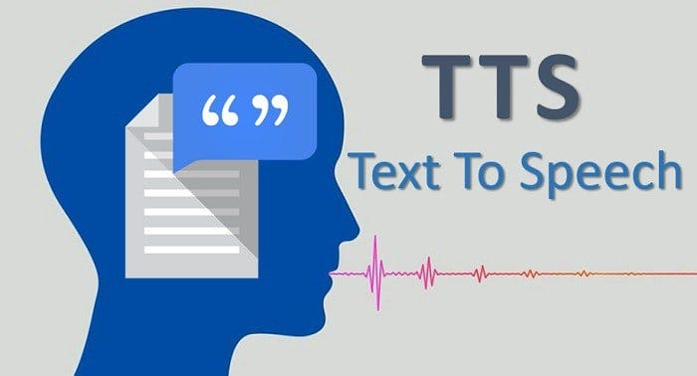
Idea & Background
Introduction
Related work
Improvement direction
Research in text-to-speech systems dates back decades.
Tacotron 2
Autoregressive
soft attention
Transformer TT
Autoregressive
No meaningful latent space
Deep Voice 3
large model and more components
we will implement a flow-based neural network for speech synthesis.

Slide 3
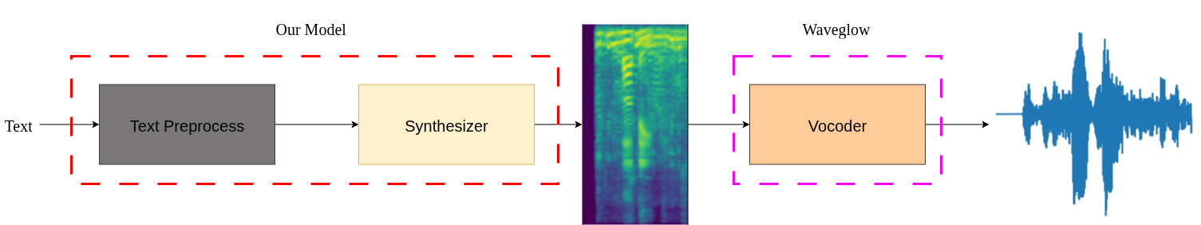
Pipeline overview
Text
→ Linguistic Features
→ Acoustic Features(Mel-Spectrogram)
→ Speech Waveform

Slide 4
→ Input: Phoneme sequence after text parsing + prosodic features
→ Output: Time-step aligned Mel-spectrogram
Flow-based model (Glow)
→ Input: Model-generated Mel-spectrogram
→ Output: speech waveform
Module: WaveGlow
number
symbol
abbreviation
Text Normalization
Word Segmentation and Phonemization
Mel
-Spectrogram
Alignment
Vocoder Reconstruction
I love TTS → AY1/L AH1 V/T T S
love → L AH1 V
Module: Monotonic Alignment Search

Slide 5
Dataset Preparation
LJ Speech dataset
13,100 short audio clips
Each clip is paired with a text transcription

Slide 6
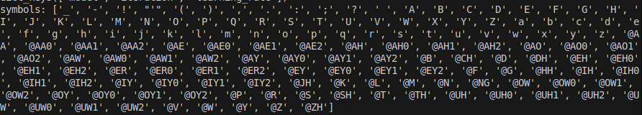
Symbol
table
special character
alphabets
phonemes
size of 149

Slide 7
Text normalization
—— Perform phonemic transcription
Between -> B IH0 T W IY1 N
the -> DH AH0
hours -> AW1 ER0 Z
of -> AH1 V
eights -> EY1 T
—— Each unit is then converted to an index, which points to the character in the symbol table

Slide 8
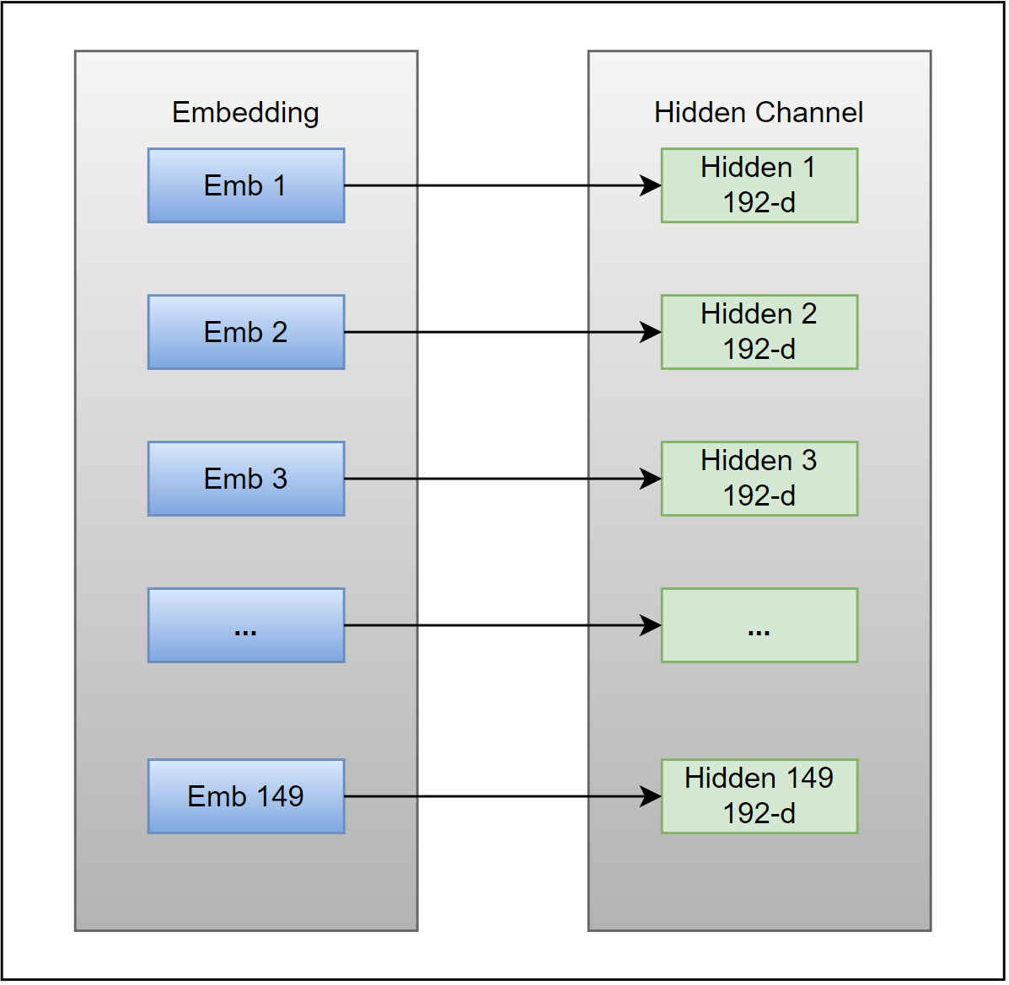
Text
Encoder
✪Input text sequence first go through an embedding layer
——where each unit projects to a hidden dimension of size 192

Slide 9
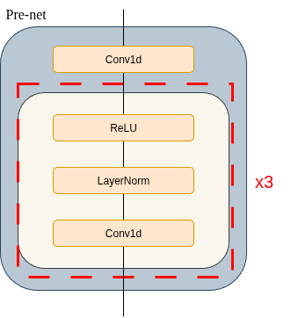
Prenet
Kernel size 5
Learn local pronunciation rules.
It mixes information from neighboring characters to create a context-aware representation for each position.

Slide 10
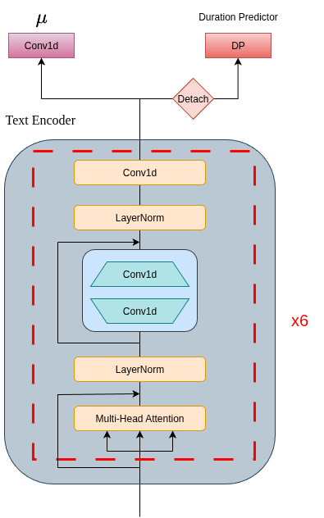
Transformer
-Encoder
Only mean prediction, no sigma.
the prior distribution is not a learned Gaussian for each phoneme, but a fixed, global distribution that the model aligns to.
Only needs to predict the mean (proj_m) to guide this alignment.

Slide 11
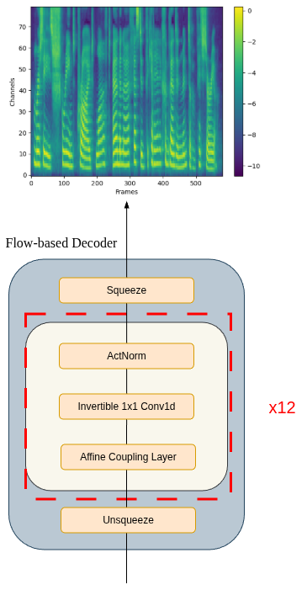
Mel-spectorgram Decoder
Normalizing flow based decoder
Transforms mel-spectrograms from simple prior distribution to the complex data distribution.

Slide 12

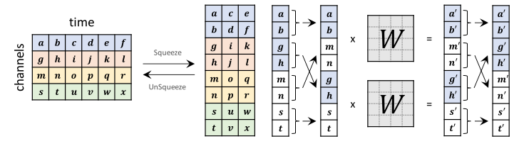
More on
Decoder
Bijective mapping
one-to-one relationship between latent representations and mel-spectrograms
Channel squeeze and unsqueeze

Slide 13
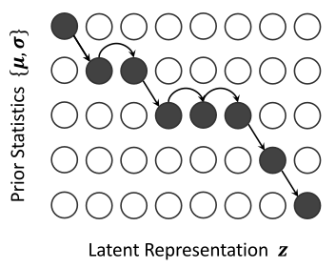
Monotonic Alignment Search
Text encoder learns to cluster mean(proj_m)for same phonemes
Flow learns to map similar sounds to similar z regions
Distance matrix starts showing diagonal-like structure

Slide 14
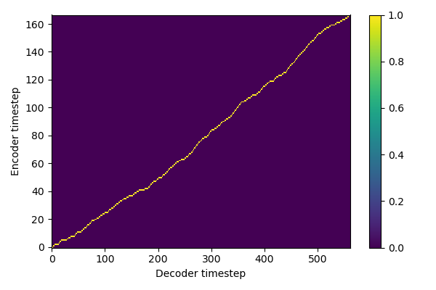
Monotonic Alignment Search
Distance matrix starts showing diagonal-like structure

Slide 15
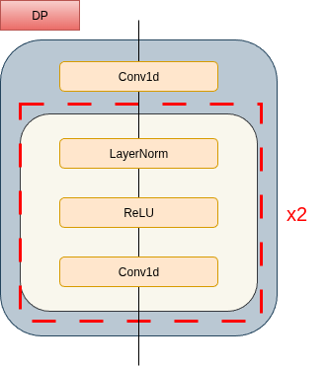
Duration
predictor
Trained using results from MAS
Used during inference to minic the ability of MAS

Slide 16

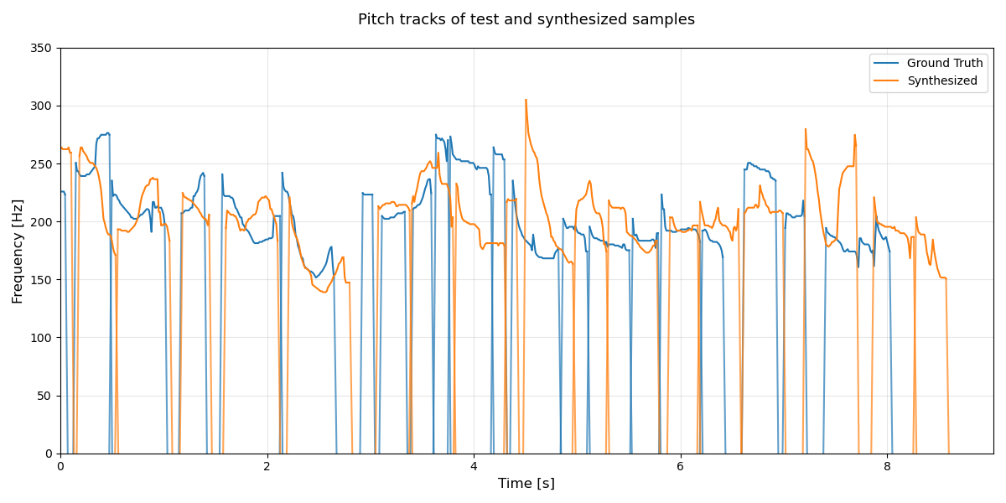
Results
Ground truth
Synthesized speech

Slide 17
Latent space manipulation
Speaking Slow
Speaking Fast
Pitch High
Pitch Low

Slide 18
Reference
Glow-TTS: A Generative Flow for Text-to-Speech via Monotonic Alignment Search,
Jaehyeon Kim, Sungwon Kim, Jungil Kong, Sungroh Yoon
Text-to-Speech Synthesis,
Paul Taylor

