Slide 2
Essay 1
Metamorphic Testing + Mitigation
explore subpopulations within sensitive indentified attributes
perturb sentences and perform MT on NLP models to detect fairness violations
(ε, k)-fairness and mitigate unfair predictions.

Slide 3
Essay 1
Metamorphic Testing + Mitigation
Pertrub
noun.adj. verb. others possibilities - long/short hair
maybe hard or inappropriate
to learn & use ConceptNet
how to mutate

Slide 4
Essay 1
Metamorphic Testing + Mitigation
(ε, k)-fairness
ε fairness constraints
k mutation range/ higher k higher confidence
Neutral Layer
a weighted output
a certfied model
SA - Evaluation

Slide 5
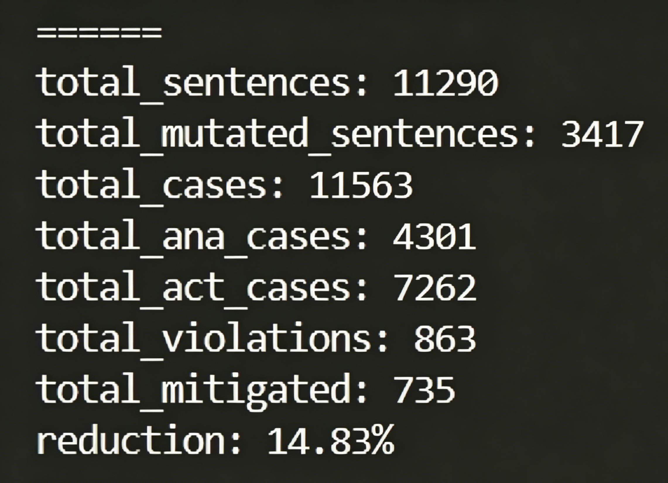
合理数量的扰动
superpod api：conceptnet-mini + dataset句子类型
S < 4
主动突变占主导
fairness
cnn 感情model： 863/11563

Slide 6

缓解策略
CNN绝对倾向
当 S < 4即k较小 变号效果差
群体分数未互补，sum倾向一侧
数学思维
单纯点到点
k -扰动空间内，模型违规的ε-边界
防御效果/鲁棒性

Slide 7
方向
1.应用现实大模型
2.vqa方法
3.

Slide 8
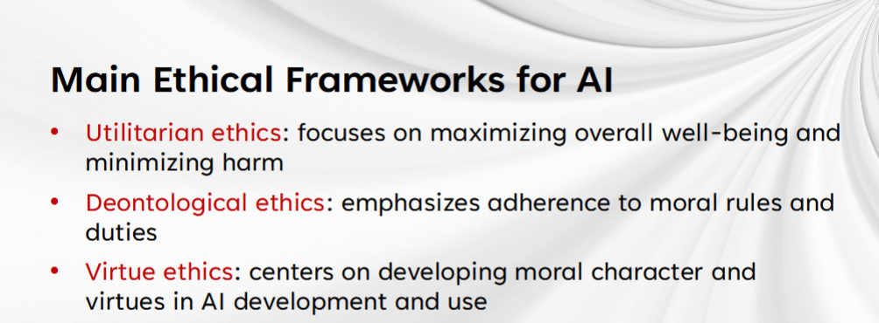
Essay 2
Reflective Equilibrium
Implicit ethics

Slide 9
Essay 2
Reflective Equilibrium
core idea Reflective Equilibrium
intuition LLM①
principles
reflection LLM② LLM③
self-correction based on interactive feedback
a package of original output + feedback possible ethical inconsistencies

Slide 10
Essay 2
Reflective Equilibrium
to learn ETHICS benchmark
how to build EthicsSuite

Slide 11
Essay 3
Split and Merge

