Slide 1
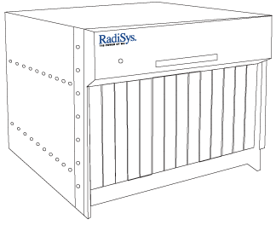
SCout commercial hardware configuration
SCout 1.0
SCout 2.0*
DB blades x 2
Promentum 4310
16 Gb RAM
146 Gb 10K SAS
Polyhedra
CG Stack
In-memory DB function with local disk storage
State maintenance
Context repository
Access control
UDR
Cross-node data synchronization
Network Switch blades
As per SCout 2.0
RadiSys® 6010 chassis
As per SCout 2.0
Network Switch blades x 2
Promentum 2210
4 SFP (copper or optical) – 1GbE
2 XFP (optical) – 1 GbE
Switch fabric for intra-chassis communication
XFP interfaces used for interchassis application-specific communication
SFP interfaces used for extra-chassis communication (OSS/BSS)
Centralized bootstrap/init for processor modules
RadiSys® 6010 chassis
14 slot, 12U, -48DC
SA Forum HPI 1.1 compliant shelf manager
Hot Swap support
SCout Core blades x 4
Promentum 4310
4 Gb RAM
CG Stack
Core SCout functionality
Resource Adpt
Resource ctrl
Policy
Context Eng.
No local disk – boot from shelf manager
Adapter blades x 6
Promentum 4310
4 Gb RAM
Optional CG Stack
Application Adapter(s)
Ex: Yap, Location front-end to managed services
Application Enablers
Core services locally deployed
SCout Core blades x 4
Promentum 4500
Xeon Quad Core with HT
Up to 64 Gb RAM
10 Gb Ethernet Fabric
64 bit MontaVista CG Linux
ENEA Element
Polyhedra Embedded DB
Context Engine
Application Switch
Adapter blades x 8
Promentum 4500
Xeon Quad Core with HT
Up to 64 Gb RAM
10 Gb Ethernet Fabric
64 bit MontaVista CG Linux
ENEA Element
Application Adapters
Optional Application Switch
*Actual hardware configuration will vary based on customer’s service requirements

