Slide 1
Deep Learning for System Identification
Marco Forgione
SUPSI – Scuola Universitaria Professionale della Svizzera Italiana
IDSIA – Dalle Molle Institute for Artificial Intelligence
marco.forgione@supsi.ch

Slide 2
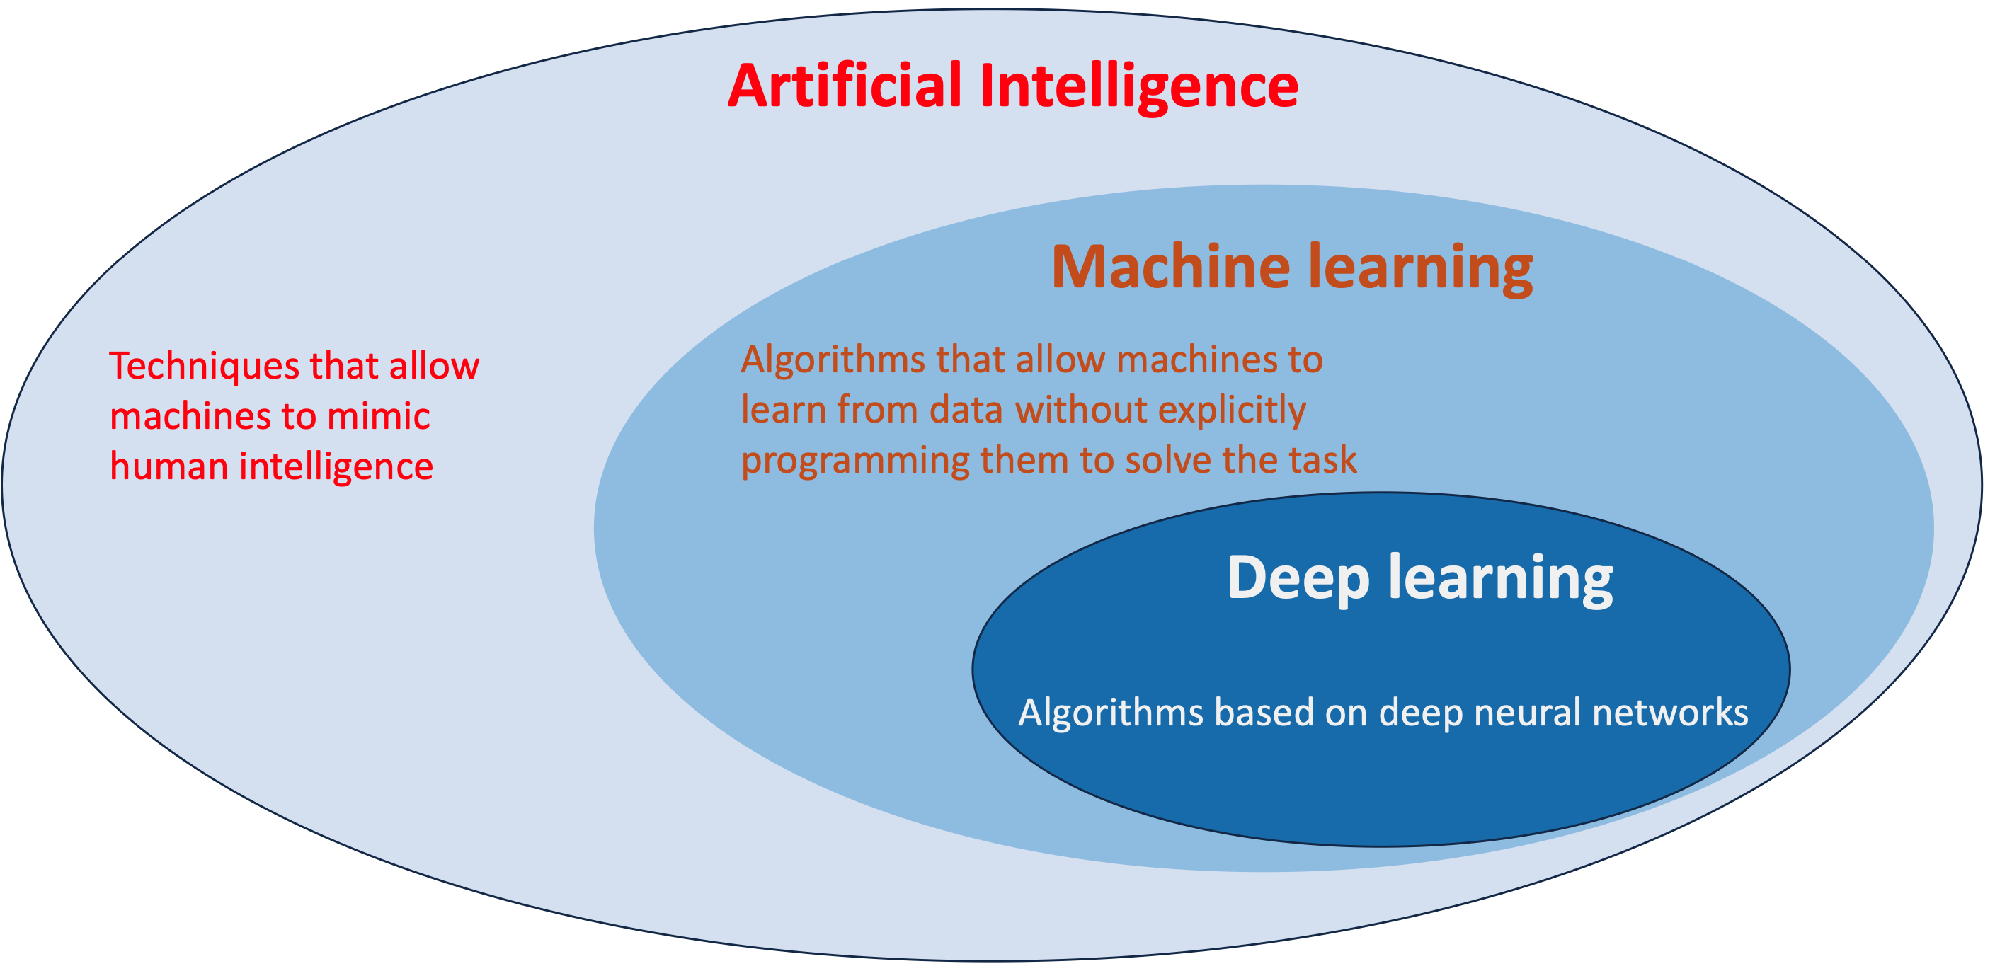
Artificial Intelligence, Machine Learning, Deep Learning

Slide 3
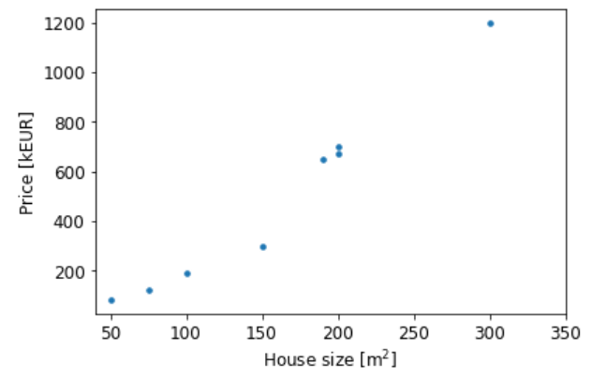
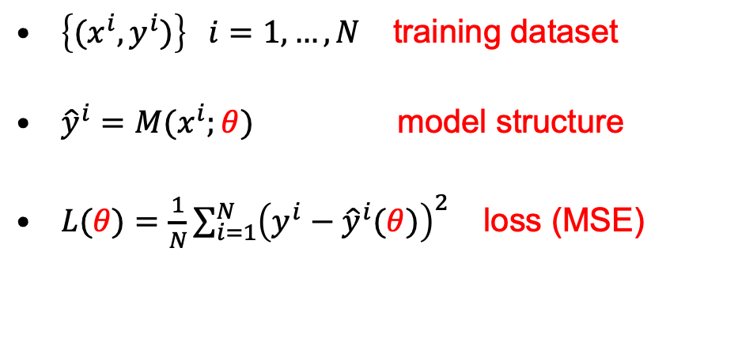

Machine learning: Regression
Real estate application
$\left\{{(x}^{i},y^{i})\right\} i=1,…,N$ training dataset
${\hat{y}}^{i}=M(x^{i};θ)$ model structure
$L(θ){=\frac{1}{N}\sum_{i=1}^{N}{{\left(y^{i}−{\hat{y}}^{i}(θ)\right)}^{2}}}_{ }$ loss (MSE)
$$θ^{∗}=arg\min_{θ}{L(θ)}$$
Expressive model structures like neural networks
Iterative optimization, often gradient-based
Efficient software for automatic differentiation

Slide 4
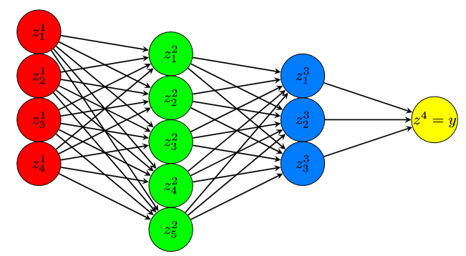
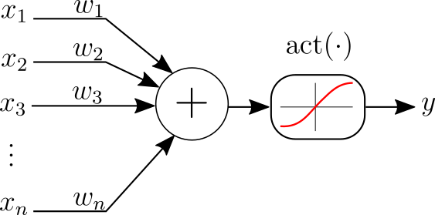
Feed-Forward Neural Networks
It is just a particular model structure
Hidden Layer 1
Hidden Layer 2
Output
Input
For regression, the output equation is typically linear (no activation function)

Slide 5
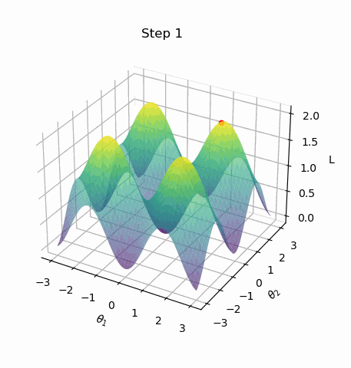
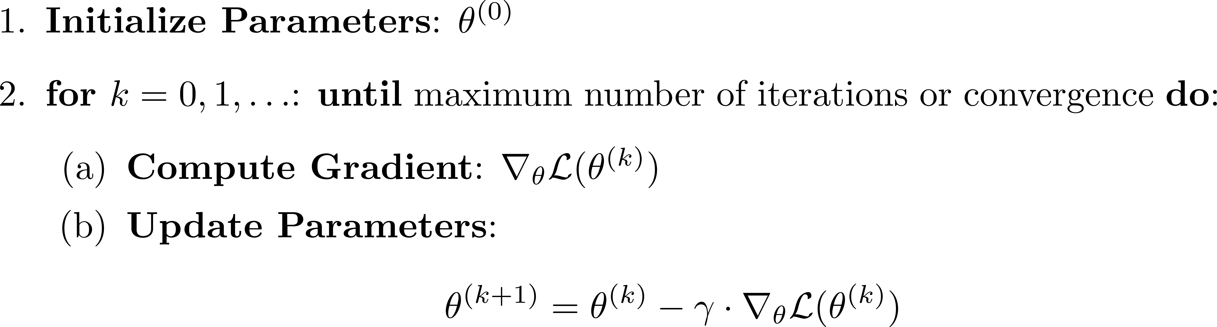
Gradient Descent
Local convergence to one of the several minima is OK!
Mini-batching: at each iteration, compute loss & gradients on a subset of the dataset
Variants of plain gradient descent like Adam are more common
Second-order methods like (L)-BFGS also possible for small/medium-scale problems

Slide 6
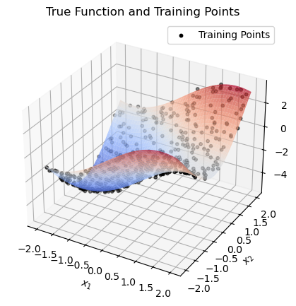
Example: synthetic toy dataset
Consider the 2D function
Training and test datasets: 500 points uniformly sampled in the domain.
Additive noise with standard deviation 0.1

Slide 7
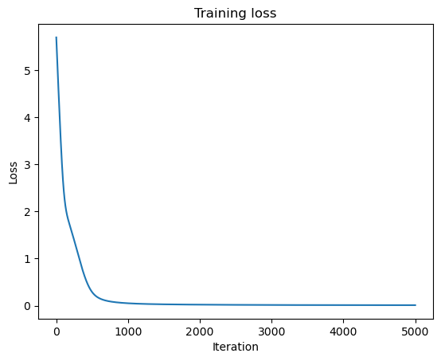

Feed-forward neural network
2 inputs, 1 output - this is the structure of $f(x)$
2 hidden layers with [16, 8] neurons
tanh non-linearities
Training with 5000 iterations of Adam…

Slide 8
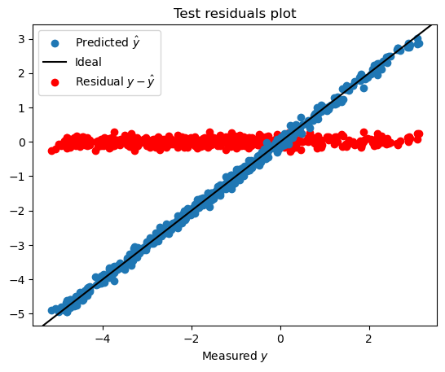
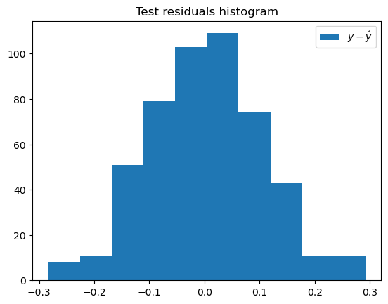
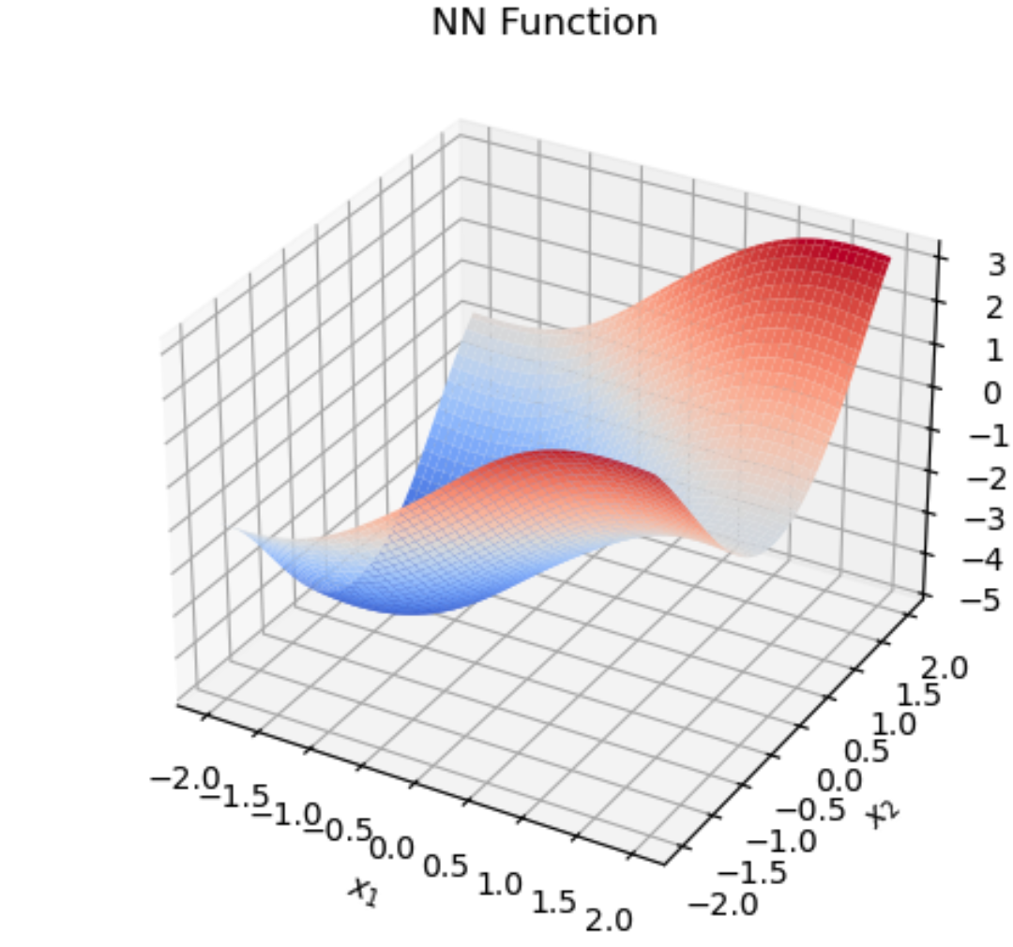
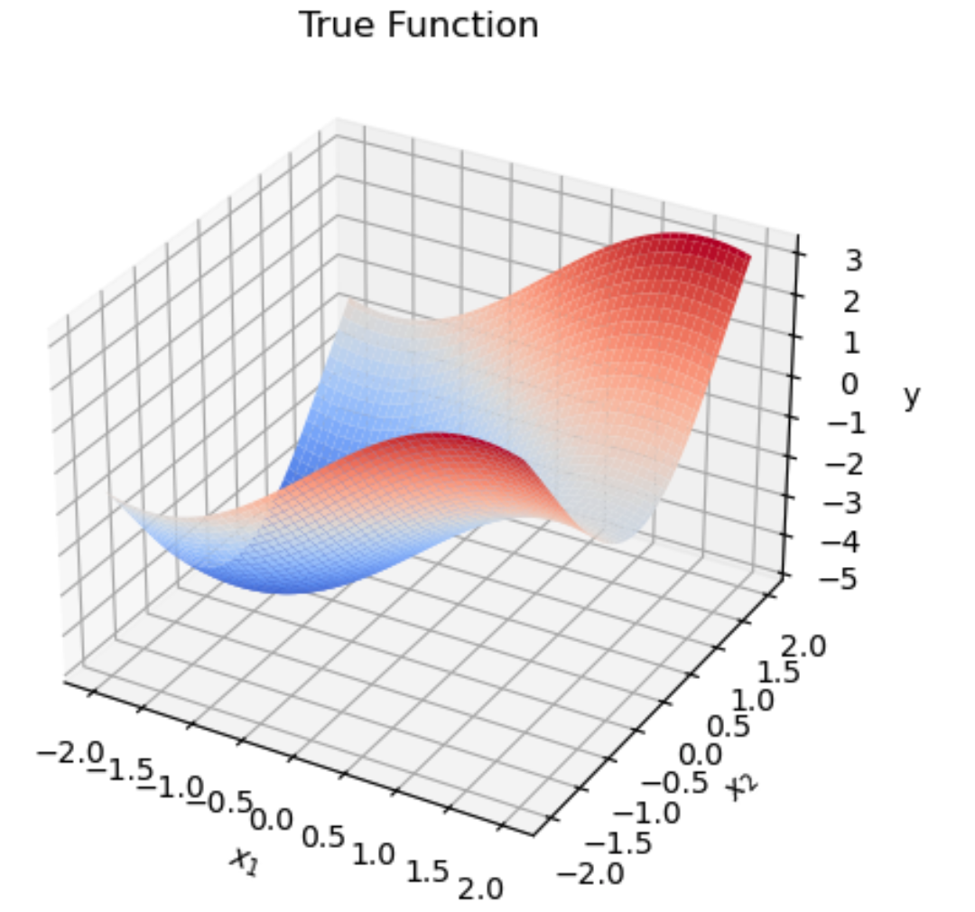
Model evaluation
It is common to inspect on the test dataset:
Predictions and residuals vs measured y (left)
Histogram of residuals (right)
Keep on following good statistical practices!
In this toy example, we can do more:
Input is 2D. We can visualize the learned function over a grid (left)
The true function is known. We can also visualize it in 2D (right)

Slide 9
Deep Learning for System Identification
Feed-forward nets fed by lagged input/outputs are directly applicable for NARX regression
State-space models with neural-network update/output maps:
  Also known as Recurrent Neural Networks

Slide 10
What we won’t cover
Advanced architectures
  physics-informed
  grounded on system theory (e.g., stable by design)
  transformers, diffusion, foundation models
Optimization
  mini-batching (to handle large datasets)
  second-order, non-smooth, constrained…
  automatic differentiation details
Theoretical aspects
  learning theory
  uncertainty quantification
  …

Slide 11




Software for Deep Learning
An essential aspect is the software implementation. Non-exaustive options are:
PyTorch and Jax: libraries on top of Python
Julia: programming language focused on numerical computations
MATLAB: you should know it already…
We will try out Jax!

Slide 12
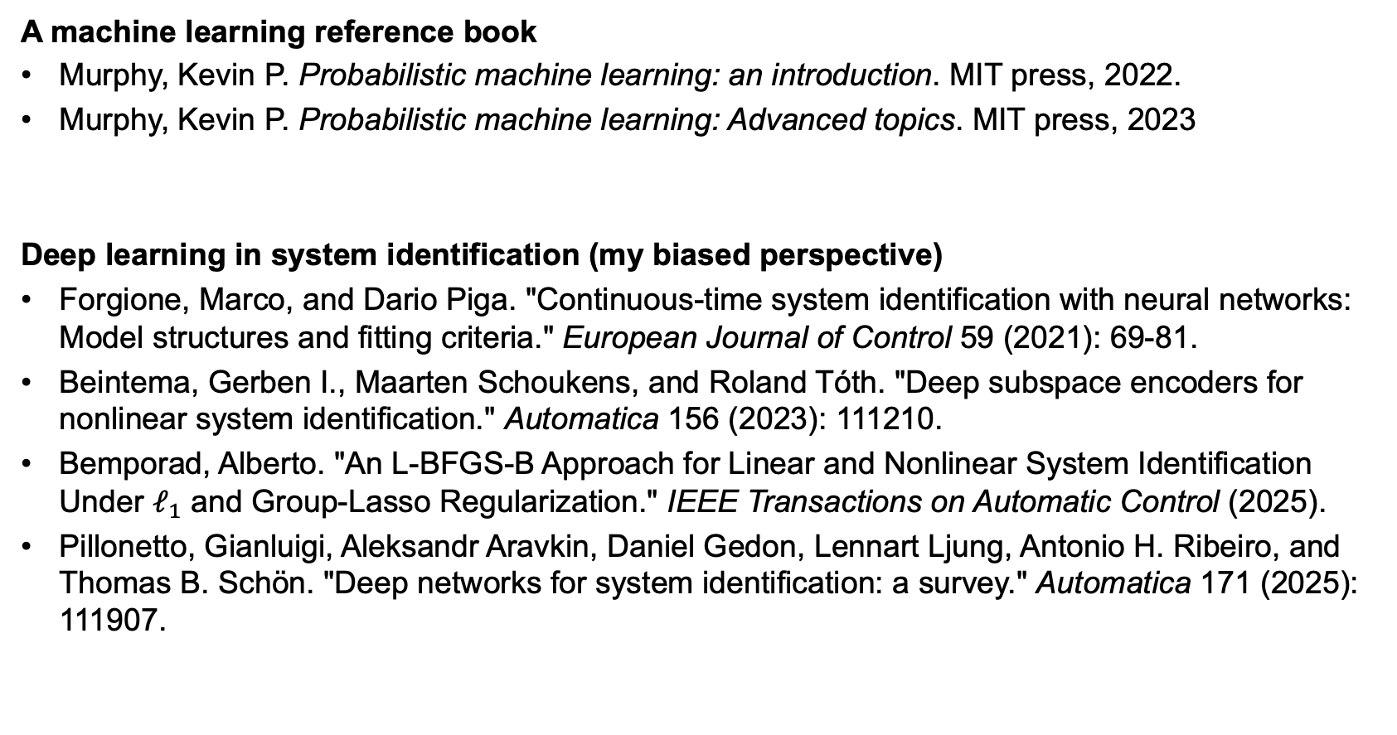
Literature
A machine learning reference book
Murphy, Kevin P. Probabilistic machine learning: an introduction. MIT press, 2022.
Murphy, Kevin P. Probabilistic machine learning: Advanced topics. MIT press, 2023
Deep learning in system identification (my biased perspective)
Forgione, Marco, and Dario Piga. "Continuous-time system identification with neural networks: Model structures and fitting criteria." European Journal of Control 59 (2021): 69-81.
Beintema, Gerben I., Maarten Schoukens, and Roland Tóth. "Deep subspace encoders for nonlinear system identification." Automatica 156 (2023): 111210.
Bemporad, Alberto. "An L-BFGS-B Approach for Linear and Nonlinear System Identification Under $ℓ_{1}$ and Group-Lasso Regularization." IEEE Transactions on Automatic Control (2025).
Pillonetto, Gianluigi, Aleksandr Aravkin, Daniel Gedon, Lennart Ljung, Antonio H. Ribeiro, and Thomas B. Schön. "Deep networks for system identification: a survey." Automatica 171 (2025): 111907.

