Slide 1
Manifold meta-learning for reduced-complexity neural system identification
Marco Forgione, Ankush Chakrabarty, Dario Piga, Matteo Rufolo, Alberto Bemporad

Slide 2
Motivation
Neural network models can effectively describe a wide variety of dynamical systems
However, they are often overparameterized. Training is computationally expensive and data-hungry.
We aim at discovering a manifold where the parameters lie for a class of systems
Given the manifold, we can learn a new system with little data and compute

Slide 3


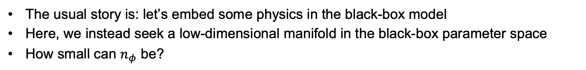
Motivation
Physics-based modeling
Black-box modeling
Bergman model of glucose-insulin metabolism
$β=(p_{1},p_{2}$, $p_{3}, γ, n)$ physical coefficients
Generic neural state-space model
$θ$ containts $n_{θ}=100−1000$black-box parameters.
learned parameter manifold.
The usual story is: let’s embed some physics in the black-box model
Here, we instead seek a low-dimensional manifold in the black-box parameter space
How small can $n_{φ}$ be?

Slide 4
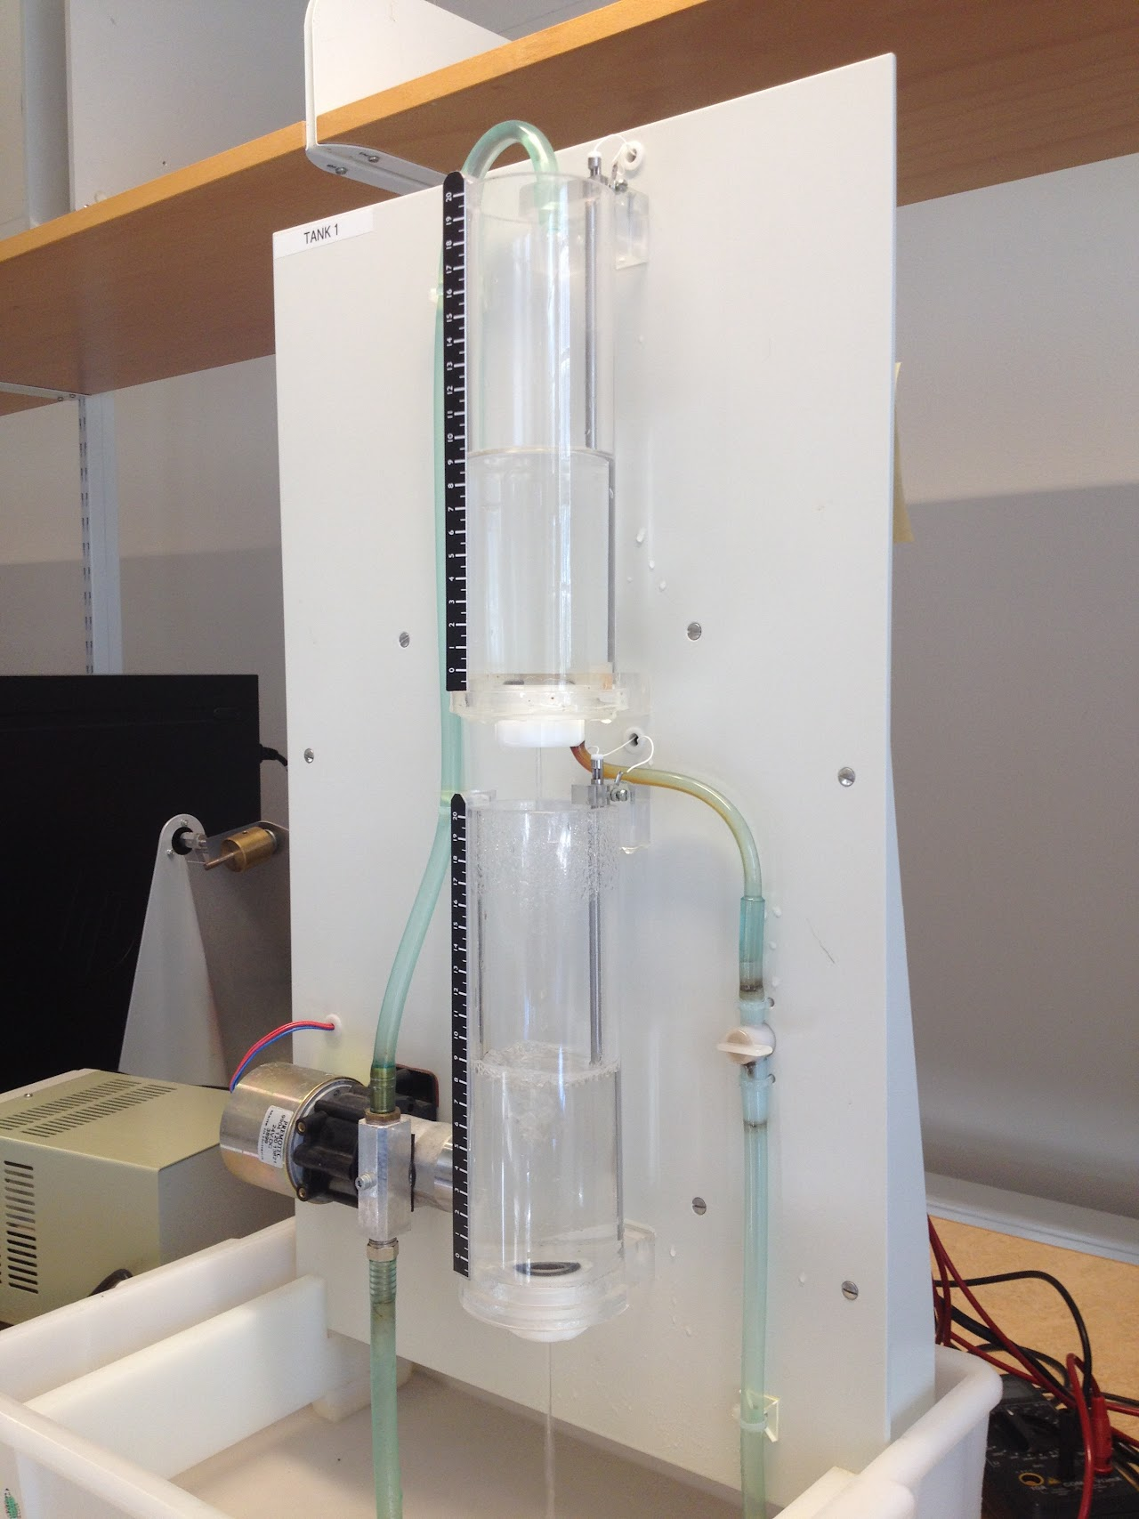

Motivation
Physics-based modeling
Black-box modeling
Two-tank system
$β=(k_{1},k_{2}$, $k_{3},k_{4})$ physical coefficients
Generic neural state-space model
$θ$ containts $n_{θ}=100−1000$black-box parameters.
learned parameter manifold.
The usual story is: let’s embed some physics in the black-box model
Here, we instead seek a low-dimensional manifold in the black-box parameter space
How small can $n_{φ}$ be?

Slide 5
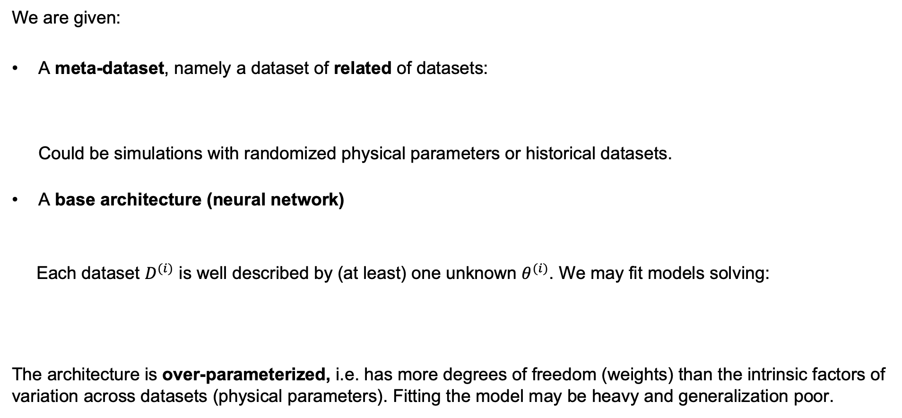
Framework
We are given:
A meta-dataset, namely a dataset of related of datasets: Could be simulations with randomized physical parameters or historical datasets.
A base architecture (neural network)
Each dataset $D^{(i)}$ is well described by (at least) one unknown $θ^{(i)}$. We may fit models solving:
The architecture is over-parameterized, i.e. has more degrees of freedom (weights) than the intrinsic factors of variation across datasets (physical parameters). Fitting the model may be heavy and generalization poor.

Slide 6
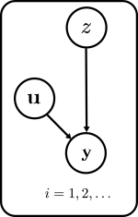
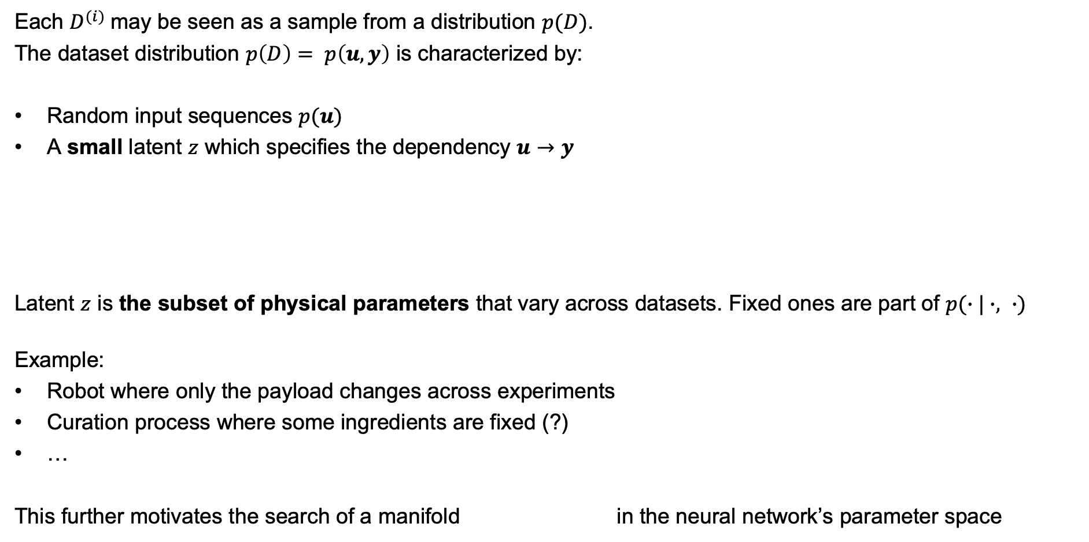
Framework
Each $D^{(i)}$may be seen as a sample from a distribution $p(D)$.
The dataset distribution $p\left(D\right)= p\left(u, y\right)$ is characterized by:
Random input sequences $p(u)$
A small latent $z$ which specifies the dependency $u→y$
Latent $z$ is the subset of physical parameters that vary across datasets. Fixed ones are part of $p(∙|∙, ∙)$
Example:
Robot where only the payload changes across experiments
Curation process where some ingredients are fixed (?)
…
This further motivates the search of a manifold in the neural network’s parameter space

Slide 7
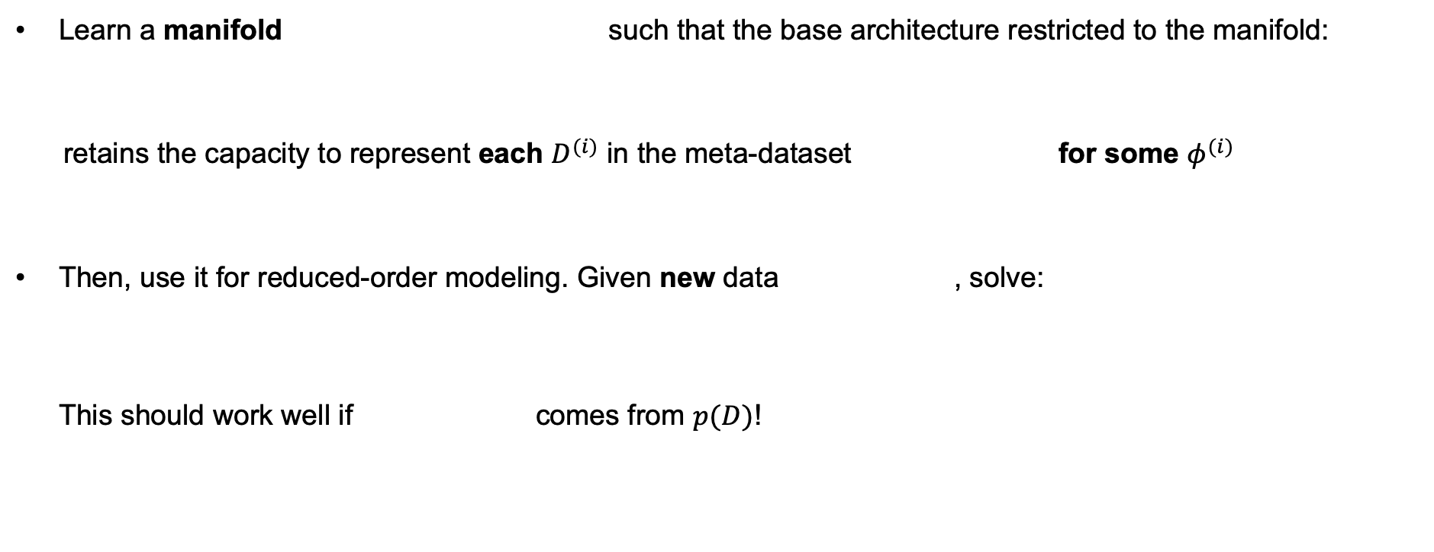
Objective
Learn a manifold such that the base architecture restricted to the manifold:
retains the capacity to represent each $D^{(i)}$ in the meta-dataset for some $φ^{(i)}$
Then, use it for reduced-order modeling. Given new data , solve: This should work well if comes from $p(D)$!

Slide 8
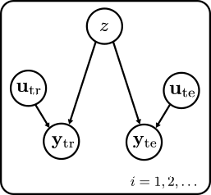
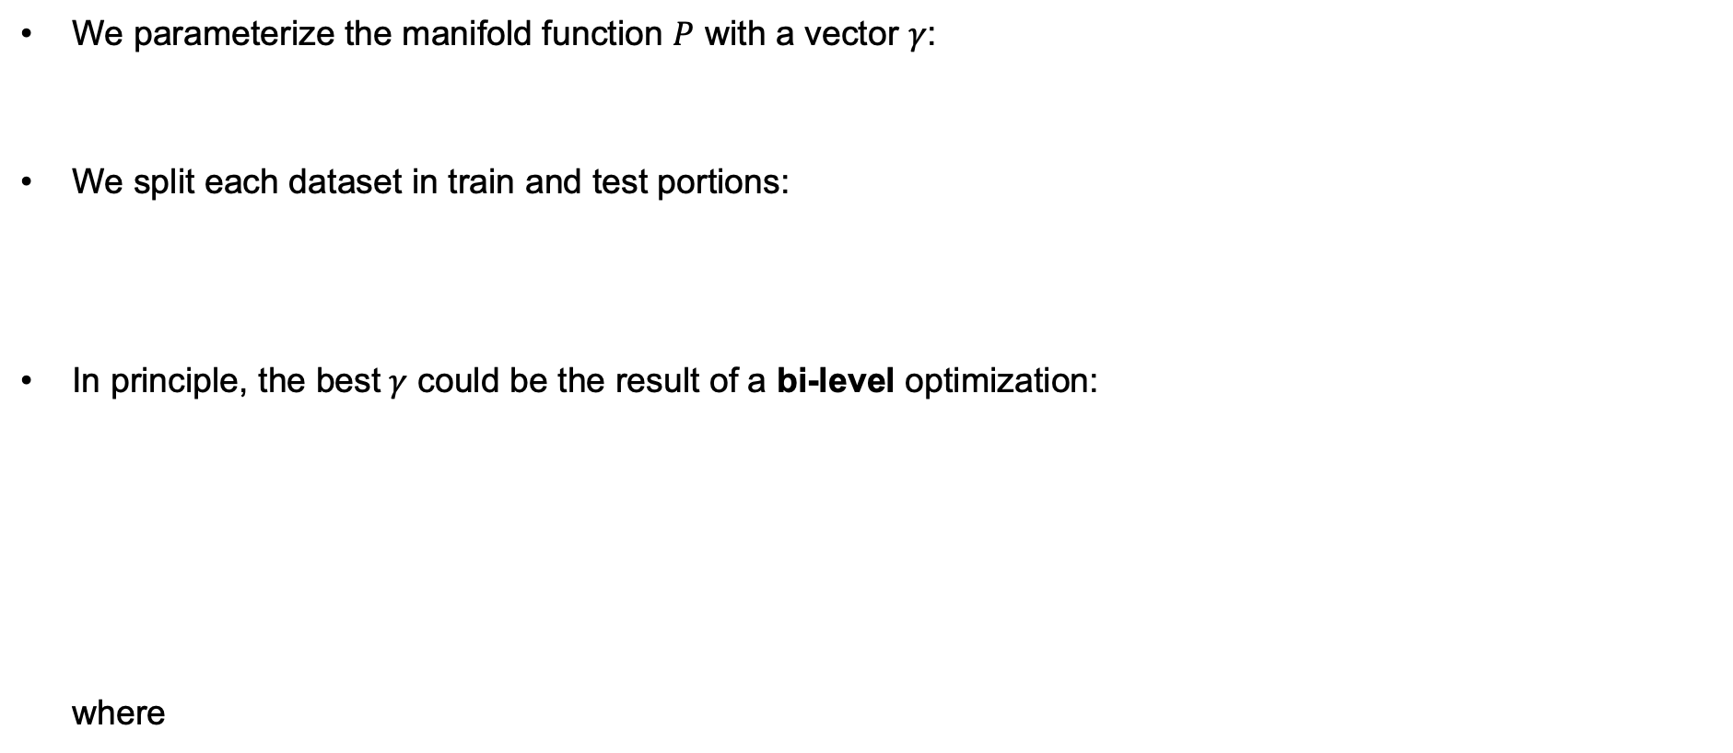
Methodology
We parameterize the manifold function $P$ with a vector $γ$:
We split each dataset in train and test portions:
In principle, the best$γ$ could be the result of a bi-level optimization: where

Slide 9
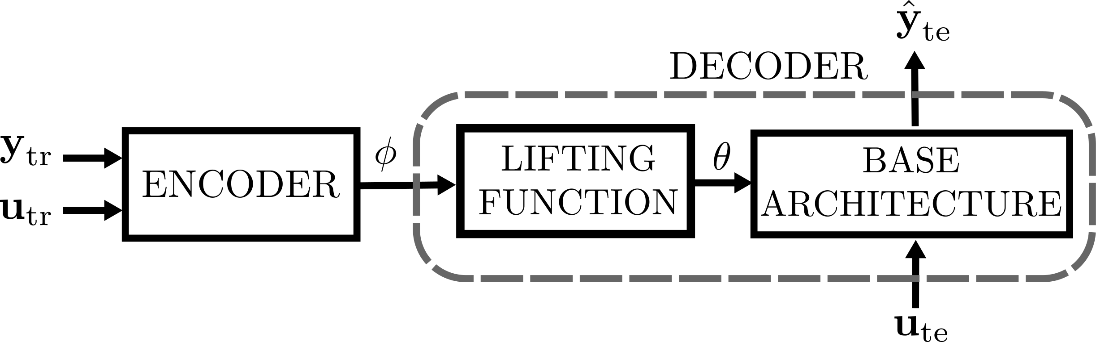

Methodology
For simplicity, we replace the inner optimization with an auxiliary neural network
We approximate the expected value with samples from and minimize wrt $γ,ψ$ with minibatch gradient descent

Slide 10
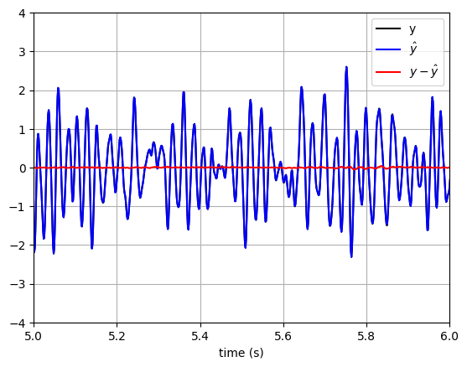

Results
Experiments on the Bouc-Wen system identification benchmark (hysteretic oscillator).
$N_{f},N_{g}$: MLPs with 1 hidden layers, 16 units ($n_{θ}=244$)
Training on 40960 points leads an almost perfect model
Can we learn with less data?
System dynamics
Test fit: 98.9%
Base architecture

Slide 11
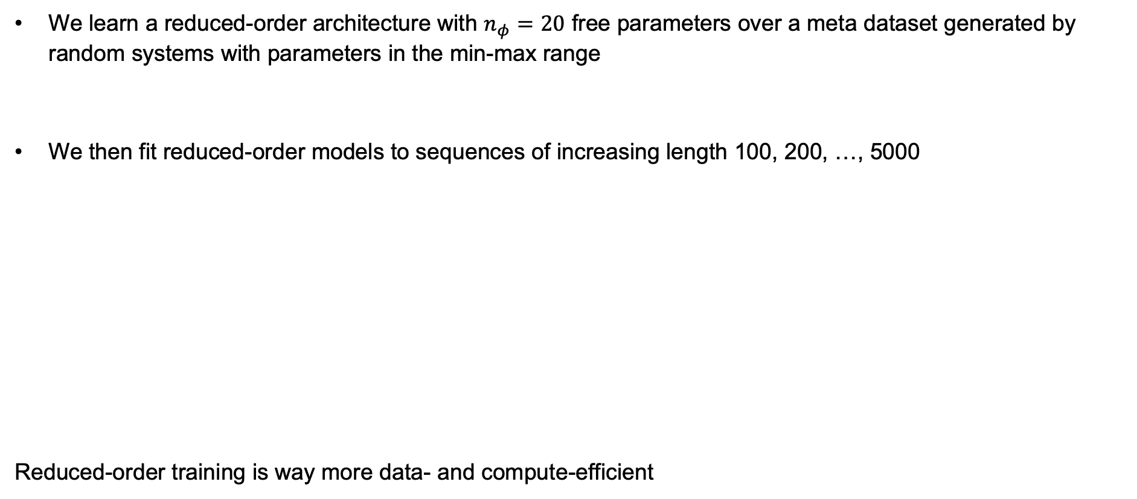
Results
We learn a reduced-order architecture with $n_{φ}=20$ free parameters over a meta dataset generated by random systems with parameters in the min-max range
We then fit reduced-order models to sequences of increasing length 100, 200, …, 5000
Reduced-order training is way more data- and compute-efficient

Slide 12
Conclusions and future works
Meta-learning of a reduced architecture as a manifold in the parameter space
Experiments on a common system identification benchmark
Increased data- and compute-efficiency
Future developments:
Variational setting to learn a reduced-order prior over the manifold
Combination with physics-inspired modeling
Extensions to state estimation and control

Slide 13
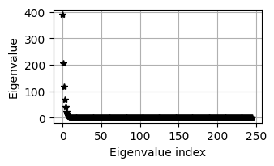
Results
Training of the base architecture:
Interestingly, the Hessian of the loss at the optimum
is close to degenerate in many directions. This further motivates reduced-order architectures
Test fit: 98.9%

Slide 14

Methodology
In principle, the best$γ$ could be the result of a bi-level optimization:
We replace the inner optimization with an auxiliary network

