Slide 1
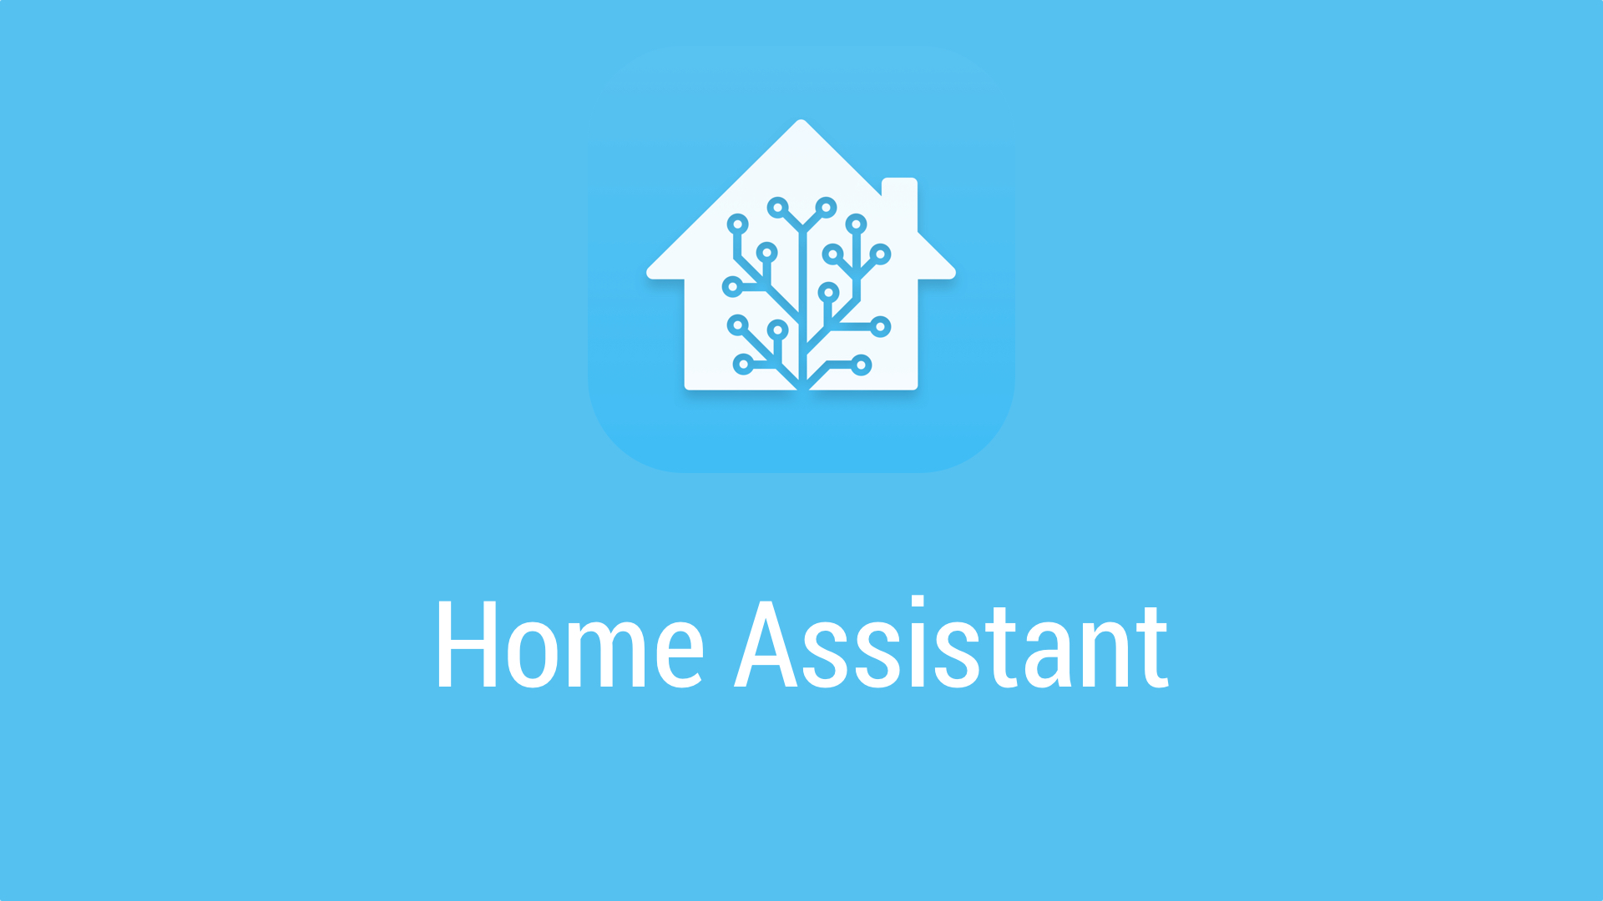

Slide 2

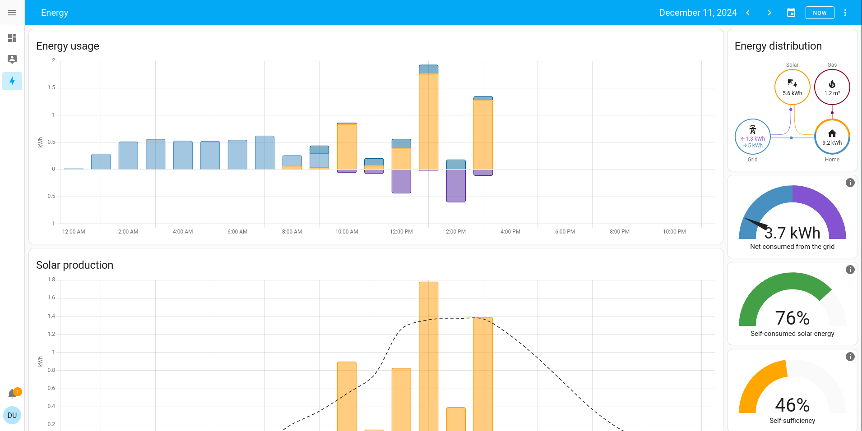
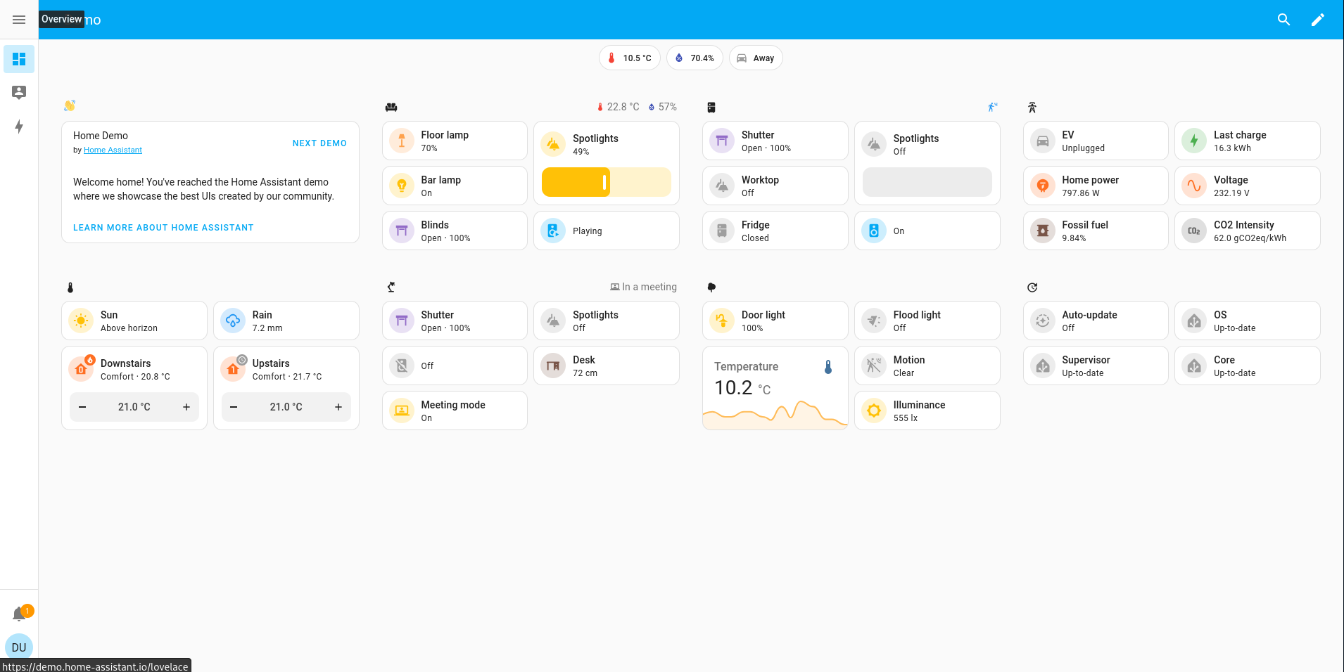
What?

Slide 3

Installing Home Assistant

Slide 4



Slide 5
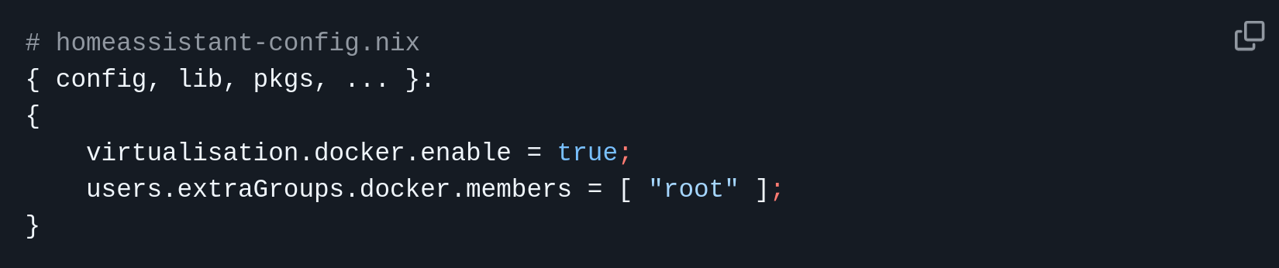
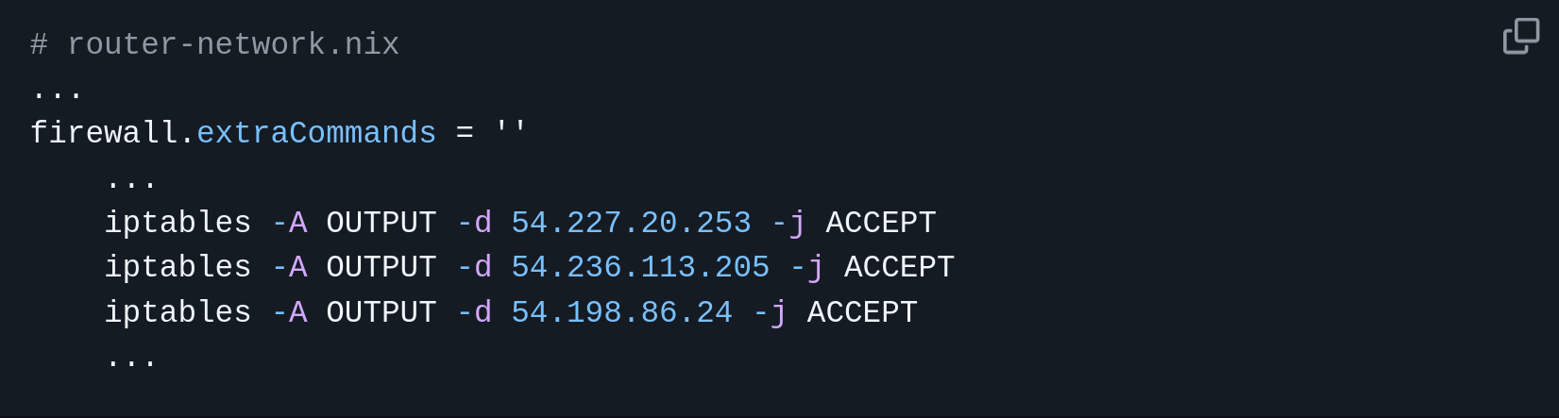
+ NixOS
Enable Docker

Slide 6
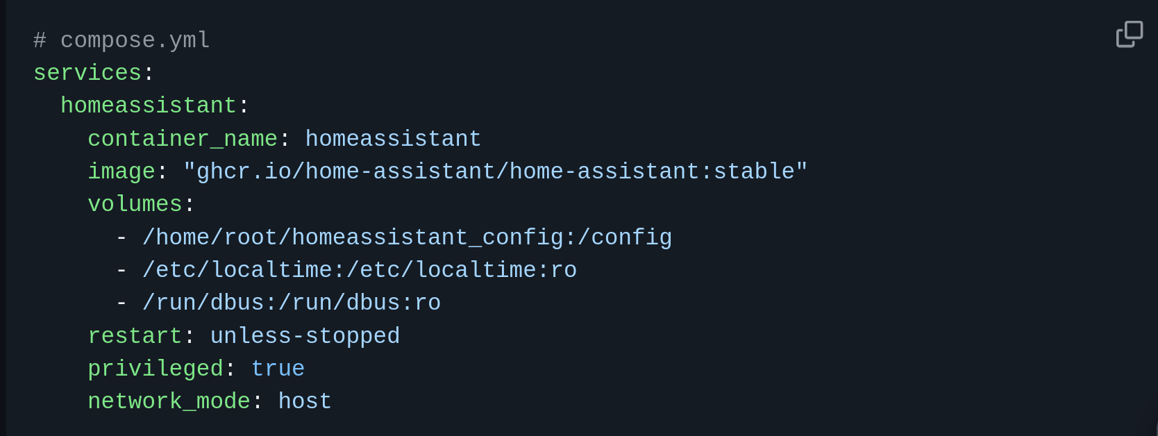
+ NixOS
Pull Home Assistant

Slide 7
+ VirtualBox

Slide 8

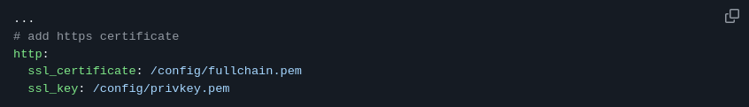
+ SSL

Slide 9


Slide 10
Configuring

Slide 11
Configuring

Slide 12
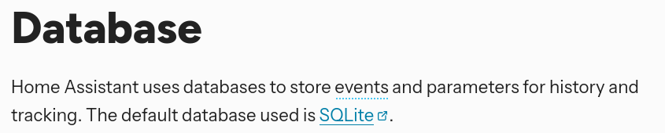

Database

Slide 13
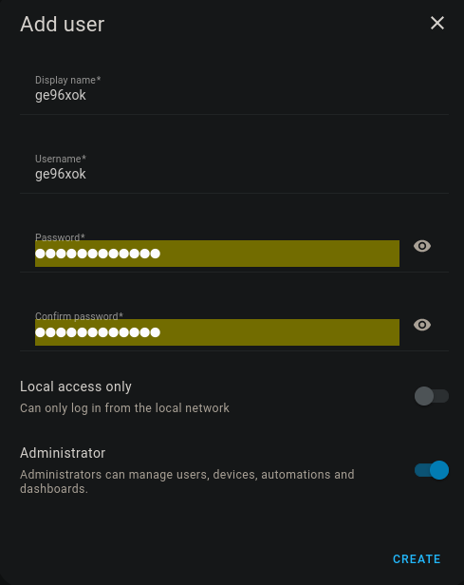
Users

Slide 14
What Else?

Slide 15
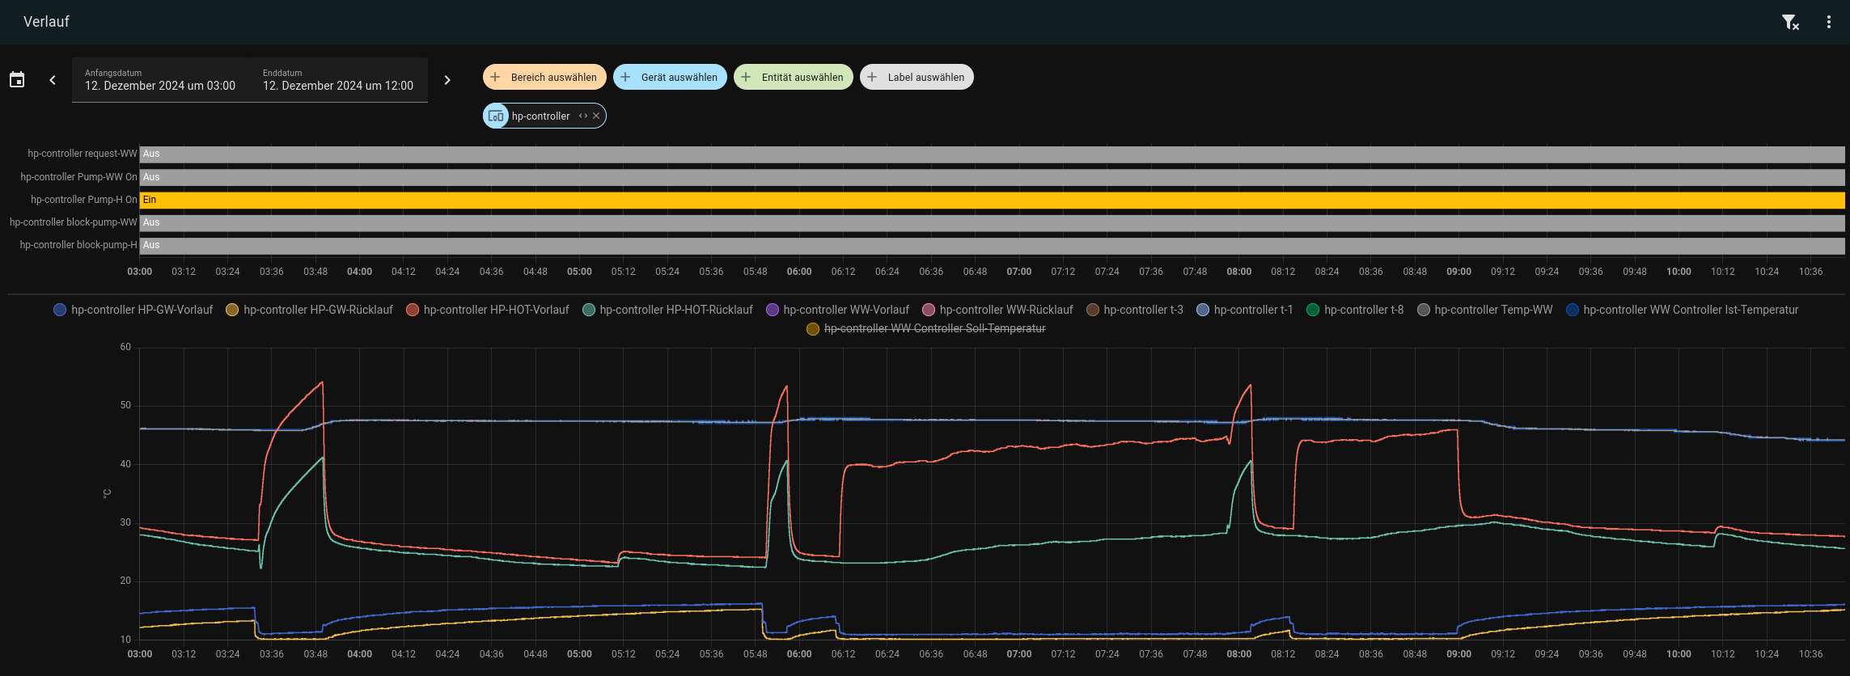
Database + Sensors

Slide 16
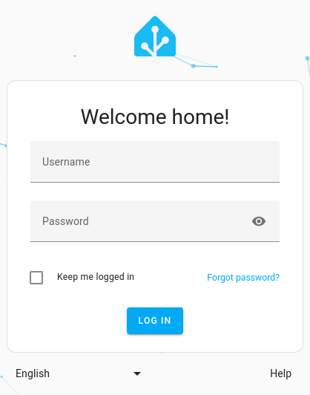
Login

Slide 17
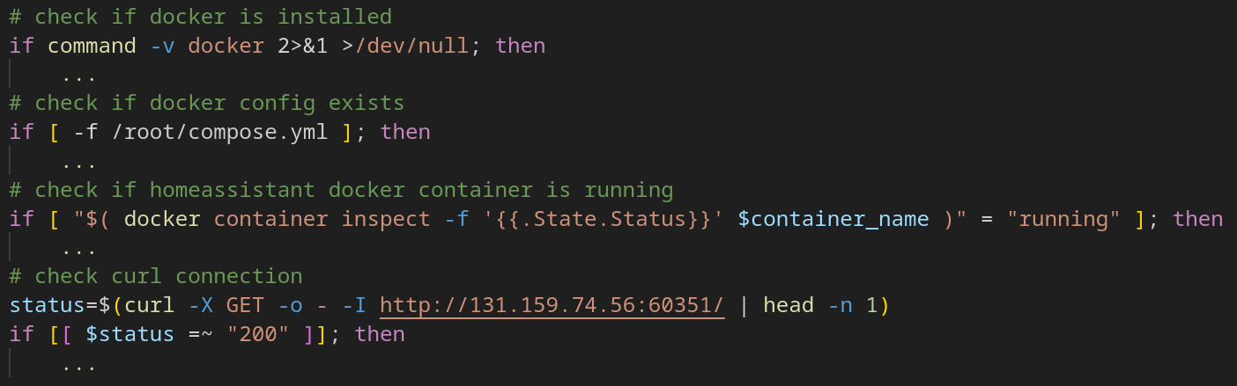
Testing

Slide 18
And now you know
(and how to install it)

