Slide 1


I’AM
VIANO FORGUSON
HIRE ME

Slide 2
Nama
TTl
Asal
Universitas
No Henpone
Email
Viano Forguson
17 januari 2003
NTT
DR.Soetomo
081271101180
nanok0742@gmail.com
Donwload 160 project
Donwload

Slide 3
Skills
HTML
70%
CSS
80%
PHP
50%
WORDPRES
70%
PHOTOSHOP
80%
FIGMA
80%

Slide 4
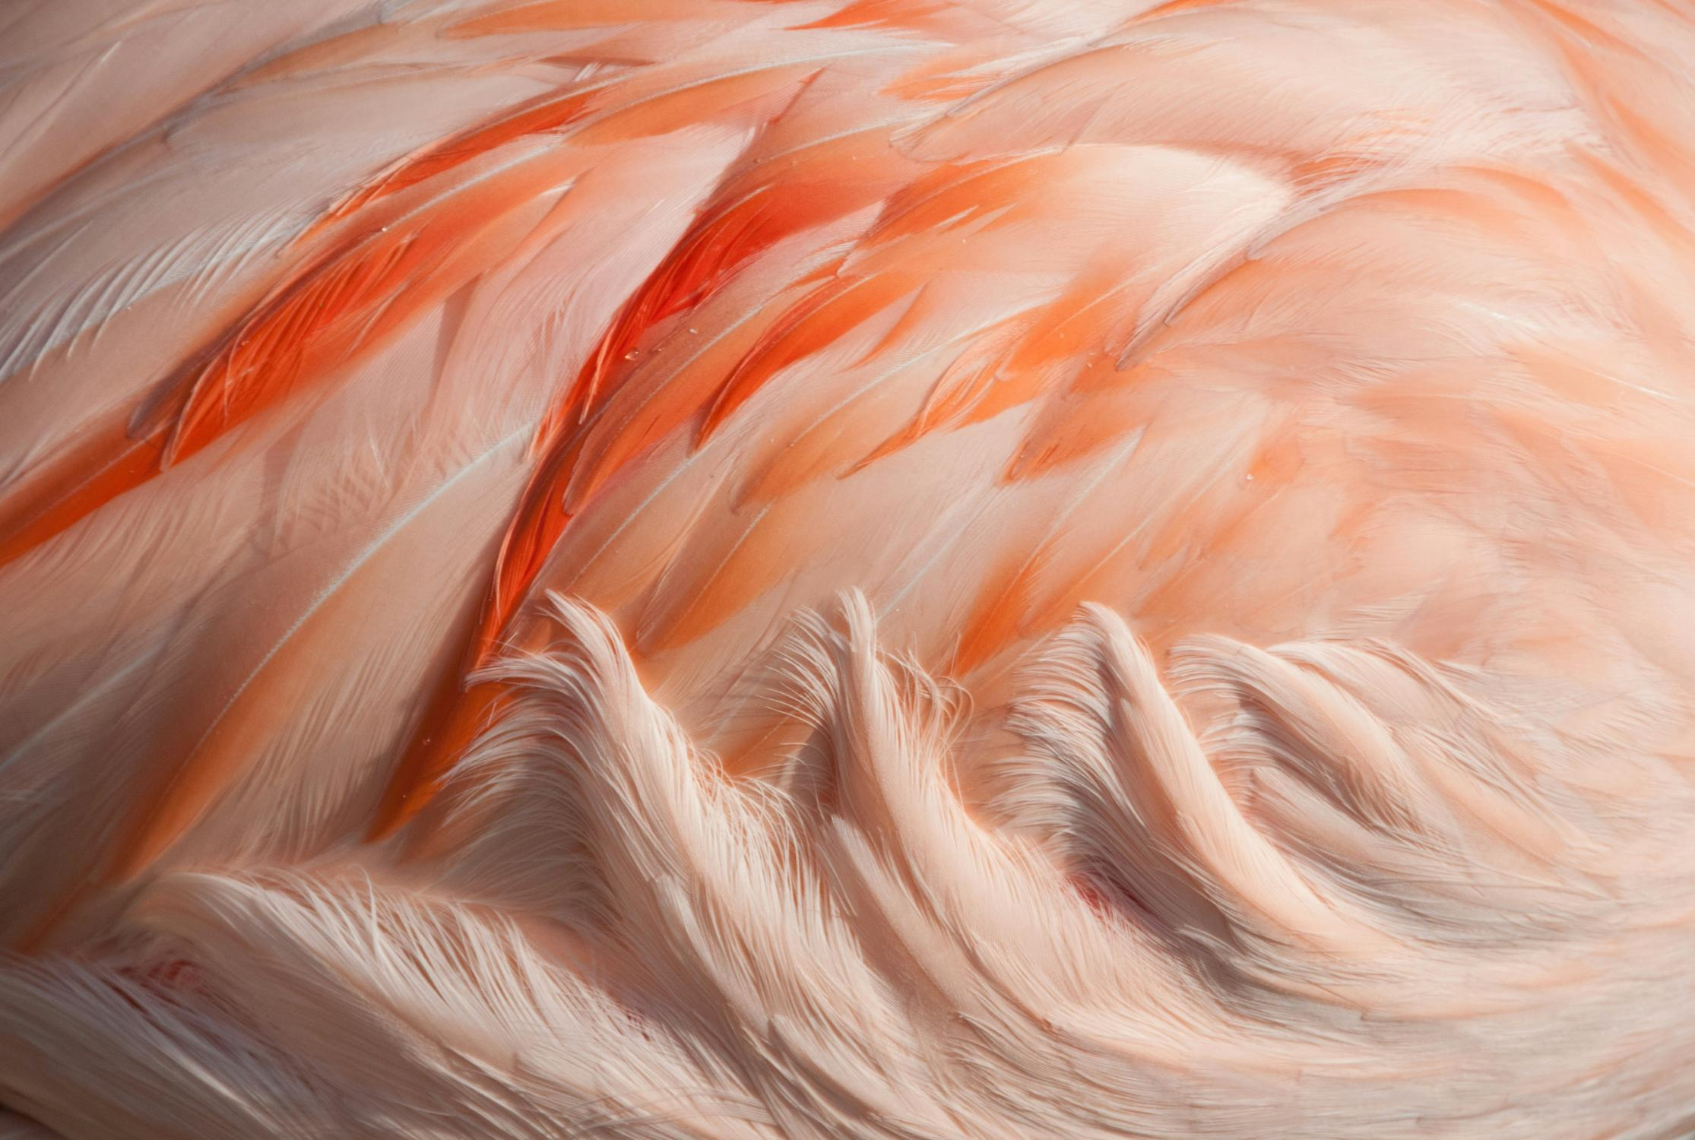
PROJECT
marianus sae
marianus sae
marianus sae
marianus sae

