Slide 1
Human Heart Diseases Prediction
Presented by
Submitted to
Name: | Id:
Forhad Ali Emon | 20-44178-2
MD. MAHBUB ALAM SIDDIK | 19-39376-1
Name : Prof. Dr. Md. Asraf Ali
Course: MACHINE LEARNING[D]
American International University Bangladesh

Slide 2
Outline
Introduction
Problem Statement
Objectives
Methodology
Results and discussion
Conclusion
References

Slide 3
Introduction
Heart disease is a major health issue and a leading cause of death worldwide.
Early detection of heart disease can improve outcomes and reduce mortality rates.
Machine learning algorithms can be used to analyze large datasets and identify patterns that may indicate the presence of heart disease.
Commonly used features for heart disease detection include age, gender, blood pressure, cholesterol levels, and electrocardiogram (ECG) readings.
Several machine learning models, such as logistic regression, decision trees, support vector machines, and naive Bayes classifiers, can be trained to predict the presence of heart disease based on these features.

Slide 4
Problem Statement
Background:
Cardiovascular diseases are a leading cause of death worldwide
Early prediction and prevention can reduce mortality
Machine learning algorithms have shown potential for predicting heart diseases
Problem:
The existing models have limited accuracy in predicting heart diseases
The lack of interpretability and generalization of these models limit their effectiveness
The need for more accurate and interpretable models for early prediction of
heart diseases

Slide 5
Problem Statement
Previous Work:
Several studies have used machine learning algorithms for heart disease prediction
Traditional models, such as logistic regression and decision trees, have been used
Deep learning models, such as neural networks, have shown better accuracy in some cases
Research Gap:
Limited research has focused on using machine learning models for predicting heart diseases in the Indian population
Most existing models have limited interpretability and generalization
The need for an accurate and interpretable model for early prediction of heart diseases
in human.

Slide 6
Problem Statement
Research Questions:
Can a machine learning model accurately predict heart diseases in population?
Can an interpretable model be developed that can aid in early detection and
prevention of heart diseases?
Which machine learning algorithms perform best in predicting heart diseases?
How can the accuracy of heart disease prediction be improved?

Slide 7
Objectives
To compare the effectiveness of various machine learning algorithms.
To provide clinicians with a tool for early heart disease detection.
Aid in the early detection and prediction of cardiac disease.
To predict cardiac disease at an early stage, providing appropriate care to patients and avoiding serious repercussions

Slide 8
Methodology
Use the heart disease dataset from the UCI machine learning repository.
Pre-process the dataset by removing missing and duplicate values.
Divide the pre-processed dataset into training and testing sets using a 70/30 ratio.
Use Logistic Regression, Decision Tree, Support Vector Machine (SVM), and Naive Bayes algorithm to forecast the likelihood of Heart Disease and categorize patient risk level.
Compare the effectiveness of various machine learning algorithms.

Slide 9
Data Collection Procedure
UCL dataset [4] was imported for model training.
The dataset was sourced from multiple sources, including the UCL repository's database [5].
A subset of 14 attributes were used from the original dataset, which included medical histories and heart disease records of 303 patients.
The dataset contained detailed information on the patient's medical features, such as age, chest discomfort type, blood pressure, sugar levels, and angina, among others.
The collected data allowed us to predict whether or not a patient had been diagnosed with heart disease using machine learning techniques

Slide 10
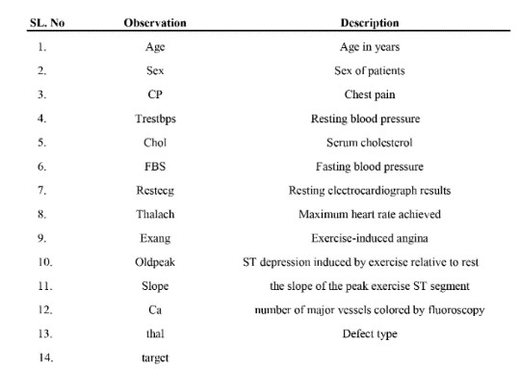
Characteristics in Dataset

Slide 11
Data validation
Data validation is an essential step in any machine learning project to ensure that the collected data is accurate, consistent, and appropriate for the task at hand. In this heart disease detection project, the following steps were taken to validate the data:
Checking for missing values
Checking for outliers
Checking for duplicate values
Checking for class imbalance
Notes:
By performing these validation steps, the accuracy and reliability of the machine learning models used in this project were improved, ensuring that they can provide useful predictions for heart disease detection.

Slide 12
Data pre-processing
in this project involves several steps that are necessary to clean and prepare the data for use in the machine learning algorithms. These steps include:
Handling missing values
Data normalization
Feature selection
Data splitting
Data encoding

Slide 13

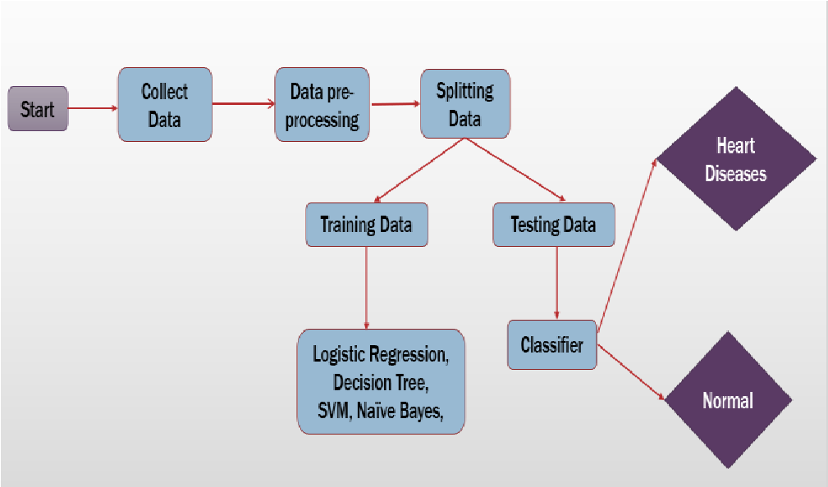
Block Diagram
Fig:1

Slide 14
Implementation

Slide 15
Implementation

Slide 16
Result

Slide 17
Result & Discussion
This section displays the outcomes of the applications of Logistic Regression, Decision Tree, Support Vector Machine (SVM), and Naive Bayes. The metrics Accuracy score, Precision (P), Recall (R), and F-measure are used to analyze the algorithm's performance. The accurate measure of positive analysis is provided by the precision metric. Recall specifies the quantity of genuine correct positives. F-measure is an accuracy test.
Precision = (TP) / (TP +FP) (2)
Recall = (TP) / (TP+FN) (3)
F- Measure = (2 * Precision * Recall) / (Precision +Recall) (4)

Slide 18
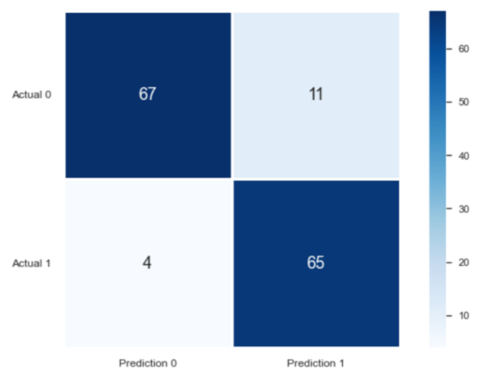
Result & Discussion
TP True positive: the patient has the disease and the test is positive.
FP False positive: the patient does not have the disease but the test is positive.
TN True negative: the patient does not have the disease and the test is negative.
FN False negative: the patient has the disease but the test is negative.
In our result we obtained,
Actual 0 = True negative
Actual 1= True positive
Prediction 0 = False negative
Prediction 1 = False positive
Fig 3: Confusion Matrix

Slide 19
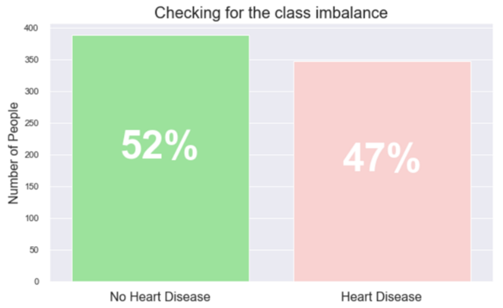
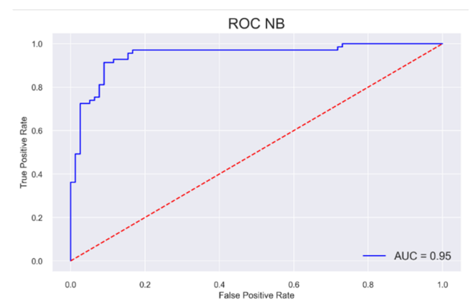
Result & Discussion
Fig : Class Imbalance
Fig: Roc NB

Slide 20
Future Work
The study may be improved in the future by creating a web application based on the Support Vector Machine (SVM) and utilizing a larger dataset than the one used in this research. This would assist to deliver better findings and aid medical professionals in accurately and efficiently predicting cardiac disease.

Slide 21
CONCLUSION
The study aimed to find the best ML algorithm for heart disease diagnosis, given the rise in fatalities caused by heart diseases.
The UCI machine learning repository dataset was used to examine the accuracy scores of four algorithms, including Logistic Regression, Decision Tree, Support Vector Machine (SVM), and Naive Bayes.
The Support Vector Machine (SVM) algorithm was found to be the most effective for predicting heart disease, with an accuracy score of 90.48%.
The results suggest that SVM can be a reliable tool for predicting heart disease and can be further explored for developing a clinical decision support system.
The study highlights the potential of ML algorithms in healthcare and the importance of accurate diagnosis for effective treatment and management of heart diseases.

Slide 22
References
Avinash Golande, Pavan Kumar T, ”Heart Disease Prediction Using Effective Machine Learning Techniques”, International Journal of Recent Technology and Engineering, Vol 8, pp.944-950,2019.
T.Nagamani, S.Logeswari, B.Gomathy,” Heart Disease Prediction using Data Mining with Mapreduce Algorithm”, International Journal of Innovative Technology and Exploring Engineering (IJITEE) ISSN: 2278-3075, Volume-8 Issue-3, January 2019.
World Health Organization. (n.d.). Cardiovascular diseases. World
Health Organization. https://www.who.int/healthtopics/cardiovasculardiseases/.
https://papers.ssrn.com/sol3/papers.cfm?abstract_id=3759562
Ronit, R. (2018, June 25). Heart Disease UCI. Kaggle. https://www.kaggle.com/ronitf/heart-disease-uci.
C. S. Dangare and S. S. Apte, “Improved study of heart disease predictionsystem using data mining classification techniques,”
InternationalJournal of Computer Applications, vol. 47, no. 10, pp. 44–
48, 2012
Sayali Ambekar, Rashmi Phalnikar,“Disease Risk Prediction by Using Convolutional Neural Network”,2018 Fourth International Conference on Computing Communication Control and Automation.
C. B. Rjeily, G. Badr, E. Hassani, A. H., and E. Andres, ―Medical
Data Mining for Heart Diseases and the Future of Sequential Mining Medical Field,‖ in Machine Learning Paradigms, 2019, pp. 71–99.

