Slide 1






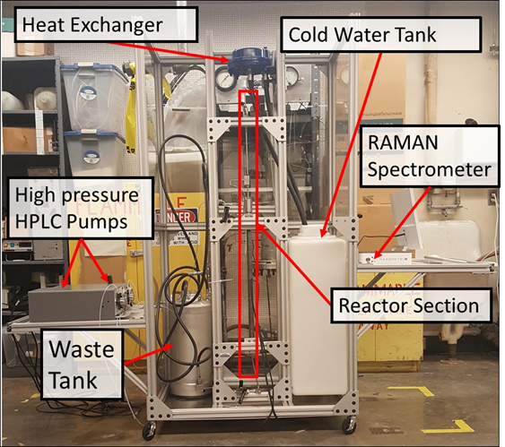
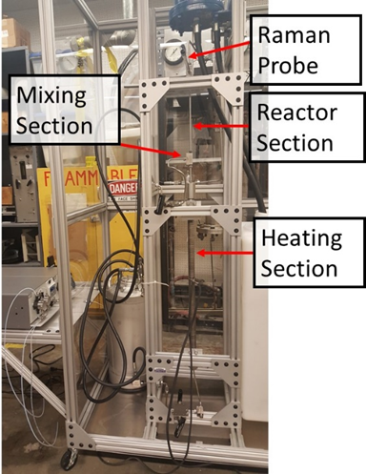
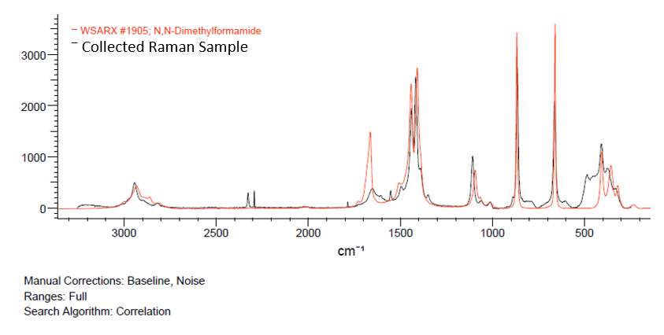
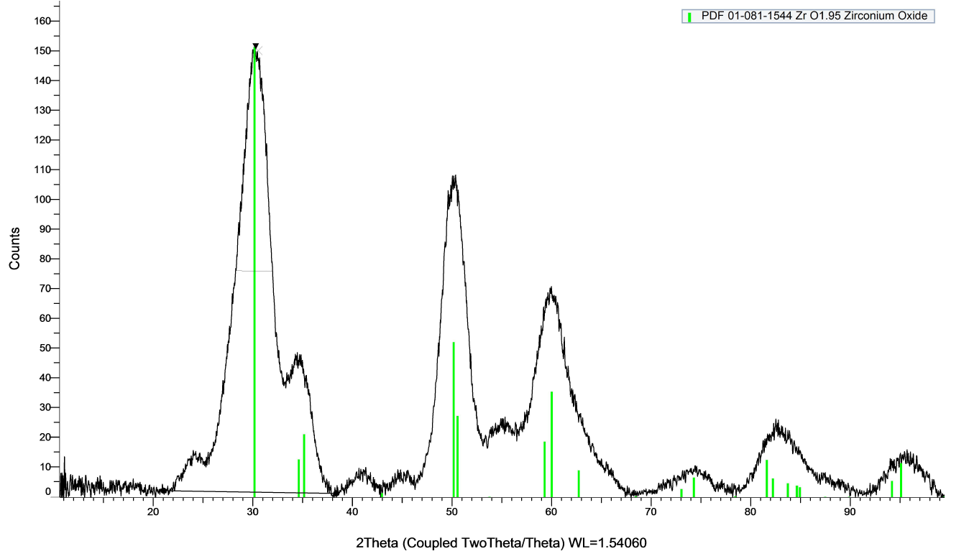
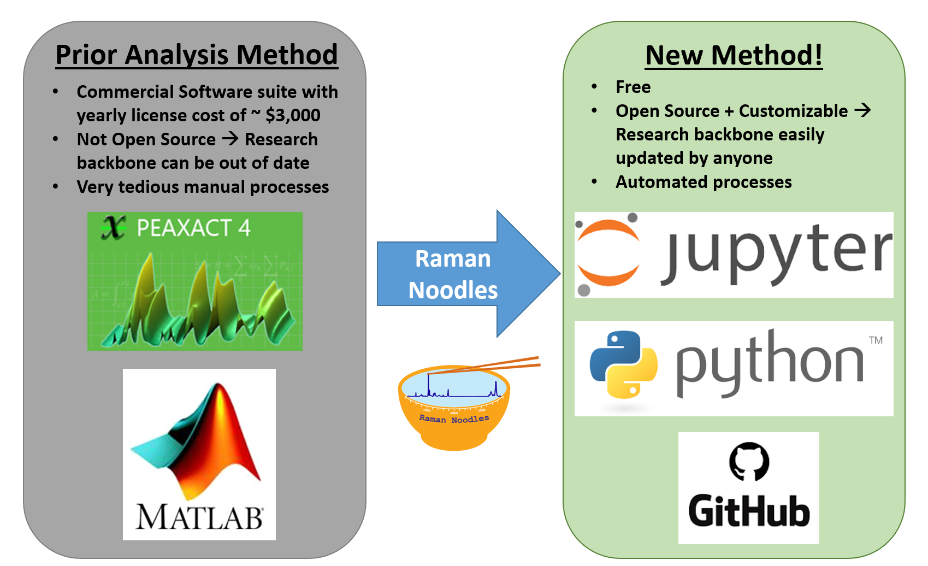
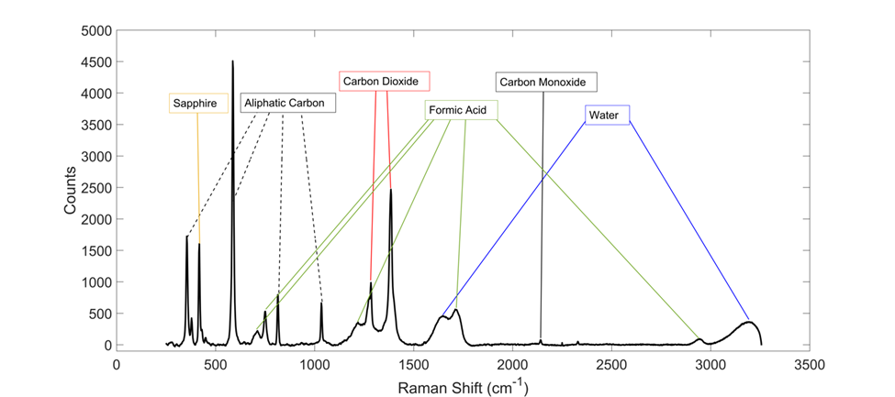
Machine Learning Based Component Identification for In-Situ Raman Spectroscopy Material Decomposition Analysis
Brandon Kern², Elizabeth Rasmussen^{1,3}, Jon Onorato^{2,3}, Parker Steichen²
¹ Department of Mechanical Engineering, ² Department of Material Science and Engineering, ³ Clean Energy Institute
University of Washington, Seattle, WA, USA
Introduction
Formic Acid gasified at 400°C
Pressure held constant at 25 MPa
Residence time of Xs
Constant fedstock concentration of 15 wt%
Results
Materials and Methods
Raman spectra is a way to both identify and quantify components based on vibrational energy different species are known to emit.
Using data from a custom built supercritical reactor on campus formic acid decomposition.
Overall decomposition of formic acid constitutes the combination of these two pathways:
Component Analysis in a Mixture Raman Signal
[text to be filled in at meeting]
FILL IN at meeting
Photographs of UW Gasification Reactor with In-Situ Raman Probe
Confidence Interval and Machine Learning
[text to be filled in at meeting]
Motivation
Conclusions and Future Work
x
Future work is focused on:
Expand software to be able to compute decomposition rates across varying parameters such as temperature, resonance time, possibly pressure.
From the defined decomposition rate the software can predict the decomposition rates using machine learning beyond the known data set limits
Goals
Acknowledgements
Data Mining and Cleaning
Importing open source data sets, creating a library of Raman spectra, uniformly formatting data in preparation for analysis
Data Visualization
Outputting plots of peak identification for user validation (if wanted)
Machine Learning
Applying X (software tool(s) name here) to test for peak identification confidence interval
Dave Beck, Chad Curtis, and Kelly Thornton
Data sets were taken from publicly available from the NIST WebBook Database and Mendeley Data, “Raman Spectra of Formic Acid Gasification Products in Subcritical and Supercritical Water”
Only open source packages were used in this work, documentation of all packages used can be found at our Github at:
https://github.com/raman-noodles

