Slide 1





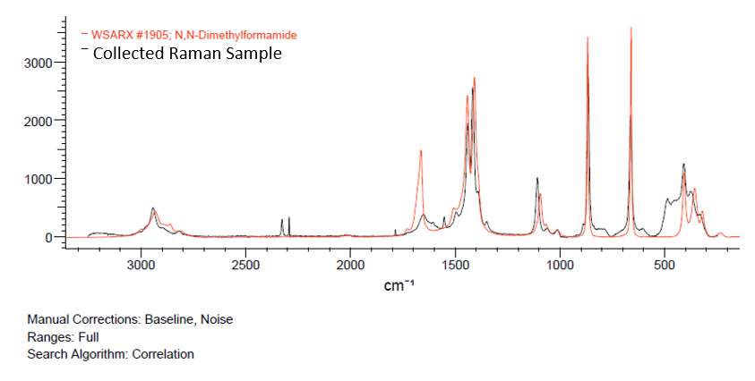
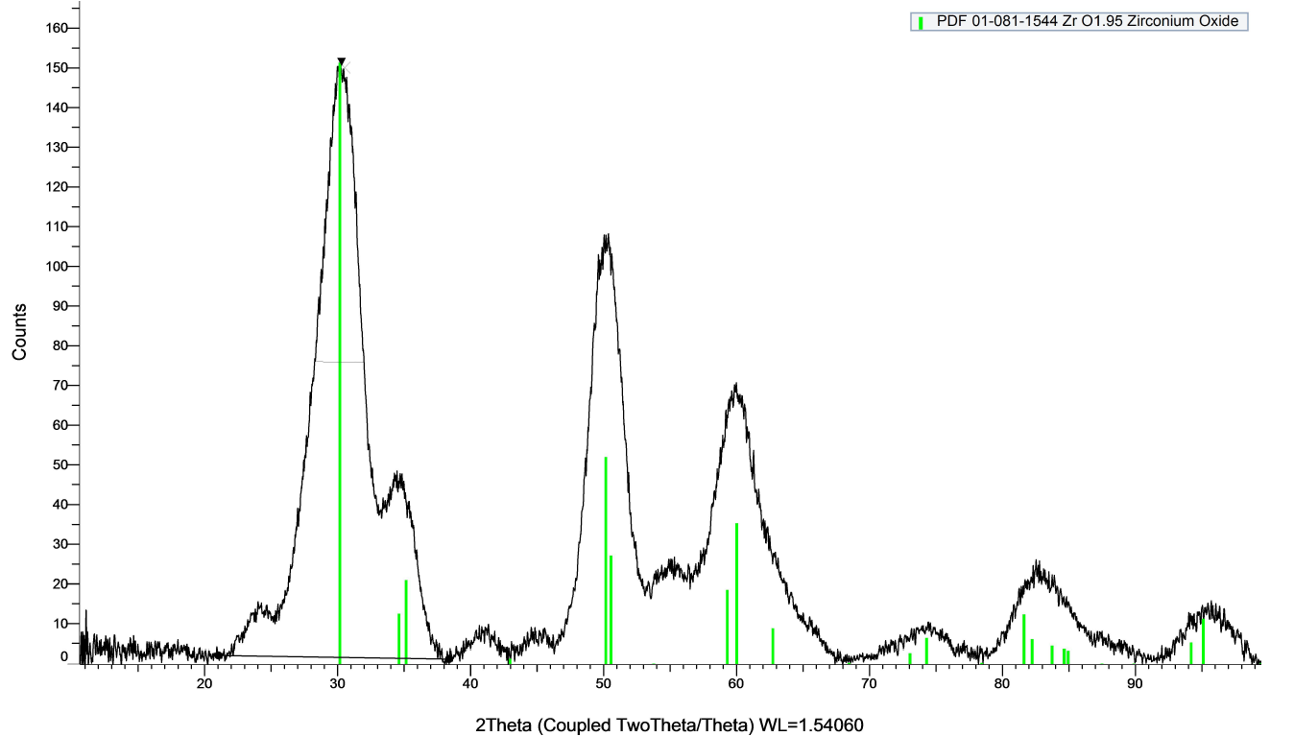
Component Identification in Mixture Raman Spectroscopy for In-Situ Material Decomposition Analysis
Elizabeth Rasmussen^{1,3}, Brandon Kern², Parker Steichen², Jon Onorato²
¹ Department of Mechanical Engineering, ² Department of Material Science and Engineering, ³ Clean Energy Institute
University of Washington, Seattle, WA, USA
Introduction
Formic Acid gasified at 400°C
Pressure held constant at 25 MPa
Residence time of Xs
Constant fedstock concentration of 15 wt%
Results
Materials and Methods
FILL IN
FILL IN
Raman Analysis
Decomposition hypothesized when presence of bubbles and vapor in product collection beaker was observed
Raman laser (785 nm wavelength, 300 mW of power) with sapphire ball cell
Fluorescent background signal removed with OriginPro Software
Compared to pure DMF signal, the collected Raman sample confirms decomposition of DMF
XRD Analysis
Using a Brunker D8 Discover with 2D XRD, the sample was analyzed against the Crystallography Open Database ZrO₂ nanoparticle formation
XRD report of synthesized product, green bars show archival data of ZrO₂
Motivation
Conclusions and Future Work
Fill in
x
Future work is focused on:
Defining s
Acknowledgements
Goals
DaveBeckandKellyThornton
DatasetsweretakenfrompublicallyavailablebatterycyclingdatafromtheUniversityofMaryland’sCenterforAdvancedLifeCycleEngineering(CALCE)Onlyopensourcepackageswereusedinthiswork,documentationofallpackagesusedcanbefoundatourgithubathttps://github.com/tacohen125/chachies
A reactor was constructed from 316 stainless steel tubing and fittings
HPLC pumps provide front-end pressure with flow rate 0.1 to 10 mL/min
Spring-loaded back pressure regulator (BPR) allows for pressure control

