Slide 1
Pursuing Quality
Chris Holt
@lefthandedgoat
github.com/lefthandedgoat/openfsharpdemo

Slide 2
So this is how grey hairs are formed?
Chris Holt
@lefthandedgoat
github.com/lefthandedgoat/openfsharpdemo

Slide 3
Wow, over the counter heartburn medication is surprisingly effective
Chris Holt
@lefthandedgoat
github.com/lefthandedgoat/openfsharpdemo

Slide 4
pls fix
Chris Holt
@lefthandedgoat
github.com/lefthandedgoat/openfsharpdemo

Slide 5
Overview
Philosophy
API Testing
UI Automation
Performance Testing
Property Based Testing
Anecdotes of wisdom

Slide 6
Philosophy
Quality is a mindset
One person can't do it
You have to change culture (challenging)
Book

Slide 7
Why?
Makes you learn about your app
UI tests help you understand from a user's standpoint
API from a consumer standpoint

Slide 8
How?
Build a second consumer of your UI/API, another application
Fresh data for every test is usually good, a new user for each one etc
-1,0,1,2,N where N is a medium number and N * 10

Slide 9
Cons
Tests are a second consumer of your application, and can make refactoring take more time
Quality can't be achieved without spending time pursuing it
Learning curve
Maintenance
“Brittle”

Slide 10
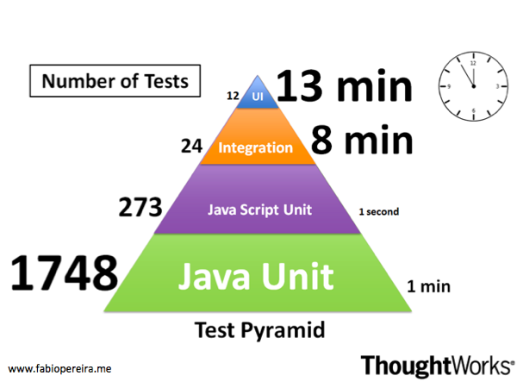
Pretty pyramid
~60,000 ms
~20,000 ms
~4 ms
~30 ms
http://fabiopereira.me/blog/2012/03/05/testing-pyramid-a-case-study/

Slide 11
API Testing
Code
Libraries
reference to your main code for types
http.fs
json serializer
custom helpers/assertions
canopy (optional, replace with unit test lib)

Slide 12
UI Automation
Code
Libraries
canopy/Selenium
reference to your main code for types
api helpers
custom helpers/assertions

Slide 13
Performance testing
Talk about stuff
Demo
Tools
Profiler (jetbrains dotTrace)
Fiddler/Charles (windows/osx)
BenchmarkDotNet

Slide 14
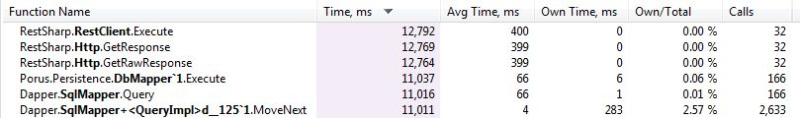

Unfortunate traces

Slide 15
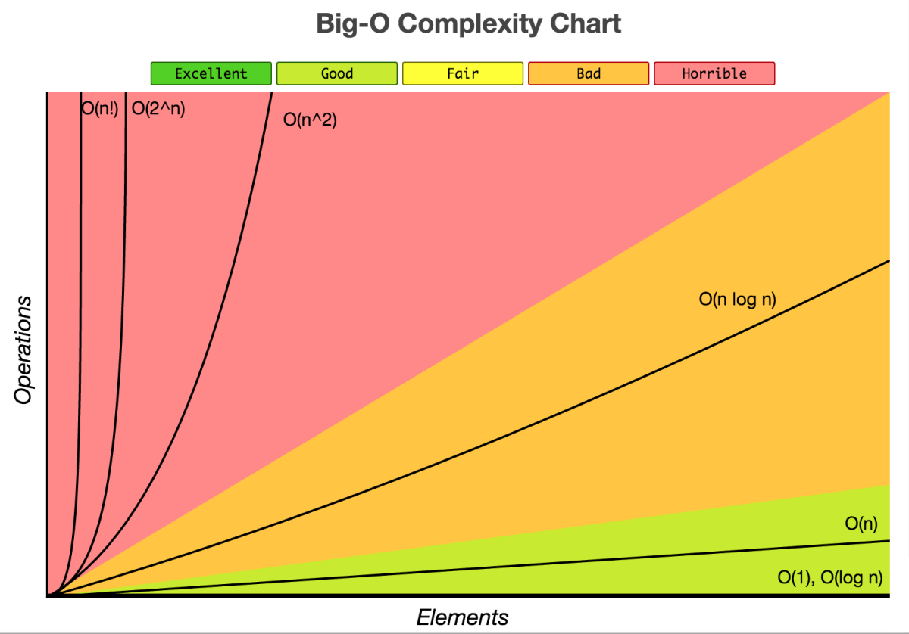
Glorious graph
http://www.jessicayung.com/big-o-notation-a-common-mistake-and-documentation/

Slide 16
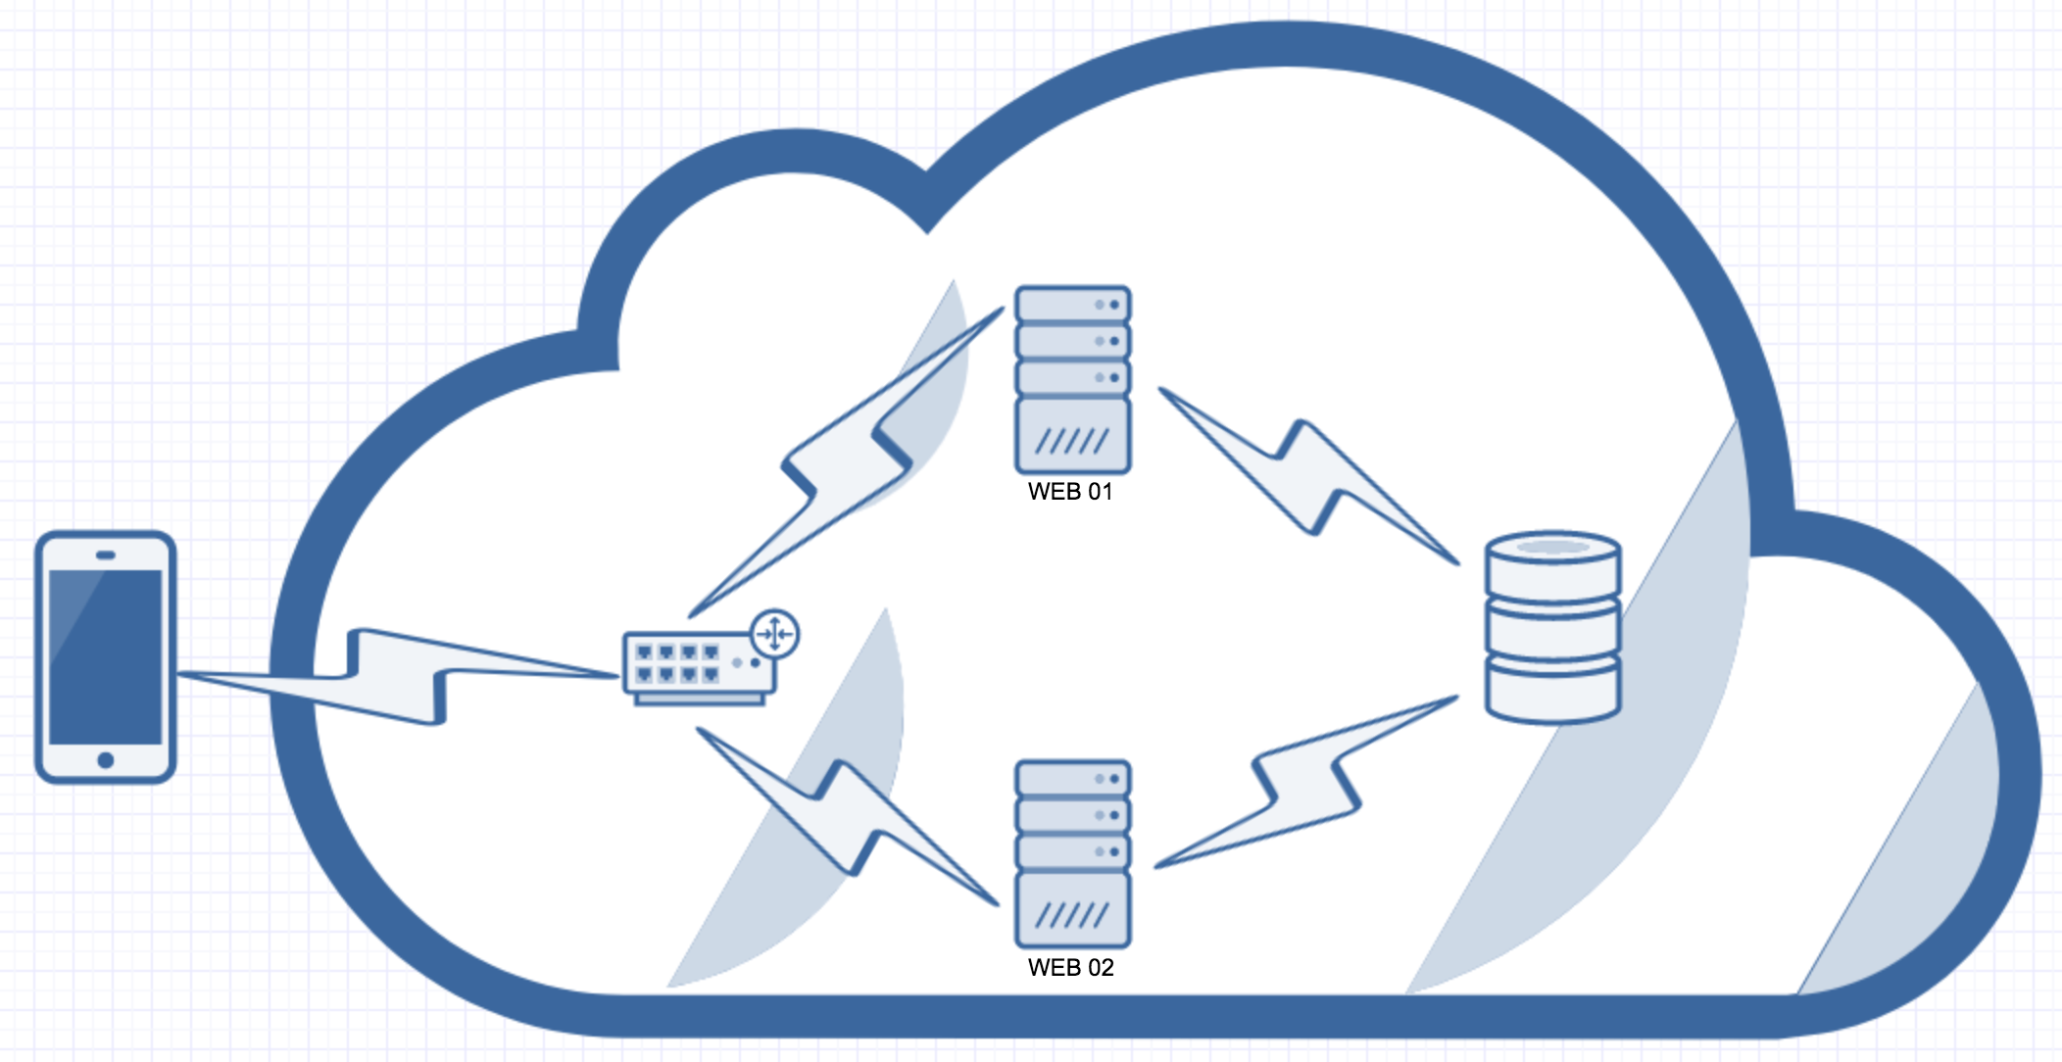
Standard diagram

Slide 17
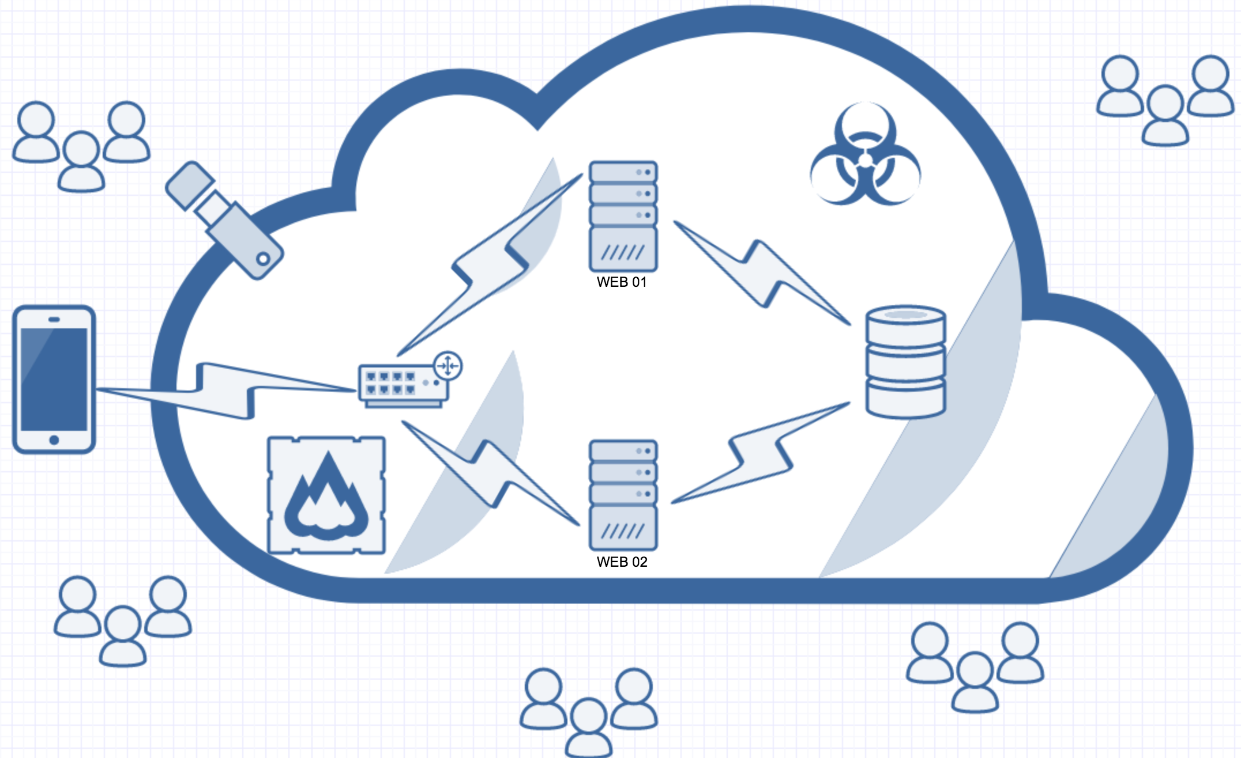
Diagram of truth

Slide 18
Slow code hurts 1 or more of these
Client CPU/Network/Memory
Your WAN
Your LAN
Web server VM’s CPU/Memory
Web server Host’s CPU/Memory (overprovisioned)
Database CPU/Memory
SAN/Disk/Network

Slide 19
pls fix

Slide 20
Property based testing
Code
Libraries
fscheck
reference to your code/helpers
unit test library

Slide 21
Anecdotes of wisdom
All code is debt, make sure the code you are writing has a value that outweighs the debt
"Everyone knows that debugging is twice as hard as writing a program in the first place. So if you're as clever as you can be when you write it, how will you ever debug it?" - Brian Kernighan
Code that 'should work' usually works < 50% of the time

Slide 22
Anecdotes of wisdom cont…
What you measure often defines your results. If developers are measured on getting tickets to 'Ready to QA' then that will influence their quality. Try measuring for low production bugs with good velocity
Generally there are two problems to solve, 1) how to do solve it in general, 2) how to solve it within the constraints of your application
POCs POCs POCs

Slide 23
Anecdotes of wisdom cont…
You test scenarios
scenarios rely on data,
test data should be easy to create
otherwise people wont test those scenarios!
Breaking happy path is embarrassing!

Slide 24
Thanks!
Find me and ask questions throughout the conference!!!
Chris Holt
@lefthandedgoat
github.com/lefthandedgoat/openfsharpdemo

