Slide 1
QUICK! Check Your Properties (and Write Better Software)
Paulmichael Blasucci
paulmichael@jet.com
Notes:
About the presenter
Associate Director at Jet.com
Part of the team behind the pricing engine
17.5 as a professional developer
Long-time Microsoft developer
.NET since it was in beta
Years of: C# > VB > IronPython > F#
2014, 2015 Microsoft MVP (F#/.NET)
Co-Founded NashF#
Co-Organizer NYC F# Users Group

Slide 2
RANDOM TESTING “Properties are described as … functions, and can be automatically tested on random input... [or] custom test data generators.”
from ICFP’00 – Claessen, Hughes
Notes:
About property-based testing
Originated with QuickCheck (in Haskell)
Since ported to many many languages
This session covers library for use with F#, C#, VB.NET, et cetera
Well-suited to functional programming, but useful with other paradigms
Especially with pure functions (also referentially transparent functions)
Allows very granular testing (and implicit guarantees via composition)
Data generation capabilities also useful outside of property-based testing
Mocking… if you do that sort of thing
Domain exploration

Slide 3
TO PROPERTY TESTING!
FROM UNIT TESTING…
[<Fact>]
let PlusIgnoresTime () =
let days = time.FromDays 7
let hours = time.FromHours 24
let civil = date.Now
Assert.Equal (civil + days
,civil + hours)
[<Property>]
let ``plus ignores time`` (civil:date) =
let days = time.FromDays 7
let hours = time.FromHours 24
civil + days = civil + hours
TEST EXECUTION SUMMARY
Tests run: 1, Errors: 0, Failed: 0, Ignored: 0
✔ PlusIgnoresTime
OK, Elapsed time: 0.0527666s
TEST EXECUTION SUMMARY
Tests run: 1, Errors: 0, Failed: 0, Ignored: 0
✔ plus ignores time
OK, passed 100 tests
Notes:
Introducing FsCheck
Uses random data and logical propositions to prove or disprove behavior
Simple eDSL for logical propositions
API for steering data generation
API for observing distributions of generated data
With or without other testing tools
Failing tests can raise exceptions, providing compatibility with: xUnit, Nunit, et cetera
Does not obviate the need for other types of testing
TDD works with specific examples, while PBT works with universal properties

Slide 4
PATTERNS: INVERSION & IDEMPOTENCEY
// inversion ... an action and its inverse cancel each other out
[Property]
public static Boolean AddAndSubtract_AreInverses (date civil, PositiveInt total)
{
var days = time.FromDays(total.Item);
return ((civil + days) - days == civil);
}
// idempotence ... an action has the same effect no matter how many times it occurs
[Property]
public static Boolean Taking_TimeDuration_IsIdempotent (time value)
{
var once = value.Duration();
var twice = value.Duration().Duration();
return (once == twice);
}
Notes:
Think of property-based testing not as a testing process, but as a design process -- a technique that helps you clarify what your system is really trying to do.
We can even test the properties of higher-order functions because FsCheck can GENERATE FIRST-CLASS FUNCTION VALUES AS INPUT DATA!!!!
Idempotence is essential for reliable systems and is a key aspect of service oriented and message-based architectures.
PRO TIP: Make sure your property checks are very fast. You will be running them a LOT!!!

Slide 5
PATTERNS: INVARIANCE & INTERCHANGE
' interchange ... the order of two or more actions does not affect the outcome
<[Property]>
Public Function Add_Change_CanBeReordered (civil As Dated, total As PositiveInt)
Dim pacStd = "Pacific Standard Time“
Dim days = Time.FromDays(total)
Dim addThenShift = Zone.ConvertTimeBySystemTimeZoneId(civil + days, pacStd)
Dim shiftThenAdd = Zone.ConvertTimeBySystemTimeZoneId(civil, pacStd) + days
Return addThenShift = shiftThenAdd
End Function
' invariance ... something remains constant, despite action being taken
<[Property] >
Public Function Add_DoesNotChange_Offset (civil As Dated, months As PositiveInt)
Dim offset = civil.Offset
Dim shifted = civil.AddMonths(months)
Return shifted.Offset = offset
End Function
Notes:
Think of property-based testing not as a testing process, but as a design process -- a technique that helps you clarify what your system is really trying to do.
We can even test the properties of higher-order functions because FsCheck can GENERATE FIRST-CLASS FUNCTION VALUES AS INPUT DATA!!!!
Interchange is especially useful for proving referential transparency (purity?)
PRO TIP: Make sure your property checks are very fast. You will be running them a LOT!!!

Slide 6
INPUT CONTROL
[<Property>]
let ``DST test oracle (naive)`` (civil :date) =
let eastern = zone.FindSystemTimeZoneById EST
let etDate = zone.ConvertTime (civil,eastern)
Zone.inUnitedStatesDaylightTime etDate
= eastern.IsDaylightSavingTime etDate
Conditional Properties
TEST EXECUTION SUMMARY
Tests run: 1, Errors: 0, Failed: 1, Ignored: 0
✘ DST test oracle (naive)
Falsifiable, after 1 test (4 shrinks), (StdGen (2119435949,296213433))
Original: 1908-04-23 23:48:57 -04:02
Shrunk: 1908-04-23 00:00:00 +00:00
Notes:
StdGen seeds can be used to demonstrably re-create (replay) a given run of FsCheck

Slide 7
INPUT CONTROL
[<Property>]
let ``DST test oracle`` (civil :date) =
let eastern = zone.FindSystemTimeZoneById EST
let etDate = zone.ConvertTime (civil,eastern)
( civil.Year >= 2007
&& eastern.IsDaylightSavingTime etDate )
==> lazy
Zone.inUnitedStatesDaylightTime etDate
Conditional Properties
TEST EXECUTION SUMMARY
Tests run: 1, Errors: 0, Failed: 0, Ignored: 0
✔ DST test oracle
OK, passed 100 tests
Notes:
REMEMBER: “Property” = “boolean expression” (i.e. tests can be used as the pre-conditions to other tests)
Conditionals allow pre-execution filtering.
When a pre-condition isn’t met, the run is scraped and a new set of random inputs is generated (i.e. acts like a filter)
Useful for expressing SIMPLE invariants and SIMPLE business rules. In many scenarios, a custom data generator is more appropriate.

Slide 8
CUSTOM DATA GENERATION
Generator (of T)
Shrinker (of T)
Arbitrary (of T)
Notes:
FsCheck provides many useful random generators out-of-the-box.
Container types can be generated so long as FsCheck knows how to generate the contained types
Often necessary to define our own
FsCheck has an API for generators and shrinkers
Use for custom data types
Use to formalize, encode business logic
Arbitrary = Generator + Shrinker for a particular type (often built from Arb module functions); defined as an interface

Slide 9
CUSTOM DATA GENERATION
Generators
Gen<Int32>
Int32
Gen<Address>
Address
Gen<List<T>>
List<T>
Size = 6: shrink [ 7,5,1,2,3,6 ]
Size = 2: shrink [ 5, 3 ]
Size = 0: shrink []
Size = 4: shrink [ 5,1,3,6 ]
Shrinkers
Notes:
Size – numeric value interpreted differently by each generator/shrinker (some even ignore it!); used to create a sense of “bigger” (or “smaller”) between generated type instances
Generator – (optionally) interprets Size; provides actual generation logic; build from a mix of: Gen module functions, Gen computation expression, Arb module functions, and custom logic needed
Shrinker – optional function which takes a randomly generated input and returns a sequence of “smaller” instances

Slide 10
INPUT CONTROL
// instead of a conditional property,
// we can use an Arb and a universal quantifier
[Property]
public static Property RoundTripSerialization ()
{
// define arbitrary generator
var zones = Gen.Elements(
from z in zone.GetSystemTimeZones()
select z)
.ToArbitrary();
// "for all" zones, run a test...
return Prop.ForAll(zones, z =>
{
var str = z.ToSerializedString();
var obj = zone.FromSerializedString(str);
return z.Equals(obj);
});
Universal Quantifiers

Slide 11
DATA GENERATION
Arb with Shrinker
Notes:
Random data generation often identifies previously unknown edge cases; also helpful in guiding exploration of an existing codebase

Slide 12
CUSTOM DATA GENERATION
''' encapsulates several IArbitrary instances
Friend Module Generator
''' generates PositiveTime instances by leveraging FsCheck's built-in
''' support for generating and shrinking TimeSpan instances
Public Function PositiveTime () As Arbitrary(Of PositiveTime)
Dim generator =
From t In Arb.Generate(Of Time)()
Where t > Time.Zero
Select New PositiveTime(t)
Dim shrinker As Func(Of PositiveTime,IEnumerable(Of PositiveTime)) =
Function (posTime)
Return From t In Arb.Shrink(posTime.Value)
Where t > Time.Zero
Select New PositiveTime(t)
End Function
Return Arb.From(generator,shrinker)
End Function
Notes:
Could’ve used a conditional property, but custom arbitrary is more efficient and better captures (otherwise implicit) business constraint
!!! Complex conditional generator (i.e. co-recursive types) can be convoluted !!!

Slide 13
DIAGNOSTICS: LABELLING PROPERTIES
[<Property (Arbitrary=[| typeof<Generator> |])>]
let ``conversion ignores detours`` (civil :date) (zone1 :zone) (zone2 :zone) =
let viaZone1 = zone.ConvertTime (zone.ConvertTime (civil,zone1),zone2)
let directly = zone.ConvertTime (civil,zone2)
(viaZone1 = directly) && (directly.Offset = zone2.BaseUtcOffset)
TEST EXECUTION SUMMARY
Tests run: 1, Errors: 0, Failed: 1, Ignored: 0
✘ conversion ignores detours
Falsifiable, after 4 tests (5 shrinks), (StdGen (199662269,296213481)):
Original: (1948-04-19 16:18:52 +04:59, (UTC+04:00), (UTC-05:00))
Shrunk: (1948-04-19 00:00:00 +00:00, (UTC+04:00), (UTC-05:00))
Notes:
Simple boolean operations (AND, OR) work… but don’t help us identify where failure occurred

Slide 14
DIAGNOSTICS: LABELLING PROPERTIES
[<Property (Arbitrary=[| typeof<Generator> |])>]
let ``conversion ignores detours`` (civil :date) (zone1 :zone) (zone2 :zone) =
let viaZone1 = zone.ConvertTime (zone.ConvertTime (civil,zone1),zone2)
let directly = zone.ConvertTime (civil,zone2)
(viaZone1 = directly) |@ sprintf “Not the same date!“
.&.
(directly.Offset = zone2.BaseUtcOffset) |@ sprintf “Not the same zone!"
TEST EXECUTION SUMMARY
Tests run: 1, Errors: 0, Failed: 1, Ignored: 0
✘ conversion ignores detours
Falsifiable, after 4 tests (5 shrinks), (StdGen (199662269,296213481)):
Label of failing property: Not the same zone!
Original: (1948-04-19 16:18:52 +04:59, (UTC+04:00), (UTC-05:00))
Shrunk: (1948-04-19 00:00:00 +00:00, (UTC+04:00), (UTC-05:00))
Notes:
FsCheck provides (AND,OR) for properties… many purpose is to use with LABELS, so properties don’t amalgamate into a useless bool
(.&.) boolean AND for properties
(.|.) boolean OR for properties
(@|) adds an arbitrary label, which is reported for falsifiable tests

Slide 15
DIAGNOSTICS: LABELLING PROPERTIES
[<Property (Arbitrary=[| typeof<Generator> |])>]
let ``conversion ignores detours`` (civil :date) (zone1 :zone) (zone2 :zone) =
let viaZone1 = zone.ConvertTime (zone.ConvertTime (civil,zone1),zone2)
let directly = zone.ConvertTime (civil,zone2)
(viaZone1 = directly) |@ sprintf “Not the same date!“
.&.
(directly.Offset = zone2.GetUtcOffset directly) |@ sprintf “Not the same zone!"
TEST EXECUTION SUMMARY
Tests run: 1, Errors: 0, Failed: 0, Ignored: 0
✔ conversion ignores detours
OK, passed 100 tests
Notes:
FsCheck provides (AND,OR) for properties… many purpose is to use with LABELS, so properties don’t amalgamate into a useless bool
(.&.) boolean AND for properties
(.|.) boolean OR for properties
(@|) adds an arbitrary label, which is reported for falsifiable tests

Slide 16
DIAGNOSTICS
TEST EXECUTION SUMMARY
Tests run: 1, Errors: 0, Failed: 0, Ignored: 0
✔ add and change can be reorderd
OK, passed 100 tests
26% Odd, East of Greenwich, trivial.
21% Even, East of Greenwich, trivial.
14% Even, West of Greenwich, trivial.
13% Odd, West of Greenwich, trivial.
8% Odd, West of Greenwich.
8% Even, West of Greenwich.
5% Odd, East of Greenwich.
5% Even, East of Greenwich.
Gathering Observations
Notes:
“meaningless to talk about random testing without discussing the distribution of test data. Random testing is most effective when the distribution of test data follows that of actual data… [when possible]”
PRO TIP: "Correctness confidence" very dependent on test distributions!!!
FsCheck does not measure coverage – dev MUST investigate distributions to ensure suitability

Slide 17
DIAGNOSTICS: GATHERING OBSERVATIONS
// a trival observation partions data into one of two buckets
[Property (Arbitrary = new []{ typeof(Generator) })]
public static Property Interchange (date civil, zone target, NonNegativeInt total)
{
var days = time.FromDays(total.Item);
var addThenShift = zone.ConvertTime(civil + days, target);
var shiftThenAdd = zone.ConvertTime(civil, target) + days;
// Does target zone support DST? Yes or no
return (addThenShift == shiftThenAdd).Trivial(target.SupportsDaylightSavingTime);
}
Notes:
Prop.trivial – a simple boolean qualification observed against a whole distribution… puts ALL tests into one of 2 buckets

Slide 18
DIAGNOSTICS: GATHERING OBSERVATIONS
// a classification partions data into one of N, labelled buckets
[Property (Arbitrary = new []{ typeof(Generator) })]
public static Property Interchange (date civil, zone target, NonNegativeInt total)
{
var days = time.FromDays(total.Item);
var addThenShift = zone.ConvertTime(civil + days, target);
var shiftThenAdd = zone.ConvertTime(civil, target) + days;
// What is civil date’s longitude, relative to GMT?
return (addThenShift == shiftThenAdd)
.Classify(civil.Offset < time.Zero, "West of Greenwich")
.Classify(civil.Offset == time.Zero, "Within Greenwich" )
.Classify(civil.Offset > time.Zero, "East of Greenwich");
}
Notes:
Prop.classify – arbitrary number of boolean qualifications observed (individually) against a whole distribution… puts SOME tests into one of N buckets

Slide 19
DIAGNOSTICS: GATHERING OBSERVATIONS
' rather than using a boolean observation, collect reports any value
<[Property] (Arbitrary := { GetType(Generator) }) >
Public Function Interchange (civil As Dated,
target As Zone,
total As NonNegativeInt) As [Property]
Dim days = Time.FromDays(total.Item)
Dim addThenShift = Zone.ConvertTime(civil + days, target)
Dim shiftThenAdd = Zone.ConvertTime(civil, target) + days
‘ Is total increment evenly divisible by 2?
Return (addThenShift = shiftThenAdd)
.Collect(IIf(total.Item Mod 2 = 0, Even, Odd))
End Function
Notes:
Prop.collect – compiles arbitrary value from each test; reported alongside percentage of overall distribution

Slide 20
DIAGNOSTICS: GATHERING OBSERVATIONS
' observations may be combined as mush as is desired
<[Property] (Arbitrary := { GetType(Generator) })>
Public Function Interchange (civil As Dated,
target As Zone,
total As NonNegativeInt) As [Property]
Dim days = Time.FromDays(total.Item)
Dim addThenShift = Zone.ConvertTime(civil + days, target)
Dim shiftThenAdd = Zone.ConvertTime(civil, target) + days
Return (addThenShift = shiftThenAdd)
.Trivial(target.SupportsDaylightSavingTime) _
.Classify(civil.Offset < Time.Zero, "West of Greenwich") _
.Classify(civil.Offset = Time.Zero, "Within Greenwich" ) _
.Classify(civil.Offset > Time.Zero, "East of Greenwich") _
.Collect(IIf(total.Item Mod 2 = 0, Even, Odd))
End Function
Notes:
Combining observations – no limit; be as complex as you want/need (but be mindful of performance!)

Slide 21
RANDOM TESTING “One of the major advantages… is that it encourages us to formulate formal specifications, thus improving our understanding…”
from ICFP’00 – Claessen, Hughes
Notes:
Not covered:
Expecting exceptions – INCLUDED IN SAMPLES (F# only!)
Time-dependent properties (F# only!)
Model-based testing
Fine-tuning output
Still more property patterns
FsCheck:
Uses random data and logical propositions to prove or disprove behavior
Simple eDSL for logical propositions
API for steering data generation
API for observing distributions of generated data
Limitations:
Not easy to define properties for certain domains
Complex conditional generator (for linked types) can be convoluted
Does NOT obviate need for other quality control mechanisms
"Correctness confidence" very dependent on test distributions

Slide 22
FURTHER INFORMATION
About F# and FsCheck
About Paulmichael Blasucci
fsharp.org
fscheck.github.io/FsCheck
fsharpforfunandprofit.com
meetup.com/nyc-fsharp
twitter.com/pblasucci
github.com/pblasucci
gitlab.com/pblasucci
linkedin.com/in/pblasucci
Notes:
NYC F# Users Group meets 3rd Saturday of every month… we also have a guest lecture one weeknight per month

Slide 23
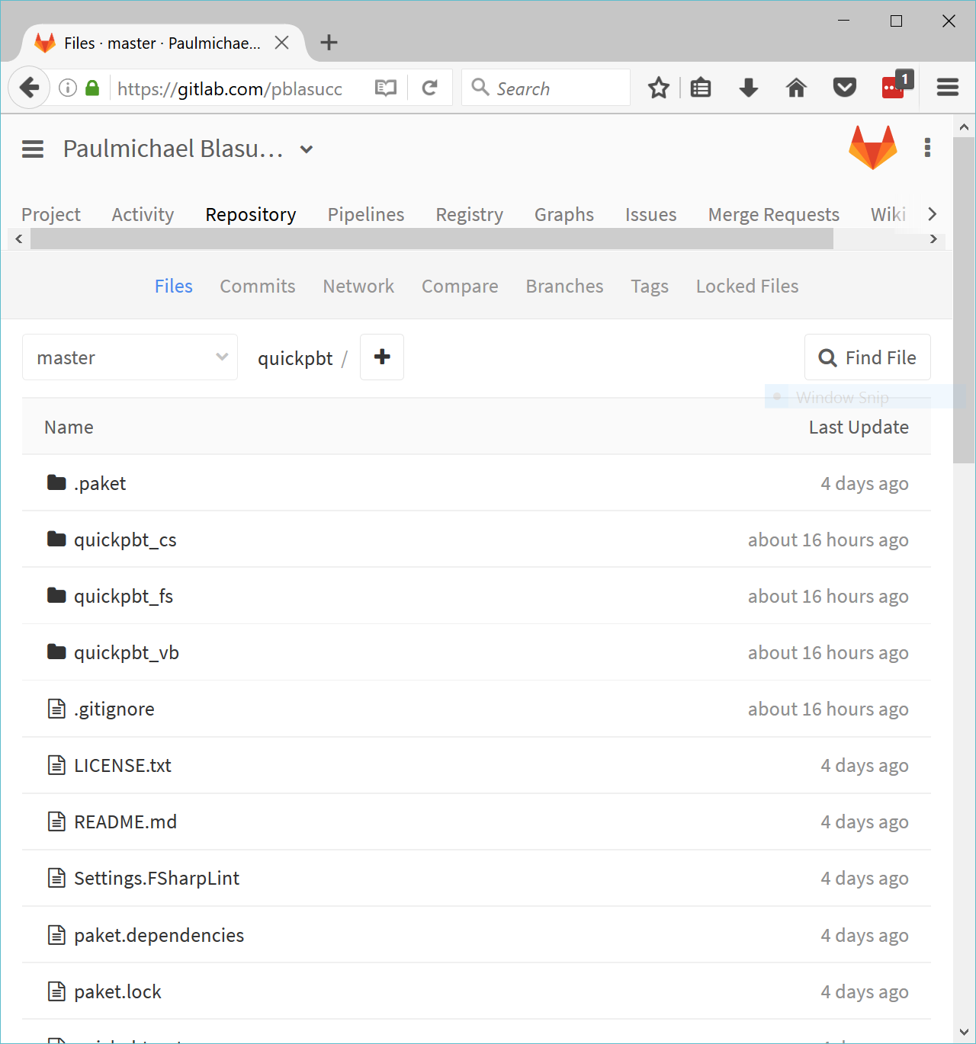
gitlab.com/pblasucci/quickpbt
More than 4,800
tests! (…ran)
My code is your code
Notes:
Download:
QuickCheck ICFP paper
This slide deck
All code samples featured in this talk
EACH SAMPLE IS IN AVAILABLE IN THREE (3) LANGUAGES
F#
C#
VB
Various bits and bobs

