Slide 1
SHOPPING CENTER WEBSITE
Nourhane Jundi & Ahmad Hawchar

Slide 2

INTRODUCTION
Our website is the result of a collaborative effort between our front-end developer and back-end developer. We've poured our expertise into crafting an elegant and efficient platform, blending creativity with code to deliver a seamless user experience on all devices.

Slide 3
TIMELINE
1
Front-end: Routes and Modules
2
Design and features
3
Back-end: folders and methods
4
Diagram

Slide 4
Front-end
Ahmad hawchar

Slide 5
Languages and frameworks
The front end of this website was created using ANGULAR as a front-end framework, and CSS for styling.

Slide 6
Features and accessibility
User Pages and features
-logged in Users are capable of browsing all the pages of the website except those made for admins
-the pages available for a user are :homepage-shop(search)-user's shopping cart-user's settings
-all pages are responsive meaning they could be accessed using all screen sizes with no breaking of pages
-users are capable of ordering their shopping cart for it to be shipped to their address( feature unavailable currently)
design
This website was intended to be an internship project therefor the design was kept minimalistic and simple

Slide 7
Admin Pages and features
-logged in admins are capable of adding-deleting-editing products(edit is still unavailable), deleting users and orders!
-the pages available for admin are: manage products-manage users-manage orders
-admins can also add and delete categories
-all admin pages were designed to be easy to use by non-programmers

Slide 8
Code and folders
Modules are lazy loaded to improve performance
Folders were separated and named in a way that provides a seamless understanding of the project by alien developers
Code was documented so that the understanding of code is made easier
The angular official documentation was followed as much as possible when creating this project
No external packages were installed to keep the build file small

Slide 9
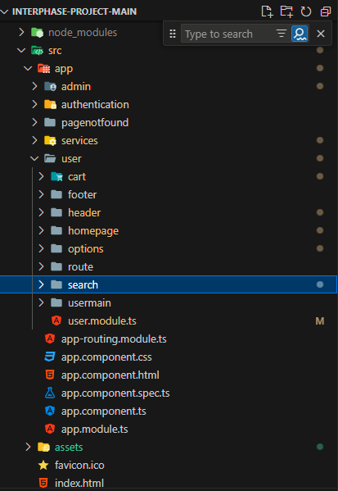

Slide 10
Back-end
Nourhane jundi

Slide 11
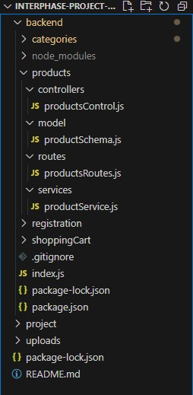

Slide 12
accessibility
-Admin:
-Managing Products
-Managing users
(ofc an Admin)
-User:
-Managing his Shopping Cart
-Managing his searches

Slide 13
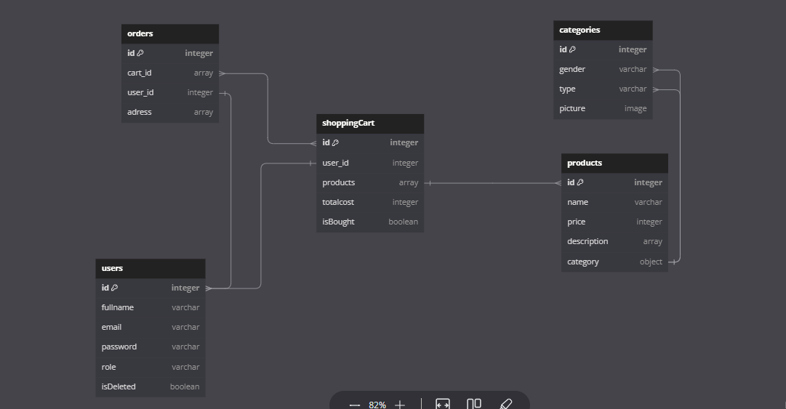

Slide 14
Questions??
Let's execute!!!

