Slide 1

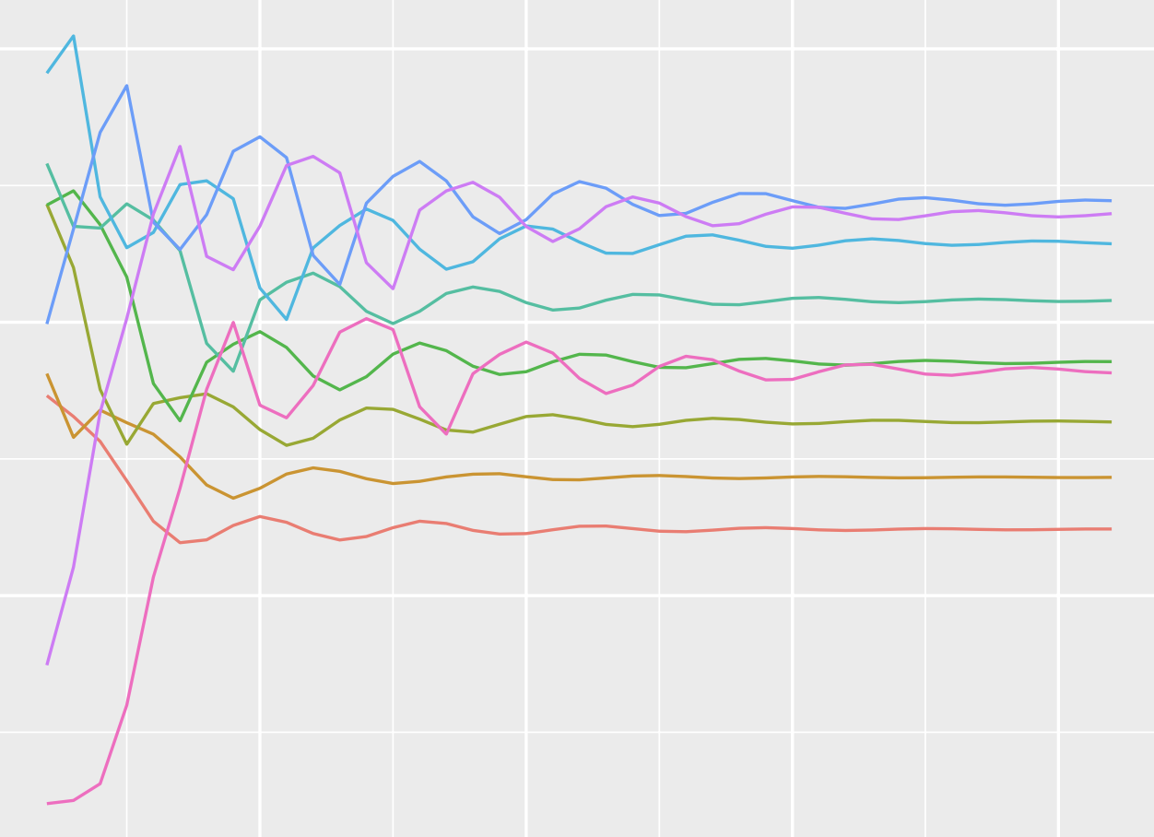
The Formal Demography Working Group
1st Meeting
29.10.2021
Vanessa di Lego, Monica Alexander and Ryohei Mogi

Slide 2

Great resources for reflection
My Life in Words and Numbers, Samuel H. Preston, 2020 + interview PAA presidential address 1984
Conceptual issues in demography, Rebecca Sear, 2018
Demography Abandons Its Core, Ronald Lee, 2001
Demography: The Past 30 Years, the Present, and the Future, Eileen M. Crimmins, 1993
Mathematical Demography: A Bibliographical Essay, Nathan Keyfitz, 1976
Population Appearances and Demographic Reality, Nathan Keyfitz, 1980
How Do We Know the Facts of Demography? Nathan Keyfitz, 1975

Slide 3
Will be added to:
https://formaldemography.github.io/working_group/

Slide 4
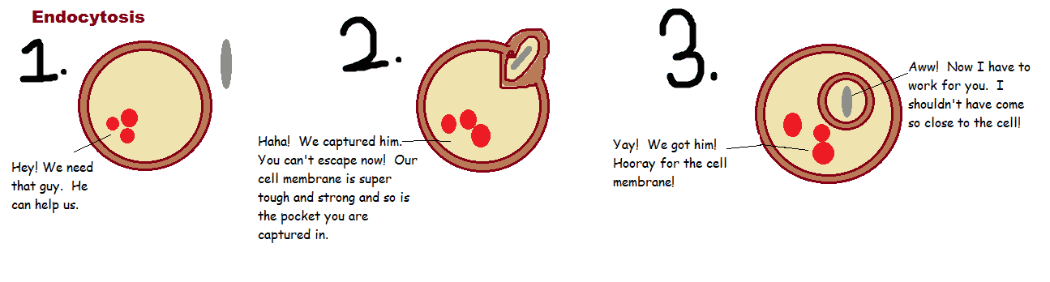
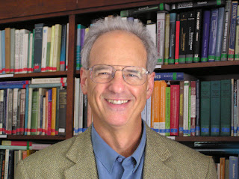
The Doughnut field …
Data and Theories of causes and consequences of population trends:
Soft rind or borders, through where the core related to the real world
Hard mathematical core; models, measurement and dynamics
Geography
History
Formal Demography
Biology
Politics
“Core” Translates into the real world through the “borders”
Medicine
Economics
Sociology

Slide 5
Cannibals or Colonizers ? (Wunsch 1995 x Sigle 2016)
1995 Guillaume Wunsch Plenary to EPC : “God Has Chosen to Give the Easy Problems to the Physicists: Or Why Demographers Need Theory”
“Demography has never had a grand explanatory paradigm, such as the postulate of rationality and the concept of utility in microeconomics…”
“The lack of a grand unified approach is not necessarily a disadvantage […] but it does mean that “that demographers have to cannibalize other fields of inquiry, in order to found their explanations”.

Slide 6
Implication: Reconciling theoretical rigor with empirical complexity
Main power of formal demography: reconcile the analytical rigor of its approach with the real-world complexity.
1. “Method is rarely entirely separable from substance in formal demography” Keyfitz, (Population Appearances and Demographic Reality, 1977)
2. “The answers that it reaches are not always commonsense, and we will meet instances in which intuition has to be adjusted to accord with what the mathematics shows to be the case” Keyfitz, (preface 1st edition of Applied Mathematical Demography, 1977)
3. “Even when the intuitive answer gives the right direction of an effect, technical analysis is still needed to estimate its amount..” Keyfitz, (preface 1st edition of Applied Mathematical Demography, 1977)
- Mathematical treatment yields new knowledge and new theories

Slide 7
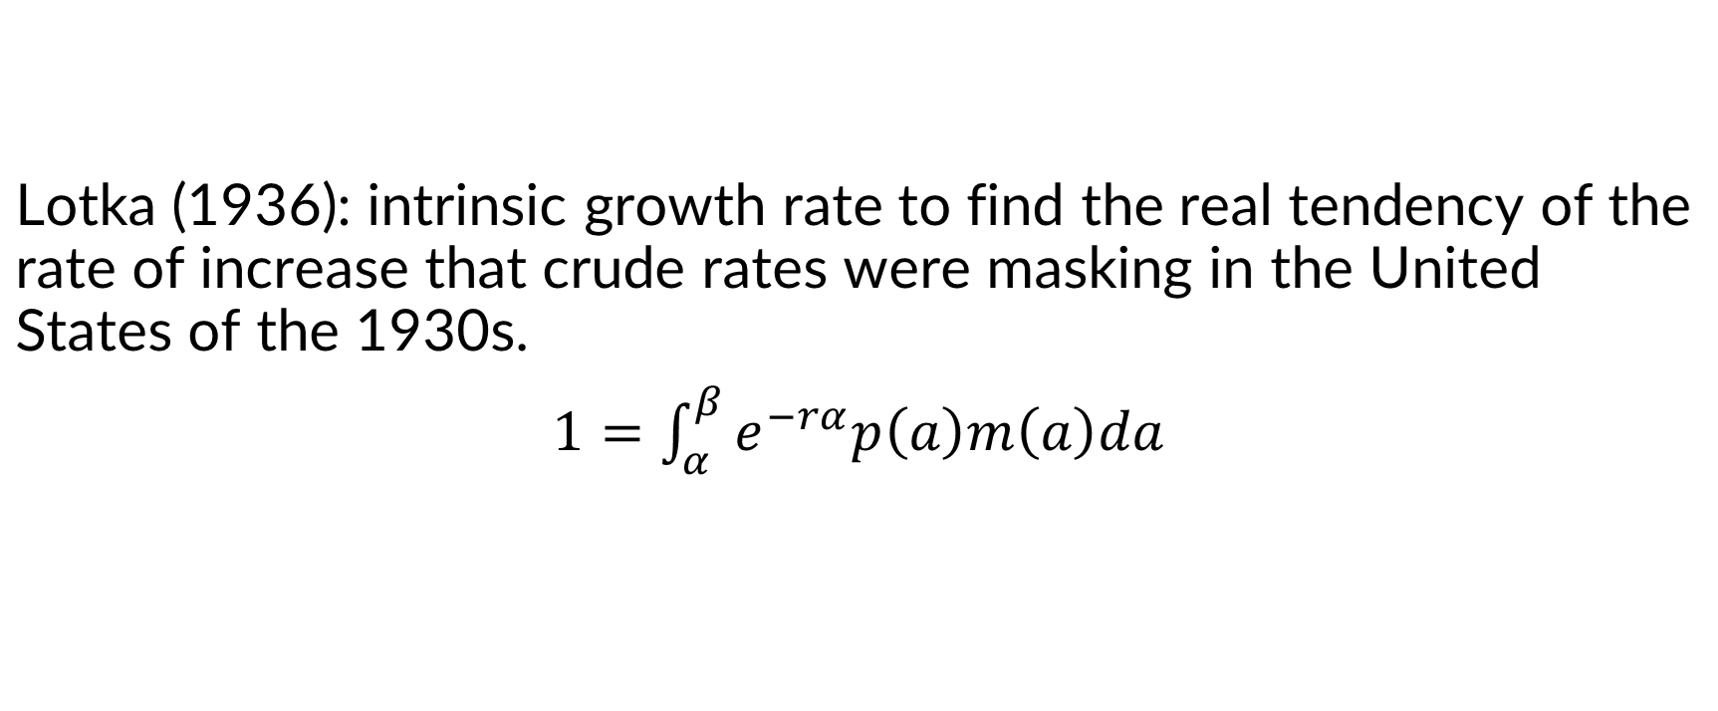

“Method is rarely entirely separable from substance in Formal Demography”
One equation to rule them all?

Slide 8
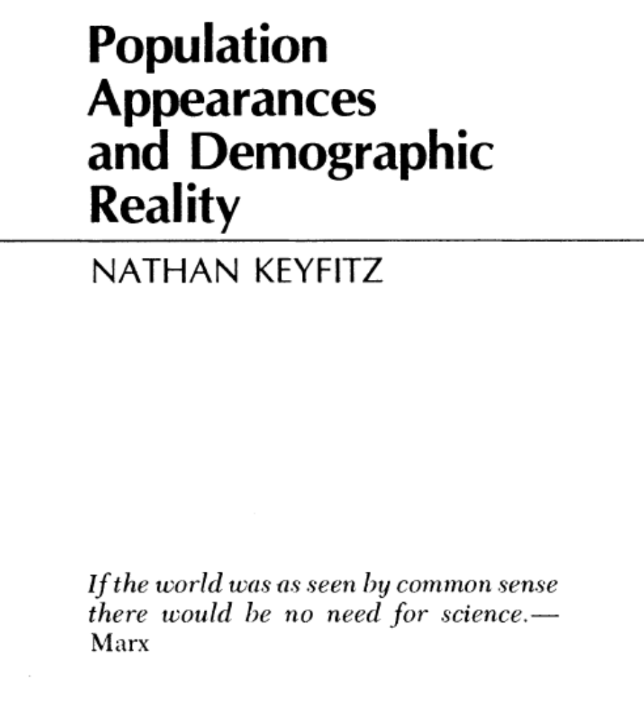
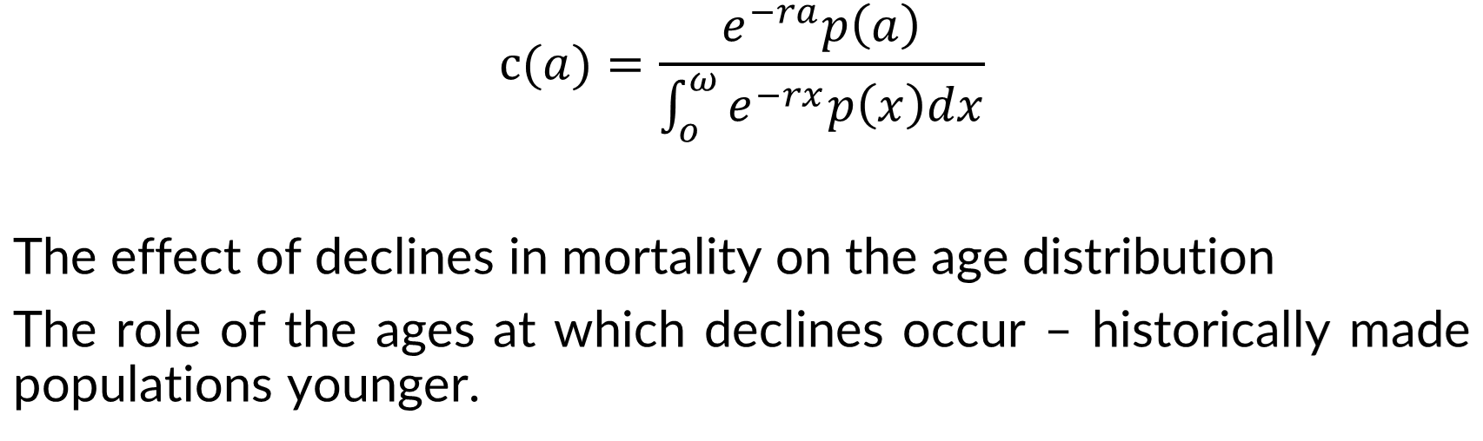
“The answers that it reaches are not always commonsense, and we will meet instances in which intuition has to be adjusted to accord with what the mathematics shows to be the case”

Slide 9
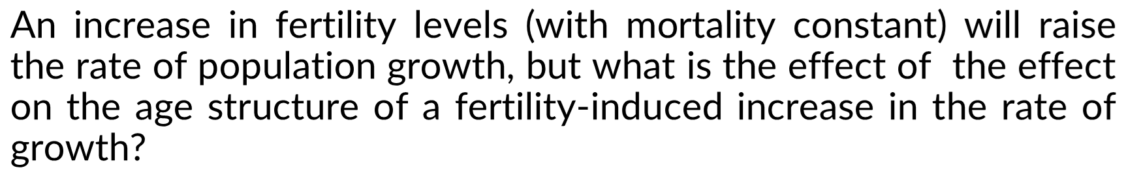
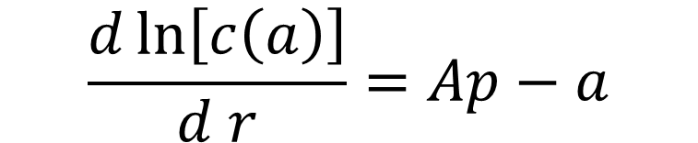
“When the intuitive answer gives the right direction of an effect but technical analysis is still needed to estimate its amount”

Slide 10

Effect of a change in fertility on the death rate; death rate will fall when fertility rises – if the mean age at death exceeds the mean age of the population.

Slide 11
Some funky stuff
Sheps (1963) - stopping rules determine the distribution of family sizes.
“Where couples differ in their chance of a given birth being a boy, stopping rules can have an effect on the sex ratio. Parents wanting boys and stopping only after having one increases the proportion of girls in the population” (Goodman, 1961).
Model life-tables (Coale and Demeny, 1966).
Age at marriage by Hernes (1972), Coale (1971), and Coale and McNeil (1972). Normally distributed entry into marriageability + three exponentially distributed delays (meeting future spouse, engagement, and marriage) - convincing behavioral model that closely fits the observed age distribution of marriage.
Indirect way of estimating “anything that comes your way”. – that´s on my mom.

Slide 12
Research questions that are enabled by or rise due to Formal Demography tractability
The theoretical limits on the length of a human life – “the oldest question” scientists and philosophers for thousands of years- mostly based on speculation and personal observations.
Starting in 1825, the problem gained tractability with the British actuary Benjamin Gompertz.
A mathematical model of mortality - risk of death increased exponentially with age.
Implications: Were that risk to continue accelerating throughout life a point would come where there would be no chance of surviving to the next year or hit an effective limit on life span.
Instead, Gompertz observed: the risk of death plateaued. “The limit to the possible duration of life is a subject not likely ever to be determined,” he wrote, “even should it exist.” –

Slide 13
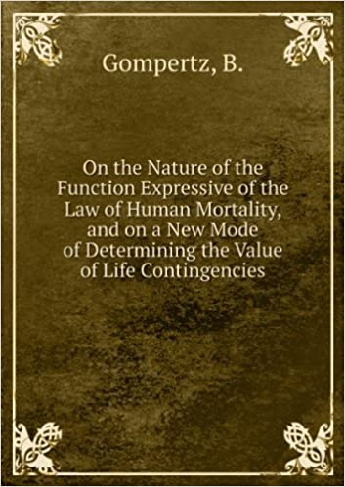
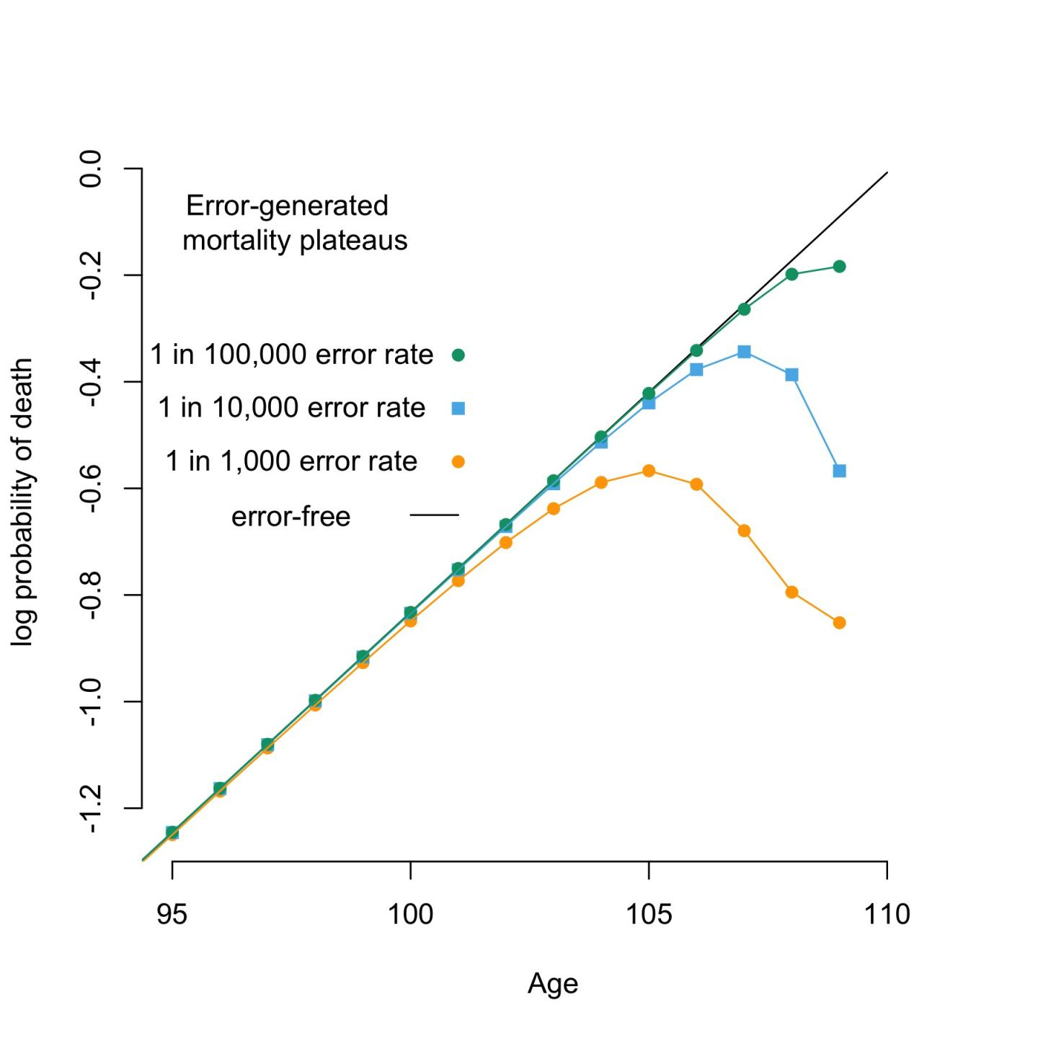
Research questions that are enabled by or rise due to Formal Demography tractability
Population appearances, demographic reality, or statistical artifact?

Slide 14
Further reflections. The stochastic nature of a deterministic science?
The start of a life table: Inferring probabilities from observed rates; a series of probabilities, yet in its application is deterministic/brings about a specific estimate. ‘Number-living Column’ – Nathan Keyfitz on the life table, 1977
Demographic stochasticity - randomness that results from the discrete nature of individuals. Notably, impacts more small populations.
Population changes are caused by and in turn cause social and economic changes.
The constructs we use to allow for navigating the waters: synthetic cohorts, etc.

Slide 15
William Brass’ book review of the Introduction to the Mathematics of Population (25 Jul 1969), by Nathan Keyfitz
Further reflections. The stochastic nature of a deterministic science?
Population mathematics versus mathematical techniques for the analysis of population data –
The first represents the mathematical relationships that represent the determinants of structure and change in real populations. In this case, you can use data to illustrate the theories, but not to justify them.

Slide 16
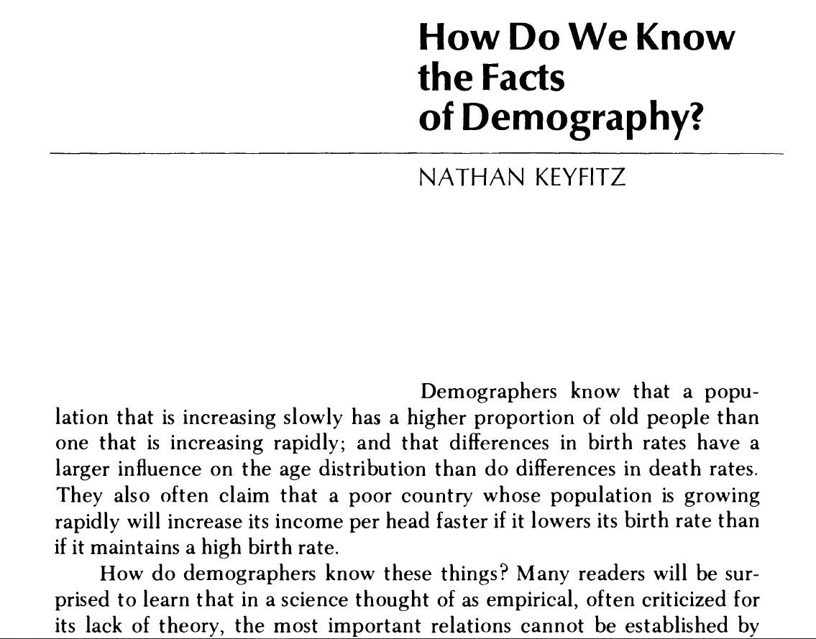
Further further reflections
Ontology: a specification of a conceptualization; A theory of what is
E.g., What is society?
Epistemology: the study of knowledge and justified belief. It is concerned with the nature, sources and limits of knowledge.
What are the necessary and sufficient conditions of knowledge?
What are its sources?
What is its structure, and what are its limits?
How we are to understand the concept of justification?
What makes justified beliefs justified?
Ontology and Epistemology (Gruber 1993)

Slide 17


Thoughts about the future of data-driven demographic research (Monica’s talk at MPIDR)
New forms of data
Increased computational power
Informing public policy
Increased pace of research
Inequality as a research issue and a researcher’s issue
Make new questions or make old questions new?
The role of collaborative research
What are some of the most instigating questions in formal
demography?

Slide 18
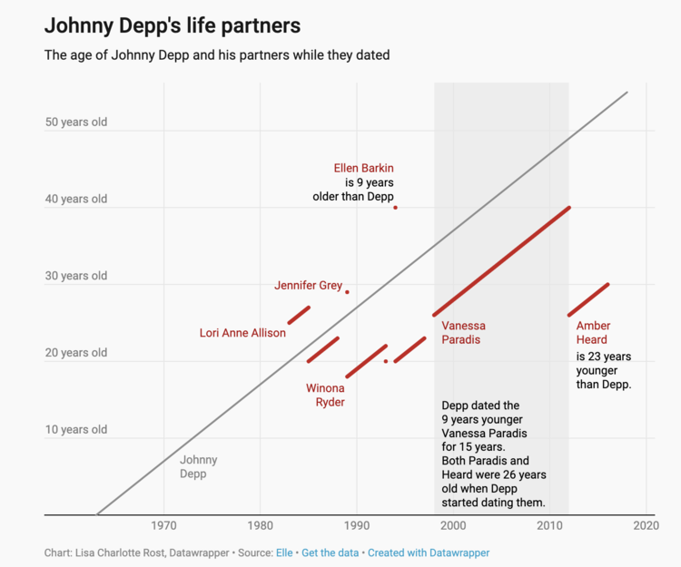
Thank You!

