Slide 1
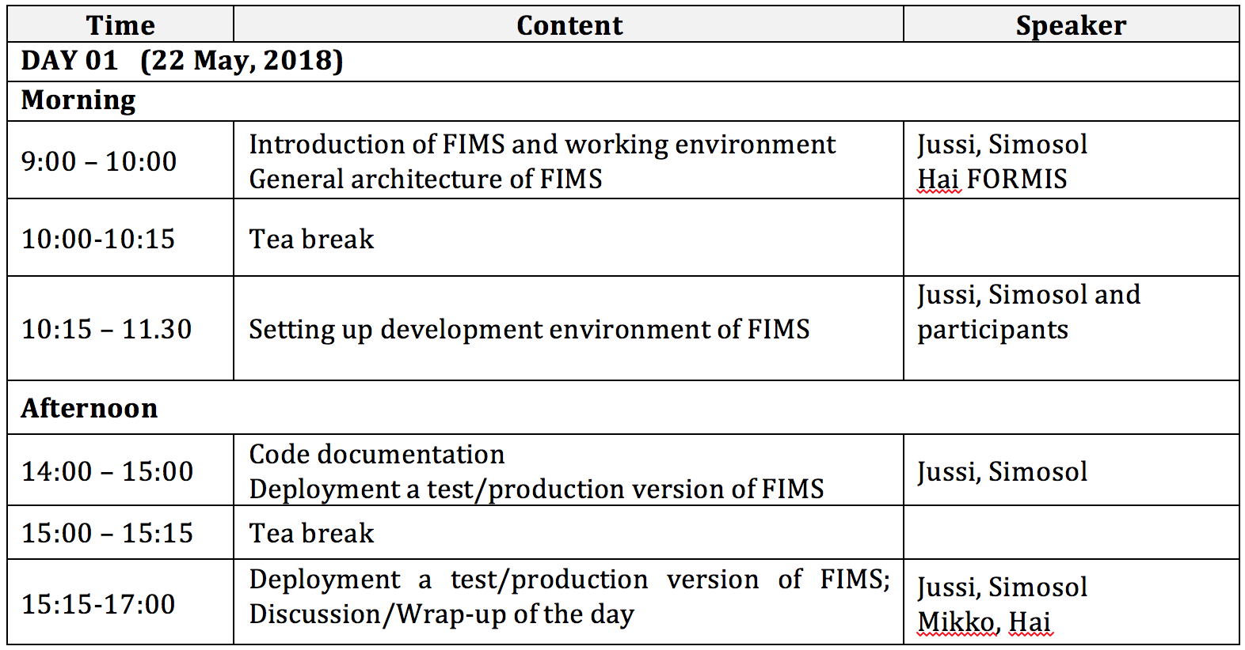
FIMS Workshop 2018-05-22

Slide 2
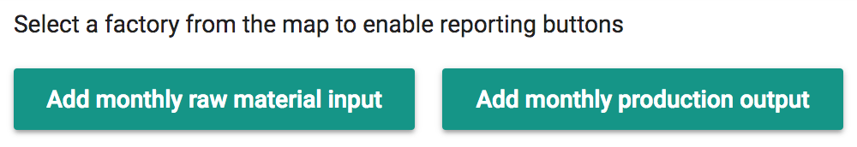
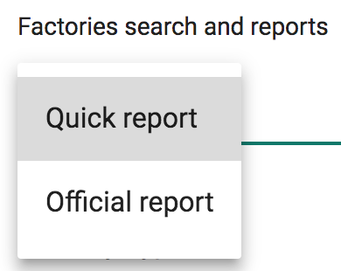
Introduction of FIMS
Industry analysis; forest resource analysis
Administration; official statistics

Slide 3
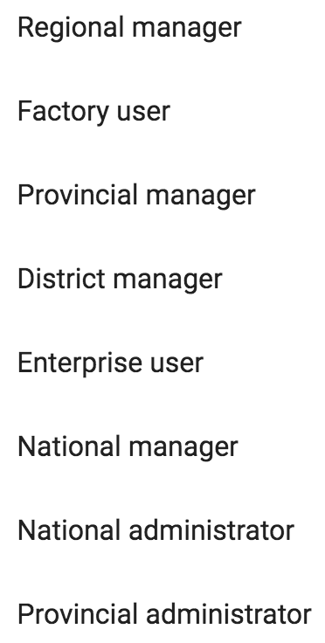
Introduction of FIMS
Different user roles

Slide 4
General architecture of FIMS

Slide 5
General architecture of FIMS

Slide 6
Setting up development environment of FIMS
UPDATED MATERIAL: http://tinyurl.com/yc8u8esv
First the server part of FIMS: FIMS back-end installation guide.pdf until this is running: python build_env.py that will take some time to complete
While the above is running, proceed with: FIMS front-end installation guide.pdf

Slide 7
Corrections to the installation documentation
Server:
Add: sudo apt-get -y install git to Essential installs
Get the FIMS server code from its Git repository: git clone https://bitbucket.org/simosol/fims-server.git
Front-end, npm installation on Ubuntu:
cd ~
curl -sL https://deb.nodesource.com/setup_8.x -o nodesource_setup.sh
sudo bash nodesource_setup.sh
sudo apt-get install nodejs

Slide 8
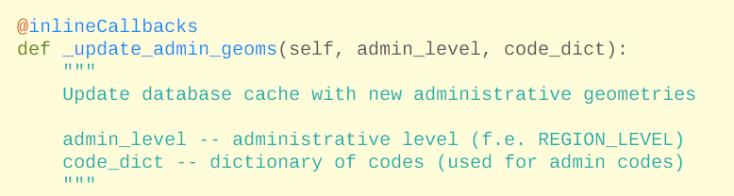
Code documentation
Server side documentation follows the Python docstring convention:
Front-end JS documentation still largely missing at this point

Slide 9
Deploying a test/production version of FIMS
Once the server side is up and running, that’s it for the server
The browser app needs to be copied to the server, see FIMS front-end installation guide.pdf

Slide 10
Jussi Rasinmäki
jussi.rasinmaki@simosol.fi
+358-400-382364
http://www.simosol.fi
http://www.simosol.fi/iptim

