Slide 1
Lecture 1 - Homework
Zhi-Kai Xu
07/31, 2023

Slide 2
Homework

Slide 3
Homework (1/6)
Main goals in this homework:
Practice to write a simple API within the required architecture.
Practice to read a datasheet/manual.

Slide 4
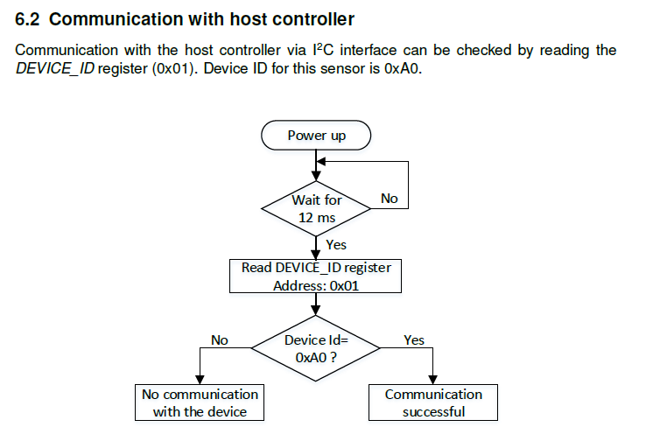
Homework (2/6)
All sensors have their own device ID. In this homework, we are going to write a program to read the register recording that ID. We often do this to check the communication with a sensor.
Sensor: WSEN-TIDS temperature sensor from Wurth Electronic.
Please refer to the datasheet.
Part 1-1: Define the register address in HW1.h.
Part 1-2: Complete the function getDeviceID() in HW1.c.

Slide 5
Homework (3/6)
Secondly, let’s set the operating mode of the sensor.
There are three mode, power-down, single-conversion, and continuous mode.
In this part, you need to read datasheet to know what are these modes and how to set them.
Also, you will practice how to correctly modify values in a register.
Part 2-1: Define the struct of register CTRL in HW1.h.
Part 2-2: Complete the function setOperatingMode() in HW1.c.

Slide 6
Homework (4/6)
Thirdly, we will set the output data rate for our sensor.
Refer to the datasheet to see what output data rates are available.
Part 3-1: Define enum different data rate in HW1.h.
Part 3-2: Complete the function setOutputDataRate() in HW1.c.

Slide 7
Homework (5/6)
Please download the datasheet/manual of the temperature sensor https://www.we-online.com/en/components/products/WSEN-TIDS
Please download the homework from our github.
For submitting, please complete the code, and send to my email.
zkxu.ii12@nycu.edu.tw

Slide 8
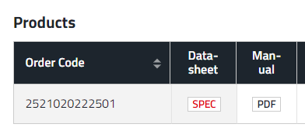
Homework (6/6)
Reference:
Our Github https://github.com/formosan-fox/STM32CubeIDE_source_files
WE sensors SDK https://github.com/WurthElektronik/Sensors-SDK_STM32/tree/main/SensorsSDK/WSEN_TIDS_2521020222501
HAL document for STM32F4 https://www.st.com/resource/en/user_manual/um1725-description-of-stm32f4-hal-and-lowlayer-drivers-stmicroelectronics.pdf

