Slide 1



IaC project with Terraform + AWS:
Ticket sales infrastructure for a major event
+
Authors:
Marc Fornés
Rubén Rodríguez

Slide 2
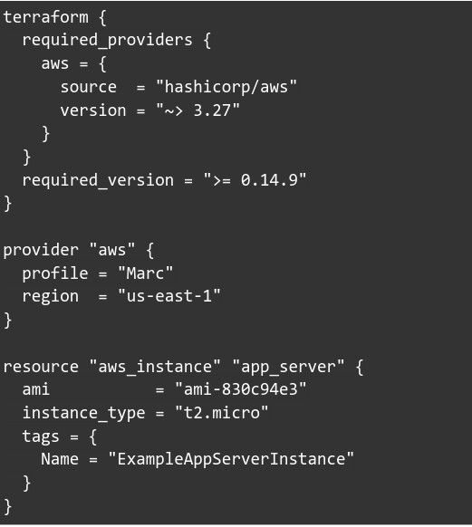
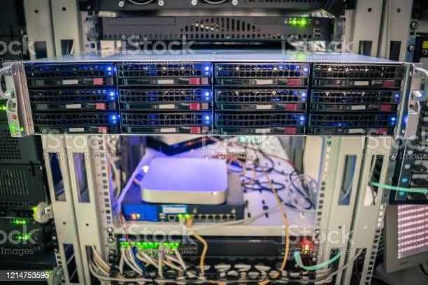
IaC
file:///home/marc/Downloads/istockphoto-1214753595-612x612.jpg

Slide 3
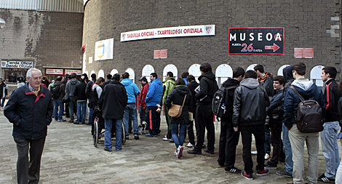

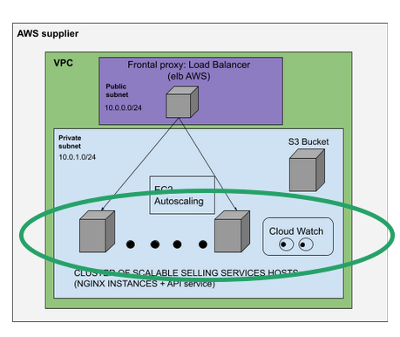
Problem:
Solution:

Slide 4

rubarc@i23: terraform plan
Terraform will do the following:
Prepare instance creation
Prepare network interface
Prepare an update for the previous state

Slide 5
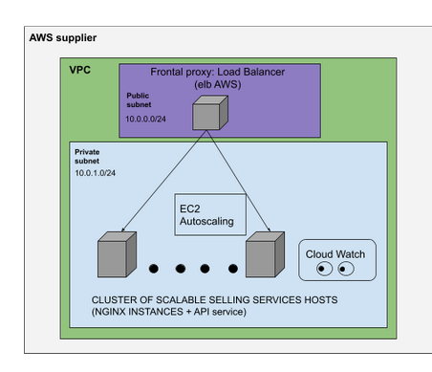

5 minutes later…
Infrastructure deployed in AWS !
AWS (buit)
rubarc@i23: terraform apply

Slide 6
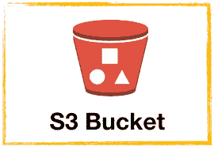


Slide 7
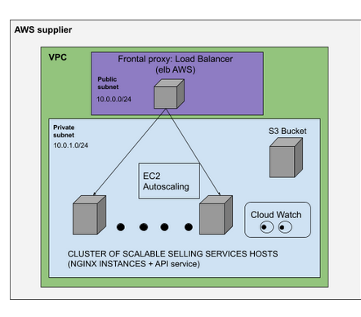
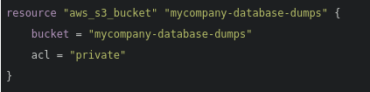
AWS (updated)
AWS (previous state)
rubarc@i23: terraform apply

Slide 8
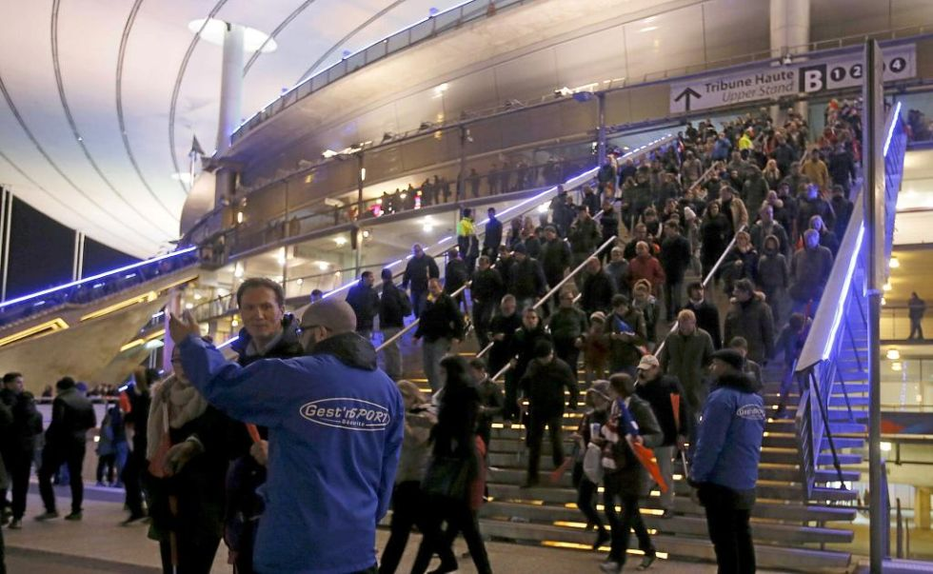
Objective:
pick up
Infrastructure
deployed in AWS
AWS (clean)
rubarc@i23: terraform destroy

Slide 9

+

Slide 10
THE END

