Slide 1

GROUP 11
MentorPulse
Skill-based mentor matching
and progress tracking
Navaneeth Krishna / Shivamshi Ullas
Chandhana / Prakshitha Pradeep
Indian Institute of Information Technology Kottayam
IIIT Kottayam
01
Notes:
MentorPulse is a local Django project that covers mentor discovery through completion. Team names and institution follow the supplied presentation. Cover illustration generated with the built-in ImageGen tool. Prompt: two translucent violet and cyan glass ribbons ascending at right on a midnight navy background, calm negative space at left, no text. Embedded asset: C:\Users\babur\OneDrive\Desktop\MentorPulse\MentorPulse\.presentation-build\cover.png
Project sources (reviewed 12 October 2026):
C:\Users\babur\OneDrive\Desktop\MentorPulse\MentorPulse\README.md
C:\Users\babur\OneDrive\Desktop\MentorPulse\MentorPulse\MentorPulse_Project_Description.md

Slide 2
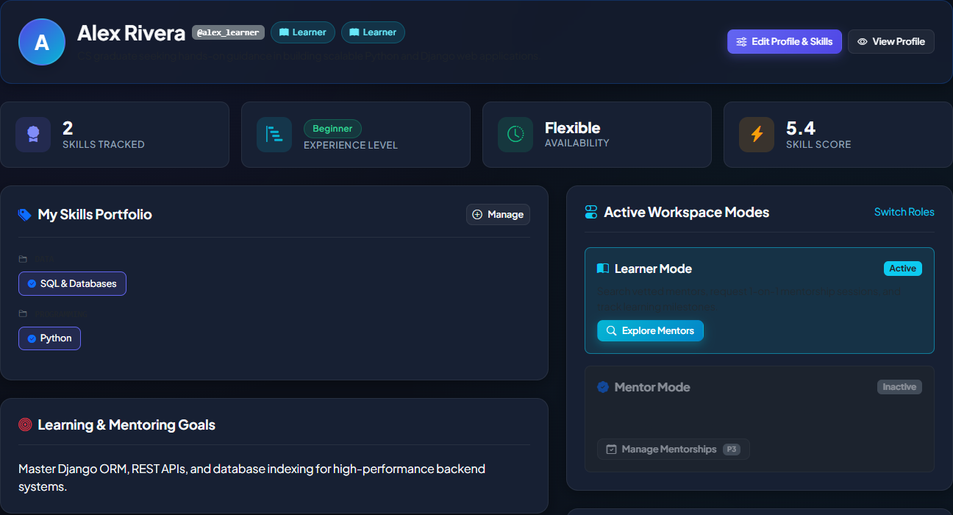
A shared workspace for mentorship
Learners find mentors by skill,
availability and experience.
Each pair can schedule sessions,
track milestones and share resources
through a single mentorship record.
Local demonstration project
Five Django domain apps
IIIT Kottayam
02
Notes:
The product is a server-rendered local demonstration. Screenshot shows the seeded learner dashboard. Seeded accounts and scenarios are demonstration data, not real adoption metrics. The five apps are accounts, matching, mentorship, gamification and notifications.
Project sources (reviewed 12 October 2026):
C:\Users\babur\OneDrive\Desktop\MentorPulse\MentorPulse\README.md
C:\Users\babur\OneDrive\Desktop\MentorPulse\MentorPulse\mentorpulse\settings.py
C:\Users\babur\OneDrive\Desktop\MentorPulse\MentorPulse\accounts\views.py
C:\Users\babur\OneDrive\Desktop\MentorPulse\MentorPulse\templates\accounts\dashboard.html

Slide 3
Problem statement and objectives
Mentorship challenges
Project objectives
Finding a suitable mentor
Rank mentors using an explainable score
Keeping learning organised
Give each pair a workspace and milestones
Recognising contribution
Record credits, feedback and achievements
Showing completion
Provide a printable completion certificate
IIIT Kottayam
03
Notes:
These are the project motivations and design objectives from the supplied specification, not measured findings from a user study. No survey percentages or impact claims are inferred. The certificate exists in the current code even though the early specification listed it as a stretch goal.
Project sources (reviewed 12 October 2026):
C:\Users\babur\OneDrive\Desktop\MentorPulse\MentorPulse\MentorPulse_Project_Description.md
C:\Users\babur\OneDrive\Desktop\MentorPulse\MentorPulse\mentorship\views.py

Slide 4
Functional requirements and user roles
Role | Implemented capabilities
Learner | Browse mentors, request guidance, track learning and give feedback
Mentor | Review requests, log sessions and support shared milestones
Dual role | Hold active Mentor and Learner assignments at the same time
Administrator | Manage users, mentorship records and content through Django Admin
Operating constraints
Local SQLite database, local file storage, in-app notifications
Document uploads up to 10 MB with an extension allowlist
IIIT Kottayam
04
Notes:
RoleAssignment stores role start and end times. Profile exposes active Mentor and Learner assignments independently. Staff access uses Django Admin. Upload validator accepts .pdf, .png, .jpg, .jpeg, .txt, .docx and .doc up to 10 MiB. The interface labels this as 10 MB. No cloud object storage, payment processor or push notification service exists.
Project sources (reviewed 12 October 2026):
C:\Users\babur\OneDrive\Desktop\MentorPulse\MentorPulse\accounts\models.py
C:\Users\babur\OneDrive\Desktop\MentorPulse\MentorPulse\mentorship\forms.py
C:\Users\babur\OneDrive\Desktop\MentorPulse\MentorPulse\accounts\admin.py
C:\Users\babur\OneDrive\Desktop\MentorPulse\MentorPulse\mentorship\admin.py
C:\Users\babur\OneDrive\Desktop\MentorPulse\MentorPulse\mentorpulse\settings.py

Slide 5
The mentorship lifecycle
01
Discover
Set skills and goals, then review ranked mentors
02
Request
Send a standard or priority request with learning goals
03
Review
Mentor accepts or rejects the pending request
04
Collaborate
Use sessions, milestones, resources and discussions
05
Complete
Mark complete, exchange feedback and print the certificate
IIIT Kottayam
05
Notes:
States in code: PENDING, ACTIVE, COMPLETED, REJECTED and CANCELLED. Requests block self-matching, require an active mentor role, and reject duplicate pending or active pairs. Rejected or cancelled requests refund the learner. Either participant or staff can access the workspace. Current completion view permits any authorised participant to mark an active mentorship completed and then forces progress to 100%.
Project sources (reviewed 12 October 2026):
C:\Users\babur\OneDrive\Desktop\MentorPulse\MentorPulse\mentorship\models.py
C:\Users\babur\OneDrive\Desktop\MentorPulse\MentorPulse\mentorship\views.py
C:\Users\babur\OneDrive\Desktop\MentorPulse\MentorPulse\gamification\services.py

Slide 6
Transparent matching rules
50%
30%
20%
Skill overlap
Availability
Experience
Shared skills divided by
the learner’s selected skills
Exact match, flexible schedule
or a lower compatibility score
Highest affinity when the mentor
is one or two levels ahead
72% example
2 of 4 skills: 25 points + flexible: 27 + one level ahead: 20
IIIT Kottayam
06
Notes:
Deterministic matching, not a trained AI model. Total = round(skill_ratio*50 + availability_ratio*30 + experience_ratio*20), clamped 0 to 100. Availability ratios: exact non-empty match 1.0, either flexible 0.9, missing 0.6, incompatible 0.2. Experience gaps +1/+2 score 1.0, +3 scores 0.9, equal levels 0.65, mentor lower 0.25. Skills default to 0.5 if none selected. Tie-breaking uses mentor profile skill_score. Illustrative example is calculated from these rules, not an observed match.
Project sources (reviewed 12 October 2026):
C:\Users\babur\OneDrive\Desktop\MentorPulse\MentorPulse\matching\services.py
C:\Users\babur\OneDrive\Desktop\MentorPulse\MentorPulse\matching\views.py

Slide 7
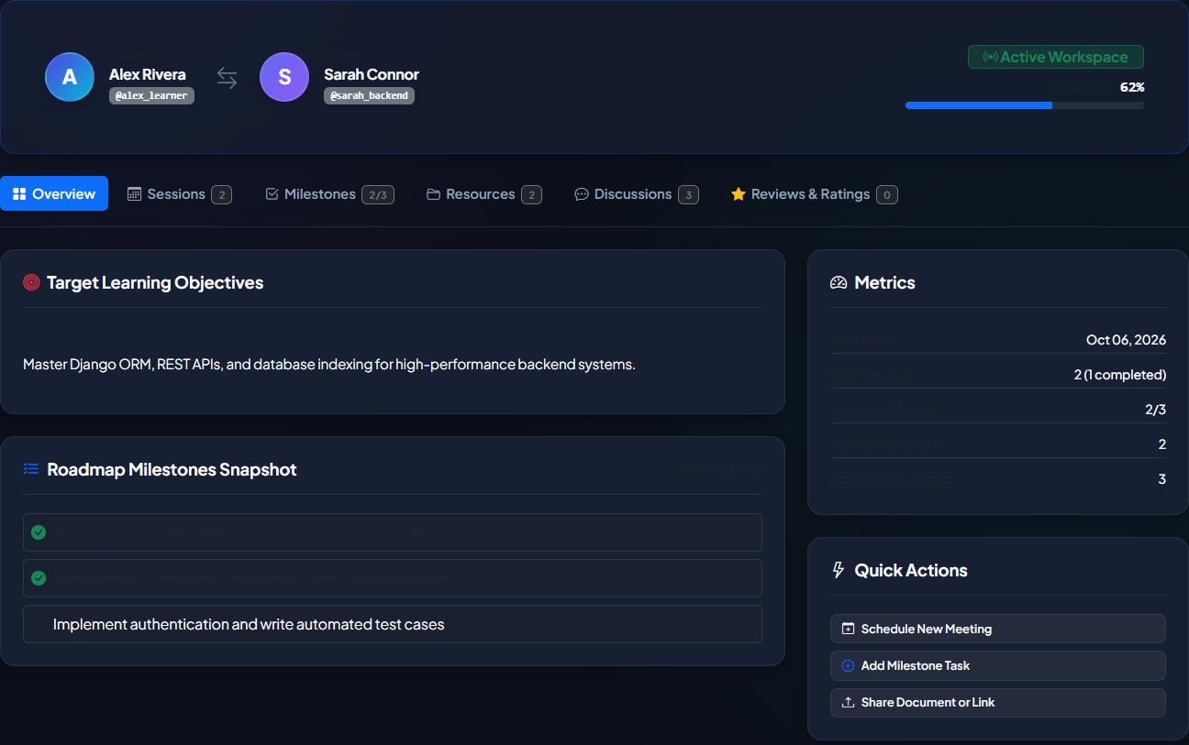
A workspace for each mentorship
Scheduled sessions
Date, agenda and an
external meeting link
Shared learning
Milestone checklist, files,
links and discussion posts
Participant access
Mentor, learner or staff
IIIT Kottayam
07
Notes:
Screenshot: active seeded mentorship between Alex Rivera and Sarah Connor. Session records store meeting URLs, not integrated video calls. DiscussionPost is an asynchronous thread, not websocket chat. Workspace permission checks rely on Mentorship.can_access. Resource upload validation lives in mentorship/forms.py.
Project sources (reviewed 12 October 2026):
C:\Users\babur\OneDrive\Desktop\MentorPulse\MentorPulse\mentorship\models.py
C:\Users\babur\OneDrive\Desktop\MentorPulse\MentorPulse\mentorship\views.py
C:\Users\babur\OneDrive\Desktop\MentorPulse\MentorPulse\templates\mentorship\workspace.html

Slide 8
Progress combines milestones and sessions
70%
30%
Milestone completion
Session completion
2 completed out of 3
contributes 46.7 percentage points
1 completed out of 2
contributes 15 percentage points
61.7%
Active demo progress
70 × (2/3) + 30 × (1/2)
IIIT Kottayam
08
Notes:
Current active demo database stores 61.7%, not the 67% claimed in README and the older slide deck. Formula when both record types exist: 70*(completed milestones/total milestones)+30*(completed sessions/total sessions). When only one type exists it receives 100% weight. No records means 0%. Marking COMPLETED forces 100%, regardless of remaining checklist items. This is a workflow completion signal, not a verified competency assessment.
Project sources (reviewed 12 October 2026):
C:\Users\babur\OneDrive\Desktop\MentorPulse\MentorPulse\mentorship\models.py
C:\Users\babur\OneDrive\Desktop\MentorPulse\MentorPulse\accounts\management\commands\seed_demo_data.py

Slide 9
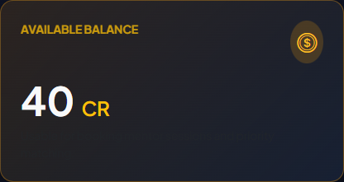
Credits record participation
Event | Credits
New account | +50
Standard request | −10
Priority request | −15 total
Completed session | +10 to mentor
Rejection or cancellation | Request fee refunded
Every automated change creates a ledger entry.
Credits are internal points with no monetary value.
IIIT Kottayam
09
Notes:
Priority costs 10 standard plus 5 extra. Priority request ordering is -is_priority then -id, with a visible flag. CreditService records starting bonus, request deduction, priority unlock, refunds and completed-session rewards. Refund and session reward services check a context string to prevent duplicates. This does not prove concurrency safety. Screenshot shows the demo learner wallet.
Project sources (reviewed 12 October 2026):
C:\Users\babur\OneDrive\Desktop\MentorPulse\MentorPulse\gamification\models.py
C:\Users\babur\OneDrive\Desktop\MentorPulse\MentorPulse\gamification\services.py
C:\Users\babur\OneDrive\Desktop\MentorPulse\MentorPulse\gamification\signals.py
C:\Users\babur\OneDrive\Desktop\MentorPulse\MentorPulse\mentorship\views.py

Slide 10
Achievements and the leaderboard
Badge | Current rule
First Steps | Complete 1 mentorship
Committed Mentor | Complete 2 as mentor
Rising Star | Skill score at least 8.0
Top Rated | Average at least 4.5, with 1+ review
Helpful Hand | Share 2 resources
Leaderboard score
10 × skill score
+ 0.5 × credit balance
+ 15 × badge count
Ranks recalculate on
relevant application events.
IIIT Kottayam
10
Notes:
These are implemented rules in BadgeService, which supersede the original specification thresholds of 5 completed mentorships, skill score >80, 5 ratings and 5 resources. First Steps checks completed mentorships despite a badge description mentioning a milestone. Skill score is a stored profile value rather than an automatic mastery score. LeaderboardService iterates all active users, calculates the score and assigns consecutive ranks after sorting. No background job or push leaderboard exists.
Project sources (reviewed 12 October 2026):
C:\Users\babur\OneDrive\Desktop\MentorPulse\MentorPulse\gamification\services.py
C:\Users\babur\OneDrive\Desktop\MentorPulse\MentorPulse\accounts\models.py

Slide 11
System architecture
Layer | Implementation
Presentation | Django templates, Bootstrap 5.3.3 and custom CSS
Application | Django 5.x with authentication, ORM and migrations
Domain logic | Python services and view handlers run synchronously
Persistence | SQLite database and local media files
Five domain apps
accounts matching mentorship
gamification notifications
IIIT Kottayam
11
Notes:
Single Django project organised into five apps, not microservices. requirements.txt constrains Django >=5.0,<6.0. The local runtime test reports Django 5.2.17. Bootstrap version 5.3.3 appears in templates/base.html. Django auth User provides authentication, extended by Profile and RoleAssignment. Credit is a wallet model and is not an authentication model. Server-rendered HTTP requests execute synchronous business logic. No Celery, Redis, REST frontend or cloud dependency exists.
Project sources (reviewed 12 October 2026):
C:\Users\babur\OneDrive\Desktop\MentorPulse\MentorPulse\requirements.txt
C:\Users\babur\OneDrive\Desktop\MentorPulse\MentorPulse\mentorpulse\settings.py
C:\Users\babur\OneDrive\Desktop\MentorPulse\MentorPulse\mentorpulse\urls.py
C:\Users\babur\OneDrive\Desktop\MentorPulse\MentorPulse\templates\base.html

Slide 12
Core data relationships
Domain | Relationships
Identity | User has one Profile and multiple RoleAssignments
Skills | Profile and Skill share a many-to-many relationship
Mentorship | Mentor and learner reference User, with one Progress record
Collaboration | Mentorship has sessions, milestones, resources and posts
Participation | User has one credit wallet, transactions and earned badges
Feedback and alerts | Feedback links a pair and reviewers, notifications belong to User
IIIT Kottayam
12
Notes:
Core relationship summary from current Django models. Mentorship has two user foreign keys (mentor and learner). Progress has a OneToOne relationship to Mentorship. Resource records uploaded_by. Feedback has unique_together on mentorship and given_by. UserBadge has unique_together on user and badge. LeaderboardEntry has one user record in the current implementation rather than the separate Leaderboard entity proposed in the initial specification.
Project sources (reviewed 12 October 2026):
C:\Users\babur\OneDrive\Desktop\MentorPulse\MentorPulse\accounts\models.py
C:\Users\babur\OneDrive\Desktop\MentorPulse\MentorPulse\mentorship\models.py
C:\Users\babur\OneDrive\Desktop\MentorPulse\MentorPulse\gamification\models.py
C:\Users\babur\OneDrive\Desktop\MentorPulse\MentorPulse\notifications\models.py

Slide 13
Automated validation
App | Tests | Coverage examples
accounts | 12 | Profiles, roles and authentication
matching | 10 | Scoring, ranking and filters
mentorship | 7 | Request flow, access and completion
gamification | 18 | Credits, badges, ratings and ranks
notifications | 6 | Inbox and read state
53
tests passed
12 October 2026
Django system checks: no issues
Functional test coverage does not establish production readiness.
IIIT Kottayam
13
Notes:
Executed python manage.py test --noinput against this workspace. Result: Ran 53 tests in 46.340s, OK, system check identified no issues (0 silenced). Per-app counts obtained from test methods in the current source: accounts 12, matching 10, mentorship 7, gamification 18, notifications 6. These tests verify selected functionality. The project has development settings and no load, security or deployment certification.
Project sources (reviewed 12 October 2026):
C:\Users\babur\OneDrive\Desktop\MentorPulse\MentorPulse\accounts\tests.py
C:\Users\babur\OneDrive\Desktop\MentorPulse\MentorPulse\matching\tests.py
C:\Users\babur\OneDrive\Desktop\MentorPulse\MentorPulse\mentorship\tests.py
C:\Users\babur\OneDrive\Desktop\MentorPulse\MentorPulse\gamification\tests.py
C:\Users\babur\OneDrive\Desktop\MentorPulse\MentorPulse\notifications\tests.py

Slide 14
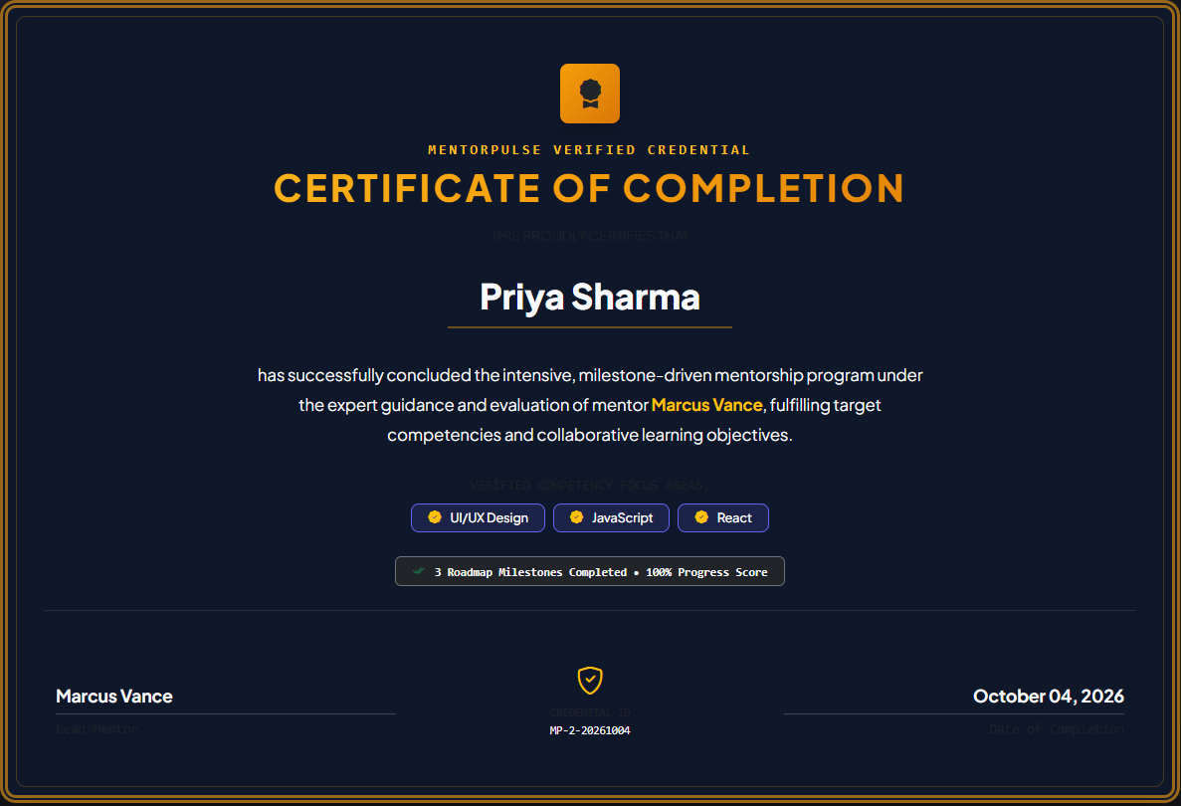
Demonstration walkthrough
Alex Rivera
Review mentor matches, then open the
active workspace at 61.7% progress
Jordan Lee
Show the pending priority request
and its 15-credit cost
Priya Sharma
Open the completed mentorship
and print the certificate
Demo Switcher supports role changes while DEBUG is enabled.
IIIT Kottayam
14
Notes:
All named people are seeded demo accounts. Active scenario: sarah_backend / alex_learner. Priority pending scenario: jordan_learner / sarah_backend. Completed scenario: marcus_frontend / priya_learner. Screenshot captures the certificate for the completed pair. Start with dependencies installed, then python manage.py migrate, python manage.py seed_demo_data and python manage.py runserver. Windows scripts debug.bat and run_demo.bat automate local setup. The seeder deletes and rebuilds demonstration scenarios, so use it with demo data. Demo switching is gated by settings.DEBUG.
Project sources (reviewed 12 October 2026):
C:\Users\babur\OneDrive\Desktop\MentorPulse\MentorPulse\accounts\management\commands\seed_demo_data.py
C:\Users\babur\OneDrive\Desktop\MentorPulse\MentorPulse\accounts\views.py
C:\Users\babur\OneDrive\Desktop\MentorPulse\MentorPulse\run_demo.bat
C:\Users\babur\OneDrive\Desktop\MentorPulse\MentorPulse\mentorship\views.py
C:\Users\babur\OneDrive\Desktop\MentorPulse\MentorPulse\templates\mentorship\certificate.html

Slide 15
Current scope and future improvements
Current local scope
Proposed next steps
SQLite and local file uploads
In-app alerts on page refresh
Manual dates and external meeting links
Completion status unlocks the certificate
Harden settings and remove demo access
Add atomic credit transactions
Require completion criteria for certificates
Evaluate matching quality with user feedback
IIIT Kottayam
15
Notes:
Proposed steps are recommendations, not implemented features or existing project commitments. Current DEBUG=True settings, a development secret and empty ALLOWED_HOSTS suit local demonstration only. Browser bootstrap assets come from public CDNs. Notifications use database records and request-time rendering, with no websocket or background reminder scheduler. Credit operations have duplicate checks but no transaction.atomic wrapper in current services. Certificate completion can be set by a participant before checklist completion. Real payments, native video integration, automated calendar sync and cloud hosting are outside the agreed local project scope.
Project sources (reviewed 12 October 2026):
C:\Users\babur\OneDrive\Desktop\MentorPulse\MentorPulse\mentorpulse\settings.py
C:\Users\babur\OneDrive\Desktop\MentorPulse\MentorPulse\accounts\views.py
C:\Users\babur\OneDrive\Desktop\MentorPulse\MentorPulse\gamification\services.py
C:\Users\babur\OneDrive\Desktop\MentorPulse\MentorPulse\notifications\services.py
C:\Users\babur\OneDrive\Desktop\MentorPulse\MentorPulse\notifications\context_processors.py
C:\Users\babur\OneDrive\Desktop\MentorPulse\MentorPulse\mentorship\views.py
C:\Users\babur\OneDrive\Desktop\MentorPulse\MentorPulse\MentorPulse_Project_Description.md

Slide 16
Mentorship with
a visible learning record
Explainable mentor discovery
Shared learning workspaces
Recorded participation and completion
Thank you
IIIT Kottayam
16
Notes:
The demonstrated outcome is a complete local workflow from matching to completion, with 53 passing functional tests. No learning impact, adoption or scalability outcome has been measured.
Project sources (reviewed 12 October 2026):
C:\Users\babur\OneDrive\Desktop\MentorPulse\MentorPulse\README.md
C:\Users\babur\OneDrive\Desktop\MentorPulse\MentorPulse\mentorship\models.py
C:\Users\babur\OneDrive\Desktop\MentorPulse\MentorPulse\matching\services.py

