Slide 1

MentorPulse
BY
Navaneeth Krishna, Shivamshi Ullas
Chandhana, Prakshitha Pradeep
Team 11
Notes:
MentorPulse: skill-based mentor matching and progress tracking. Team names follow the supplied presentation. Local demonstration project with five Django domain apps.
Project sources reviewed 12 October 2026:
C:\Users\babur\OneDrive\Desktop\MentorPulse\MentorPulse\README.md
C:\Users\babur\OneDrive\Desktop\MentorPulse\MentorPulse\MentorPulse_Project_Description.md

Slide 2
Introduction
MentorPulse connects learners with suitable mentors and manages the mentorship journey in one local web application.
Matching
Rule-based score: 50% skills, 30% availability, 20% experience
Collaboration
Sessions, milestones, shared resources and asynchronous discussions
Recognition
Credit ledger, feedback, badges and printable completion certificates
Implementation
Django 5.x, SQLite and five domain apps with 53 passing tests
Notes:
Matching is deterministic, not a trained AI model. Availability and experience use discrete rules. Notifications and leaderboard updates are synchronous application events, not pushed real-time updates. Certificates exist in the current implementation. Executed python manage.py test --noinput on 12 October 2026: 53 tests passed, no system check issues.
Project sources reviewed 12 October 2026:
C:\Users\babur\OneDrive\Desktop\MentorPulse\MentorPulse\matching\services.py
C:\Users\babur\OneDrive\Desktop\MentorPulse\MentorPulse\mentorship\models.py
C:\Users\babur\OneDrive\Desktop\MentorPulse\MentorPulse\gamification\services.py
C:\Users\babur\OneDrive\Desktop\MentorPulse\MentorPulse\notifications\services.py
C:\Users\babur\OneDrive\Desktop\MentorPulse\MentorPulse\requirements.txt
C:\Users\babur\OneDrive\Desktop\MentorPulse\MentorPulse\README.md

Slide 3
2. Problem statement & Objectives
Problem statement
Objectives
Learners need a mentor whose skills,
availability and experience fit their goals.
Mentorship needs shared tools for
sessions and visible learning progress.
1
Rank mentors with a transparent
compatibility score
2
Keep sessions, milestones and
resources in a shared workspace
3
Record participation with credits,
feedback and achievements
4
Recognise completion with a
printable certificate
Notes:
These are project motivations and objectives, not quantified results from a user study. The current implementation supports Mentor and Learner roles simultaneously through separate RoleAssignment records. Standard mentorship flow: discover, request, accept or reject, collaborate, complete.
Project sources reviewed 12 October 2026:
C:\Users\babur\OneDrive\Desktop\MentorPulse\MentorPulse\MentorPulse_Project_Description.md
C:\Users\babur\OneDrive\Desktop\MentorPulse\MentorPulse\accounts\models.py
C:\Users\babur\OneDrive\Desktop\MentorPulse\MentorPulse\mentorship\views.py

Slide 4
3. Requirements ( Functional & Non functional)
Functional
Non-functional
Accounts and roles
Sign in as a Mentor, Learner or both
Matching and collaboration
Rank mentors, review requests and track progress
Participation and completion
Credits, badges, feedback and a certificate
Local operation
SQLite database and local media storage
Access and uploads
Authentication and participant access checks
Files up to 10 MB with an extension allowlist
Validation and traceability
53 passing tests and a credit ledger
Notes:
Credit rules in current code: +50 starting credits, -10 for a standard request, -15 total for priority, +10 to mentor per completed session, request fee refunded on rejection/cancellation. Badge thresholds: First Steps one completed mentorship, Committed Mentor two completed as mentor, Rising Star skill_score >=8.0, Top Rated average >=4.5 with at least one review, Helpful Hand at least two resources. Leaderboard = skill_score*10 + credit_balance*0.5 + badge_count*15. Extension allowlist: .pdf, .png, .jpg, .jpeg, .txt, .docx and .doc, limit 10 MiB. Development settings and demo switching require hardening before production.
Project sources reviewed 12 October 2026:
C:\Users\babur\OneDrive\Desktop\MentorPulse\MentorPulse\accounts\models.py
C:\Users\babur\OneDrive\Desktop\MentorPulse\MentorPulse\mentorship\forms.py
C:\Users\babur\OneDrive\Desktop\MentorPulse\MentorPulse\mentorship\models.py
C:\Users\babur\OneDrive\Desktop\MentorPulse\MentorPulse\gamification\services.py
C:\Users\babur\OneDrive\Desktop\MentorPulse\MentorPulse\mentorpulse\settings.py

Slide 5
4. System architecture
Presentation layer
Django templates, Bootstrap 5.3.3 and custom CSS
Application layer
Django authentication, ORM, views and Python services
Data layer
SQLite database and local files for uploaded resources
Five domain apps
accounts matching mentorship
gamification notifications
Notes:
Single Django project, not microservices. User authentication uses Django auth, extended by Profile and RoleAssignment. Credit is a wallet model, not an authentication model. Profile has a many-to-many relationship with Skill. Mentorship references two Users and one Progress record, with related Session, Milestone, Resource and DiscussionPost records. Gamification owns Credit, CreditTransaction, Feedback, Badge, UserBadge and LeaderboardEntry. Notification belongs to User. Services run synchronously in HTTP handlers. No Celery, Redis, payment gateway, video API or calendar sync exists. External meeting URLs support session records.
Project sources reviewed 12 October 2026:
C:\Users\babur\OneDrive\Desktop\MentorPulse\MentorPulse\mentorpulse\settings.py
C:\Users\babur\OneDrive\Desktop\MentorPulse\MentorPulse\mentorpulse\urls.py
C:\Users\babur\OneDrive\Desktop\MentorPulse\MentorPulse\accounts\models.py
C:\Users\babur\OneDrive\Desktop\MentorPulse\MentorPulse\mentorship\models.py
C:\Users\babur\OneDrive\Desktop\MentorPulse\MentorPulse\gamification\models.py
C:\Users\babur\OneDrive\Desktop\MentorPulse\MentorPulse\notifications\models.py
C:\Users\babur\OneDrive\Desktop\MentorPulse\MentorPulse\templates\base.html

Slide 6
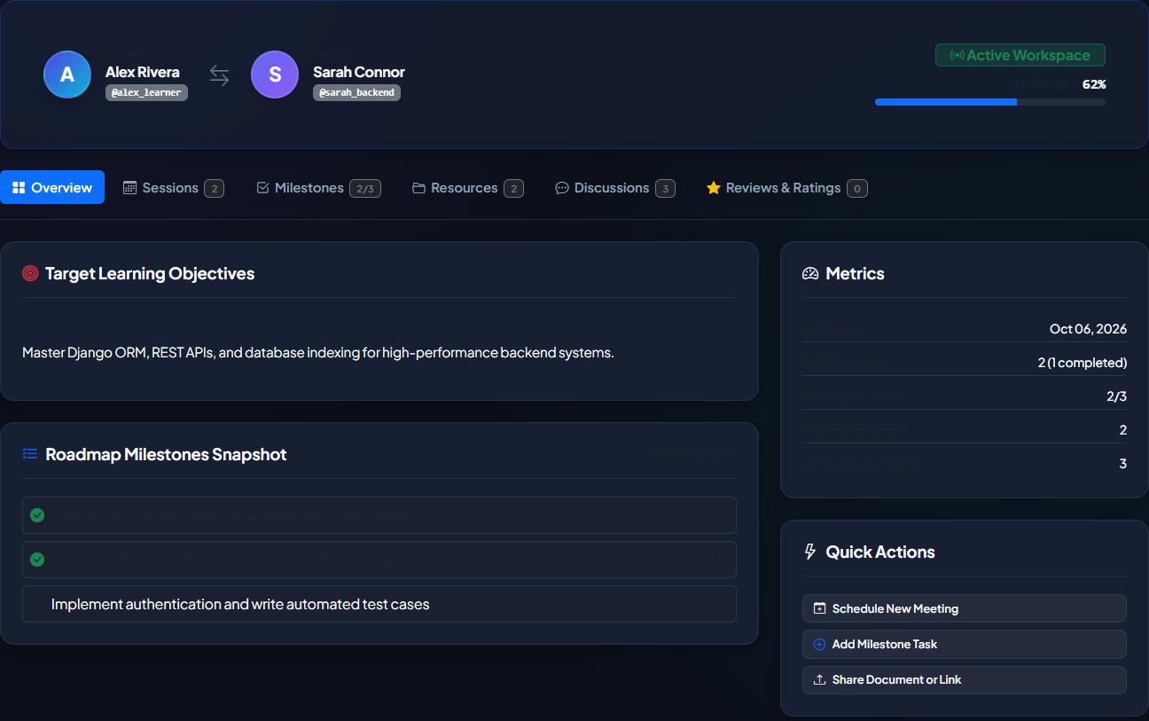
5. Demonstration
Seeded demonstration scenarios
Alex Rivera
Active workspace: 61.7% progress
Jordan Lee
Pending priority request: 15 credits
Priya Sharma
Completed mentorship and certificate
Local launch: migrate, seed_demo_data, runserver
Demo Switcher changes accounts while DEBUG is enabled
Notes:
Live demo uses fictional seeded accounts. Active pair: Sarah Connor and Alex Rivera. Progress = 70*(2/3 completed milestones) + 30*(1/2 completed sessions) =61.7%. Workspace rounds this to 62% in its display. The README and old presentation say 67%, which does not match the implemented weighted formula. Completed pair: Marcus Vance and Priya Sharma, 100% and certificate. Jordan Lee has a priority pending request to Sarah Connor costing 15 credits. Setup: pip install -r requirements.txt, python manage.py migrate, python manage.py seed_demo_data, python manage.py runserver. Windows debug.bat/run_demo.bat automate setup. Seeder rebuilds demo data. Tests: python manage.py test --noinput, 53 passed on 12 October 2026. Per-app counts: accounts12, matching10, mentorship7, gamification18, notifications6. Credit/refund and session rewards include duplicate guards but lack atomic database transactions. Marking a mentorship COMPLETED forces 100% regardless of checklist completion, so certificates indicate workflow completion rather than independently assessed mastery.
Project sources reviewed 12 October 2026:
C:\Users\babur\OneDrive\Desktop\MentorPulse\MentorPulse\accounts\management\commands\seed_demo_data.py
C:\Users\babur\OneDrive\Desktop\MentorPulse\MentorPulse\accounts\views.py
C:\Users\babur\OneDrive\Desktop\MentorPulse\MentorPulse\mentorship\models.py
C:\Users\babur\OneDrive\Desktop\MentorPulse\MentorPulse\templates\mentorship\workspace.html
C:\Users\babur\OneDrive\Desktop\MentorPulse\MentorPulse\mentorship\views.py
C:\Users\babur\OneDrive\Desktop\MentorPulse\MentorPulse\gamification\services.py
C:\Users\babur\OneDrive\Desktop\MentorPulse\MentorPulse\run_demo.bat

