Slide 1
ΣΔ Stream Computation

Slide 2
Acknowledgments

Slide 3
Master’s Seminar Goals
Make ΣΔ Stream Computation accessible to a wider audience
jupyter notebooks (python)
  Input state space model, OSR and bit rate
  Optimized cofficents for Stream Computation
  simulation?

Slide 4
What is ΣΔ Stream Computation?
Direct computaion
Lower latency, xOSR less
Less resources, mutiplier-less, 10x
Based on intergate vs time shift
  Removed Singularity at 1

Slide 5
ΣΔ Bit-streams

Slide 6
ΣΔ Bit-Stream PSD

Slide 7
Other ΣΔ Bit-stream benifs & Pitfalls

Slide 8
Why not Shift-Based LTI?
No noise shaping
Coroalated noise

Slide 9
Gravitating Poles & zeros
Apraching singualry
Faster sample time leads to instability
Goowin plot

Slide 10
Material from ΣΔ Stream Computation
The slides with this format are from Joseph Poverelli’s PhD thesis defense
The exposition of this thesis use plain formatting to distinguish it from the original material
The thesis can be found at https://escholarship.org/uc/item/4f46n0h6
Thanks Joseph for all your guidance

Slide 11
State space model
Input, outputs
Diferaintial equasions
LTI system, continus time
Many phiscal system can be reprsented
Filter, control modling. Etc
Starting in time
Add equasions

Slide 12
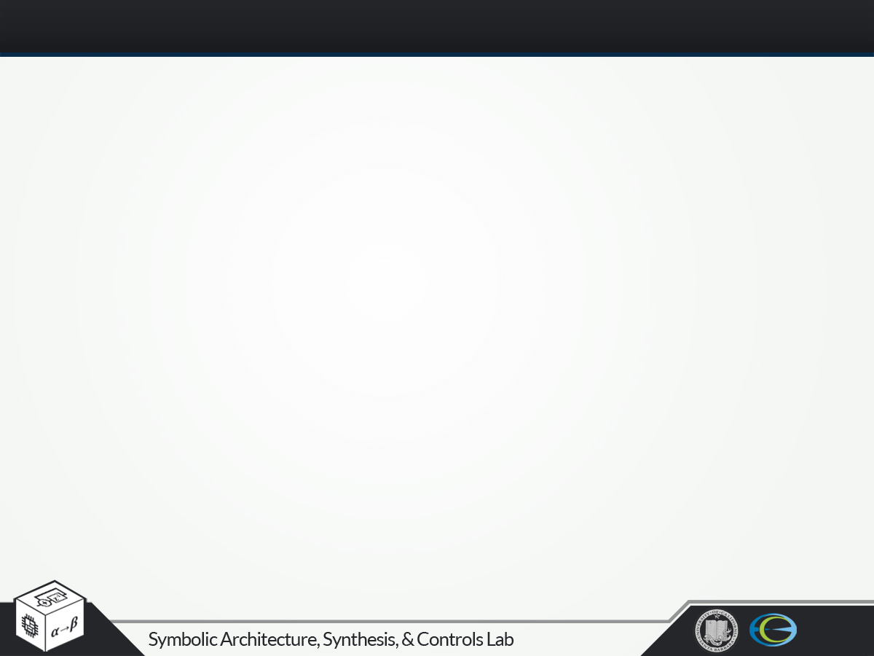
The Delta Operator
Alternative to shift operator q
However, with the delta operator system
where
and
with
then
Continuous time performance!!!!

Slide 13
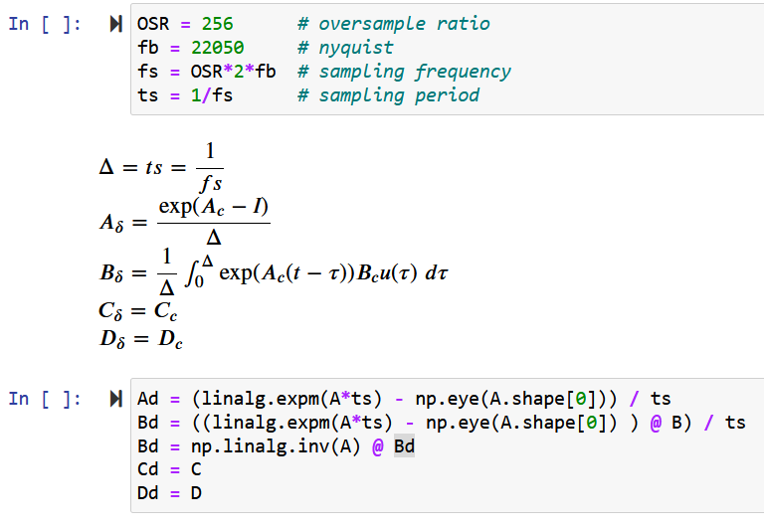
Continuous Time to Sampled Time

Slide 15
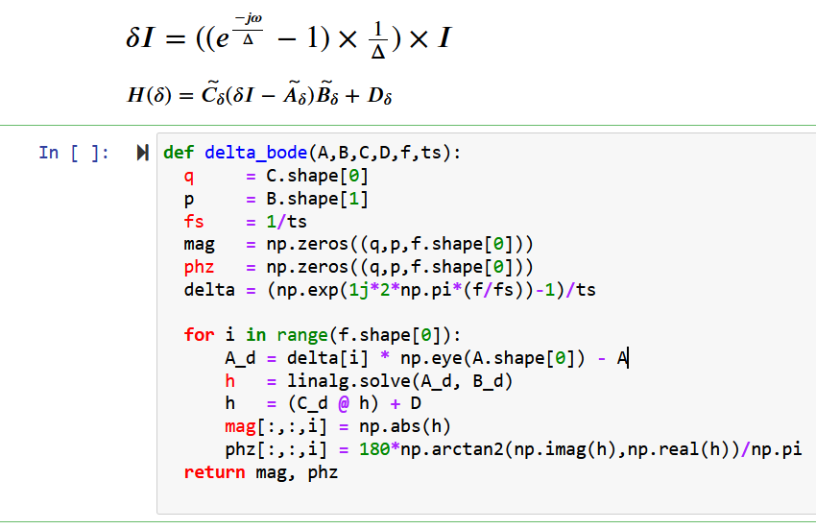
ΣΔ Bode Vectors

Slide 16
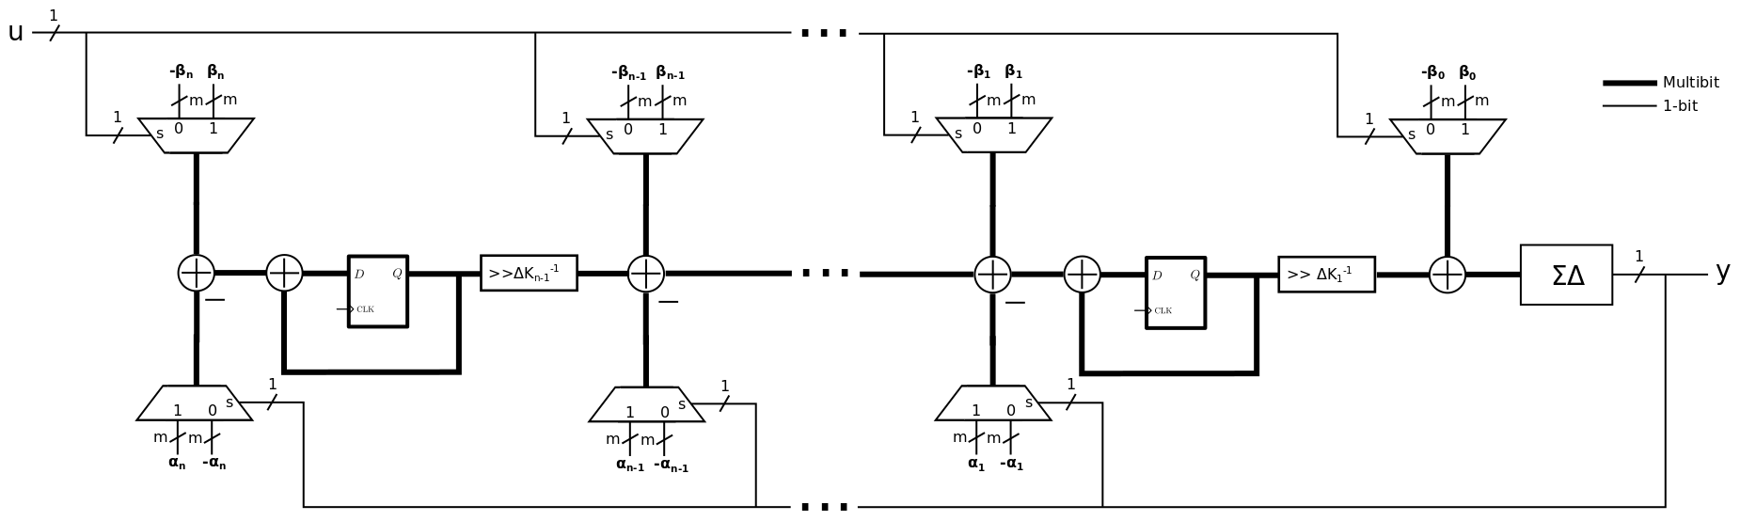
ΣΔ Filter Architecture
One discrete ΣΔ
  Transform coefficients to canonical realization
Emulates transfer functions:
Low noise gain and Low sensitivity to coefficient perturbations
  Higher than state space realization

Slide 17
Design by Emulation
Continuous to discrete design...very popular strategy
Begin with continuous model
Convert to discrete delta domain
Apply structural transformation and scaling

Slide 18
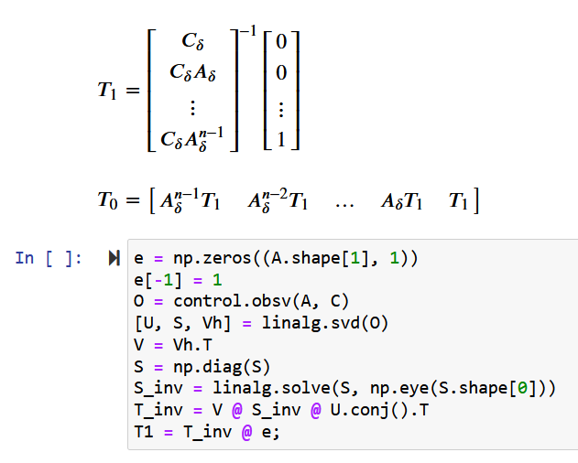
Structural Transformation

Slide 19
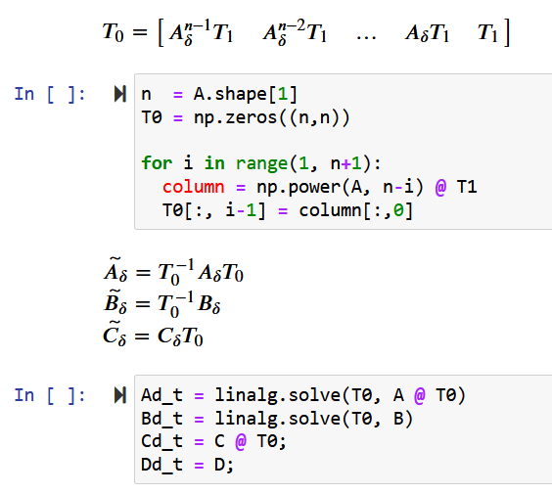
Structural Transformation

Slide 20
Dynamic Range Scaling

Slide 21
ΣΔ Filter Node

Slide 22
Noise Propagation

Slide 23
Quantization Noise

Slide 24
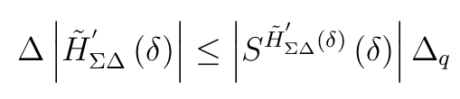
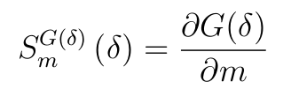
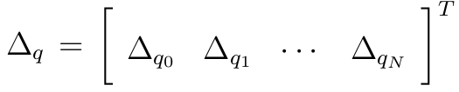
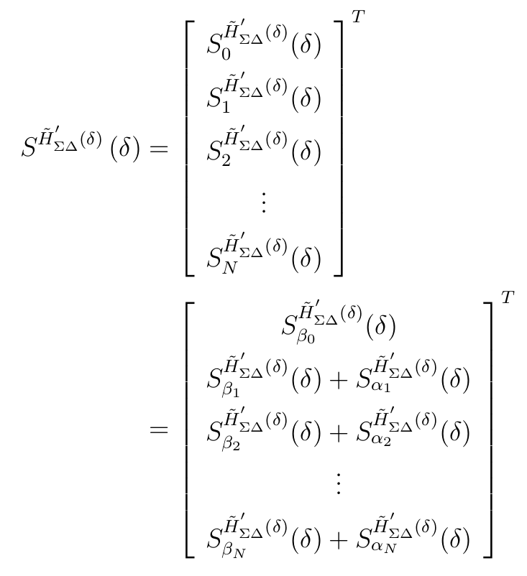
Coefficient Sensitivity
Effect of coefficient quantization
Use linear first order approximation
Construct Sensitivity Matrix
Total transfer function deviation
where
Deviation bound is conservative!

Slide 25
SD dIIR Sensitivity
S_asys
S_alpha
H
S_beta
null_sys
S_bsys
S_beta0
S_beta

Slide 26
Bit-width Optimization

