Slide 1
Capstone Engagement
Assessment, Analysis, and Hardening of a Vulnerable System
Andrew Forrest

Slide 2
Table of Contents
This document contains the following sections:
Network Topology
01
02
Red Team: Security Assessment
03
Blue Team: Log Analysis and Attack Characterization
Hardening: Proposed Alarms and Mitigation Strategies
04

Slide 3
Network Topology
‹#›

Slide 4
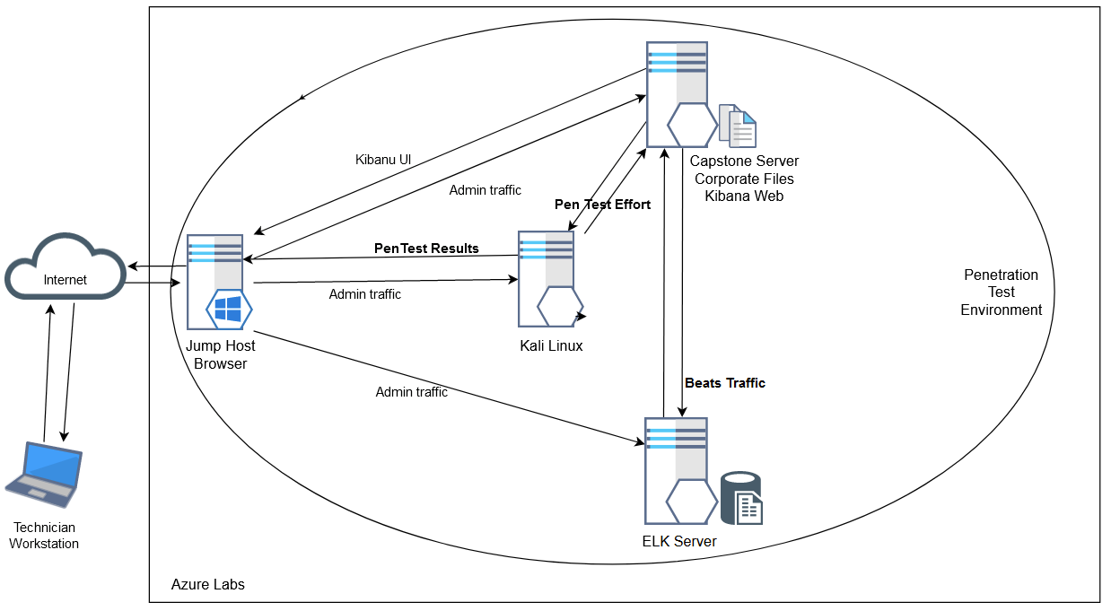
Network Topology
Network
Address Range:
192.168.1.0/24
Netmask:255.255.255.0
Gateway:192.168.1.1
Machines
IPv4: 192.168.1.105
OS: Linux
Hostname:Capstone
IPv4: 192.168.1.100
OS: Linux
Hostname: ELK
IPv4: 192.168.1.90
OS: Kali Linux
Hostname: Kali
IPv4: 192.168.1.1
OS: Windows 10 Pro
Hostname: Jump Host

Slide 5

Red Team
Security Assessment
‹#›

Slide 6
Recon: Describing the Target
Nmap identified the following hosts on the network:
Hostname | IP Address | Role on Network
ELK Server | 192.168.1.100 | ELK Server 9200/tcp open wap-wsp
Capstone | 192.168.1.105 | Capstone Corporate Server 80/tcp open http
Kali | 192.168.1.90 | Pen Test Station 22/tcp open ssh
Jump Host | 192.168.1.1 | Jump Host 2179/tcp open vmrdp

Slide 7
Vulnerability Assessment
The assessment uncovered the following critical vulnerabilities in the target:
Vulnerability | Description | Impact
CVE-2007-5461 | Apache Tomcat - 'WebDAV' Remote File Disclosure | A remote authenticated user could read arbitrary files and write request via WebDAV, potential for loss of sensitive data.
CVE-2017-15715 | LFI (Local File Inclusion) allows an attacker to read and likely execute files other than those intended to be served by the machine | An LFI vulnerability allows attackers to gain access to sensitive credentials
CWE 521: Weak Password Requirements | Weak passwords are vulnerable to being matched quickly with commonly available tools. | Accounts are vulnerable to being exploited and providing attackers authenticated access to the network.
CWE 307 : improper restriction of excessive authentication attempts | No password lockout policy in place | An attacker is free to continually attempt to guess a password utilising brute force means.

Slide 8
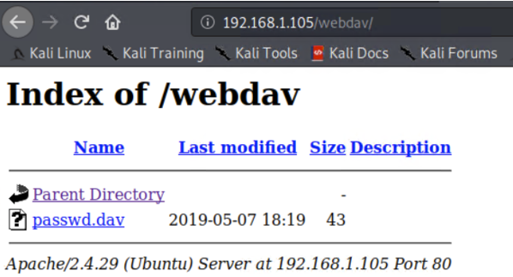
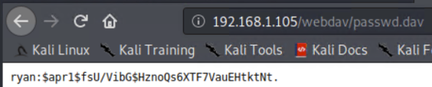
Exploitation: WebDAV file disclosure
01
02
03
Tools & Processes
With the access credentials known, we authenticated via browser and the files in WebDAV were available.
Achievements
Detail of a secure password contained in passwd.dav exposed remotely.
Apache version displayed.
Exploitation Evidence
Screenshots below;

Slide 9
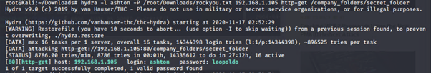
Exploitation: No account lockout
01
02
03
Tools & Processes
The vulnerability was exploited using hydra, a brute force password matching tool. A password list file, rockyou.txt, was downloaded and utilised.
Achievements
The password for the account of ashton was determined in short order. The account provides access to the “secret_folder”
Exploitation Evidence
Screenshot of the hydra tool displaying the command executed and results:

Slide 10
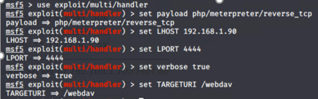
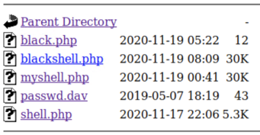

Exploitation: Local File Inclusion
01
02
03
Tools & Processes
The Metasploit framework was used to create .php packaged exploits, which were copied to the machine using curl. A local listener is set up. The php is executed and a session is opened.
Achievements
A remote session was achieved on the target machine. Reverse shell available
Exploitation Evidence
Screenshots of exploits below:

Slide 11

Blue Team
Log Analysis and
Attack Characterization
‹#›

Slide 12
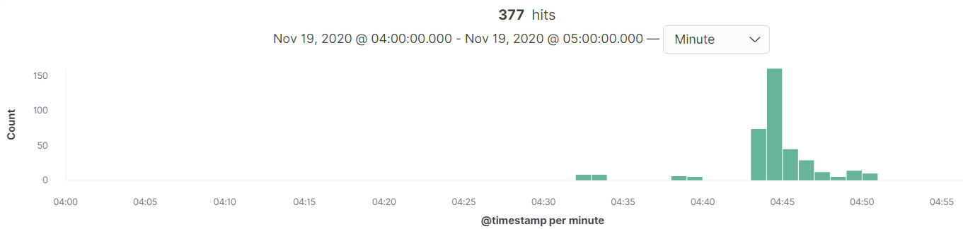
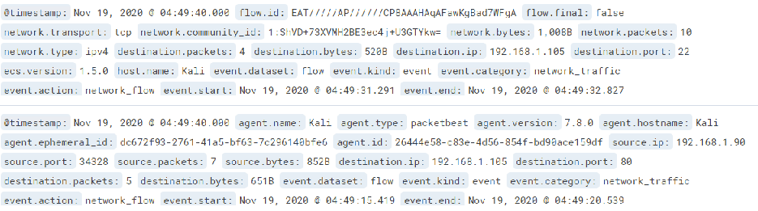
Analysis: Identifying the Port Scan
The port scan occurred around 04:45 am; 377 packets were sent from source IP 192.168.1.90
The activity moved from port to port, indicating that this was a port scan

Slide 13
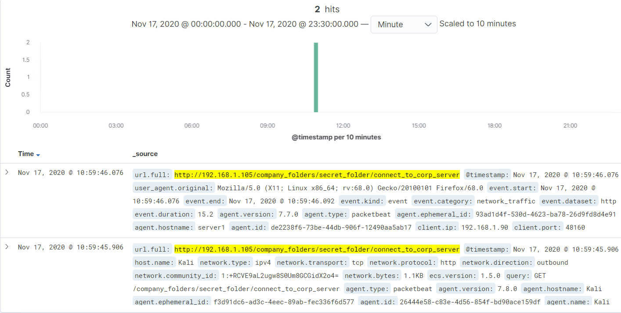
Analysis: Finding the Request for the Hidden Directory
There were 2 requests at 10:59 on Nov 17
connect_to_corp_server is the filename. It contains details on how to connect to the /WebDAV share, including a hash ryans password.

Slide 14
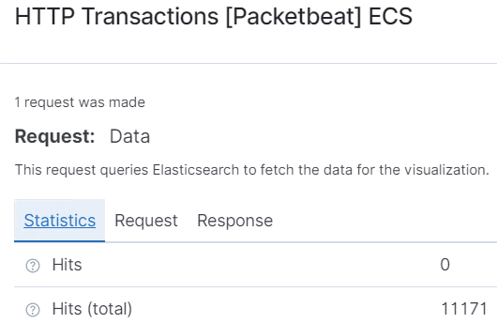
Analysis: Uncovering the Brute Force Attack
11171 requests were made in the attack
11170 requests had been made before the attacker discovered the password

Slide 15
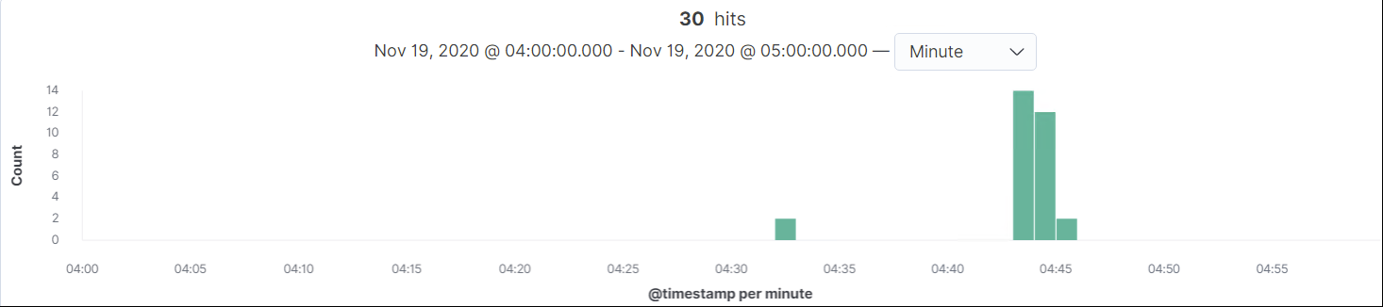
Analysis: Finding the WebDAV Connection
.
Kibana Search:
source.ip : 192.168.1.90 and http.response.status_code : 200 and url.full : "http://192.168.1.105/webdav/"
Requests made to this directory; count = 30
Successful requests were made for the files passwd.dav and shell.php

Slide 16
Blue Team
Proposed Alarms and
Mitigation Strategies
‹#›

Slide 17
Mitigation: Blocking the Port Scan
Linux iptables can be configured to DROP tcp packets based on the threshold;
$IPT -A INPUT -p tcp –syn -m recent –name portscan –rcheck –seconds 60 –hitcount 10 -j LOG
$IPT -A INPUT -p tcp –syn -m recent –name portscan –set -j DROP
It is good practice to drop all traffic by default
iptables -P INPUT DROP
iptables -P FORWARD DROP
iptables -P OUTPUT DROP
however we then need to specify rule chains for permitted services from and to authorised addresses or subnets.
What kind of alarm can be set to detect future port scans?
We can monitor the logs of recently dropped packets (iptables) and have a tool action based on the threshold.
I would suggest a threshold of;
10 hits within 60 seconds to activate this alarm.
Inotify-tools is an open source method for monitoring and setting actions
Notes:
References: https://meterpreter.org/how-to-prevent-port-scan-in-linux/

Slide 18
Mitigation: Finding the Request for the Hidden Directory
We could set an alarm with audit.d to inform us when this file is accessed in future.
To make changes persistent, add them to the /etc/audit/audit.rules file
-w company_folders/secret_folder/
connect_to_corp_server -p war -k connect_to_corp
-w: watch.
-p: permission you want to audit/watch, r for read, w for write, x for execute, a for append.
-k: keyword for this audit rule
In this case, the alarm threshold should be 2 per day.
Requiring simply a username / password combination is not adequate. We should adopt certificate based authentication for the hidden directory. Only clients with a valid certificate installed will then be able to access the hidden directory.
openssl x509 -req -days 365 -in server.csr -signkey server.key -out server.crt
sudo cp server.crt /etc/ssl/certs
sudo cp server.key /etc/ssl/private
We then need to configure our applications to use the certificate. This will also make the application traffic run with a secure protocol; https with SSL/TLS encryption
Notes:
References: https://www.thegeekdiary.com/how-to-audit-file-access-on-linux/
https://ubuntu.com/server/docs/security-certificates

Slide 19
Mitigation: Preventing Brute Force Attacks
Brute force attacks involve a high volume of requests. We should establish a baseline of normal activity around a resource and report on volume anomalies.
With a normal activity level of say 50 requests per hour, the activity may be condensed to a shorter period, especially after a break. A threshold of 100 requests in a 5 minute period would activate this alarm and not be triggered by our normal activity
Blocking brute force attacks on passwords can be accomplished by locking out an account after say three failed requests. We should have an enterprise account policy that enforces this (and enforce stronger passwords). Another means is to return an non-standard response to failed logins, return a 200 success code with a page for “failed login”, instead of the standard 401 error. Also, after a failed login attempt we should prompt the user to answer a secret question. This would prevent even a known password being used at this time.
Notes:
References: https://owasp.org/www-community/controls/Blocking_Brute_Force_Attacks

Slide 20
Mitigation: Detecting the WebDAV Connection
Detecting future access to this directory could be accomplished within existing infrastructure using packet beats, with a focus on http requests to /WebDAV or via auditd.
The threshold set to activate this alarm would be based on normal usage. For example; if we have 10 users daily and some may request the file (http GET) more than once, I would set the alarm threshold at a count 16 in 10 hours. We should alarm on every http PUT request, other than those from an authorised IP address.
IP whitelisting; setting configuration on the host to control access could be done using an iptables rule set that allows requests and responses only from and to a listed IP.
# whitelist IP address 192.168.0.123
# Allow incoming connections from 192.168.0.123
iptables -A INPUT -s 192.168.0.123 -j ACCEPT.
# Allow outgoing connections to 192.168.0.123
iptables -A OUTPUT -d 192.168.0.1 -j ACCEPT
Notes:
References:https://help.serversaustralia.com.au/s/article/How-To-Whitelist-An-IP-Address-In-IPTables

Slide 21
Mitigation: Identifying Reverse Shell Uploads
Setting an alarm - assuming the upload is rare, we should alert on every http PUT request. Where uploads are routine, every http PUT request from an unauthorised IP address should alarm.
We can set an alarm that targets specific file types, being those that are not normal for the shared folder.
A baseline of normal activity and a threshold of normal times 2 would be a reasonable threshold at which to activate this alarm. For .php files, we should alert for every attempt - set threshold at 1.
We can use specific local configuration to extend the functionality of Apache. Placing a configured .htaccess file in a web server directory will affect all files, folders and sub-directories.
Specifically to deny a .php file to be run we insert this configuration block into our .htaccess file
<Files *.php>
deny from all
</Files>
Notes:
References: https://serverfault.com/questions/677633/how-can-i-disable-specific-file-type-uploads-globally-in-apache
http://www.htaccess-guide.com/

Slide 22
IMPORTANT
The Penetration Test uncovered that one employee is using the password
of another to access corporate information.
In line with best-practice, strict role-based access controls should be enforced,
including revoking access for those that no longer perform that role.
Reference: https://owasp.org/www-community/Access_Control
End of Presentation

