Slide 1
FINAL PROJECT Vulnerabilities: Attack, Defend and Remediate
USYD Cybersecurity Bootcamp Wk 24
Andrew Forrest

Slide 2
OVERVIEW RED TEAM BLUE TEAM ANALYST
ATTACKER ROLE
Discovery / Enumeration
Network Topology
Critical Vulnerabilities
Exploitation of Targets
Avoiding Detection
Maintaining Access
DEFENDER ROLE
Monitoring of Activity
Alerts Criteria
Hardening Systems
Patching Components
NETWORK ANALYST ROLE
Packet Capture/Analysis
Normal Activity
Malicious Activity
Notes:
For the Final Project we needed to adopt different roles, firstly an Attacker – Red Teamer, capture the flag activity. Then a Defender – Blue Teamer, used my skills to configure the infrastructure to be more resilient and to alert us of a probable attack. The third section was being a Network Analyst, capturing and analysing traffic to identify norms and abnormalities.

Slide 3
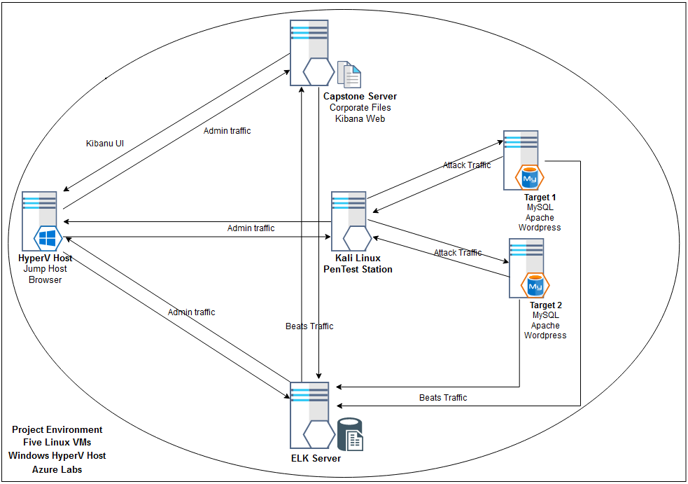
NETWORK SCHEMATIC
Range: 192.168.1.0/24 Mask: 255.255.255.0 Gateway: 192.168.1.1
MACHINES
Capstone Server 192.168.1.105 Linux 4.6
Target 1 192.168.1.110 Linux 3.2 - 4.9
Target 2 192.168.1.115 Linux 3.2 - 4.9
ELK Server 192.168.1.100 Linux 4.6
Kali Pen.Test Station 192.168.1.90 Linux 2.6.32
Notes:
My schematic of the environment, initially created from the attack reconnaissance results, then enhanced with features used in the Blue Team activities.
Includes traffic flows for the attack, the monitoring and alerting infrastructure, and server administration.
Factually, all five machines are VMs that reside on the HyperV Host within an Azure Lab environment.
The pentest station shown in the centre was used to attack both target machines.
There is an Elastic Stack installation having beats installed on the target machines, Elastic Search and Logstash on the ELK server and Kibana Web on the Capstone server.

Slide 4
Critical Vulnerabilities Target 1
Description | Impact | Common Weakness
Sensitive information in source code comments | Sensitive information disclosure | CWE-540 https://cwe.mitre.org/data/definitions/540.html
Weak password requirements | Easily guessed password for user Michael. Server login achieved | CWE-521 https://cwe.mitre.org/data/definitions/521.html
Password in configuration file | Root access to wordpress db Sensitive information disclosure | CWE-260 https://cwe.mitre.org/data/definitions/260.html
Execution with unnecessary privileges | Steven's login can run any python script. Server root access gained | CWE-250 https://cwe.mitre.org/data/definitions/250.html
Unrestricted Upload of File with Dangerous Type | A persistent backdoor was uploaded to the server | CWE-434 https://cwe.mitre.org/data/definitions/434.html
Notes:
A total of 56 CVEs with rating above zero were detected, these were common to both targets.
Understanding vulnerabilities properly may require a deep technical knowledge of a specific component.
A common weakness was referenced for each exploit.
The CWE provides extensive details such as observed examples, CVE links, potential mitigations and detection methods.
I consider critical vulnerabilities are those that can be readily exploited and have a significant impact. I evidence the impact in coming slides.

Slide 5
Critical Vulnerabilities Target 2
Description | Impact | Common Weakness
Information leakage through directory listing | Provides a complete index of all the resources within a directory | CWE-548 https://cwe.mitre.org/data/definitions/548.html
Improper Sanitization of Special Elements used in an OS Command | Parameterises an arbitrary command appended to a valid URL path | CWE-78 https://cwe.mitre.org/data/definitions/78.html
Local file inclusion / Path traversal | Sensitive information disclosure | CWE-22 https://cwe.mitre.org/data/definitions/22.html
Notes:
For Target 2, critical vulnerabilities were exploited to acquire information on resources, execute remote commands, and disclose sensitive information.

Slide 6
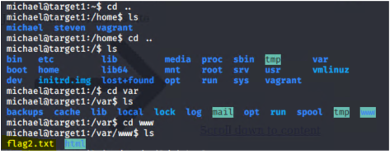
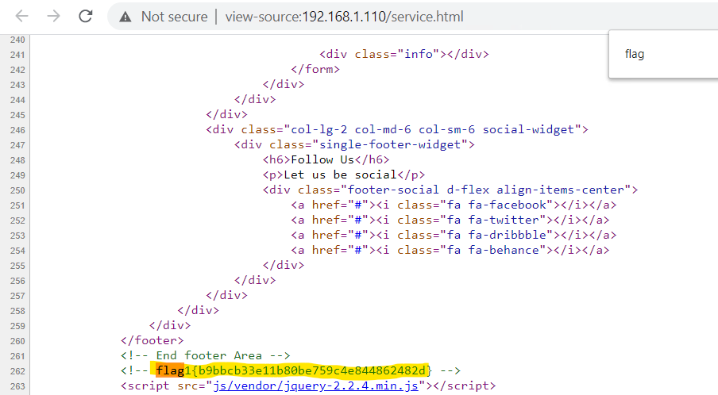
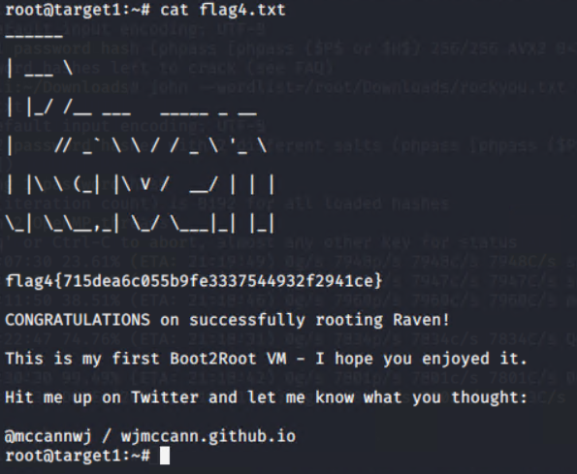
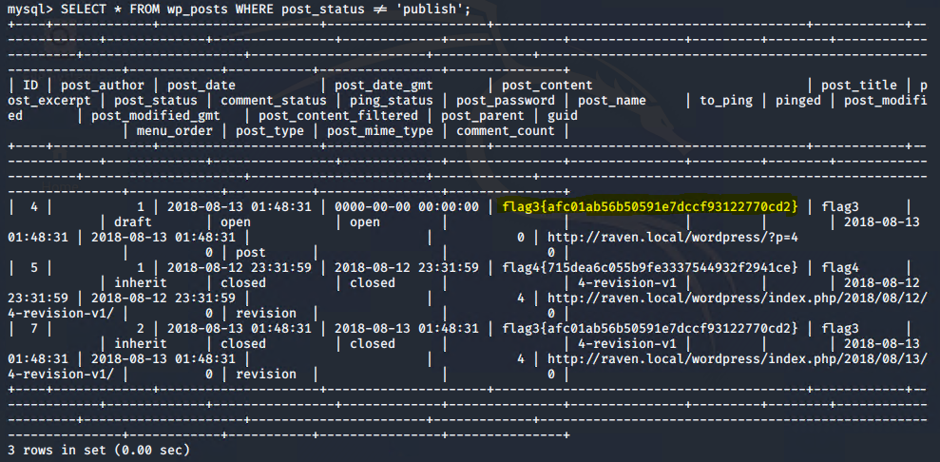
Exploitation Target 1 Comments left in code Weak password requirements led to initial authenticated foothold User Enumeration for password cracking Contact Form flaw leveraged to load backdoor Hash of User Passwords led to cracking of logins Backend DB root access
Notes:
Evidence of captured flags that were located using various means;
I was able to gain a login, find user password hashes, crack the hashes, load a backdoor, elevate privilege and obtain backend DB root access.

Slide 7
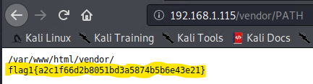
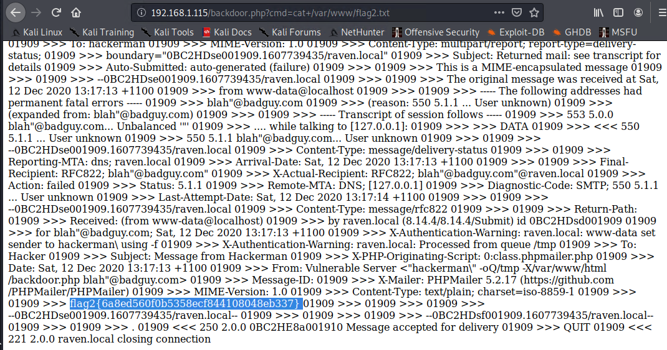
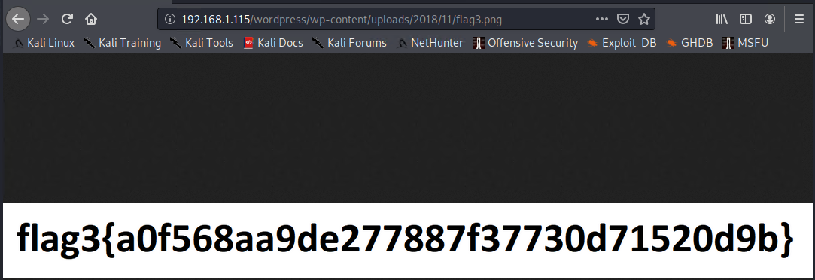
Exploitation Target 2 Information leakage through directory listing Improper Sanitization of Special Elements used in an OS Command Path traversal Local file inclusion achieved via backdoor
Notes:
Evidence of captured flags for Target 2;
directory listing, path traversal, running remote shell commands, local file inclusion were the exploit methods I used here.

Slide 8
Avoiding Detection and Maintaining Access Stealth Exploitation Persistent backdoor Remote command execution
Operate enumeration tools with stealthier options to avoid detection (slow the execution of attacks)
Restrict brute force methods to local execution (extract then crack)
Using a custom exploit, a backdoor was uploaded to the target
The backdoor will persist after system reboot
Remote command execution available
Notes:
High volume intensive network scans and brute force attacks on logins will likely raise alarms.
Attackers that have secured access may make numerous low volume reconnaissance passes to avoid detection.
They will gather pieces of the puzzle to create a picture of the network, then make incremental gains towards their target.

Slide 9
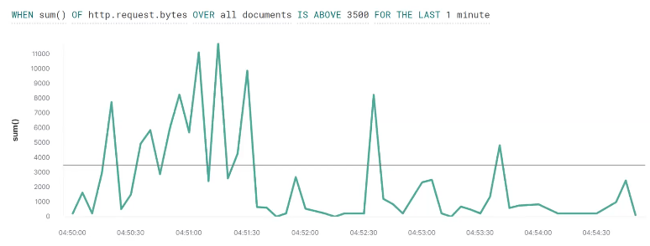
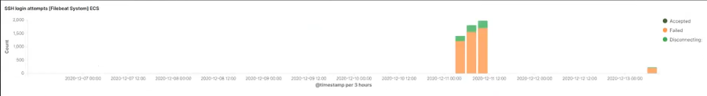
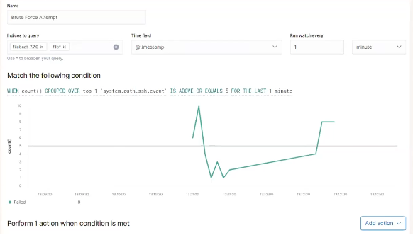
Monitoring Activity and Alerting Network Defender Maintain effective monitoring of assets. Understand variations in normal activity patterns. Tailor alerting thresholds, minimise false positives. Trigger planned mitigation actions, automated and manual.
Notes:
Kibana Watcher screen, monitoring http requests, threshold 3500 / minute
Kibana Watcher Alert configuration, SSH logins exceeding 5 or more in one minute will alert, configure to email or text out to support team and/or to raise an incident ticket.

Slide 10
Hardening Systems and Patching All Components Sound processes and efficient procedures should be in place. Compliance is a MUST.
Hardening means reducing the surface area for an attack to occur.
Restricting what actions can occur under what login; applying the principle of least privilege. Lock it down tight!
Uninstall or disable components and services that are not required.
Patching is updating OS, platform and software components with verified security fixes. Do this on a regular cycle. Just do it!
Include a contingency to expedite installing fixes for Zero Day exploits. All hands on deck!
Notes:
System hardening reduces the surface area for an attack to occur. This is a highly effective preventative technical control and should be considered with every Change.
Maintaining platforms to be current in terms of security patching is necessary to protect against vulnerabilities that are documented in the public domain.
Patching non-compliance presents a tangible and avoidable risk.
Security experts say that, “It is no longer a question of IF you will be hacked, - but WHEN !

Slide 11
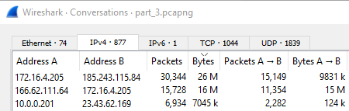
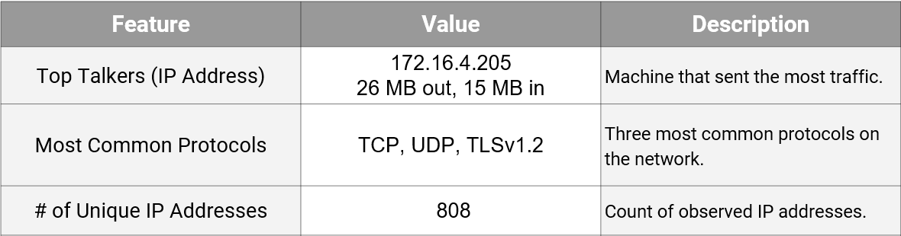
Traffic Profile and Normal User Behavior NETWORK ANALYST Watching YouTube via an unauthorised internal site Rotterdam-PC > mysocialchaos.com (6MB/sec peak) Reading the news ... TIME Magazine cloud.newsletters.time.com Photo Essays ; Libya's Roman Ruins
Notes:
I identified a single standout IP that was using many times more bandwidth than other devices. A clandestine internal network streaming videos was detected.

Slide 12
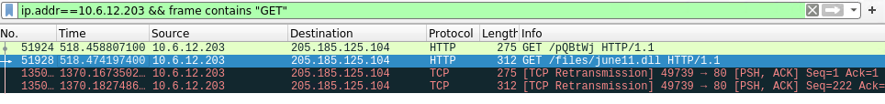
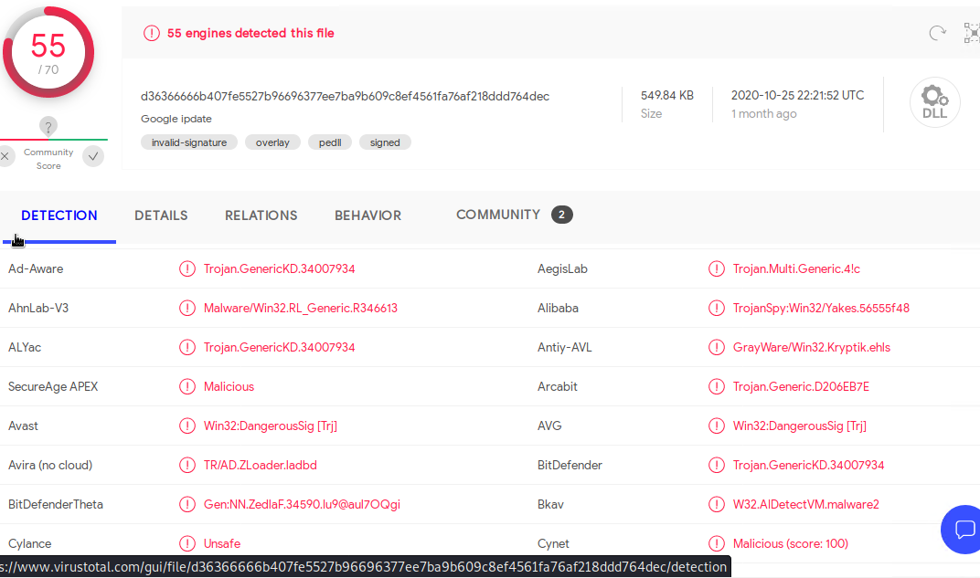
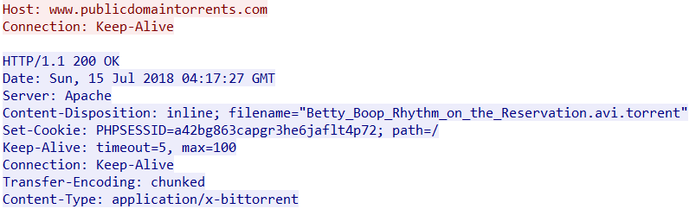
Malicious / Illegal Activity Trojan infected file Remote command injection Torrent download
Notes:
There was malicious activity documented being a trojan upload and remote code execution.
Network resource was used for a bit torrent download

Slide 13
Project Challenges and Experience Knowledge applied Precision of execution and documentation Items of interest New skills
Project Challenges
Vulnerability research: relating vulnerabilities found on the fly then matching these to exploits; this aspect demands thoroughness.
Mitigation research: What approaches are feasible ? What is the most appropriate solution for each of the vulnerabilities ?
Avoiding detection: How could an attacker act more stealthily to avoid detection ? What can a defender do to mitigate this ?
Time pressure: Working on multiple aspects at the same time whilst gathering details for documentation and reports at each step.
Most Exacting Aspect
Exploring network activity, utilizing more wireshark functionality to detail anomolies / suspicious activities. Requires precision and lateral thought.
Experience Gained
Kibana Watcher: learned to use the Watcher feature for the different beats, defining specific alert criteria and setting appropriate thresholds.
Notes:
The project required me to work on multiple concurrent activities and produce accurate results in a relatively short time period.
Capturing the flags and drilling into network activity is gratifying as the results are visible immediately.
Detailing the vulnerabilities and remediations requires thoroughness, cross referencing multiple sources and accuracy in documentation.
Using a new feature or tool and obtaining beneficial outcomes was most pleasing to me.

Slide 14
END OF PRESENTATION
Questions ?
Notes:
Thank you for watching my presentation.
I am happy to answer any questions if there is time ?

