Slide 1
FINAL PROJECT OVERVIEW Vulnerabilities: Attack, Defend and Remediate
USYD Cybersecurity Bootcamp Week 24
Andrew Forrest
Notes:
Good Evening. Andrew Forrest here, a recent graduate from the USYD CyberSecurity Bootcamp.
I am presenting a non-technical Overview of my final project.

Slide 2
PEN. TESTER / ATTACKER : DEFENDER : NETWORK ANALYST RED TEAM Pen. Tester BLUE TEAM Security Ops Analyst SECURITY ANALYST Network Traffic
Discovery, Enumeration, Gather Artifacts,
Document Exploits, Capture Flags.
Monitoring and Alerting,
Remediation of Vulnerabilities.
Analysis of Captured Traffic,
Normal, Malicious and Illegal Activity
Notes:
Meeting the project deadline required actioning multiple tasks concurrently and assuming three individual roles: being a Pen Tester / Red Team member, a Security Operations Analyst / Blue Team member, and also working as a Network Security Analyst.

Slide 3
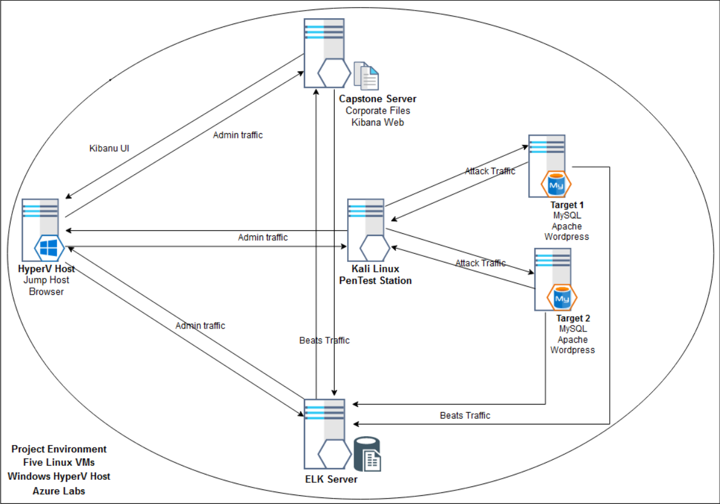
SCHEMATIC Hyper V Host Pen Test Station Two Targets Elastic Search and Logstash Kibana Web
Notes:
My Network Schematic, Shows internal traffic flows between servers.
From the left: the Hyper V / Jump Host, in the centre my Kali Linux Pen Test Station, to the right the two target machines (running Wordpress)
Beats from these are sent the ELK Server below (which runs Elastic Search and LogStash) and up top is our Kibana Web Server.
Physically, there are five VMs, all residing on the Hyper-V Host.

Slide 4
Critical Vulnerabilities - Target 1
Description | Impact | CWE # and CV Score
Sensitive information in source code comments | Sensitive information disclosure | CWE-540 - 9.0 https://cwe.mitre.org/data/definitions/540.html
Weak password requirements | Easily guessed password for user Michael. Server login achieved | CWE-521 - 8.0 https://cwe.mitre.org/data/definitions/521.html
Password in configuration file | Root access to wordpress db Sensitive information disclosure | CWE-260 - 8.0 https://cwe.mitre.org/data/definitions/260.html
Execution with unnecessary privileges | Steven's login can run any python script. Server root access gained | CWE-250 - 8.5 https://cwe.mitre.org/data/definitions/250.html
Unrestricted Upload of File with Dangerous Type | A persistent backdoor was uploaded to the server | CWE-434 - 8.5 https://cwe.mitre.org/data/definitions/434.html
Notes:
Critical Vulnerabilities Target 1.
I located; Comments in source code, Weak password requirements, Password in config. file, Execution with unnecessary privileges, and No restriction of file upload type.
For each vulnerability, I reference a Common Weakness and used CVSS to determine a vulnerability score.

Slide 5
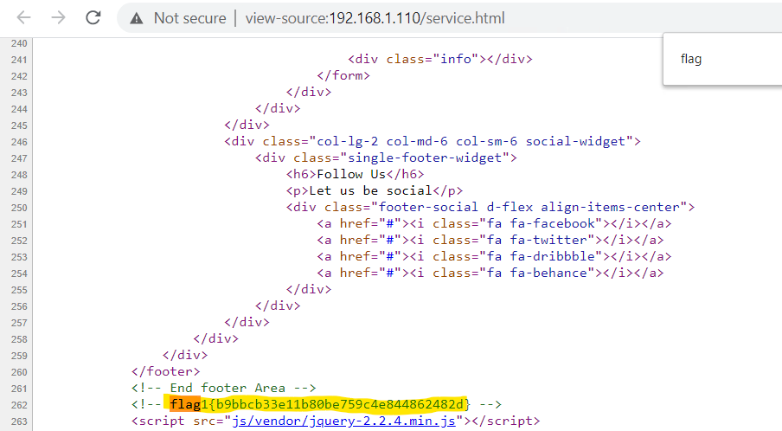
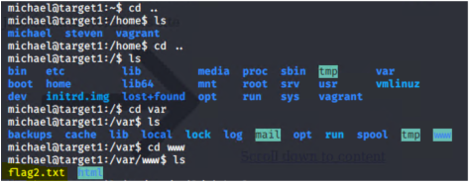
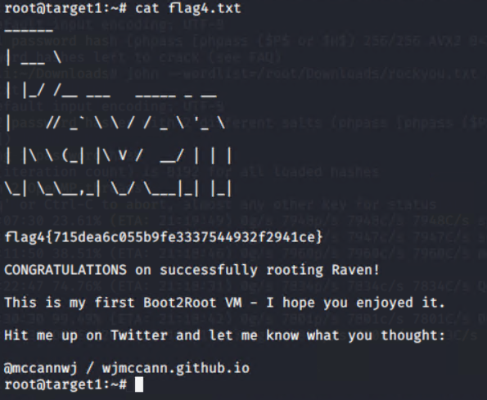
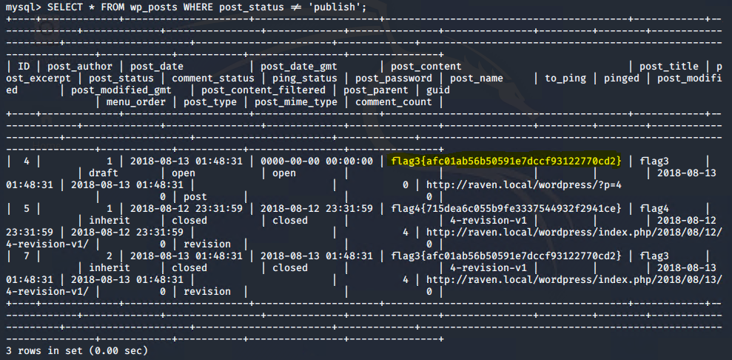
Exploitation Target 1 – Steps and Artifacts RED TEAM Comments left in code Weak password requirements, initial authenticated foothold User Enumeration for password cracking Hash of User Passwords led to cracking of logins Contact Form flaw leveraged to load backdoor Backend DB root access
Notes:
The Exploitation of Target 1.
Flag 1 was found using view source. Due to a weak password, I was able to gain a login, discover and crack user password hashes.
Then login as another user, elevate privilege to root, use a custom script to install a backdoor, and obtain root access to the backend database.

Slide 6
Critical Vulnerabilities - Target 2
Description | Impact | CWE # and CV Score
Information leakage through directory listing | Provides a complete index of all the resources within a directory | CWE-548 - 8.0 https://cwe.mitre.org/data/definitions/548.html
Improper Sanitization of Special Elements used in an OS Command | Parameterises an arbitrary command appended to a valid URL path | CWE-78 - 8.0 https://cwe.mitre.org/data/definitions/78.html
Local file inclusion / Path traversal | Sensitive information disclosure | CWE-22 - 8.0 https://cwe.mitre.org/data/definitions/22.html
Notes:
Vulnerabilities on Target 2.
I found; Leakage of information through directory listing, Improper sanitization of commands, Local file inclusion and Path Traversal.

Slide 7
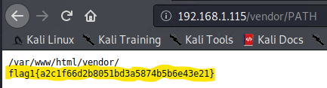
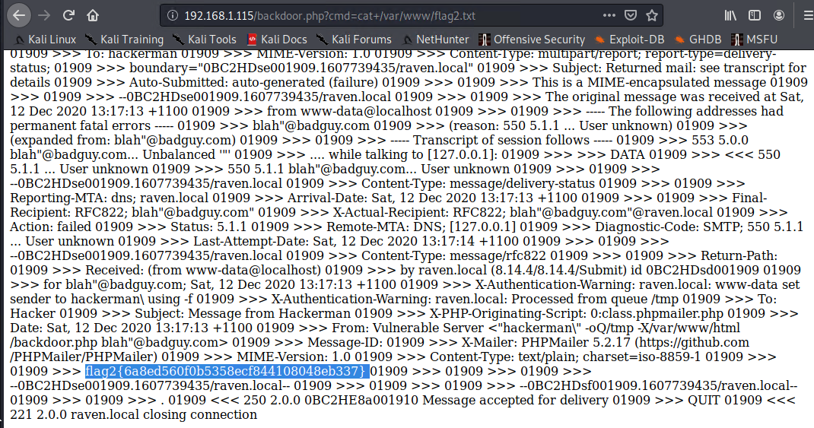
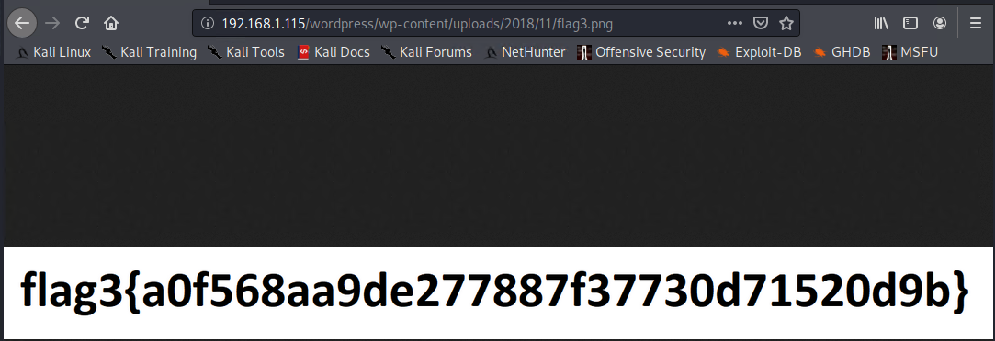
Exploitation Target 2 - Steps and Artifacts RED TEAM Information leakage through directory listing Improper Sanitization of Special Elements used in an OS Command Path traversal Local file inclusion achieved via backdoor
Notes:
The Exploitation of Target 2 was progressed initially by a Directory Listing weakness, the information gathered enabled me to use path traversal to gain further sensitive information.
I then used remote shell commands for local file inclusion to discover the final flag.

Slide 8
Avoiding Detection and Maintaining Access RED TEAM Stealth Exploitation Persistent backdoor Remote command execution
Operate enumeration tools with stealthier options to avoid detection (slow the execution of attacks).
Restrict brute force methods to local execution (extract then crack).
Using a custom exploit, a backdoor was uploaded to the target.
The backdoor will persist after system reboot.
Remote command execution available.
Notes:
An attacker may avoid detection by repeated low volume reconnaissance passes, each providing an incremental gain.
Attackers maintain network access by installing a persistent backdoor and using remote command execution.

Slide 9
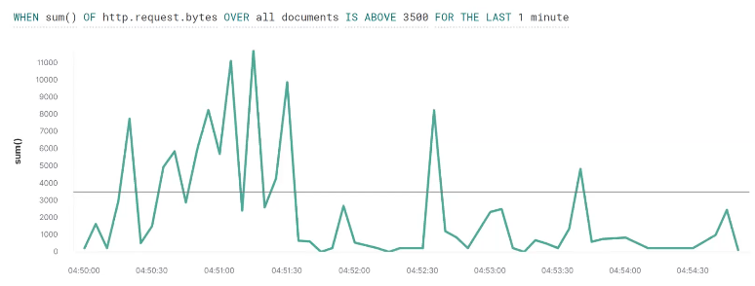
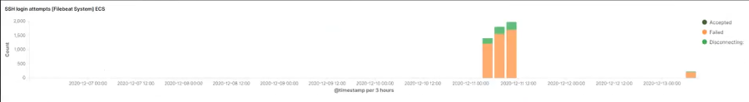
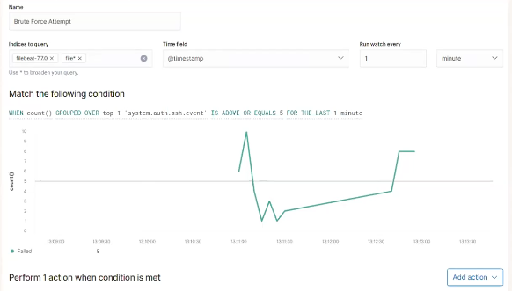
Monitoring Activity and Alerting BLUE TEAM Maintain effective monitoring of assets. Understand variations in normal activity patterns. Tailor alerting thresholds, minimise false positives. Trigger planned mitigation actions; customized to suit.
Notes:
Next, as a Security Ops analyst, I used the Watcher feature of Kibana to;
Configure a monitor with an alert for Excessive http requests.
This alert would be triggered by an attacker using an enumeration tool.
Another alert was for five or more SSH logins within a one minute period.
This alert would be triggered by an attacker executing a brute force login attack.

Slide 10
Hardening of Systems and Patching All Components Reducing surface area available to attackers Apply principle of least privilege aggressively Patching processes, Regular and Emergency Compliance is a vital !
Restricting what actions can occur under what login.
Uninstall or disable components and services that are not required.
Lock it down tight!
Patching is updating OS, platform and software components with verified security fixes. Do this on a regular cycle. Just do it!
Include contingencies to expedite installing fixes for Zero Day exploits.
Sound processes and efficient procedures should be in place.
Notes:
System hardening reduces the surface area available to an attacker. Locking down thoroughly is a highly effective preventative technical control.
Uninstall or disable any services that are not specifically required. The principle of least privilege should be applied Aggressively.
Protect against disclosed vulnerabilities with Regular security patching and an Emergency patching processes for zero day exploits.
Maintaining patching compliance for all components is of vital importance!

Slide 11
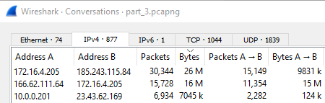
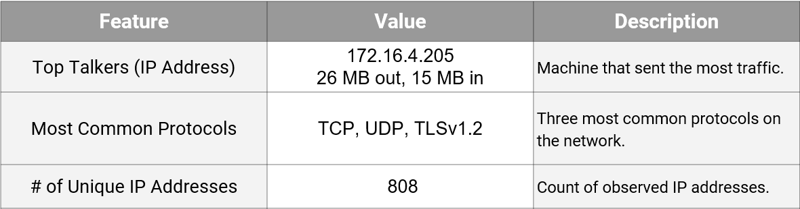
Traffic Profile and Normal User Behavior NETWORK ANALYST Watching YouTube via an unauthorised internal site Rotterdam-PC > mysocialchaos.com (6MB/sec peak) Reading the news , TIME Magazine cloud.newsletters.time.com Photo Essays ; Libya's Roman Ruins
Notes:
Adopting the Network Analyst role, I used wireshark to identify; an IP that was using suspiciously more bandwidth than other devices, and
A clandestine internal network used for streaming videos.

Slide 12
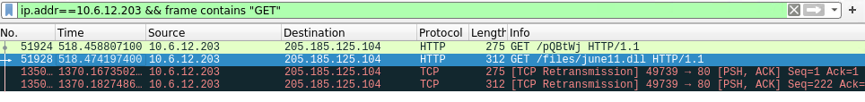
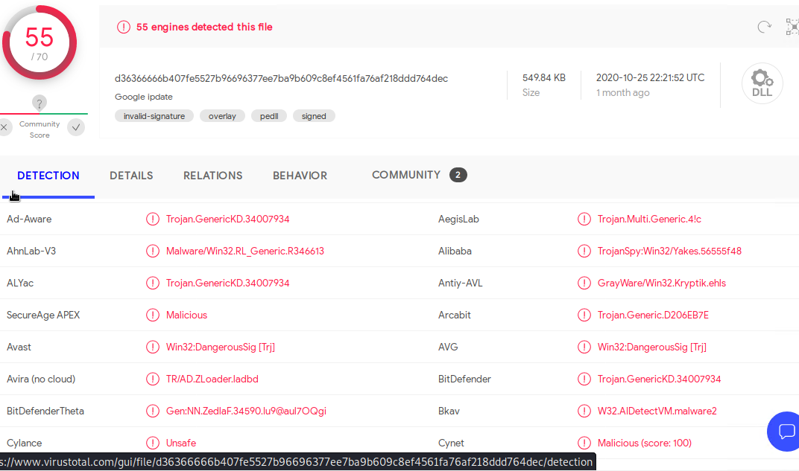
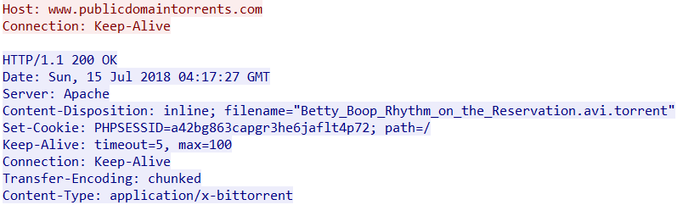
Evidence of Malicious and Illegal Activities Trojan infected file Remote command injection Torrent download
Notes:
Regarding Malicious activity; I discovered a Trojan was uploaded, and a remote code execution attack on an external server.
I also found that network resources were used for an illegal bit torrent download.

Slide 13
Project Challenges Select the appropriate tools at each stage Execute with precision Document progress Implement targeted monitoring and alerts Produce accurate and clear reports Recommend solutions
Project Challenges
Vulnerability research: matching vulnerabilities to exploits; this aspect demands thoroughness.
Mitigation research: What approaches are feasible ? What is the most appropriate solution for each of the vulnerabilities ?
Avoiding detection: How could an attacker act more stealthily to avoid detection ? What can a defender do to mitigate this ?
Time pressure: Working on multiple aspects at the same time whilst gathering details for documentation and reports at each step.
Most Exacting Aspect
Exploring network activity, utilizing more wireshark functionality to detail anomalies / suspicious activities. Requires precision and lateral thought.
New Feature Learned
Kibana Watcher: learned to use the Watcher feature for the different beats, defining specific alert criteria and setting appropriate thresholds.
Notes:
Project Challenges
I was required to complete multiple concurrent tasks, some with unfamiliar tools, within a strict time limit.
Deliverables were; detailing accurate results in three technical reports, plus producing and delivering a technical presentation.
I needed to: Select the appropriate tools at each stage, Execute with precision, Document my progress, Produce accurate and clear reports, Implement targeted monitoring with alerts, and Recommend solutions for the vulnerabilities found.
My project submission earned an A- and my overall academic average was A+

Slide 14
PRESENTATION END
Questions ?
Andrew Forrest
Notes:
Thank you for your attention this evening.
I am happy to answer any questions if there is time. ...
Kibana Watcher feature and wpscan are tools that I had not used before.
Configuring monitors and alerts requires knowledge of both network activity and attack methods.
The packet capture analysis included numerous subnets with many of traffic flows examined.
Detailing vulnerabilities and remediations required referencing current authoritative sources with thoroughness, and demanded accuracy in documentation.
Non-assessed additional work:
GitHub Markdowns for each of the three aspects covered:
a) Offense Actions
b) Defensive Actions
c) Network Analysis
Non-technical Overview presentation for Virtual Demo day.

