Slide 1
FINAL PROJECT Vulnerabilities: Attack, Defend and Remediate
USYD Cybersecurity Bootcamp Wk 24
Andrew Forrest
Notes:
For the final project we used a Lab environment that simulates a feasible real-world scenario.

Slide 2
PENETRATION TESTER RED TEAM ATTACKER CAPTURE FLAGS
Discovery
Enumeration
Identify Critical Vulnerabilities
Exploitation of Targets
Avoiding Detection
Maintaining Access
Notes:
I needed to adopt three different roles, firstly an Attacker – a Red Teamer, performing a capture the flag activity.
Tools / skills used in pen test included: nmap, nikto, legion, wpscan, hydra, john, a python script, a php script and querying mySQL.

Slide 3
DEFENDER BLUE TEAM SECURITY OPERATIONS REMEDIATIONS
Monitoring of Activity
Alerts Criteria
Hardening Systems
Patching Components
Notes:
Secondly a Defender – a Blue Teamer, part Security Ops, detailing effective Remediations for the vulnerabilities I found.
I recommended actions to make the Targets more resilient to attack and I used my skills to configure monitors and alerting to detect and warn us of a probable attack.

Slide 4
NETWORK ANALYST WIRESHARK TRAFFIC PROFILE ACTIVITY BEHAVIOURS
Packet Capture
Capture Analysis
Normal Activity
Malicious Activity
Illegal Activity
Notes:
The third Role is being a Network Analyst, capturing and analysing traffic with wireshark.
Profiling traffic, determining activity norms and abnormalities.
Searching for malicious or illegal activity.

Slide 5
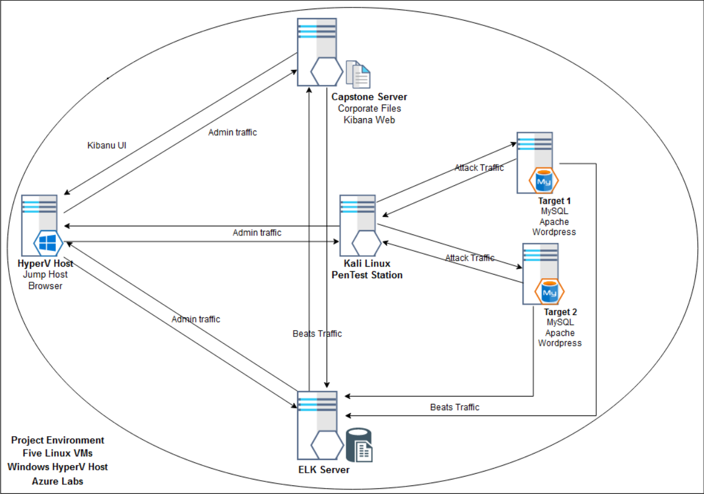
NETWORK SCHEMATIC TARGETS ELK STACK
Notes:
My schematic of the environment, initially created from the attack reconnaissance results, then enhanced with features used in the Blue Team activities.
Includes traffic flows for the attack, the monitoring and alerting infrastructure, and server administration.
Factually, all five machines are VMs that reside on the HyperV Host within an Azure Lab environment.
The pentest station shown in the centre was used to attack both target machines.
There is an Elastic Stack installation having beats installed on the target machines, Elastic Search and Logstash on the ELK server and Kibana Web on the Capstone server.

Slide 6
Critical Vulnerabilities Target 1
Description | Impact | Common Weakness
Sensitive information in source code comments | Sensitive information disclosure | CWE-540 https://cwe.mitre.org/data/definitions/540.html
Weak password requirements | Easily guessed password for user Michael. Server login achieved | CWE-521 https://cwe.mitre.org/data/definitions/521.html
Password in configuration file | Root access to wordpress db Sensitive information disclosure | CWE-260 https://cwe.mitre.org/data/definitions/260.html
Execution with unnecessary privileges | Steven's login can run any python script. Server root access gained | CWE-250 https://cwe.mitre.org/data/definitions/250.html
Unrestricted Upload of File with Dangerous Type | A persistent backdoor was uploaded to the server | CWE-434 https://cwe.mitre.org/data/definitions/434.html
Notes:
A total of 56 CVEs with rating above zero were detected, these were common to both targets.
Understanding specific vulnerabilities properly requires a deep technical knowledge of a specific component. I have many years experience with this.
A common weakness was referenced for each exploit.
The CWE provides extensive details such as observed examples, CVE links, potential mitigations and detection methods.
Comments in source code, weak password requirements, password in configuration file, execution with unnecessary privileges, no restriction of file upload type.
These items might appear simplistic however security audits find these exact issues all over the place in live systems.

Slide 7
Critical Vulnerabilities Target 2
Description | Impact | Common Weakness
Information leakage through directory listing | Provides a complete index of all the resources within a directory | CWE-548 https://cwe.mitre.org/data/definitions/548.html
Improper Sanitization of Special Elements used in an OS Command | Parameterises an arbitrary command appended to a valid URL path | CWE-78 https://cwe.mitre.org/data/definitions/78.html
Local file inclusion / Path traversal | Sensitive information disclosure | CWE-22 https://cwe.mitre.org/data/definitions/22.html
Notes:
For Target 2, critical vulnerabilities were exploited to acquire information on resources, execute remote commands, and disclose sensitive information.
The activity was designed to make me use different exploit for find the flags on each Target.

Slide 8
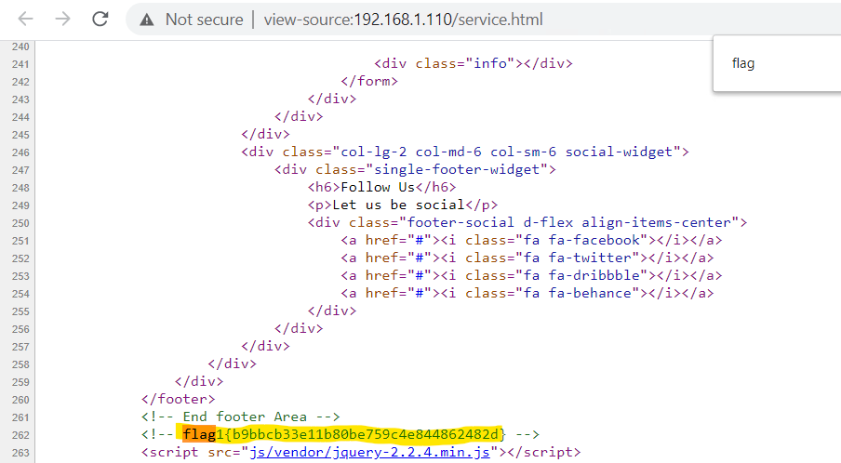
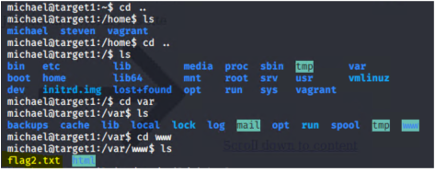
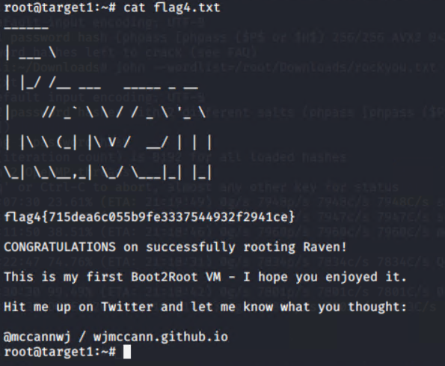
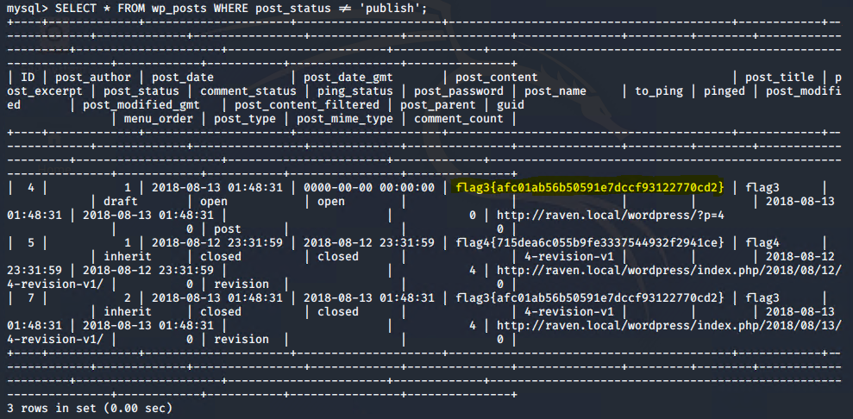
Exploitation Target 1 RED TEAM Comments left in code Weak password requirements, initial authenticated foothold User Enumeration for password cracking Hash of User Passwords led to cracking of logins Contact Form flaw leveraged to load backdoor Backend DB root access
Notes:
Evidence of captured flags that were located using various means;
I was able to gain a login, find user password hashes, copy these to a file, export the file and crack the hashes remotely.
Then I was able to login as another user, elevate privilege to root, install a backdoor via custom script, and obtain backend DB root access.
Four out of four flags were captured on Target 1.

Slide 9
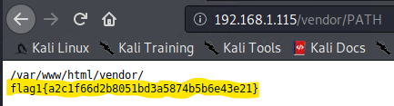
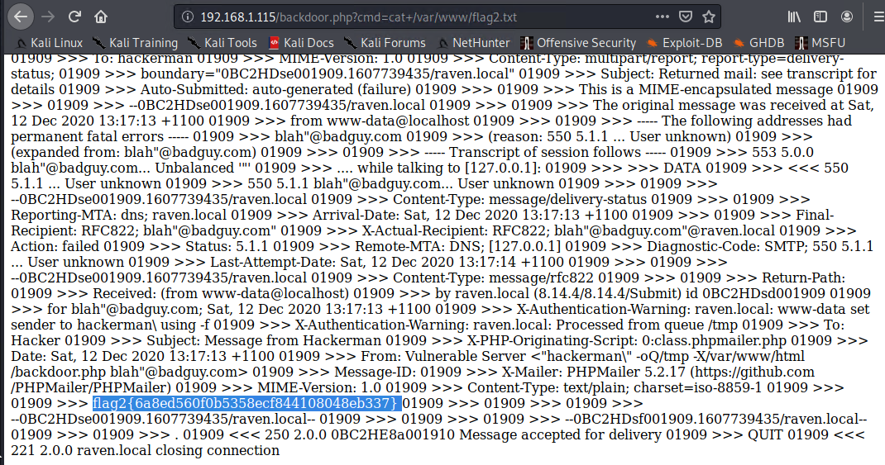
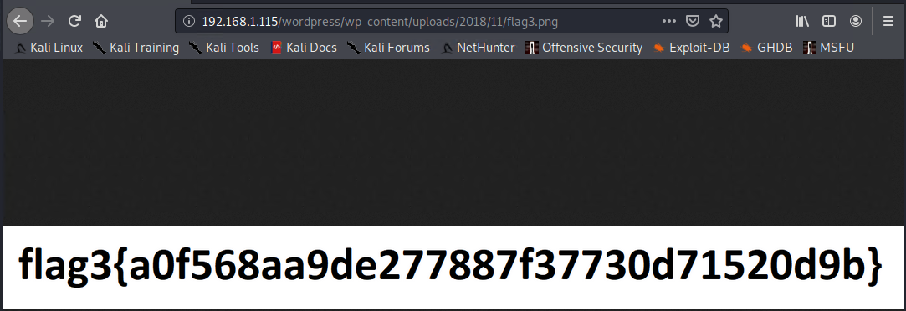
Exploitation Target 2 Information leakage through directory listing Improper Sanitization of Special Elements used in an OS Command Path traversal Local file inclusion achieved via backdoor
Notes:
Evidence of captured flags for Target 2;
Exploitation was progressed initially by a Directory listing weakness, the information gathered enabled me to use path traversal to gain more sensitive information.
Then, running remote shell commands I used local file inclusion and the output contained my third flag.
Three out of three flags were captured on Target 2.

Slide 10
Avoiding Detection and Maintaining Access Stealth Exploitation Persistent backdoor Remote command execution
Operate enumeration tools with stealthier options to avoid detection (slow the execution of attacks)
Restrict brute force methods to local execution (extract then crack)
Using a custom exploit, a backdoor was uploaded to the target
The backdoor will persist after system reboot
Remote command execution available
Notes:
High volume intensive network scans and brute force attacks on logins will likely raise alarms.
Attackers that have secured access may make numerous low volume reconnaissance passes to avoid detection.
They will gather pieces of the puzzle to create a picture of the network, then make incremental gains towards their target.

Slide 11
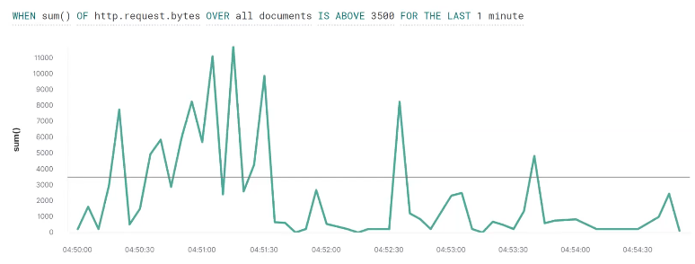
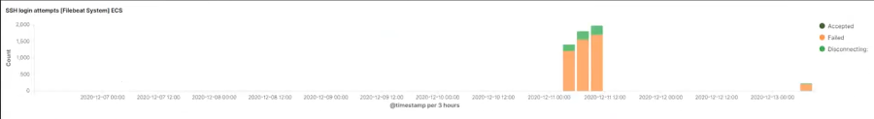
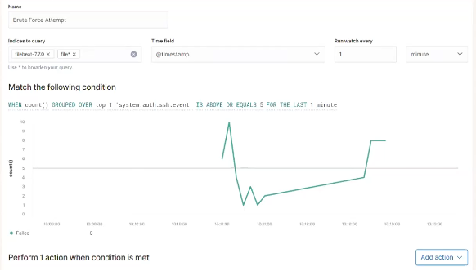
Monitoring Activity and Alerting BLUE TEAM Maintain effective monitoring of assets. Understand variations in normal activity patterns. Tailor alerting thresholds, minimise false positives. Trigger planned mitigation actions, automated and manual.
Notes:
Kibana Watcher screen, monitoring http requests, threshold set at 3500 requests / minute
This would be triggered by an attacker using wpscan.
Kibana Watcher Alert configuration, 5 or more SSH logins within one minute will alert,
configure to email or text out to support team and/or to raise an incident ticket.
This would be triggered by an attacker using hydra to execute a brute force login attack.

Slide 12
Hardening Systems and Patching All Components Sound processes and efficient procedures should be in place. Compliance is a MUST.
Hardening means reducing the surface area for an attack to occur.
Restricting what actions can occur under what login; applying the principle of least privilege. Lock it down tight!
Uninstall or disable components and services that are not required.
Patching is updating OS, platform and software components with verified security fixes. Do this on a regular cycle. Just do it!
Include a contingency to expedite installing fixes for Zero Day exploits. All hands on deck!
Notes:
System hardening reduces the surface area available to an attacker. This is a highly effective preventative technical control and should be considered with every Change.
Maintaining platforms to be current in terms of security patching is necessary to protect against vulnerabilities that have been documented in the public domain.
Patching non-compliance is a tangible and avoidable risk.
Security experts say that, “It is no longer a question of IF you will be hacked, - but WHEN !

Slide 13
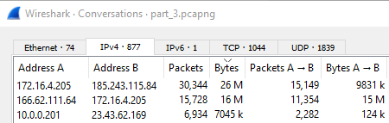
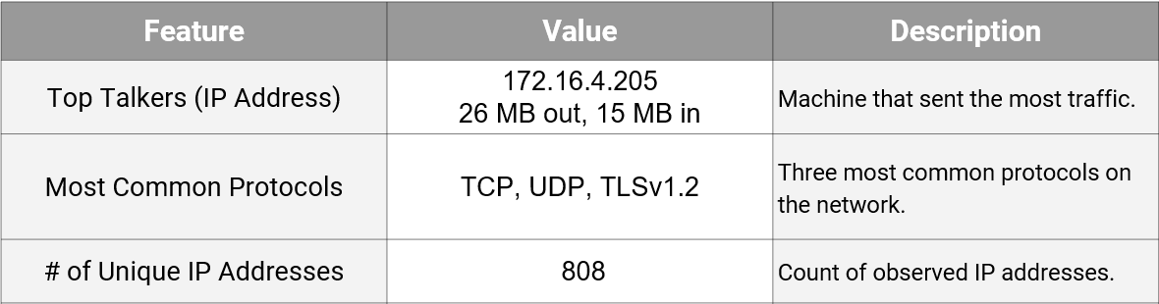
Traffic Profile and Normal User Behavior NETWORK ANALYST Watching YouTube via an unauthorised internal site Rotterdam-PC > mysocialchaos.com (6MB/sec peak) Reading the news ... TIME Magazine cloud.newsletters.time.com Photo Essays ; Libya's Roman Ruins
Notes:
I identified a single standout IP that was using many times more bandwidth than other devices. A clandestine internal network streaming videos was detected.

Slide 14
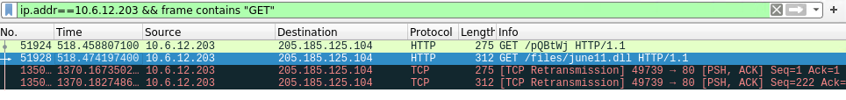
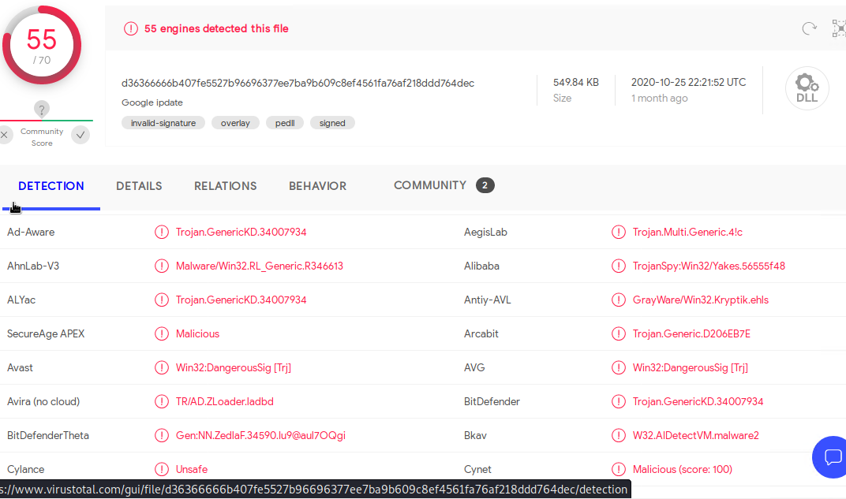
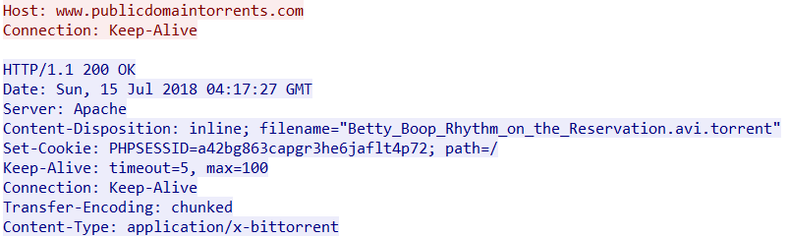
Malicious / Illegal Activity Trojan infected file Remote command injection Torrent download
Notes:
There was malicious activity documented being a trojan upload and remote code execution attack on an external server.
Network resource was used for a bit torrent download

Slide 15
Project Challenges and Experience Knowledge applied Precision of execution and documentation Items of interest New skills
Project Challenges
Vulnerability research: matching vulnerabilities to exploits; this aspect demands thoroughness.
Mitigation research: What approaches are feasible ? What is the most appropriate solution for each of the vulnerabilities ?
Avoiding detection: How could an attacker act more stealthily to avoid detection ? What can a defender do to mitigate this ?
Time pressure: Working on multiple aspects at the same time whilst gathering details for documentation and reports at each step.
Most Exacting Aspect
Exploring network activity, utilizing more wireshark functionality to detail anomolies / suspicious activities. Requires precision and lateral thought.
Experience Gained
Kibana Watcher: learned to use the Watcher feature for the different beats, defining specific alert criteria and setting appropriate thresholds.
Notes:
The project required me to work on multiple concurrent activities and produce accurate results in a relatively short time period.
Numerous different tools were used to complete various tasks.
Capturing the flags and drilling into network activity is gratifying as the results are tangible.
Detailing the vulnerabilities and remediations requires thoroughness, cross referencing multiple sources and accuracy in documentation.
Using a new feature of Kibana and exploring various pen testing tools to obtain beneficial outcomes was most pleasing to me.

Slide 16
END OF PRESENTATION
Questions ?
Notes:
Thank you for watching my presentation.
I am happy to answer any questions if there is time ?

