Slide 1
Pokémon Eagle Version
CS 125 @ Embry – Riddle Aeronautical University
Forrest Mobley, Colton Van Orsdel, & Vince Tran

Slide 2

Code Objectives & Outline
MAIN
The Games:
Catch them all
Defeat the Pokémon Champion’s League
Have fun
What We Did:
Battle Simulator
Intro
Starter Pokémon
Utilities
Battle Simulator
Player Stats
NPC Stats
Psuedo – random Battles

Slide 3
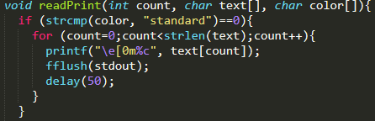
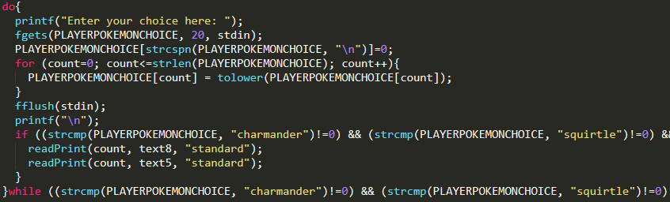
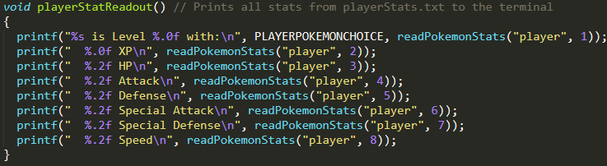
Intro & Starter
Author: Forrest Mobley
Intro
Print statements for days
Starter
Choose your starter Pokémon
Choose the type of Pokémon you wish to battle against for the next battle
Utilities
Useful functions such as clear(), readPrint(), and StatReadout()
Includes a debugLauncher() to test/debug faster

Slide 4
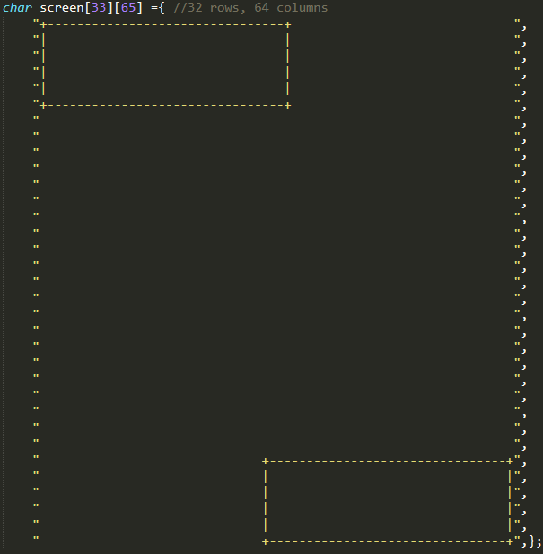
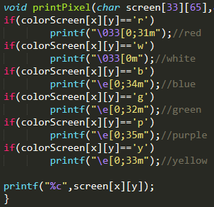
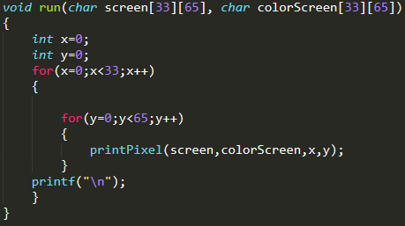
BattleUI
Author: Vince Tran
Most important lines of code
screen and colorScreen
32 high, 64 wide
For both characters and color
Functions to render the UI:
printPixel – prints a letter in a certain color
run - utilizes printPixel to print the whole screen
http://web.theurbanpenguin.com/adding-color-to-your-output-from-c/

Slide 5
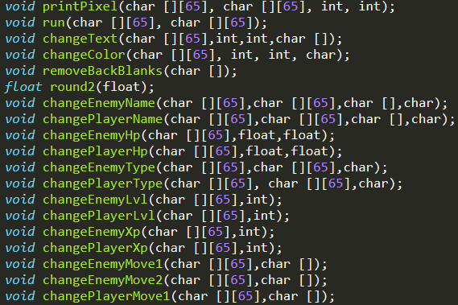
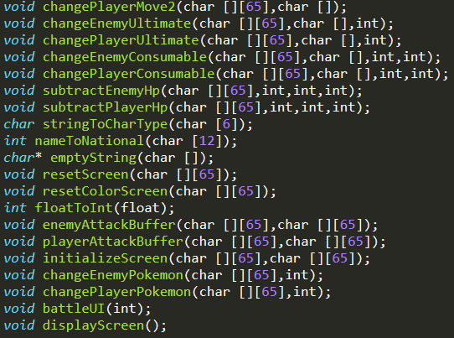
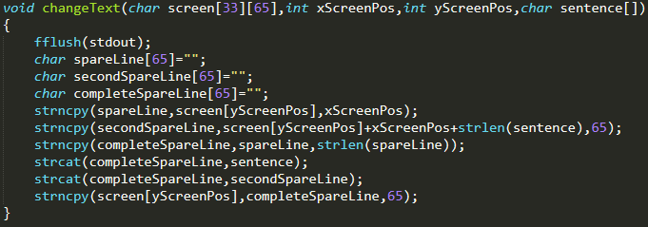
BattleUI Supporting Functions
Author: Vince Tran
Revolved around changing the screens
Functions for each part of the screen
Mainly string and array manipulation
https://www.tutorialspoint.com/c-program-to-convert-a-number-to-a-string
https://stackoverflow.com/questions/16645583/how-to-copy-a-char-array-in-c

Slide 6
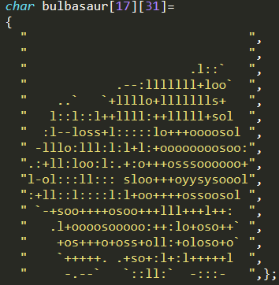
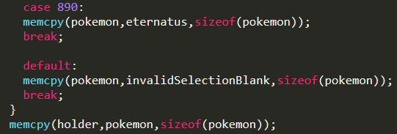
PokeFiles Ascii Art
Author: Vince Tran
Derived from https://pokemondb.net/
Took their images and ran it through several programs
Jpg->Ascii->Formatting->Array
BattleUI accessed these ascii images with a memcpy function
https://www.text-image.com/convert/ascii.html
http://www.unit-conversion.info/texttools/replace-text/

Slide 7
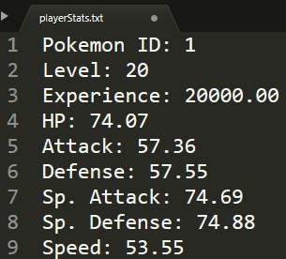
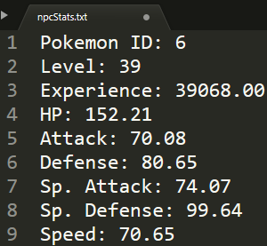
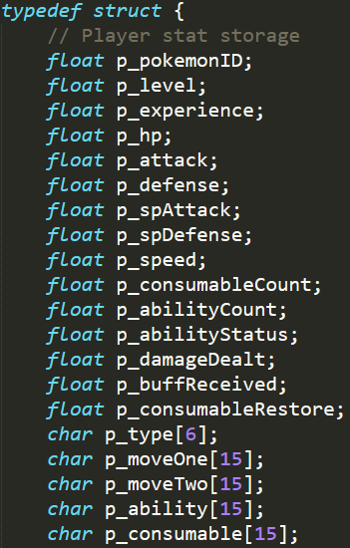



Combat Scenario Concept
Author: Colton Van Orsdel
Default stats saved in individual files
Combat stats in global struct
Stat Implementation
HP/Attack/Defense/Speed
Live-updating in battleUI
Varied Battles
Pokemon choices/types
Level-ups and modifiers
Moves & Consumables
Varied effects & strengths
Attack; special; ability; consumable
“Smart” opponent
Pseudo-random weighted choice
Move-choice menu integrated into UI display
Varied ability effects & uses

Slide 8
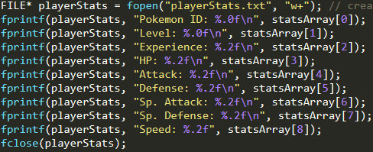
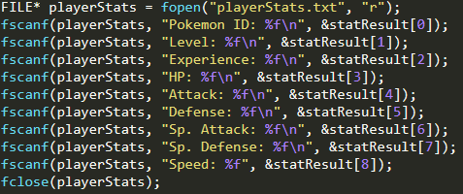
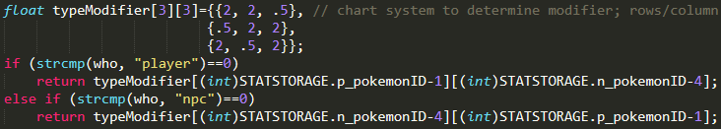
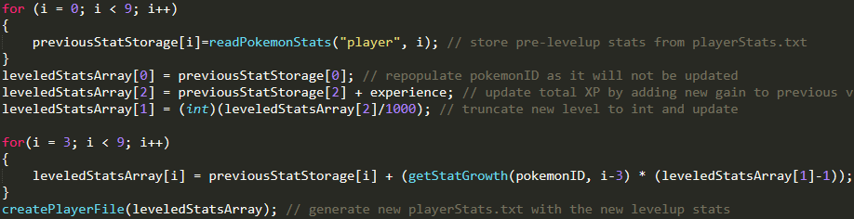
Combat Scenario Supporting Functions
Author: Colton Van Orsdel
Writing to text files
Reading from text files
Stat Generation & Storage
File I/O default stat storage
generate, read, level-up
Type-Specific Features
Effectiveness modifier
Varied abilities & stats
Level-up
Modify stat files directly
Introduces new features
Damage Calculation
Actual Pokemon formula
Implements stats & modfiers
Grid-system to determine modifier
Updating text files with leveled stats (post-generation)
Pokemon Damage Formula:

Slide 9
References

