Slide 1
tips for instructors in adapting Maker Lab methods
This document was developed as part of a collection to support open-inquiry physical science experiments in Bachelor's level lab courses, and published with a Creative Commons Attribution-NonCommercial-ShareAlike 4.0 International License. Everyone is free to reuse or adapt the materials under the conditions that they give appropriate attribution, do not use them nor derivatives of them for commercial purposes, and that any distributed or re-published adaptations are given the same Creative Commons License.
Freek Pols (https://orcid.org/0000-0002-4690-6460) helped with the conception and development of these materials.
Forrest Bradbury (https://orcid.org/0000-0001-8412-4091) of Amsterdam University College is responsible for this material and can be reached by email: forrestbradbury ("AT") gmail.com .
The full and up-to-date set of materials can be found in this GITHUB repository: https://github.com/forrestbradbury/MakerLab

Slide 2
outline: tips for instructors
purpose
motivation
two example course/project schedules
necessary materials & logistics
checklist for good open inquiry topics
safety and ethics in open inquiries
guiding students’ open inquiries
peer interaction & feedback during open inquiries
suggested extras: guest lectures, excursions, online videos

Slide 3
purpose
This collection of materials supports open-inquiry physical science experiments in Bachelor's level lab courses.
Their open-source publication has been expedited because they serve as a model for pandemic-resilient science labs (https://arxiv.org/abs/2006.06881).
Most of the materials have been written as Jupyter Notebook documents and other text-based formats, lending themselves to further collaborative development, adaptation, and expansion within this git repository: https://github.com/forrestbradbury/MakerLab

Slide 4
motivation
Flipped-lab open-inquiry methods support:
  Students’ sense of ownership and responsibility
  Students’ critical engagement with the empirical research process
  Students’ appreciation for the scientific method
Leveraging the Maker movement’s tools and resources allows for:
  Student independence (ubiquitous online resources help guide their work)
  Huge variety of sensors to suit interests & skill levels (including modern solid-state and MEMS technologies)
  Safe and inexpensive tools suitable for experimenting without supervision
  Open-source code for transparent measurements (not a “black-box”)
  Empowerment and lowering barriers to authentic experimental scientific research

Slide 5
two example course/project schedules
Full course (~168 student work hours)
  This was piloted at Amsterdam University College in spring semester 2020
Short course component (55-80 student work hours)
  Shorter open-inquiry projects may be suitable for upper-level lab courses, especially when students are already familiar with some of the relevant skills

Slide 6

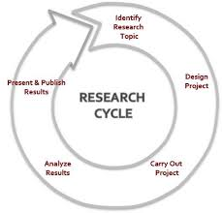
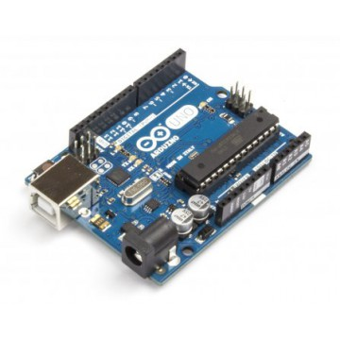
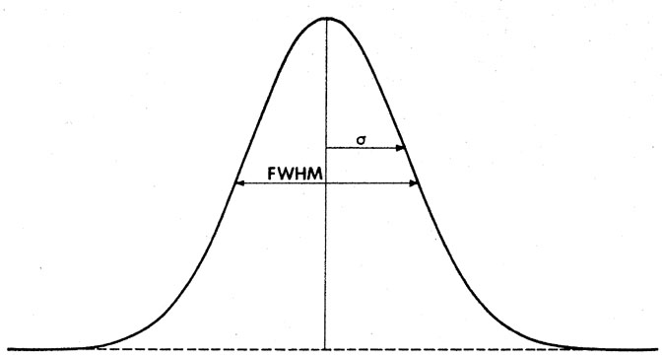
schedule for full course (~168 student work hours)
The original Maker Lab course is an extensive full semester course.
The repository’s Lecture Notes & Structured Experiments (in Jupyter Notebook) and some of the videos support the initial “skills training” phase.
Besides other repository materials, the subsequent slides also give tips for the open inquiry phases. Additionally, a full example schedule is given in the “AUC_course_manual” document.
skills training
via structured inquiries
1st open inquiry
with individual team meetings
2nd open inquiry
with individual team meetings
– go/no go “pre-proposal”
– go/no go “pre-proposal”
– final presentation (video)
– final presentation (video?)
– midway report
– midway report
uncertainty analysis
Pre-recorded videos are highly recommended for the final presentations because they allow students to become science ambassadors through sharing their projects with the wider world – sparking discussions about science and the scientific method.

Slide 7
schedule short course component (55-80 student work hours)
A shorter variant with a single open-inquiry project will need to skip materials in this repository – depending on what skills students already possess.
The repository’s Structured Experiments (in Jupyter Notebook) will likely need to be combined and shortened or completely re-invented using sensors and experiments more appropriate to the course.
Besides other repository materials, the subsequent slides also give tips for the open inquiry phases. Additionally, a full example schedule is given in the “short_open_inquiry” document.
skills training
via structured inquiry
open inquiry
with individual team meetings
– go/no go “pre-proposal”
– final presentation (video)
– midway report
Pre-recorded videos are highly recommended for the final presentations because they allow students to become science ambassadors through sharing their projects with the wider world – sparking discussions about science and the scientific method.

Slide 8
necessary materials & logistics
While leveraging the Maker movement allows for considerable self-sufficiency, students obviously must have supplies on hand in advance of performing their experiments.
  Instructors should therefore make some general decisions ahead of time about the scope & flexibility of the projects and purchase necessary supplies.
  Will students need to be sent (or even asked to order) a full set of Maker tools & sensors? Or, will students be able to visit campus where a more basic set can be supplemented as needed?
This repository includes a spreadsheet with options for sets of Maker tools & sensors, including ideas for intermediate and advanced level materials.

Slide 9
checklist for good open inquiry topics
Safety & Ethics | Have students considered all relevant safety and ethical issues? If there are concerns, have they been thoroughly addressed?
Science or Demonstration? | Do they have a scientific research question? Sometimes students just get excited to invent something or demonstrate a particular scientific concept without thinking about how measurement might be involved. While some invention/demonstration projects might be allowable (as measurement is involved to quantify the limits of their contraption’s abilities), students should be strongly cautioned that these are in fact risky double-projects: they must first successfully build their contraption before starting to measure its capabilities. There is significant gray area here and it’s up to the course instructor to draw the lines.
Suitable topic? | Each course should impose its own limitations on topic suitability. For example, either the methods or the studied scientific relation might have to involve concepts beyond those learned in high school.
Scientific evidence | Do students understand what their proposed sensor measures, and precisely how that measured quantity might answer their research question?
Background knowledge | Are there critical gaps in their scientific or mathematical knowledge?
Feasibility (practical) | Have students identified all necessary supplies? If not in hand, will they arrive far in advance of midway report?
Feasibility (theoretical) | Is estimated measurement uncertainty lower than estimated effect size? Are these estimates reasonable?
Next steps:
  Specific advice should be given for any insufficient categories above.
  At this stage, students’ details of the statistical / mathematical models and data analysis steps will likely be rough. They should be encouraged to report full details by the midway report (and already fully analyze all data they’ve collected by that point).

Slide 10
safety and ethics in open inquiries
Course coordinators and/or lab technicians should help TA’s with assessing pre-proposals, and make sure to look at the safety and ethical concerns.
Many sensors can provide biological data (EKG boards for example), which must be treated with care and confidentiality.
Further, while the Arduinos and most sensors are not dangerous themselves, the students’ proposed experimental plans might be. As an example: the pilot Maker Lab course at AUC involved a hospital trip & surgical operation for a student project participant when a household object being used in the experiment rolled off a table onto a bare toe.
Students must be told to read all usage-safety documentation for the equipment they use – even if they are just incorporating their own household objects.
The response to students’ pre-proposals is essentially a go/no-go on their initial plans.
For unsupervised experimental work, the final responsibility rests with the students. Both student researchers and any participants should feel enabled to stop experiments at any time if they have concerns involving safety or ethics. For these reasons, it’s critically important to foster a safety-conscious culture within the class. Instructors without experience in potentially hazardous research work should consider taking part in trainings. And, experiments involving human subjects my require prior permission from the university’s ethical review board.

Slide 11
guiding students’ open inquiries
The previous skills-building phase includes exercises/materials for training in the empirical research process:
  Two (or more) synchronous group brain-storming sessions help students share ideas and instructors share expectations
  Semi-structured experiments involve different ways to measure the same quantity with differing uncertainties, thus fostering comparative design thinking because different experimental designs have consequences for the quality of scientific evidence
  The “Empirical Research Process” Jupyter Notebook document shows the full arc & iterative nature of experimental research (as originally described by Carl Wieman in “Comparative cognitive task analyses of experimental science and instructional laboratory courses”, Phys. Teach. 53, 349 (2015).)
During the open-inquiry phase, Freek Pols (https://orcid.org/0000-0002-4690-6460) likes to ask three questions:
  Are you sure?
  Is that an assumption?
  How might you (experimentally) validate it?
Besides listening to their progress updates, ideas, and plans, and repeatedly asking Freek’s Socratic questions, it is important to have structured & scheduled project meetings, milestones, deliverables, and feedback. Examples can be found in the “AUC Maker Lab course manual” and “short Maker Lab component” documents.
Individual meetings between instructors/TAs and the project teams constitute the main contact time during the open-inquiry phase. Tips for these meetings include:
  ~30 minutes each (20 minute minimum), ideally constituting ~10% of total student work time during open-inquiry phase
  Can combine two project teams in longer meetings early on (especially if topics overlap), as they can learn from each other
  Both/all project team members must be present
  Virtual meetings are a good substitute, and sometimes even preferable when students need to demonstrate their experimental setup which is built up at their homes
  Additional meeting times should ideally be available upon request
  Instructors play a supportive instead of a directive role in these meetings, like a helpful research group leader. Students appreciate the help and attention – even if they might initially find it difficult to explain details of their ideas and results.

Slide 12
peer interaction & feedback during open inquiries
Due to the pandemic measures, AUC’s pilot Maker Lab course’s only synchronous group peer feedback activities during the open-inquiry phases included some early brainstorming sessions and a final session with a couple real-time student presentations. The students reported a desire for more synchronous interaction with their peers (beyond their teams). The flipped-lab structure can easily accommodate such peer interactions so long as synchronous group activities are possible (online or in-person). The following could be conducted for each open inquiry project.
Early brainstorming sessions
Short informal pitches and peer Q&A prior to the Pre-proposal deadline
Options at Midway point where teams present their initial proof-of-concept results and further plans:
  Short informal progress updates (including also images of experimental setup) and peer Q&A prior to Midway report deadline
  In-person Midway presentations
Short informal presentations of results (two slides including most important figure(s) and uncertainty budget table) and peer Q&A prior to the Final presentation deadline
Final session with highlight reel from student videos (or, if in-person, their experimental demonstrations?)
Simple ways to increase peer feedback include requiring that all student audience members share one question and one suggestion for each of the presenters (in-person on a small notecard, or online via the group chat).

Slide 13
suggested extras
A flipped-classroom approach allows more flexible use of contact time. The first two ideas are suggested synchronous activities. The suggested online videos can be shared asynchronously.
guest lecture by local researcher using Maker materials
excursion to local Maker space
suggested online videos (links in the repository) :
  Forrest Bradbury’s lectures on electronic sensors
  Thierry Slot’s bubble counter lectures
  Noisebridge Hackerspace documentary / virtual tour

