Slide 1
Mocking & Moq Framework
Forrest Coward

Slide 2
Why use mocks?
A Mock object is a simulated object that mimics the behavior of real objects in controlled ways
Mocks are used during testing to control program output and isolate the system under test
Objects that are mocked usually have the following properties:
non-deterministic (e.g. get the current time)
contains or produces state that is difficult to reproduce (e.g. a network error)
is slow or unreliable
requires access to resources other than memory

Slide 3
Mock Frameworks: Advantages
You do not need to write your own mock classes!
Never create another mock class or add logic to an existing one because you want slightly different behavior
With hand rolled mocks, you end up with a large test classes with lots of static state or constructor parameters so tests can controller the test behavior
The mock is closer to the test code because it is the test code
Less boilerplate: only mock methods you need, right in your test
Easier verification: automatically verify method invocations
Better refactoring: if you add a method to an interface, you will not break your test project, and you do need to update test implementations

Slide 4
Mock Frameworks: Disadvantages
Yet another framework to learn…
If you over mock, your tests become fragile, or even useless
Mock across significant architecture boundaries, but not within those boundaries
Interface explosion
May promote close coupling to internals
Still must write setup code for mocks
This can become similar to a testing implementation
Mocks are another tool: they can both help and hurt you

Slide 5
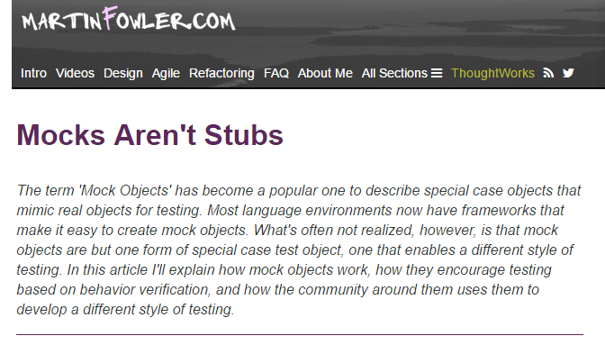
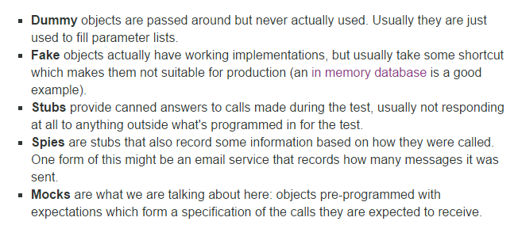
Aside: Mocks versus Stubs
Terminology is confusing: mocks, fakes, stubs, dummies, spies
These distinctions are usually not that important in practice

Slide 6
Moq Framework for .NET
https://github.com/Moq/moq4
The most popular and ‘friendly’ mocking framework for .NET
Moq is the only testing package listed on the top 100 downloaded Nuget packages
5500 average downloads per day
66 pages of search results for Microsoft projects using Moq on GitHub: https://github.com/search?utf8=%E2%9C%93&q=org%3Amicrosoft+moq&type=Code
.NET, Azure, VSTS all are using Moq on many projects
The library was created mainly for developers who aren't currently using any mocking library, and who are typically manually writing their own mocks
Practical, unobtrusive and straight-forward way to quickly setup dependencies for your tests

Slide 7
Moq Framework: Can Only Mock Interfaces
Not Microsoft Fakes: cannot mock out some random System assembly
Using Moq in legacy code can be difficult or require lots of refactoring
Forces developers to use dependency injection
Objects should be passed their dependencies (which are interfaces)
For System.File.IO, must write an interface that wraps it if you want to mock it
Notes:
Dependency injection is one form of the broader technique of inversion of control. Rather than low level code calling up to high level code, high level code can receive lower level code that it can call down to. This inverts the typical control pattern seen in procedural programming.
As with other forms of inversion of control, dependency injection supports the dependency inversion principle. The client delegates the responsibility of providing its dependencies to external code (the injector). The client is not allowed to call the injector code

Slide 8
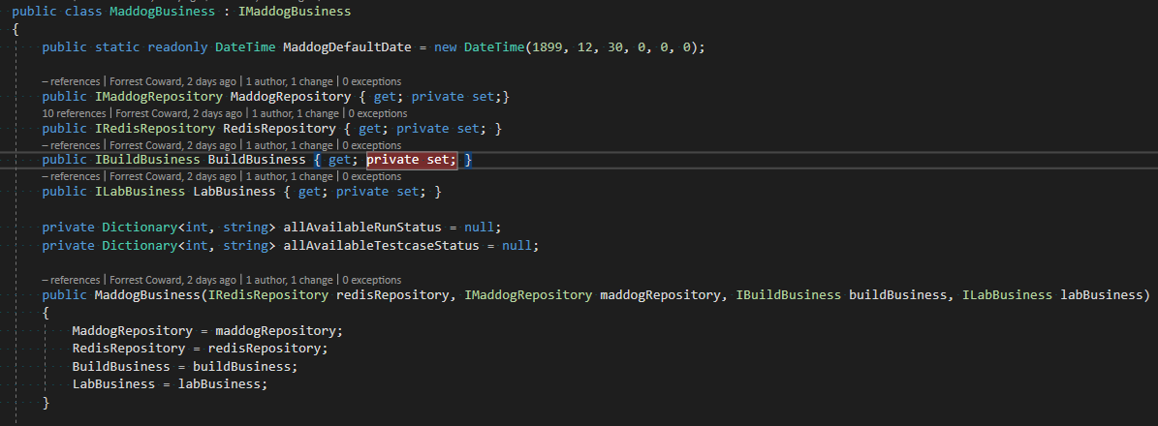
D.I. Example One

Slide 9
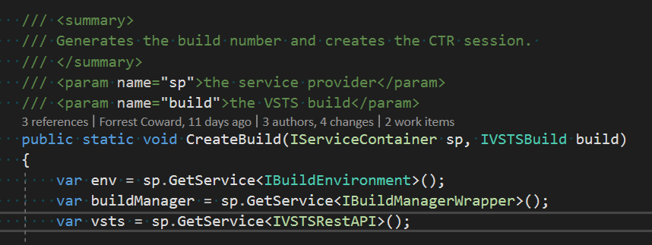
D.I. Example Two

Slide 10
public interface IFoo
{
Bar Bar { get; set; }
string Name { get; set; }
int Value { get; set; }
bool DoSomething(string value);
bool DoSomething(int number, string value);
string DoSomethingStringy(string value);
bool TryParse(string value, out string s);
bool Submit(ref Bar bar);
int GetCount();
bool Add(int value);
}
public class Bar
{
public virtual Baz Baz { get; set; }
public virtual bool Submit() { return false; }
}
public class Baz
{
public virtual string Name { get; set; }
}
Mocking Methods
var mock = new Mock<IFoo>();
// Calling DoSomething with “ping” returns true.
mock.Setup(foo => foo.DoSomething("ping")).Returns(true);
// Out arguments.
var outString = "ack";
// Calling TryParse with “ping” will return true, and the out argument will return "ack", lazy evaluated.
mock.Setup(foo => foo.TryParse("ping", out outString)).Returns(true);
// Ref arguments.
var instance = new Bar();
// Only match if the ref argument to invocation is the same instance.
mock.Setup(foo => foo.Submit(ref instance)).Returns(true);
// Access the underlying object.
var fooObject = mock.Object;
Moq Examples

Slide 11
public interface IFoo
{
Bar Bar { get; set; }
string Name { get; set; }
int Value { get; set; }
bool DoSomething(string value);
bool DoSomething(int number, string value);
string DoSomethingStringy(string value);
bool TryParse(string value, out string s);
bool Submit(ref Bar bar);
int GetCount();
bool Add(int value);
}
public class Bar
{
public virtual Baz Baz { get; set; }
public virtual bool Submit() { return false; }
}
public class Baz
{
public virtual string Name { get; set; }
}
Throwing Exceptions
var mock = new Mock<IFoo>();
// Throwing when invoked with specific parameters.
mock.Setup(foo => foo.DoSomething("reset")).Throws<InvalidOperationException>();
mock.Setup(foo => foo.DoSomething("")).Throws(new ArgumentException("command"));
Returning Different Values Per Invocation
var calls = 0;
mock.Setup(foo => foo.GetCount())
.Returns(() => calls)
.Callback(() => calls++);
// Returns 0 on first invocation, 1 on the next, and so on.
Console.WriteLine(mock.Object.GetCount());
Lazy Return Values
// Lazy evaluating return value.
var count = 1;
mock.Setup(foo => foo.GetCount()).Returns(() => count);
Moq Examples

Slide 12
public interface IFoo
{
Bar Bar { get; set; }
string Name { get; set; }
int Value { get; set; }
bool DoSomething(string value);
bool DoSomething(int number, string value);
string DoSomethingStringy(string value);
bool TryParse(string value, out string s);
bool Submit(ref Bar bar);
int GetCount();
bool Add(int value);
}
public class Bar
{
public virtual Baz Baz { get; set; }
public virtual bool Submit() { return false; }
}
public class Baz
{
public virtual string Name { get; set; }
}
Argument Matching
var mock = new Mock<IFoo>();
// Any value
mock.Setup(foo => foo.DoSomething(It.IsAny<string>())).Returns(true);
// Matching Func<int>, lazy evaluated.
mock.Setup(foo => foo.Add(It.Is<int>(i => i % 2 == 0))).Returns(true);
// Matching ranges.
mock.Setup(foo => foo.Add(It.IsInRange<int>(0, 10, Range.Inclusive))).Returns(true);
// Matching regex.
mock.Setup(x => x.DoSomethingStringy(It.IsRegex("[a-d]+", RegexOptions.IgnoreCase))).Returns("foo");
Matching can be applied to any and all arguments.
Moq Examples

Slide 13
public interface IFoo
{
Bar Bar { get; set; }
string Name { get; set; }
int Value { get; set; }
bool DoSomething(string value);
bool DoSomething(int number, string value);
string DoSomethingStringy(string value);
bool TryParse(string value, out string s);
bool Submit(ref Bar bar);
int GetCount();
bool Add(int value);
}
public class Bar
{
public virtual Baz Baz { get; set; }
public virtual bool Submit() { return false; }
}
public class Baz
{
public virtual string Name { get; set; }
}
Mocking Properties
// Mock a get. Same thing.
mock.Setup(foo => foo.Name).Returns("bar");
mock.SetupGet(foo => foo.Name).Returns("bar");
mock.SetupProperty(foo => foo.Name, "bar");
// Mock a set.
string setValue;
mock.SetupSet(foo => foo.Name = It.IsAny<string>()).Callback<string>(value => setValue = value);
// Auto-mocking hierarchies (a.k.a. recursive mocks).
mock.Setup(foo => foo.Bar.Baz.Name).Returns("baz");
// Start "tracking" sets/gets to this property for verification later.
mock.SetupGet(f => f.Name);
Moq Examples
Notes:
If you are trying to mock a Readonly property, you have to use SetupGet as SetupProperty doesn't work in that case. Whereas SetupProperty can be used for non readonly properties if you want to set expectation.

Slide 14
public interface IFoo
{
Bar Bar { get; set; }
string Name { get; set; }
int Value { get; set; }
bool DoSomething(string value);
bool DoSomething(int number, string value);
string DoSomethingStringy(string value);
bool TryParse(string value, out string s);
bool Submit(ref Bar bar);
int GetCount();
bool Add(int value);
}
public class Bar
{
public virtual Baz Baz { get; set; }
public virtual bool Submit() { return false; }
}
public class Baz
{
public virtual string Name { get; set; }
}
Using Callbacks
var mock = new Mock<IFoo>();
var calls = 0;
var callArgs = new List<string>();
mock.Setup(foo => foo.DoSomething("ping"))
.Returns(true)
.Callback(() => calls++);
// Access invocation arguments.
mock.Setup(foo => foo.DoSomething(It.IsAny<string>()))
.Returns(true)
.Callback((string s) => callArgs.Add(s));
// Alternate equivalent generic method syntax.
mock.Setup(foo => foo.DoSomething(It.IsAny<string>()))
.Returns(true)
.Callback<string>(s => callArgs.Add(s));
// Access arguments for methods with multiple parameters.
mock.Setup(foo => foo.DoSomething(It.IsAny<int>(), It.IsAny<string>()))
.Returns(true)
.Callback<int, string>((i, s) => callArgs.Add(s));
// Callbacks can be specified before and after invocation.
mock.Setup(foo => foo.DoSomething("ping"))
.Callback(() => Console.WriteLine("Before returns"))
.Returns(true)
.Callback(() => Console.WriteLine("After returns"));
}
}
Moq Examples

Slide 15
public interface IFoo
{
Bar Bar { get; set; }
string Name { get; set; }
int Value { get; set; }
bool DoSomething(string value);
bool DoSomething(int number, string value);
string DoSomethingStringy(string value);
bool TryParse(string value, out string s);
bool Submit(ref Bar bar);
int GetCount();
bool Add(int value);
}
public class Bar
{
public virtual Baz Baz { get; set; }
public virtual bool Submit() { return false; }
}
public class Baz
{
public virtual string Name { get; set; }
}
Method & Property Verification
var mock = new Mock<IFoo>();
mock.Verify(foo => foo.DoSomething("ping"));
// Verify with custom error message for failure.
mock.Verify(foo => foo.DoSomething("ping"), "When doing operation X, the service should be pinged always");
// Method should never be called.
mock.Verify(foo => foo.DoSomething("ping"), Times.Never());
// Called at least once, with argument matcher.
mock.Verify(foo => foo.DoSomething(It.Is<string>(x => x.StartsWith("p"))), Times.AtLeastOnce());
// Called a variable amount of times.
mock.Verify(foo => foo.DoSomething("ping"), Times.Exactly(3));
// Verify getter invocation was read between 2 and 5 times, regardless of value.
mock.VerifyGet(foo => foo.Name, Times.Between(2, 5, Range.Exclusive));
// Verify setter called with specific value.
mock.VerifySet(foo => foo.Name = "foo");
// Verify setter with an argument matcher.
mock.VerifySet(foo => foo.Value = It.IsInRange(1, 5, Range.Inclusive));
Moq Examples
Notes:
Will throw an exception if the verify fails.

Slide 16
Strict vs. Loose Mocks
var mock = new Mock<IFoo>(MockBehavior.Strict);
// Default.
var mock = new Mock<IFoo>(MockBehavior.Loose);
“Strict”: Raises an exceptions for anything that doesn't have a corresponding expectation
Default is “Loose”: never throws and returns default values or empty arrays, enumerables, etc. if no expectation is set for a member

Slide 17
Warning: Close Coupling to Internals
Is it really important you called method X five times?
If a change is made to called method X an additional time, your test will break.
If it does not alter the test outcome, then you probably should not verify it
Everything about Moq promotes white box testing. You have to know what to mock (loose mocking is nice here), and sometimes which parameters to pass.
Notes:
Taken to extreme: can make sure every method in the method you are testing is called the exact amount of times. This makes it impossible to change the method without breaking the test.

Slide 18
Other Moq Features
Can mock Events and raising Events
Linq2Mock
Multiple interface mocks
Mock repositories and mock discovery

Slide 19
At the end of the day…
Moq helps you quickly set up and verify mock objects for your test suite without lots of extra test code
Moq promotes good design practices through dependency injection and decoupling of concerns
Moq makes refactoring easier

