Slide 1
Starcraft 2 Overview
Popular real time strategy game developed by Blizzard Entertainment
In its primary game mode, two players compete against one another
A match consists of players gathering resources and commanding units with goal of crushing opponent
Based on a players performance, they are placed into one of seven leagues

Slide 2
Starcraft 2 League Overview
League | Class | Percent of Players
Bronze | 1 | 8%
Silver | 2 | 20%
Gold | 3 | 32%
Platinum | 4 | 20%
Diamond | 5 | 18%
Master | 6 | 2%
Grandmaster (GM) | 7 | 200 players
Note: Leagues are not fixed. Players can be promoted/demoted with good/bad play.

Slide 3
Task:
Given a Starcraft 2 Replay file, predict the league of both of the players
Each replay is 2 data points, one for each player.
Data Set: 135 data points from each league

Slide 4
Parsing Replays
Replays were parsed for features using SC2Reader: https://github.com/graylinkim/sc2reader
Replays were gathered in bulk from drop.sc: http://drop.sc

Slide 5
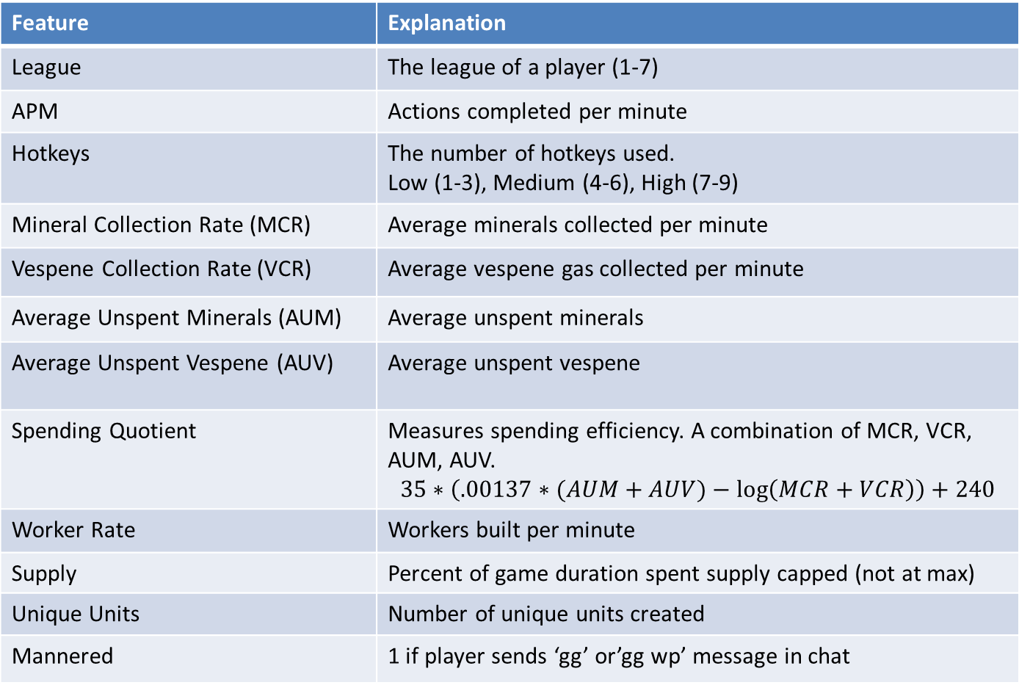
Selected Features
Feature | Explanation
League | The league of a player (1-7)
APM | Actions completed per minute
Hotkeys | The number of hotkeys used. Low (1-3), Medium (4-6), High (7-9)
Mineral Collection Rate (MCR) | Average minerals collected per minute
Vespene Collection Rate (VCR) | Average vespene gas collected per minute
Average Unspent Minerals (AUM) | Average unspent minerals
Average Unspent Vespene (AUV) | Average unspent vespene
Spending Quotient | Measures spending efficiency. A combination of MCR, VCR, AUM, AUV. $$35∗\left(.00137∗(AUM+AUV)−\log\left(MCR+VCR\right)\right)+240$$
Worker Rate | Workers built per minute
Supply | Percent of game duration spent supply capped (not at max)
Unique Units | Number of unique units created
Mannered | 1 if player sends ‘gg’ or’gg wp’ message in chat

Slide 6
Average Feature Values vs. League
 | Bronze | Silver | Gold | Platinum | Diamond | Master | GM
APM | 42.7 | 53.8 | 70.8 | 77.3 | 103.7 | 128.2 | 156.8
Hotkeys | 1.9 | 2.6 | 3.2 | 3.3 | 3.9 | 4.9 | 5.6
Minimap | 14.8 | 29.8 | 33.5 | 37.8 | 49.5 | 59.6 | 66.7
MCR | 719 | 823 | 902 | 931 | 993 | 1033 | 1030
VCR | 209 | 223 | 253 | 258 | 282 | 294 | 289
UM | 1074 | 902 | 860 | 730 | 654 | 540 | 412
UV | 515 | 461 | 445 | 415 | 338 | 370 | 313
SQ | 35.6 | 46.1 | 53.6 | 58.7 | 66.2 | 73.8 | 81.3
Workers | 2.12 | 2.64 | 2.81 | 3.15 | 3.46 | 2.62 | 3.75
Supply | 8.30 | 8.08 | 8.50 | 7.76 | 7.82 | 7.43 | 6.77
Unique | 6.54 | 6.55 | 6.92 | 7.14 | 7.46 | 7.68 | 7.72
Manner | .10 | .14 | .18 | .17 | .15 | .15 | .14

Slide 7
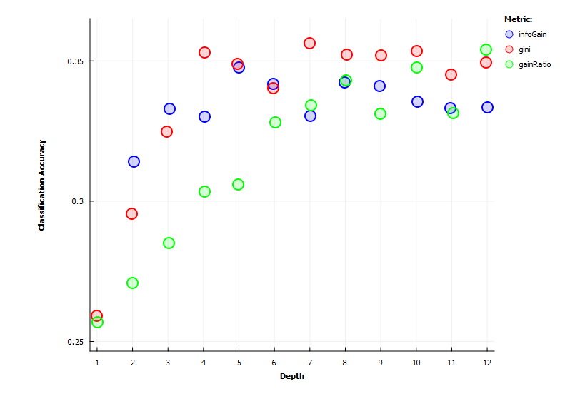
Accuracy vs. Tree Depth for Different Split Metrics (5-Fold Cross Validation)

Slide 8
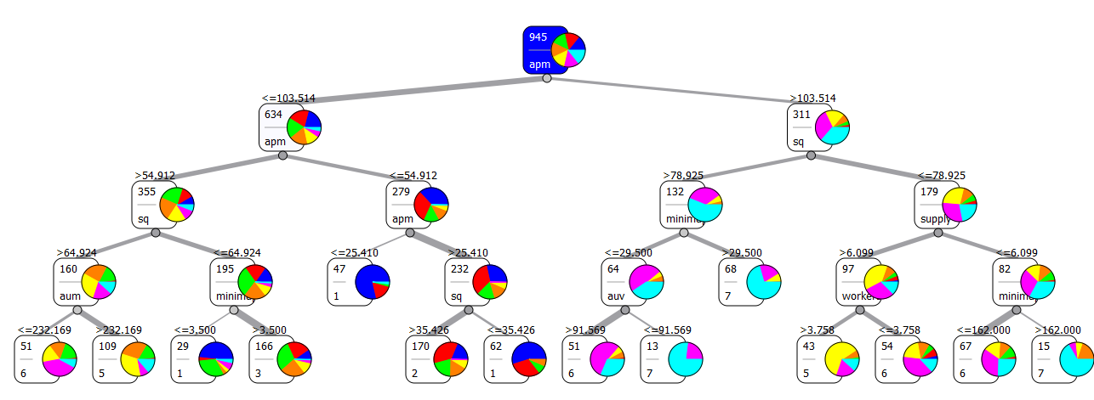
An Example Decision Tree
(Best discovered decision tree had depth 7 – did not fit on slide)
Gini index splitting with depth four and 5-fold cross validation
35% accuracy
74% accuracy within one league

Slide 9
Random Forests
Random Forest is an ensemble method that constructs many decision trees and outputs the class that is the mode of the classes output by the individual trees
Each individual tree is constructed using a random subset of the features
Parameters: # of trees, tree split metric, # of random attributes used per tree
Depth per tree is not fixed, keep splitting until no longer beneficial to do so.

Slide 10
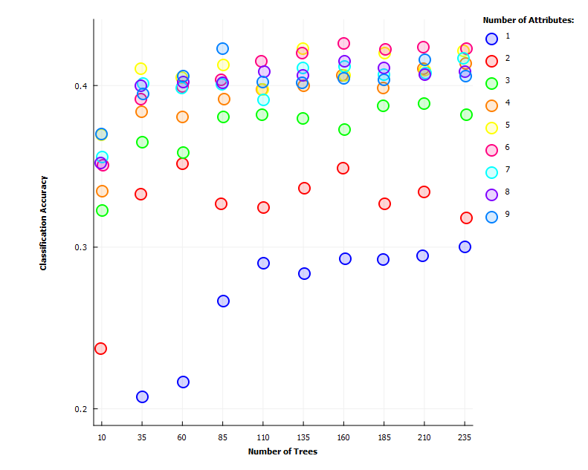
Accuracy vs. Number of Trees for Different Number of Randomly Selected Features Per Tree (Gini split , 5-Fold Cross Validation)

Slide 11
Feature Selection Using Random Forests
Feature | Score
APM | 7.36
SQ | 5.30
Minimap | .75
AUM | .74
MCR | .60
VCR | .51
Hotkeys | .50
Workers | .49
AUV | .41
Supply | .14
Unique | .01
Mannered | -.07
Basic idea: classification score decreases when an important feature is left out
Over many trees, we can rank which features give best classification results
Actions per minute and spending quotient (SQ) by far the best features
Top 4-5 features about as good as using them all

Slide 12
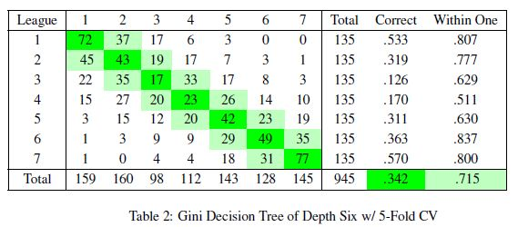
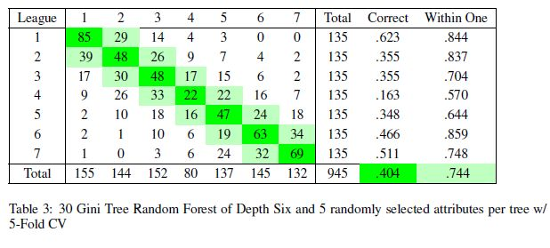
Typical Result Distributions
Note:
Actual league is on the left.
Prediction league is on the top.

Slide 13
Overall Results (All Using 5-Fold CV)
Method | Classification Accuracy | Classification Accuracy With Error of One League Allowed
Best Random Forest (trees: 160, split: gini, randomly selected features per tree:5) | 42.43% | 74.28%
Naïve Bayes | 37.25% | 71.74%
Linear SVM (complexity bound: .5, tolerance: .0015) | 37.57% | 78.09%
Best Decision Tree (depth:7, split: gini) | 35.87% | 70.89%
10-Nearest-Neighbor | 29.31% | 64.97%

Slide 14
Many Issues Modeling League as a Discrete Value
In reality, each player has a hidden match making rating (MMR) that represents a point on the continuous distribution of skill.
Leagues are a partitioning of MMR distribution.
MMR overlaps between leagues. For example, a high end silver player is better than a low end gold.
A players league is not their true skill.
A good player on a new account has high skill and low league. Takes a little bit for MMR to stabilize.

Slide 15
Discussion of Results
Best classification accuracy of ~42.5% achieved using random forests.
This seems bad, but is much better than 1/7
If we consider a correct classification as within one league of the correct league, then we get a classification accuracy of ~75%
Because of how MMR works, the within one league accuracy is likely a much better indication of a good classification

Slide 16
Discussion of Results Continued
Actions per minute (APM) and spending quotient (SQ) are the best predictors of skill out of the selected features
Intuitively this makes sense: these features are less likely to vary from game to game. For example, if two grandmaster players play, APM and SQ remain high, but other features may be nullified because both players are of similar skill.
SQ is a combination of MCR, VCR, AUM, AUV (none of which are great predictors). Displays the power of feature combination.

