Slide 1
Hierarchical Control for
Aircraft Electronic Power Systems
Forrest Iandola and Huy Vo
UC Berkeley, EE249 – Embedded Systems

Slide 2
Outline
Motivation
Aircraft Power Architecture
Introduction to Load Shedding
Low-Level Controller Ensures Safety
Optimization-based Controller
  Optimizes for minimal load shedding, minimal generator usage
Fusion of Optimal and Low-Level controllers
Results

Slide 3
Motivation
Make avionics power management smarter
By “smarter,” we mean:
Always preserve safety in airplane power systems
After preserving safety, maximize the quality of service
Use fewer generators when feasible

Slide 4








Aircraft Power System Architecture
Generator 1
Aux Power Unit
Generator 2
Controls / Load Management System
(The problem at hand)
Left Bus
Sheddable Loads
Left Bus
Non-Sheddable Loads
Right Bus
Sheddable Loads
Right Bus
Non-Sheddable Loads

Slide 5
Load Shedding
Two types of loads in airplane EPS
  Sheddable (e.g. cabin lights, kitchen, passengers’ laptops)
  Non-sheddable (navigation system, electronic actuators, other avionics systems)
Generators have a maximum power output
If loads require more power than generators can produce, EPS sheds some sheddable loads
  In practice, typically use a pre-assigned load shedding priority table

Slide 6
Low-Level LMS for Safety
Goal: preserve safety if workloads change or if generators fail
  Ensure that system is powered
  Shed loads to stay under power rating
Low-level controller directly applies priority tables for load shedding and generator selection
Low-level controller samples system at every timestep (e.g. 50ms of system time)
  Ensure that no non-sheddable load is unpowered for more than 50ms

Slide 7
Optimal Load Management System
Optimizes this objective function:
  Min( (sheddable loads) * weights + (generator selection) * weights + (number of generators used) )
Main goal: avoid shedding loads as much as possible
  Also balance costs from multiple priority tables
But, the optimization is somewhat computationally expensive
  0.5s in Matlab for ~10 timesteps on Intel 3930K 6-core processor
  Too time-consuming to run at every timesteps
[1] M. Maasoumy, P. Nuzzo, M. Kamgarpour, C. Tomlin, A. Sangiovanni-Vincentelli and M. Mozumdar, “OLMS: Optimal Load Management System for Aircraft Electric Power Distribution,” in press.

Slide 8
Optimal Load Management System
Embodies Model Predictive Control (MPC)
  The controller understands the system architecture
Receding horizon: periodically compute the optimization for a horizon of timesteps
[1] M. Maasoumy, P. Nuzzo, M. Kamgarpour, C. Tomlin, A. Sangiovanni-Vincentelli and M. Mozumdar, “OLMS: Optimal Load Management System for Aircraft Electric Power Distribution,” in press.

Slide 9




Hierarchical Control
Best of both worlds:
  Use an Optimal LMS to minimize load shedding
  Use a Low-Level LMS to preserve safety
High-Level Controller
(optimization)
Low-Level Controller
(BPCU)
Actuate!
Sensors
(generator failures,
Workloads)
Notes:
Huy starts talking here

Slide 10
Hierarchical Control
The high-level controller optimizes over a horizon, but the input data over the horizon is imperfect
If High-Level Controller’s configuration is unsafe due to stale data, revert to to Low-Level controller
High-Level Controller
(optimization)
Low-Level Controller
(BPCU)
Actuate!
Sensors
(generator failures,
workloads)

Slide 11
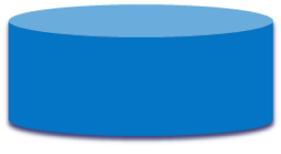
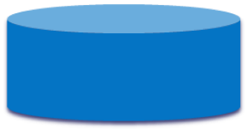






Simulation Design
Low-level controller checks that high-level controller’s configuration is not unsafe
High-level controller is triggered every n timesteps
Historical Workload
Actual Workload
Fast clock
High-Level Controller
(optimization)
Low-Level Controller
(BPCU)
Actuate!
Slow clock
Sensors
(generator failures,
workloads)

Slide 12
Experimentation
2 kinds of failure scenarios
  Generator failures
    Generators can spontaneously, HL-LMS can’t respond fast enough
  Unexpected power request on load
    Could have higher request than what HL-LMS expects

Slide 13
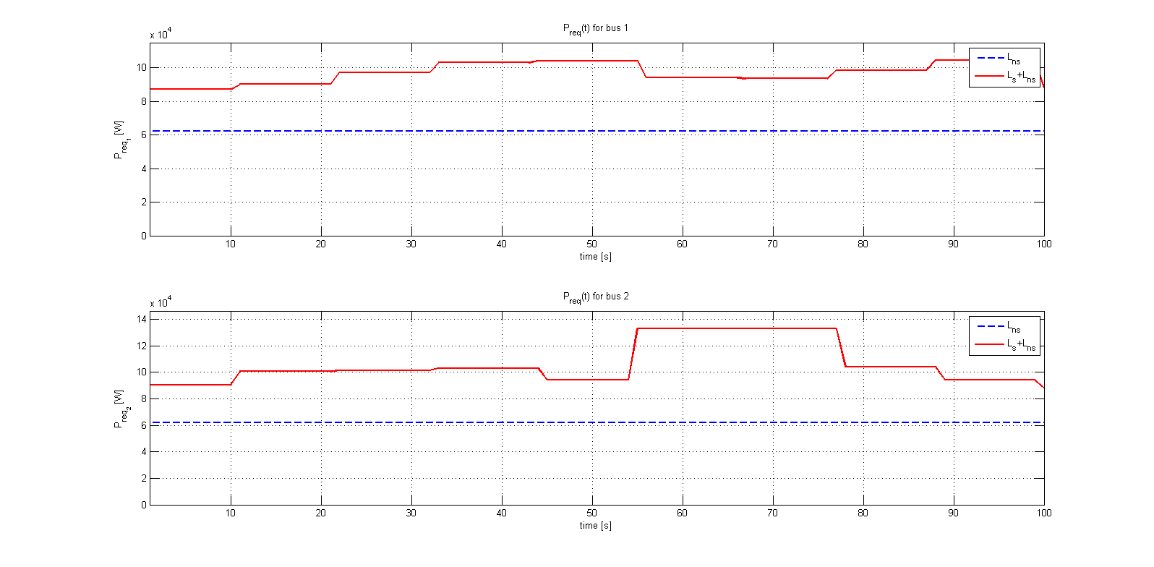
Modeling Power Request
Notes:
This is historical data of power requests
Notice the times when total request is over 100000W
Main generators are rated at 100000W so must load shed if consumption is over

Slide 14
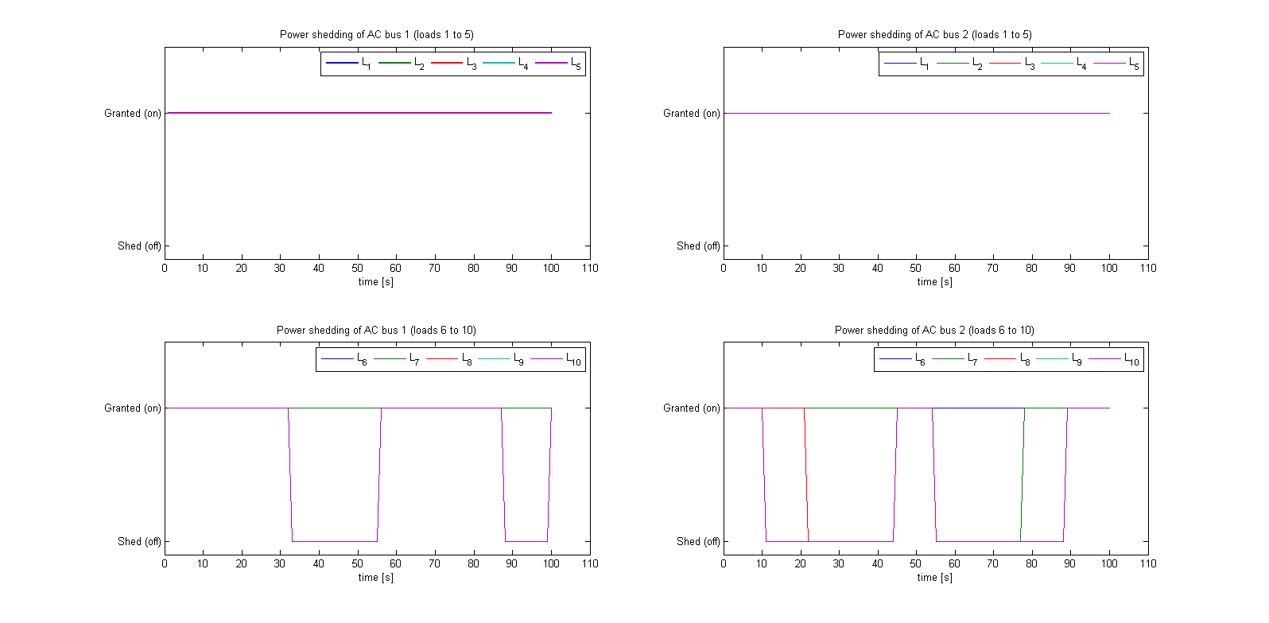
Load Shedding By Low Level LMS
Notes:
Low Level working in isolation
Sheds load according to its priority table
Notice that only loads 6-10 are shed
Quite a few loads are shedded

Slide 15
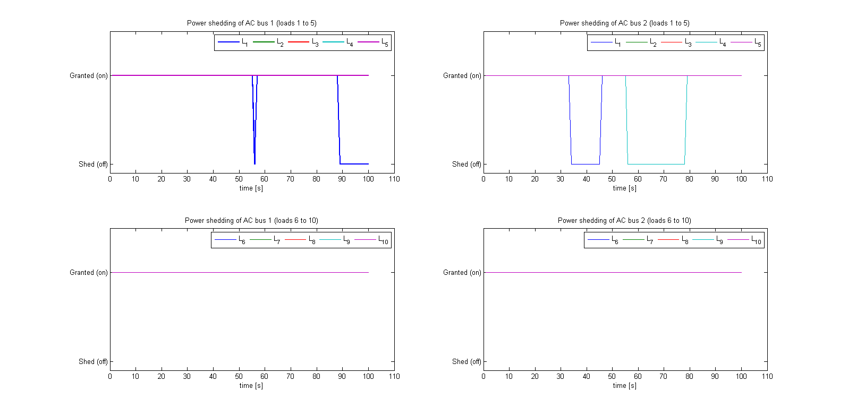
Load Shedding by Optimal LMS
Notes:
Load Shedding by the High Level system
Notice that much fewer loads are shed, but its shedding the higher priority ones
In particular, loads in the set 6-10 are not shed

Slide 16
Handling Generator Failures
Generator 2 fails at time=45
HL-LMS only runs every so often
  Because of the nature of the optimization problem
  Leaves the system in an unsafe state
Need LL-LMS
  Closely monitors the system
  Can correct for failures

Slide 17
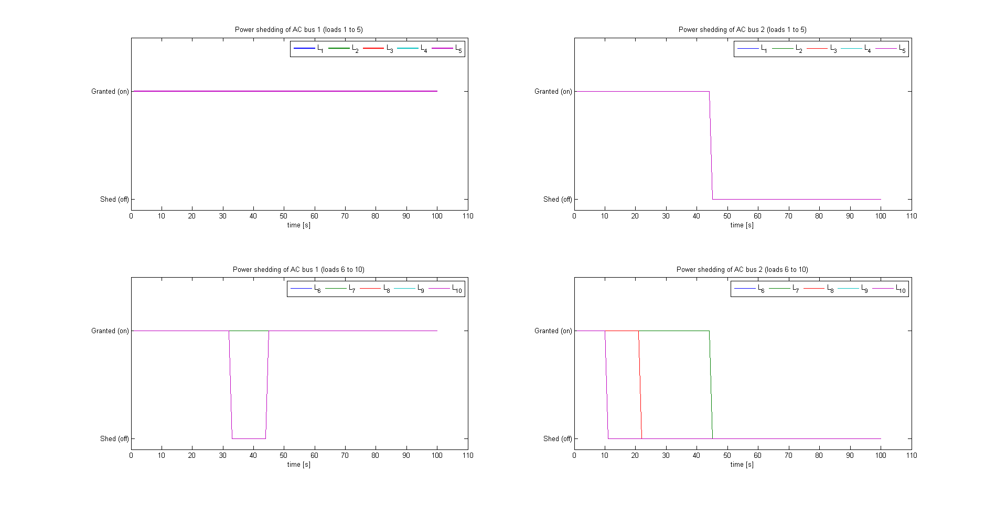
Handling Generator Failures – LL-LMS
Notes:
For the sake of comparison
LL-LMS in isolation
Notice the huge number of loads shed

Slide 18
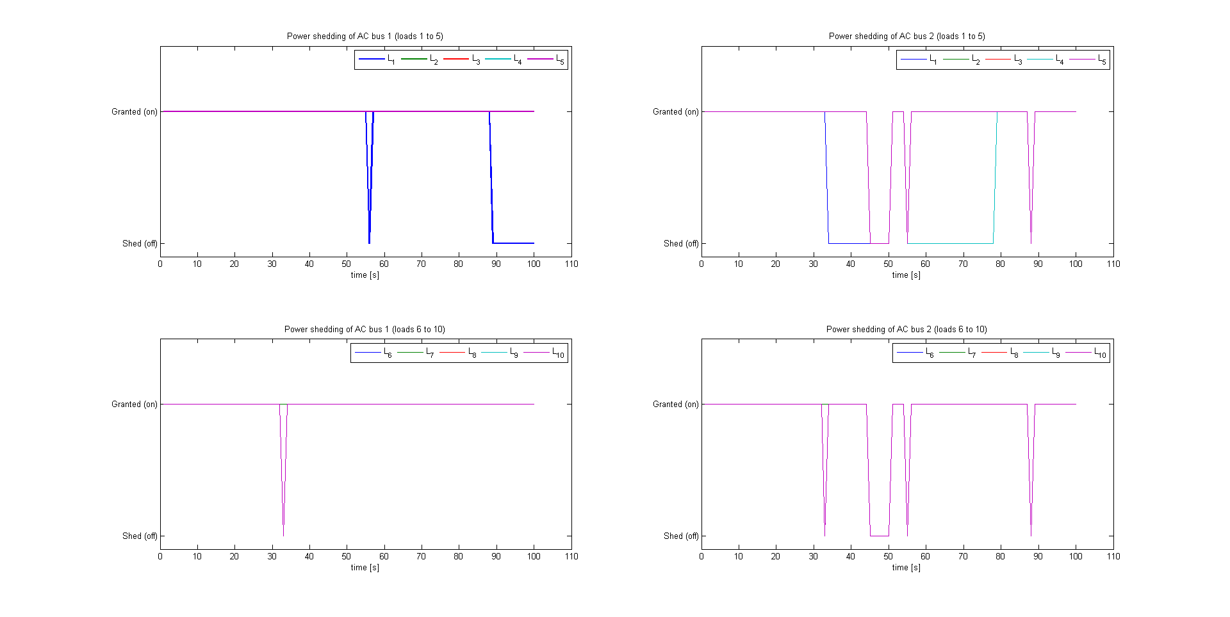
Handling Generator Failures – H-LMS

Slide 19
Perturbed Workloads
Recall
  O-LMS uses receding horizon optimization problem
  Difficult to program the O-LMS with live data
  This means O-LMS is oblivious to actual power usage
Solution
  Use LL-LMS to correct load shedding

Slide 20
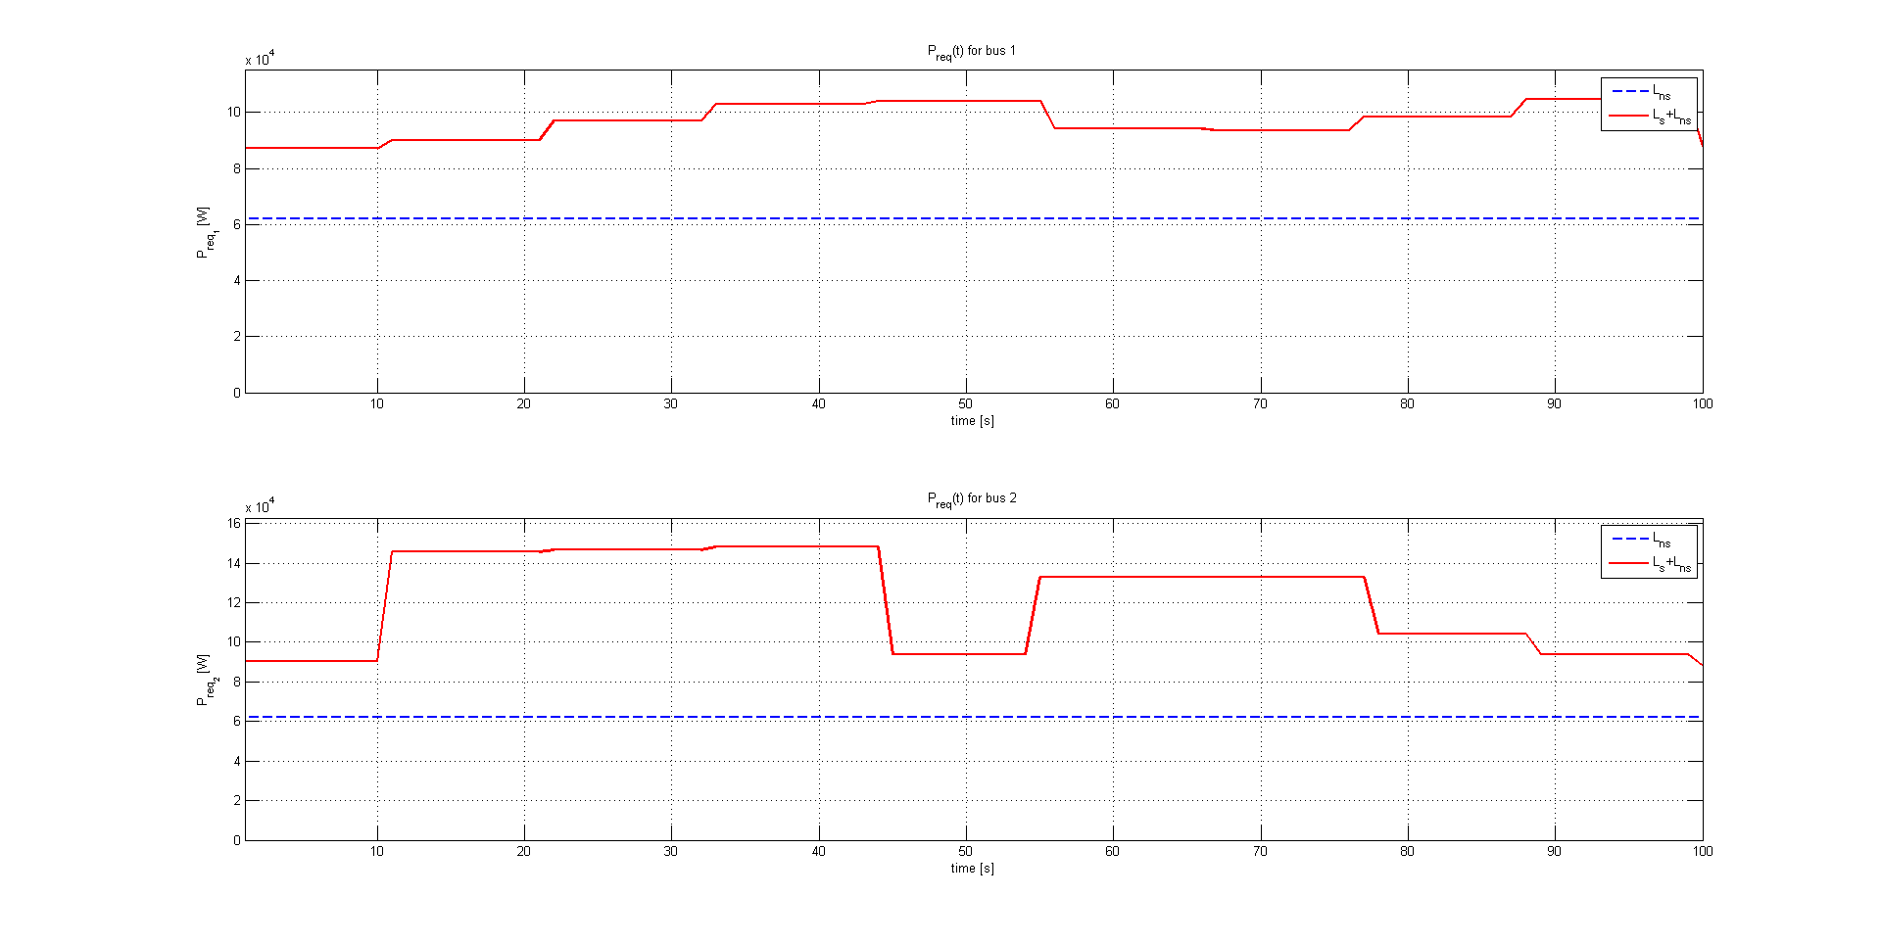
Perturbed Workloads
Notes:
Actual load request that we’re simulating
Difference is huge power spike

Slide 21
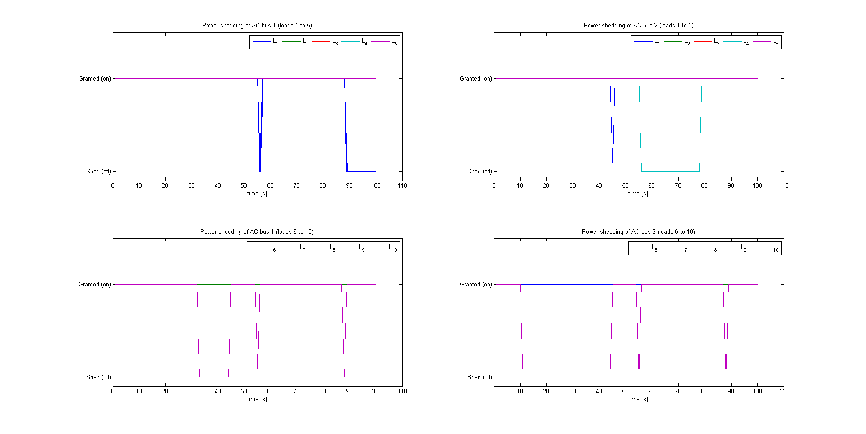
Results: Perturbed Workloads

Slide 22
Results: HL-LMS Objective Function
TODO: plot with LL-LMS vs. HL-LMS, and generator failures

Slide 23
Results: HL-LMS Objective Function
TODO: plot with LL-LMS vs. HL-LMS, and perturbed workload

Slide 24
TODO
Platform stuff
Contract stuff
Think about how to explain the two datasets (historical and actual)
Add extra 10-timestep delay for using HL results
More experiments:
In terms of objective function, how does the LL-LMS do?
Build a good LL-LMS (just add better generator priority table) and compare it to HL-LMS. Is it distinguishable?

