Slide 1
摘要赏析
导 师: 毕远国教
讲授人: 胡兵
制作日期: 2019/9/30

Slide 2
论文详情
Title：On the Feasibility of Rerouting-Based DDoS Defenses
Published in: 2019 IEEE Symposium on Security and Privacy (SP)

Slide 3
摘要结构
解释当前现状
概述本文内容
总结本文结论

Slide 4
摘要结构
解释当前现状
概述本文内容
总结本文结论

Slide 5
当前现状
原文：Large botnet-based flooding attacks have recently demonstrated unprecedented damage.
译文：攻击造成巨大破坏
原文：However, the best-known end-to-end availability guarantees against flooding attacks require costly global-scale coordination among autonomous systems (ASes).
译文：当前解决方案需要大量自治系统的协调

Slide 6
当前现状
原文：A recent proposal called routing around congestion (or RAC) attempts to offer strong end-to-end availability to a selected critical flow by dynamically rerouting it to an uncongested detour path without requiring any inter-AS coordination.
译文：最近提出的一个方案(RAC)可选关键流到不阻塞的path并且还不需要协调各自治系统。

Slide 7
当前现状
以上即为对当前现状的一个总结，使用了三句话介绍了当前的网络流量攻击的大背景，众多学者提出解决方案的不足，并引出最近的一个解决方案RAC可以克服这些不足。

Slide 8
摘要结构
解释当前现状
概述本文内容
总结本文结论

Slide 9
本文内容概述
This paper presents an in-depth analysis of the (in)feasibility of the RAC defense and points out that its rerouting approach, though intriguing, cannot possibly solve the challenging flooding problem.
本文对RAC的是否适用进行了深入的讨论，指出虽然方法很有趣，但却不能很好地解决问题。（直接说出了本文的观点：RAC[51]方法行不通）

Slide 10
本文内容概述
An effective RAC solution should find an inter-domain detour path for its critical flow with the two following desired properties: (1) it guarantees the establishment of an arbitrary detour path of its choice, and (2) it isolates the established detour path from non-critical flows so that the path is used exclusively for its critical flow.
一个有效的RAC方法所需要的特点有：能够找到新的detour path；保证新建detour path不被非重要流使用。（这里道出RAC方法需要的特性，意思就是[51]中提出的方法它没有这个特性，所以不可行）

Slide 11
本文内容概述
However, we show a fundamental trade-off between the two desired properties, and as a result, only one of them can be achieved but not both. Worse yet, we show that failing to achieve either of the two properties makes the RAC defense not just ineffective but nearly unusable.
大意为：在现实中环境中如果使用RAC方法有时只能满足一个，有时甚至一个都实现不了，因此方法基本无效。（说明了方法为什么不可行）

Slide 12
本文内容概述
When the newly established detour path is not isolated, a new adaptive adversary can detect it in real time and immediately congest the path, defeating the goals of the RAC defense. Conversely, when the establishment of an arbitrary detour path is not guaranteed, more than 80% of critical flows we test have only a small number (e.g., three or less) of detour paths that can actually be established and disjoint from each other, which significantly restricts the available options for the reliable RAC operation.
这一段对前面提出的两个特性加以说明，为什么RAC防御方法需要那两个属性：不满足第一个则新建的detour path很快又会被阻塞；不满足第二个则降低了RAC的可用性。

Slide 13
本文内容概述
本部分总结了为什么RAC方法不行，本文的基本内容就是通过各种实验分析RAC方法的各种不可行性。

Slide 14
摘要结构
解释当前现状
概述本文内容
总结本文结论

Slide 15
本文结论
The first lesson of this study is that BGP-based rerouting solutions in the current inter-domain infrastructure seem to be impractical due to implicit assumptions (e.g., the invisibility of poisoning messages) that are unattainable in BGP's current practice.
第一点：基于BGP的重路由解决方案不可行，因为当前BGP环境达不到假设前提条件。

Slide 16
本文结论
Second, we learn that the analysis of protocol specifications alone is insufficient for the feasibility study of any new defense proposal and, thus, additional rigorous security analysis and various network evaluations, including real-world testing, are required.
第二点，对于一个新提出的防御方法而言仅仅对于协议层面的可行性分析是不够的，还需要严谨的安全性分析和很多现实网络环境的评估。

Slide 17
本文结论
Finally, our findings in this paper agree well with the conclusion of the major literature about end-to-end guarantees; that is, strong end-to-end availability should be a security feature of the Internet routing by design, not an ad hoc feature obtained via exploiting current routing protocols.
最后，本文的总结结果与当前很多学术研究结论相符，即：端到端的可用性需要从现实网络路由的设计来考虑，而不是从当前的路由协议来考虑。
该部分为本文通过分析RAC的不可行性工作中得到的结论总结。

Slide 18
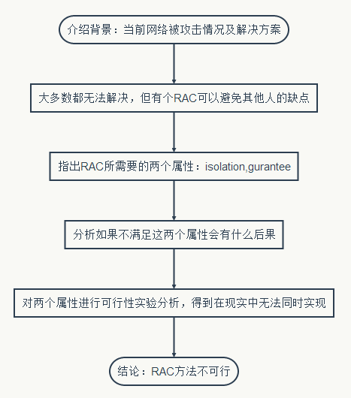
摘要总体评论
展示出了文章的基本结构：背景，本文工作，框架；
介绍了本文的工作框架：在现实中是否能满足两个重要属性；
结构严谨，表达简明，语义确切，符合规范。

Slide 19
Thank you!
个人拙见，还请老师指正

