Slide 1
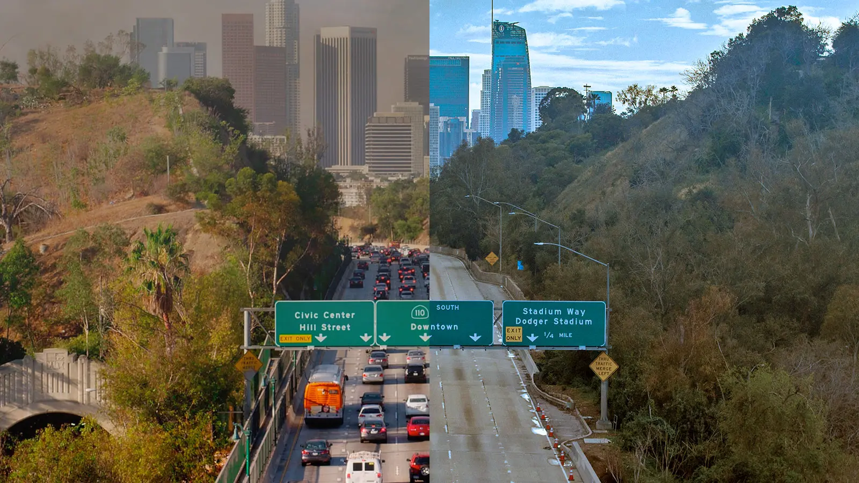


Rethinking
SB 375
Legislative pathways to transform California's transportation landscape
from incumbent stagnation
to climate accountability

Slide 2
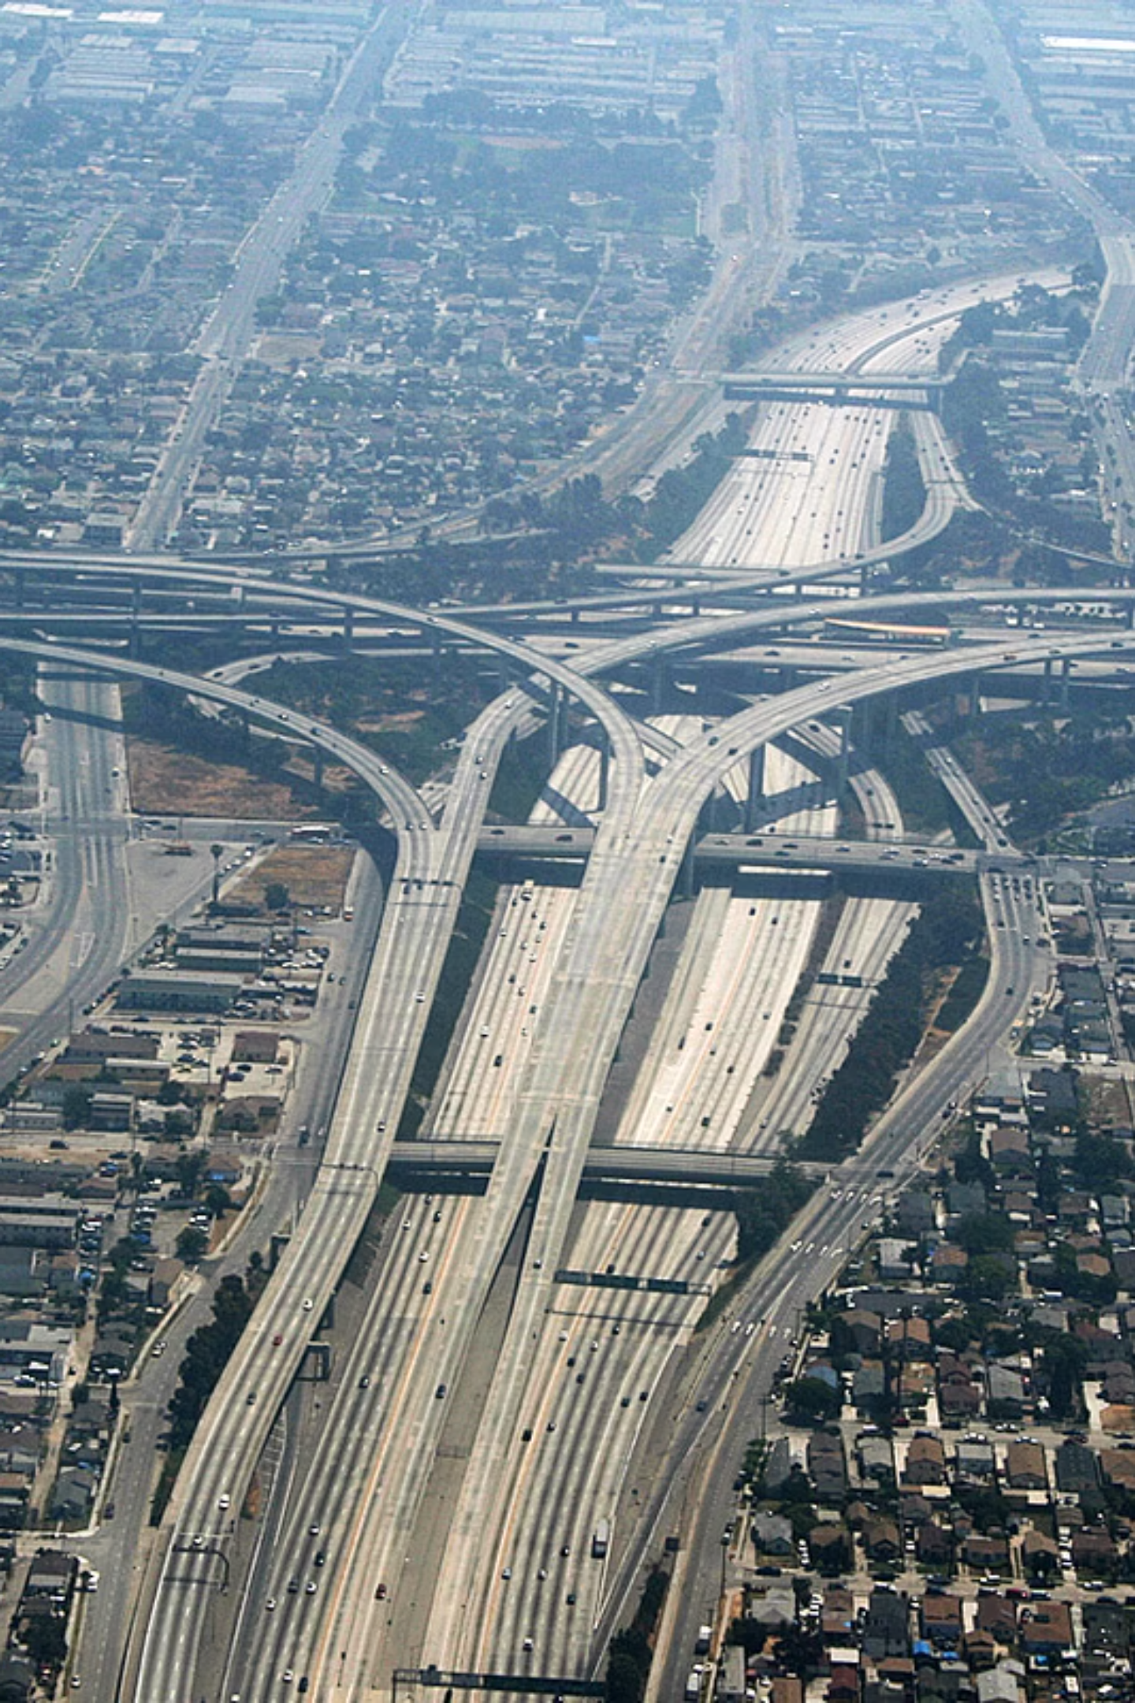
Californiacation: A Traffic Problem
Californians drive nearly ~1 Billion miles DAILY.
~40,000 trips around the Earth's equator.
1
Notes:
I want to start not with policy — but with something everyone in this room has experienced. Sitting in traffic. Watching the air quality index tick up on a hot afternoon. Wondering why, despite everything we've heard about California's climate leadership, our roads keep getting more congested and our air keeps getting worse. That's what this project is about. And the answer isn't 'drive less.' It's about changing what we fund.

Slide 3
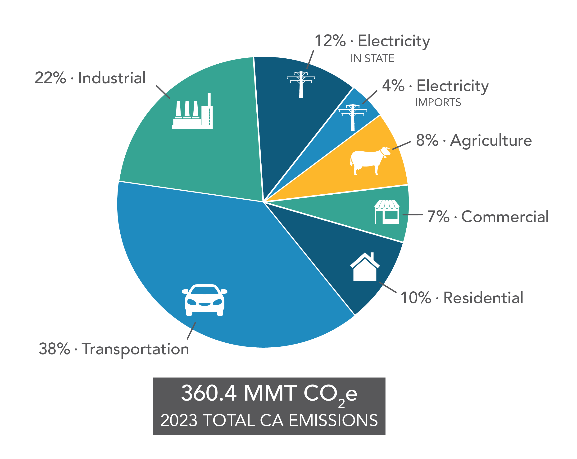
Transportation emissions make up majority of share
38%
Statewide greenhouse gas emissions from transportation sector (CARB 2023)
~137 MMT
CO₂e emissions from transportation, more than industry, electricity, and buildings combined
Source: CARB

Slide 4

MCS Capstone Project Scope
This research was conducted in partnership with NRDC to find legislative pathways to make California's transportation spending match its climate goals.
The Sponsor
The Question
The Approach
NRDC (Natural Resources Defense Council) is one of nation's leading environmental policy advocacy organizations.
Zak Accuardi, Director of Director, Mobility Choices, Climate & Energy.
California SB 375 requires regions to plan for lower GHG emissions.
But planning and implementation are two different things. Why isn't there better implementation?
Policy analysis + stakeholder interviews + spatial data mapping across 18 California Metropolitan Planning Organization (MPO) regions.
2
Notes:
This capstone was done through UC Berkeley's Rausser College of Natural Resources. My partner on the project was NRDC — the Natural Resources Defense Council — specifically Zak Accuardi, who works on exactly these questions professionally. I want to be upfront: this is a policy analysis project, not an engineering one. We're looking at how laws are written and how money flows — not at individual driver behavior.

Slide 5
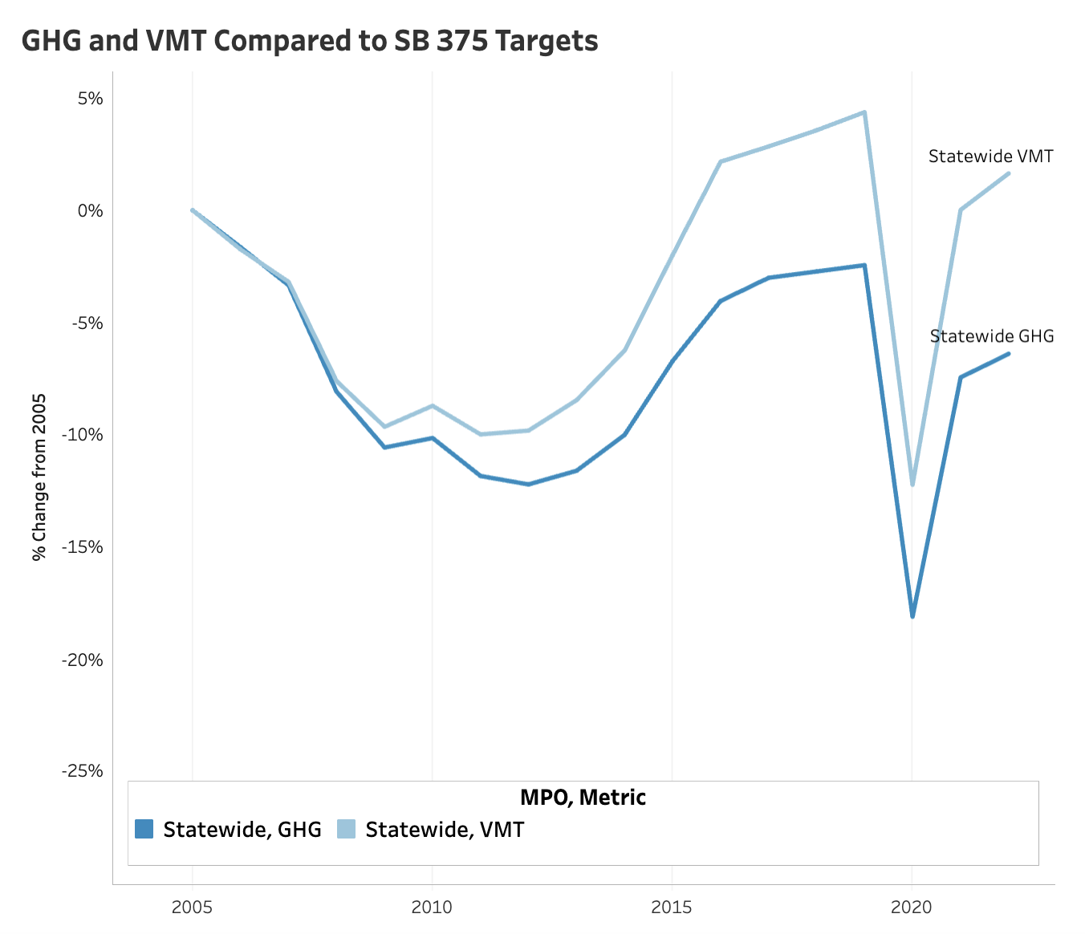
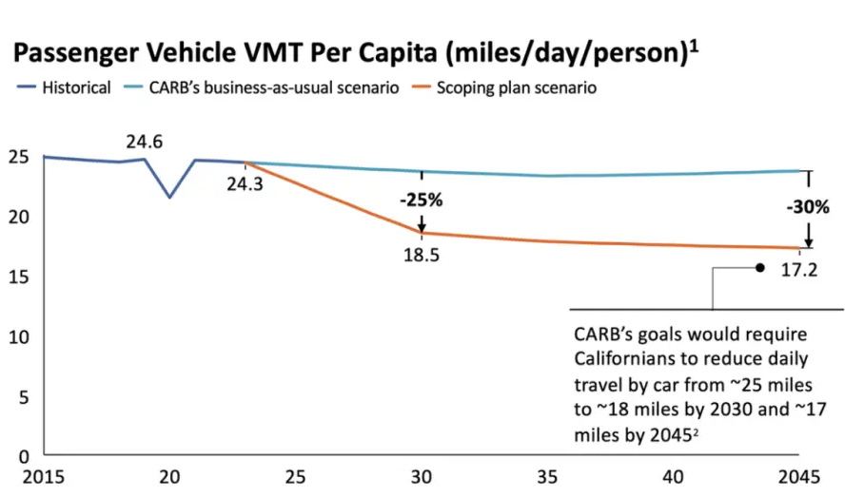
What Is VMT, and Why Does It Keep Going Up?
Vehicle Miles Traveled (VMT): the total miles driven by all cars in a region.
A measurement for California's climate transportation progress.
VMT: CA's daily driving tab
Californians drive about 24–25 miles per person per day
Carbon neutrality by 2045: ~17 miles per person per day
Gap is only growing
3
Notes:
VMT is the single most important metric in this presentation, so I want to make sure it's crystal clear. It's not complicated — it's just the total mileage bill California runs up every day. The reason it matters for climate is simple: more miles driven equals more fuel burned equals more emissions. What's striking is that even as electric vehicles have grown, total VMT has continued to climb — which means electrification alone won't get us there. We have to actually drive less, collectively.

Slide 6
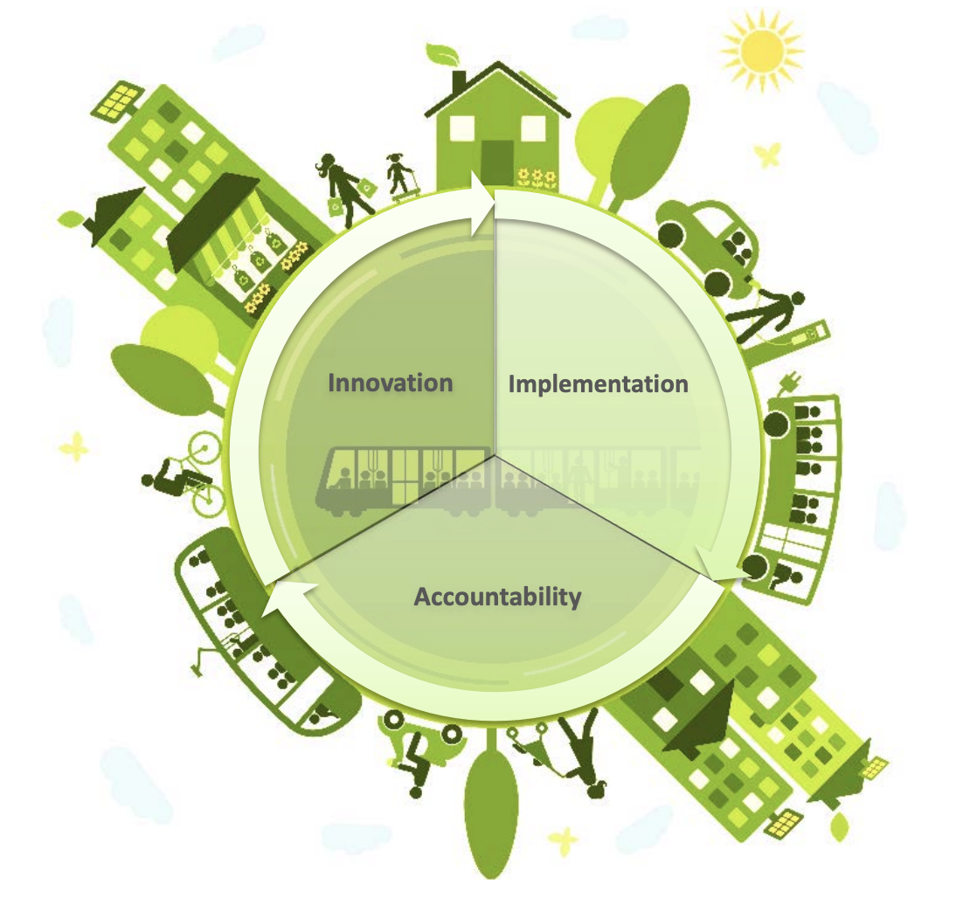
Policy Context: SB 375 (2008)
Passed in 2008, SB 375 requires every California region to create a plan showing how it will reduce transportation emissions. The keyword is 'plan.'
SB 375 requires California's 18 MPOs to each produce a "Sustainable Communities Strategy" (SCS): a transportation and land use plan aligned with state climate targets
Regions must show, on paper, how their plan achieves those targets
SB 375 was groundbreaking in 2008. Sixteen years later, VMT and GHG emissions are still rising
4
Notes:
SB 375 was genuinely a landmark law when it passed. It was the first in the country to link transportation planning to climate targets at a regional level. The idea was: if we require regions to plan for lower emissions, the spending will follow. Spoiler: it didn't. And the reason why is what I want to show you next.

Slide 7
The Problem: Good Plans, No Enforcement
SB 375 requires regions to write plans that show a path to lower emissions.
It doesn't require them to follow the plan.
• Regions can submit a plan projecting significant VMT reductions, then fund highway expansions that generate more driving — with no legal consequence
• This gap between planning and spending is where climate progress gets lost
• Result: VMT and emissions are trending upward statewide, even as regions report "on track" in their plans
What SB 375 Requires
It Doesn't Require
• Plans
• Projections
• Targets
• Spending alignment
• Enforcement
• Consequences for missing targets
5
Notes:
This is the core insight of the whole project, and I want to make sure it lands. SB 375 is a planning mandate. It requires good documents. It does not require good spending decisions. And in practice, what we've seen is that regions produce plans showing impressive VMT reductions — and then fund projects that do the opposite. There's no mechanism that says: if you miss your target, you lose your highway funding. That's the gap we're trying to close. • Think of it like a gym membership where you write a detailed workout schedule every four years — but no one ever checks if you showed up
• Regions can submit a plan projecting significant VMT reductions, then fund highway expansions that generate more driving — with no legal consequence
• This gap between planning and spending is where climate progress gets lost
• Result: VMT and emissions are trending upward statewide, even as regions report "on track" in their plans

Slide 8

The Legislative Vehicle: SB 1087 (Cabaldon)
A technical bill introduced in February 2026 quietly touches the same legal code as SB 375.
A rare window to insert real accountability.
What SB 1087 Does
Why This Matters
Introduced by Senator Cabaldon, SB 1087 makes administrative updates to California's transportation planning framework:
• Changes how often regions must update their plans (from every 4 years to every 8 years)
• Changes how $25 million in planning grants are allocated (from discretionary to population-based)
• Shifts grant administration away from Caltrans
Because SB 1087 can create legislative hooks to utilize specific code sections where climate accountability language can be inserted during the amendment process.
A technical bill becomes a potential climate accountability bill.
6
Notes:
This is where the project gets strategic. We couldn't just amend SB 375 directly — the legal structure is too narrow for investment mandates. But SB 1087, introduced just this February, opens the right doors. It's currently a fairly dry administrative bill. But because it touches the same code sections, it gives advocates a vehicle to attach real enforcement mechanisms this legislative session. The window is open right now.

Slide 9
Other States Already Closed This Gap
Colorado, Minnesota, Virginia, and Massachusetts each passed laws that tie transportation dollars directly to climate performance. California can adapt all four.
COLORADO — Budget Lock
MINNESOTA — Capacity Trigger
Any project that increases emissions must be paired with transit, bike lanes, or demand management to offset the impact. No mitigation = no funding.
Any highway expansion over 0.5 miles requires a 20-year emissions impact study. If it fails, the project must be redesigned, offset, or canceled.
VIRGINIA — Climate & Equity Scoring
MASSACHUSETTS — Emission Caps
Projects are scored on GHG reduction, multimodal access, and benefits to disadvantaged communities. Sprawl-inducing projects naturally score lower and lose funding.
Legally binding, annually declining CO₂ limits for the state DOT. Miss the target and supplemental corrective measures are legally required.
7
Notes:
None of these states reinvented the wheel. They just added consequences. Colorado locked the budget. Minnesota required honest accounting. Virginia built equity into the scoring. Massachusetts made the targets legally binding. California has the policy infrastructure to do all four — we just need the political will to attach them to the right bill.

Slide 10
Reform Option 1: The 'Corrective Action' Moratorium
If a region misses its emissions targets twice in a row, highway expansion funding is frozen until it has a credible plan to get back on track.
• Modeled on: Colorado's GHG Budget Lock
• Trigger: Two consecutive planning cycles with missed GHG (greenhouse gas) targets
• Consequence: No state or federal funds may be spent on projects that add new highway lanes until CARB (California Air Resources Board) certifies a credible Corrective Action Plan
• Restoration: Funding resumes only when the region demonstrates a binding path back to its 2035 and 2045 targets
• Political viability: MODERATE: most feasible near-term option; consequence is a VMT pause, not a permanent cut
[DIAGRAM: Flowchart — Miss target once → Warning Miss target twice → Corrective Action → Funding freeze → CARB review → Funding restored]
8
Notes:
This is the scenario I'd recommend as the starting point for this legislative session. It's not the most transformative option, but it's the most politically viable. The key insight is that it doesn't permanently cut anyone's funding — it creates a pause with a clear path to restoration. That makes it much harder to oppose. A region that's genuinely making progress has nothing to fear from this.

Slide 11
Reform Option 2: The 'VMT Neutral' Investment Rule
Before any highway expansion gets funded, it must prove it won't increase total driving — or fund the alternatives that offset it.
• Modeled on: Minnesota's Capacity Trigger
• Requirement: Any project adding vehicle capacity must complete a 20-year GHG (greenhouse gas) and VMT (Vehicle Miles Traveled) impact assessment before inclusion in a regional funding program
• If the assessment shows a net increase in driving, the project sponsor must fund a VMT Mitigation Plan (transit improvements, bike infrastructure, or infill housing) that fully offsets projected 20-year impact
• In plain English: if you want to widen a highway, you have to pay for the bus lines that absorb the extra demand
• Political viability: STRONG, but contested: highway agencies will push back
9
Notes:
This one has real teeth. It basically says: 'Big Highway' projects have to fund their own climate offsets. If Caltrans wants to add a lane on I-5, it has to show that the induced demand won't blow up regional emissions targets — and if it will, it has to fund transit or housing alternatives that absorb that demand. This is how you stop the cycle of building more roads and then wondering why there's more traffic.

Slide 12
Reform Option 3: The 'Climate Floor' Scoring Test
No project that fails a climate performance test should be eligible for state transportation funding
• Modeled on: Virginia's SMART SCALE Scoring + Massachusetts' Enforceable Emission Caps
• Climate Floor: Any project with a negative net score for VMT (Vehicle Miles Traveled) reduction is automatically ineligible for state funding, regardless of how it scores on other criteria
• Objective Need Standard: Projects must address a need identified in a statewide assessment — not just a locally-defined traffic throughput goal
• Multimodal Alternatives Test: For every mobility need identified, at least two non-highway alternatives must be evaluated with the same rigor as the capacity project
• If a multimodal option scores better on climate, the highway expansion is statutorily ineligible
• Political viability: TRANSFORMATIVE but faces strongest opposition
10
Notes:
This is the long game. It fundamentally restructures how California decides what gets funded — not by tweaking the scoring at the margins, but by establishing a hard floor. If your project makes climate worse, it doesn't get state money. Full stop. Virginia and Massachusetts have shown this is legally defensible and politically survivable — but it will require building a broader coalition than Scenario 1 to get there.

Slide 13
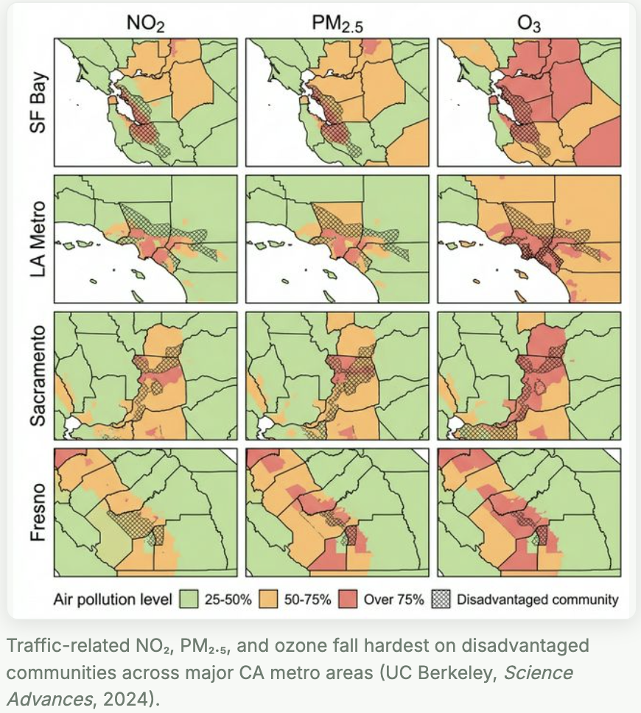
The Stakes: Who Bears the Burden Today
The communities closest to California's busiest freeways face some of the worst air quality, the highest emissions exposure, and the fewest transportation alternatives.
• 309 hotspots census tracts: high VMT and high pollution burden
• I-710, I-105, SR-99, and I-80 corridors
• Central Valley: lower per-capita VMT but concentrated freight and agricultural traffic exposure
• Reformed investment: transit, walking infrastructure, infill housing
11
Notes:
I want to be transparent about a methodological choice here. We used per-capita VMT as our primary metric, which can actually undercount burden in places like the Central Valley, where absolute freight traffic is enormous but spread across a smaller population. The 309 hotspot number is conservative. The human reality — elevated asthma rates, cardiovascular disease, premature death near these corridors — is well-documented in the literature and should not be obscured by the averages. Note: per-capita VMT can appear lower in dense urban corridors even when absolute pollution burden is highest.

Slide 14
Future Outlook
We’re not on track to reach our VMT reduction targets.
We can change course.
The Gap
The Ask
NRDC: Deploy three-scenario frameworks in legislative advocacy.
California: VMT accountability language.
Transportation Planners: Plans are not investments. Investments are investments.
California's climate targets require structural changes to land use, transit investment, and pricing that go well beyond any single legislation.
12
Notes:
I want to end with honesty. Someone in the room is probably thinking: 'Even if all three scenarios pass, does California hit its targets?' And the answer is: not automatically. These reforms are necessary but not sufficient. What they do is stop the hemorrhaging — stop funding projects that actively undermine the plans we've already written. That's not nothing. That's the foundation. The ask I'd leave you with is simple: the next time you hear that a region 'has a plan' to reduce emissions, ask what happens if they don't follow it. Right now, the answer is nothing. These reforms change that answer.

Slide 15


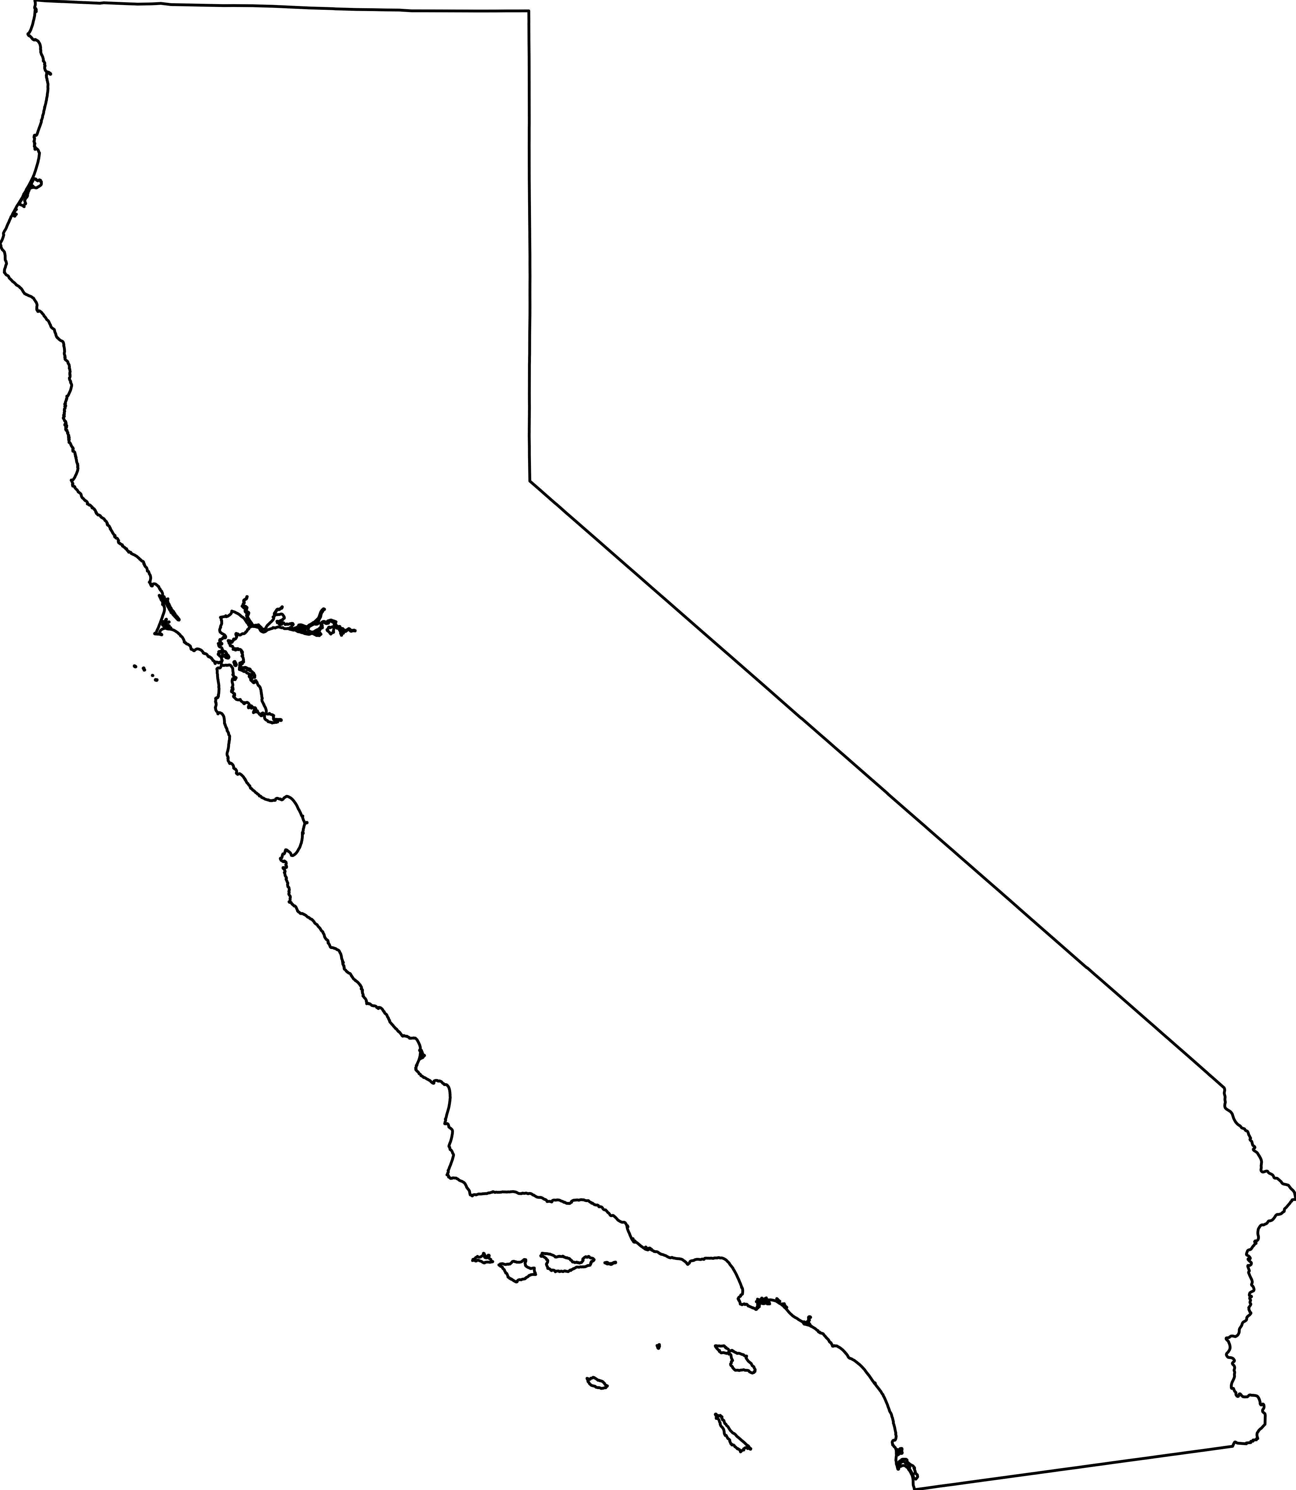
Recommendations & Ask
NRDC
For Transportation Planners
Deploy the three-scenario framework and dashboard in legislative advocacy
The dashboard and data pipeline are open-source and reproducible. Any MPO, advocacy organization, or researcher can fork, adapt, and deploy them.
California
Input VMT-accountability language.

