Slide 1
Insporational Material
https://www.blackbirdcabs.co.uk/available-now

Slide 2
handles
https://www.speakerbuildersupply.com/vintage-style-leather-look-amp-handle-p/hvint.htm

Slide 3
Tolex options
https://www.mojotone.com/cabinets/cabinet-parts-hardware/tolex-carpet-and-tweed?page=4
https://guitarcabinetsdirect.com/cat/tolex/
https://www.speakerbuildersupply.com/tolex-in-dozens-of-patterns-s/1822.htm

Slide 4
Cabinets
https://pay.ebay.com/rxo?action=success&sessionid=2101411961017
Order # 02-10879-40399 on ebay dec 2, eta jan 8
https://www.ebay.com/itm/304173337705?hash=item46d224cc69:g:9VEAAOSw3T5b5waS
Needs 22-3/8” wide chassis to fit

Slide 5

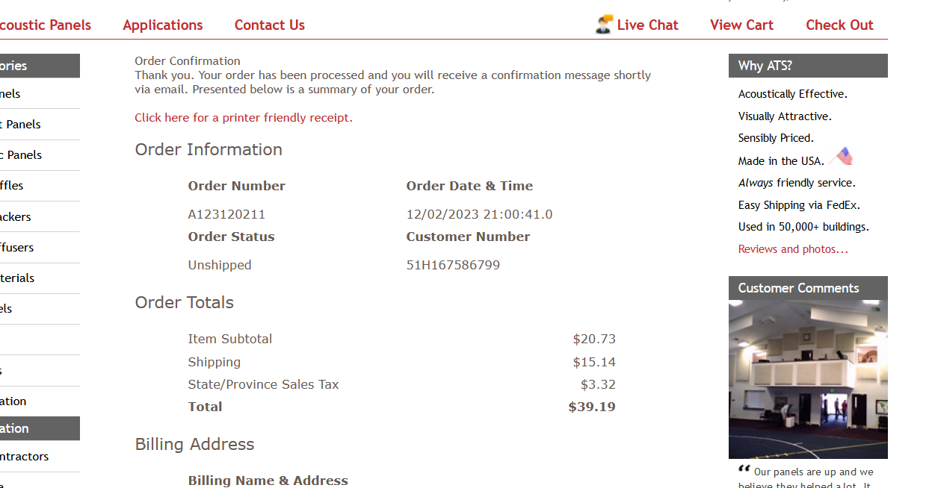
Grill Cloth
fr701

Slide 6
Colorways (acd)
Natural finish
Fir grill cloth
Leather handle (saddle brown)

Slide 7
Notes on playing quiet
https://www.youtube.com/watch?v=yT4HyWgXNHs
Speaker swapped with eminance maverick?
Volume pedal after buffer – keeps eq the same
Volume on guitar up, amp volume 3-5
Guitar
V max
Buffered tuner
Other pedals
Volume pedal
Amp input
v 3-5

Slide 8
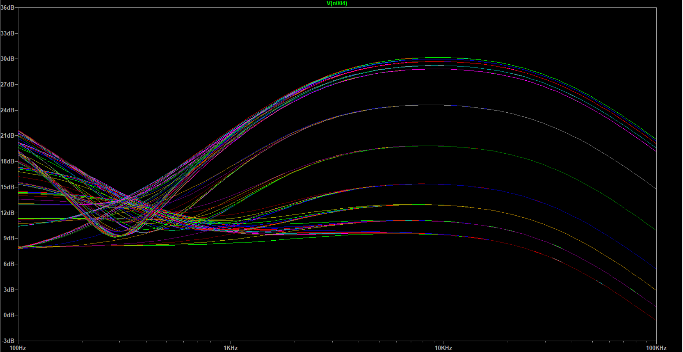
Ab763 normal tone stage 12ax7

Slide 9
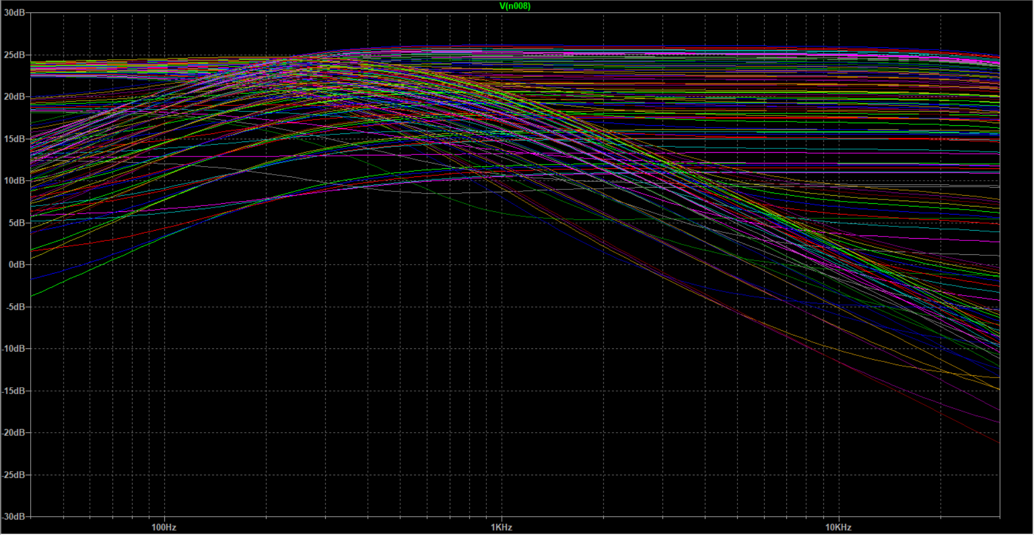
AMZ2

Slide 10
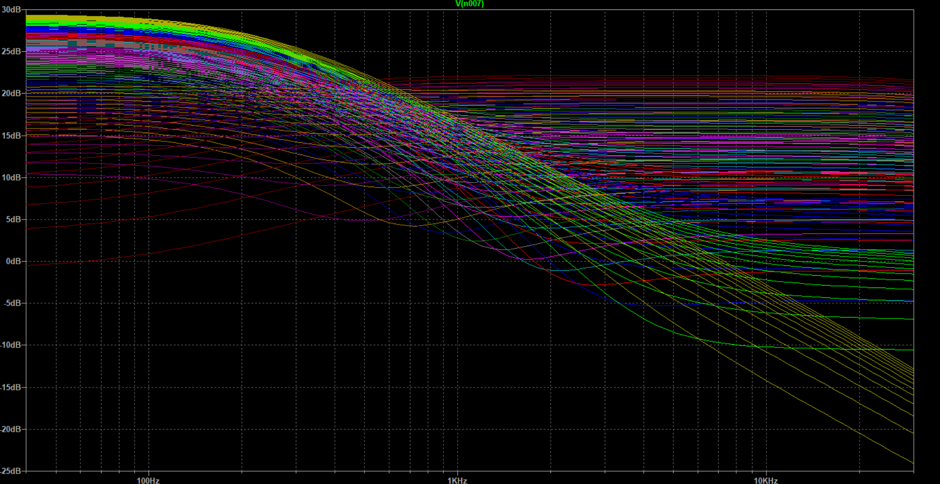
AMZ1
This one

Slide 11
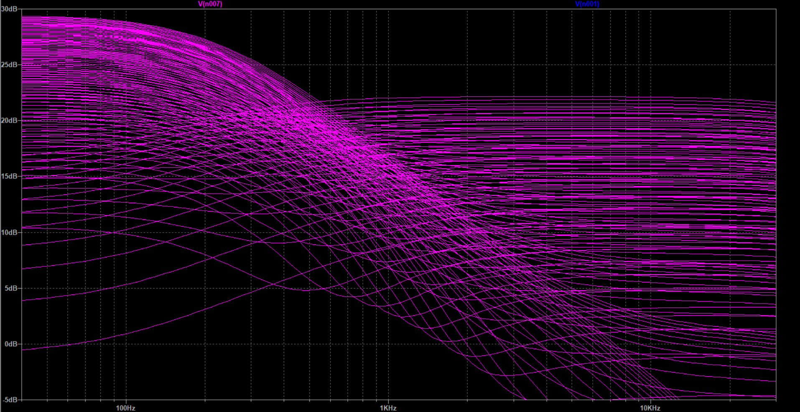
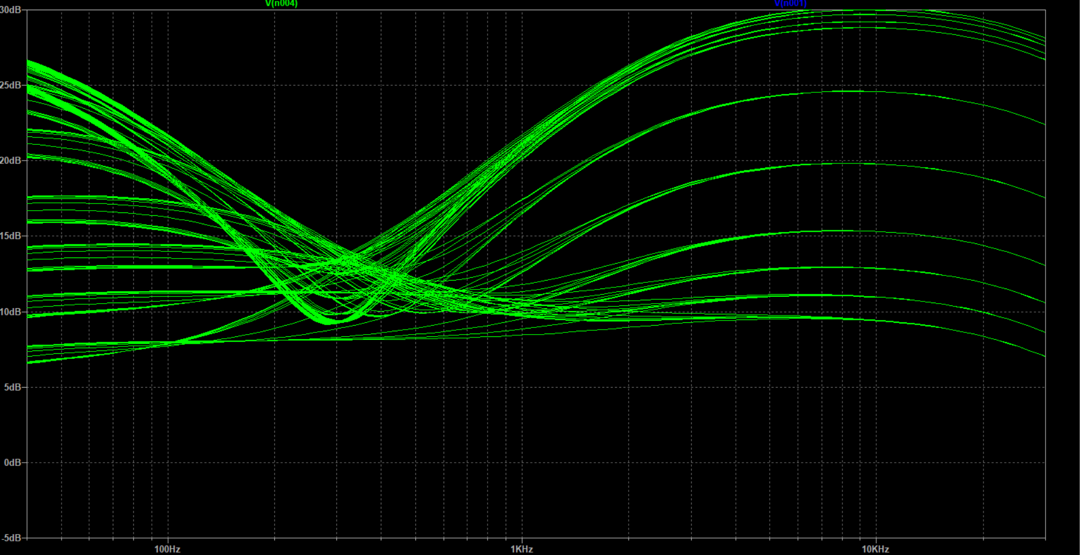
Normal (green) vs amz (magenta)

Slide 12
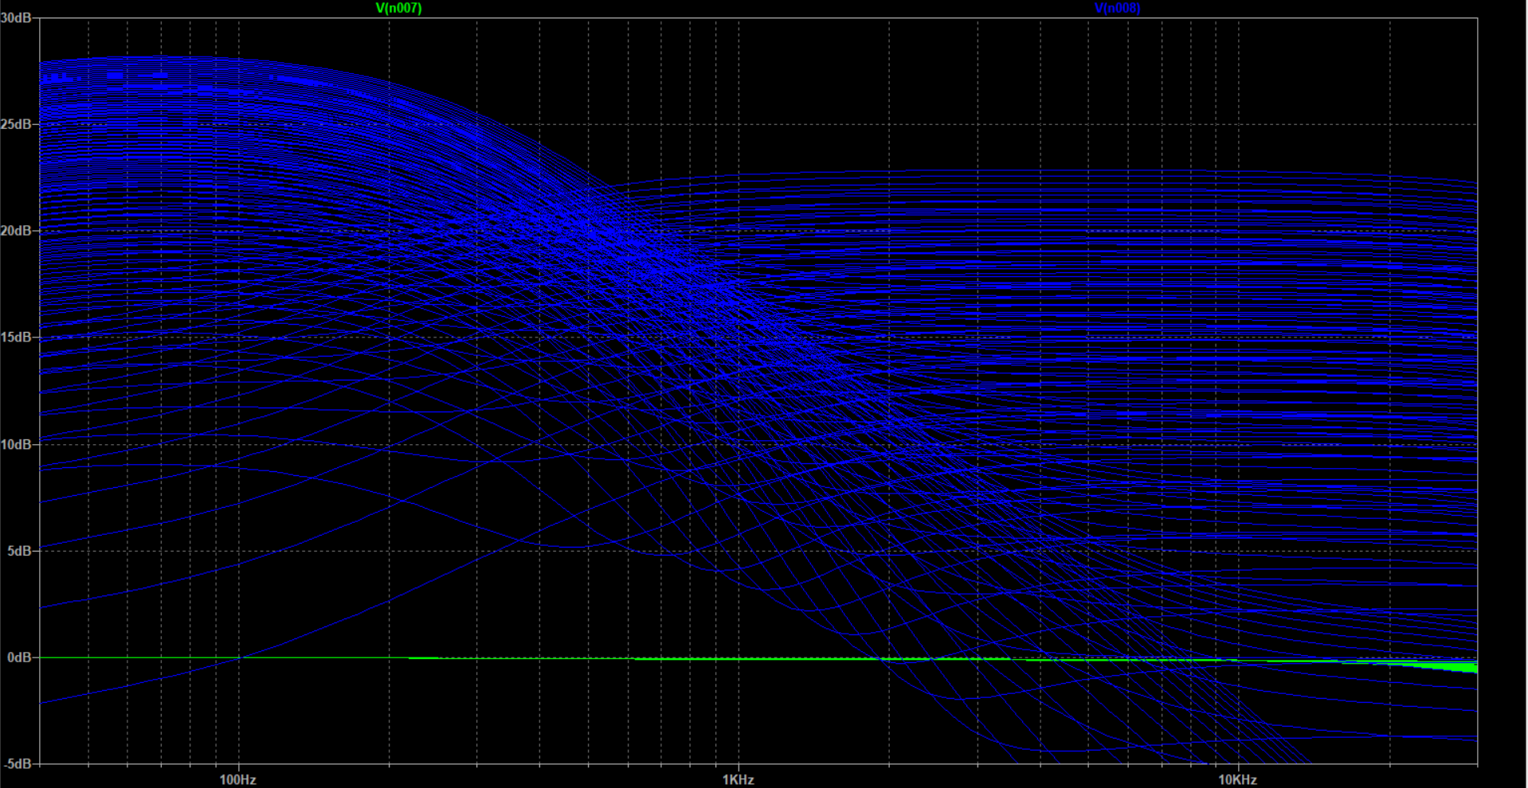
Amz thunderbolt (blue) with .05u coupling cap

Slide 13
Layout
https://robrobinette.com/images/Guitar/AB763_Models/AB763_Deluxe_Reverb_Layout_DIYLC.png

