Slide 1



Slide 2


R
R
R
R
R

Slide 3
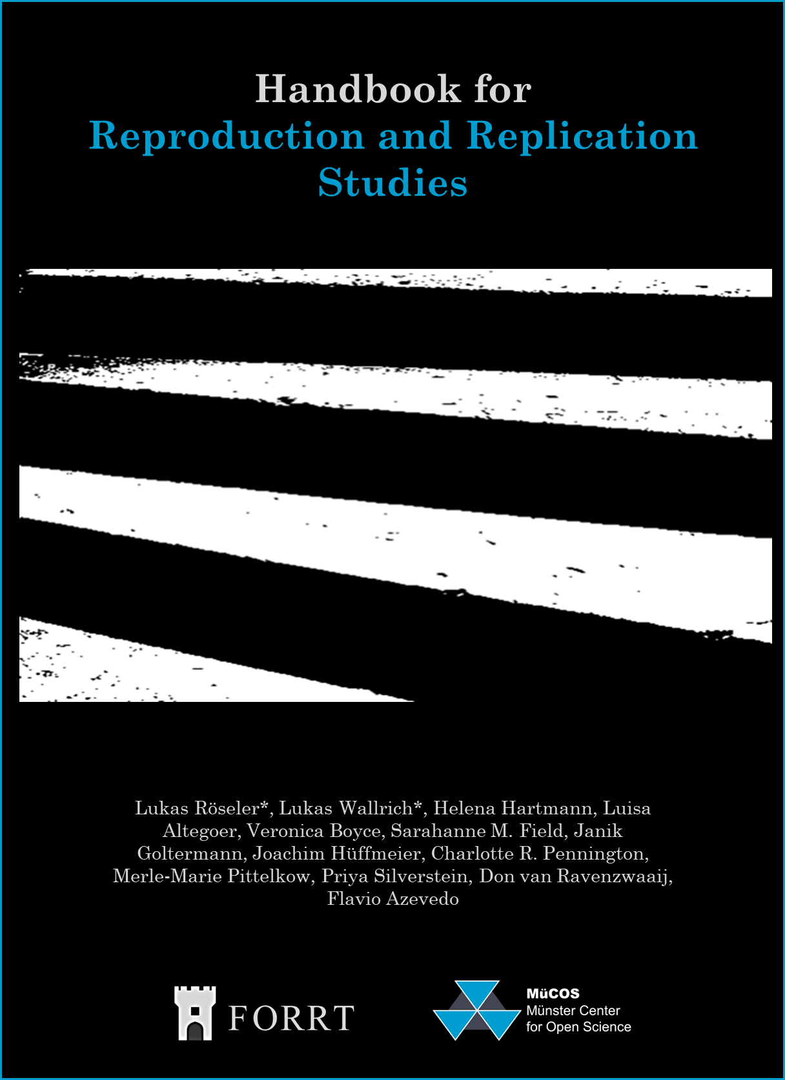


Handbook for Reproduction and Replication Studies
Lukas Röseler*, Lukas Wallrich*, Helena Hartmann, Luisa Altegoer, Veronica Boyce, Sarahanne M. Field, Janik Goltermann, Joachim Hüffmeier, Charlotte R. Pennington, Merle-Marie Pittelkow, Priya Silverstein, Don van Ravenzwaaij, Flavio Azevedo

