Slide 1
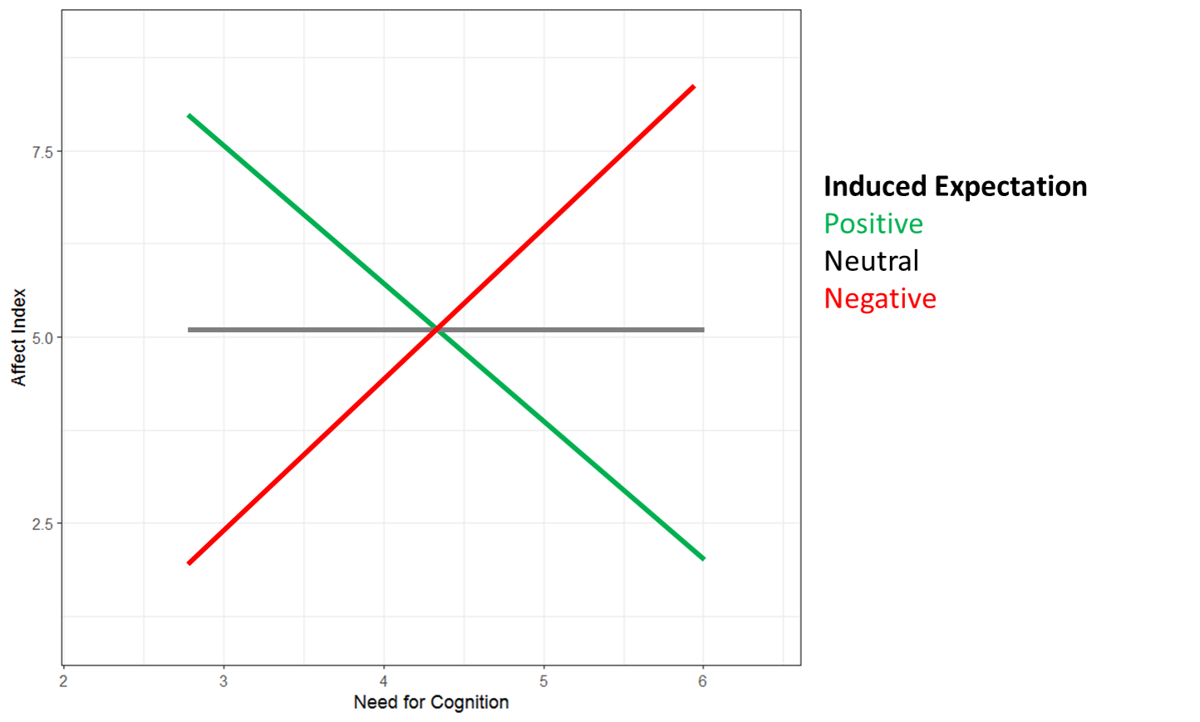
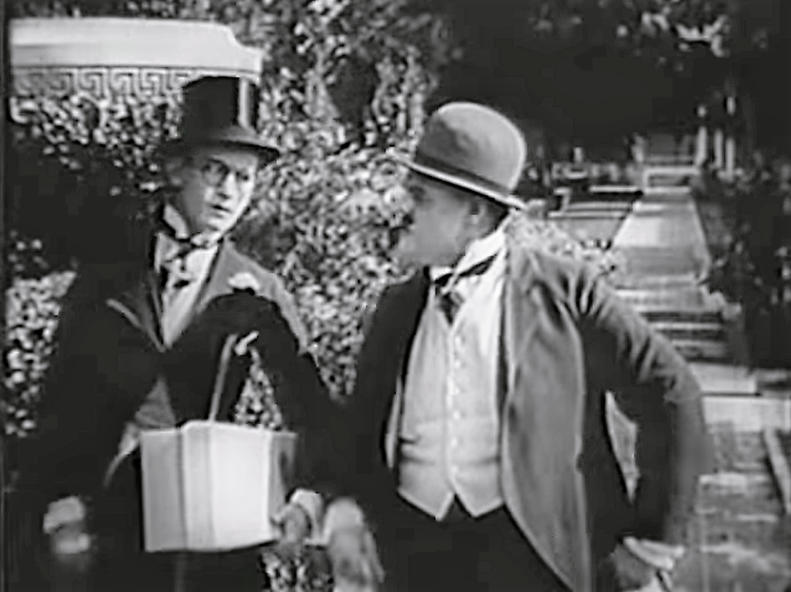
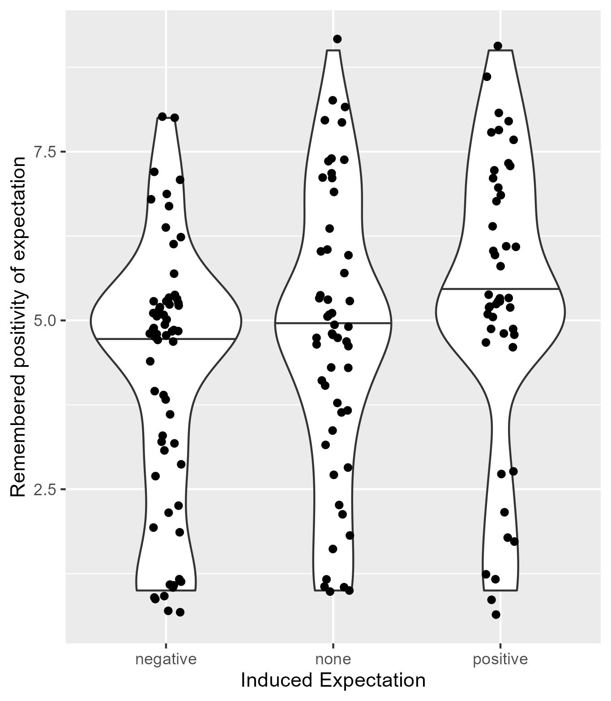
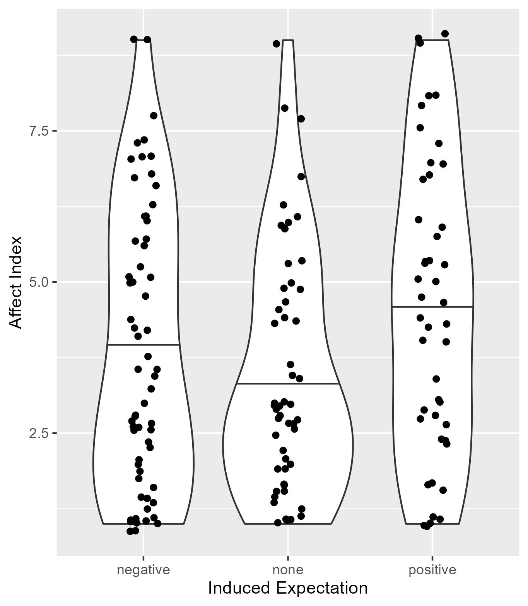
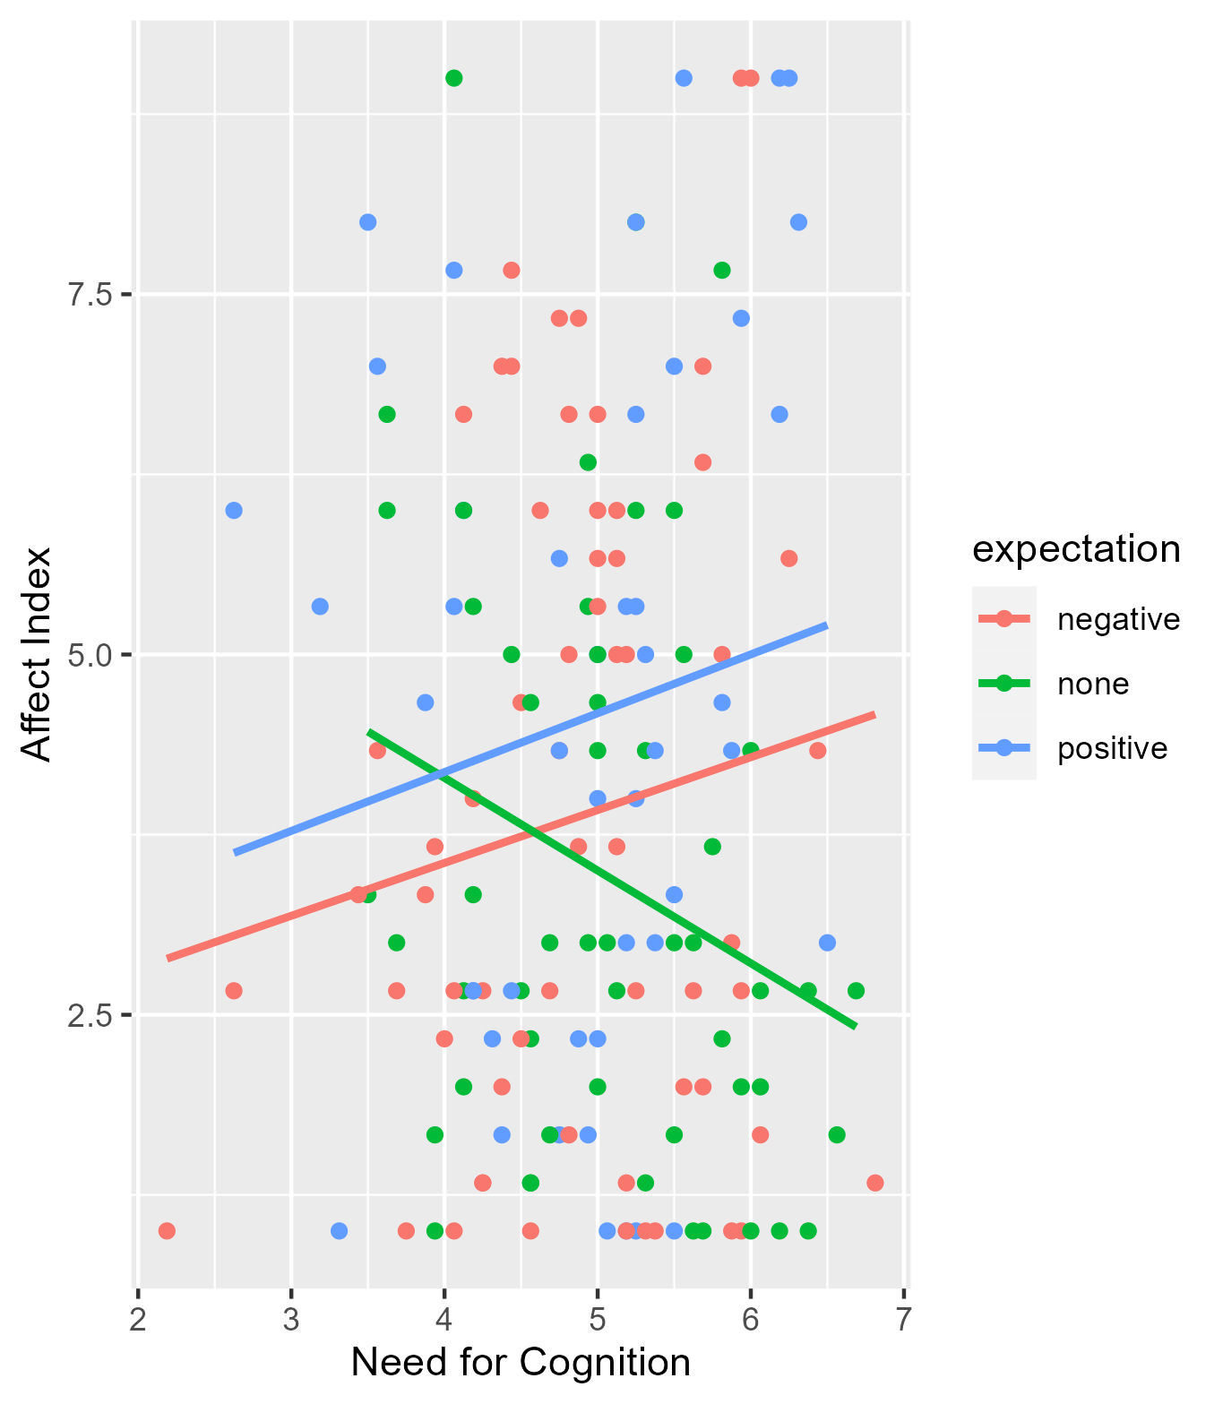
Need for Cognition and Affective Expectations as Determinants of Affective Reactions
A preregistered replication study
Röseler, L., Bauer, M., Bruzsa, A., Deublein, M. B., Doetsch, C. A., Drach, K., Förster, N., Friedinger, K., Gianella, D., Kloß, H., Müller, A. M., Rieger, E. M., Schmidt, C. L., Schoen-Reynders, R. D., Seitz, A., Van den Bergh, J., Wild, A. A.
Lukas.roeseler@uni-bamberg.de
Data and preregistration: https://osf.io/rge23/
Affective Expectation Model & Need for Cognition
Affective Expectation Model (Wilson et al., 1989): Inconsistency between expectations and experiences leads to assimilation or contrast effects in affective reactions
Need for Cognition (Cacioppo & Petty, 1982; Cohen, 1957): Stable individual disposition in cognitive motivation as desire to engage in a cognitive activity or enjoyment of a cognitive activity
Assimilation and contrast effects are moderated by interindividual differences in Need for Cognition (Geers & Lassiter, 2003)
Assimilation effects:
If discrepancy not noticed → Affective reactions are assimilated towards expectation
Contrast effects:
If discrepancy is noticed → Affective reactions are contrasted with expectation
Hypothesis (Geers & Lassiter, 2003, Study 1)
Why replicate?
Original study (Geers & Lassiter, 2003, Study 1) has been conducted two decades ago and therefore without preregistration
To our knowledge, effects haven‘t been replicated so far
We created new expectation induction movies and used one of the two original movies
We replicated study 1 as closely as possible using preregistration via the replication recipe (Brandt et al., 2014)
Method (Geers & Lassiter, 2003, Study 1)
Randomized assignment to experimental condition and use of cover story
Affective Stimulus: Presentation of unfunny 6-minute film clip
Experimental conditions (affective expectation induction): positive vs. negative vs. none
Need for Cognition Scale (Cacioppo, Petty & Kao, 1984)
Affective reaction: 3 item affect index (self-report)
Results
Geers & Lassiter, 2003, Study 1
Replication
Cronbach‘s Alphas für die beiden Skalen
Affective Reaction Effect | Contrast and assimilation effects consistent with hypotheses | No effects consistent with hypotheses
N | 160 | 161
R² | 0.04
Erklärungen für Rep.-Fehlschlag:
Power
Original ist falsch
False negative bei uns
Zu starke Abweichungen von Originalstudie
(z.B. Don‘t Shove Film funktioniert micht mehr, …)
Conclusion
Effects were not replicated. This suggests the power of the replication was too low or the original study was false positive.
REFERENCES
Brandt, M. J., IJzerman, H., Dijksterhuis, A., Farach, F. J., Geller, J., Giner-Sorolla, R., . . . van 't Veer, A. (2014). The Replication Recipe: What makes for a convincing replication? Journal of Experimental Social Psychology, 50, 217–224. https://doi.org/10.1016/j.jesp.2013.10.005
Cacioppo, J. T., & Petty, R. E. (1982). The need for cognition. Journal of personality and social psychology, 42(1), 116.
https://doi.org/10.1037/0022-3514.42.1.116
Cacioppo, J. T., Petty, R. E., & Feng Kao, C. (1984). The efficient assessment of need for cognition. Journal of personality assessment, 48(3), 306-307.
https://doi.org/10.1207/s15327752jpa4803_13
Cohen, A. R. (1957). Need for cognition and order of communication as determinants of opinion change. The order of presentation in persuasion, 79-97.
Geers, A. L., & Lassiter, G. D. (2003). Need for cognition and expectations as determinants of affective experience. Basic and Applied Social Psychology, 25(4), 313-325.
https://doi.org/10.1207/S15324834BASP2504_5
Wilson, T. D., Lisle, D. J., Kraft, D., & Wetzel, C. G. (1989). Preferences as expectation-driven inferences: effects of affective expectations on affective experience. Journal of personality and social psychology, 56(4), 519.
https://doi.org/10.1037/0022-3514.56.4.519
Data, Code, Poster and Preprint: https://osf.io/rge23/
Corresponding author: Lukas.roeseler@uni-bamberg.de

