Slide 1
The Adventures of Tom Sawyer
Book Report
Group 1, Class 27

Slide 2
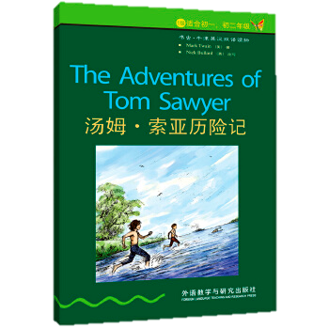
Introduction
Information about this book:
The Adventures of Tom Sawyer is a novel published by American writer Mark Twain in 1876. When he wrote this story, American society is accelerating its transformation under the influence of the Civil War. This book describes the free and lively psychology of children with cheerful words in order to reflect the broad social reality of America at that time.
accelerating [əkˈseləreɪtɪŋ] v. 加速，使加速
the Civil [ˈsɪvl] War 南北战争
psychology [saɪˈkɒlədʒɪ] n. 心理，心理学
The Adventures of Tom Sawyer

Slide 3
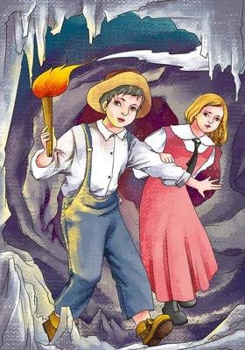
Main Characters
Characters in the story :
Tom Sawyer – A clever and naughty boy.
Huckleberry Finn – Tom’s homeless friend.
Joe Harper – Tom’s another friend.
Becky Thatcher – A girl loved by Tom.
Aunt Polly – Tom’s guardian.
Injun Joe – A very bad murderer.
And many other characters……
Tom Sawyer and Becky Thatcher

Slide 4
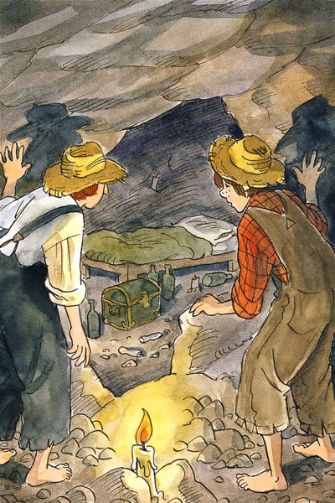
Word Master
Some new words.
funeral n. 葬礼=burial
fence n. 栅栏，篱笆，围栏
alive adj. 活着的
live v. 住；居住；生存 adj. 活的，现场直播的
minister n. 部长；牧师；公使
jail n. 监狱；监禁；牢 v. 监禁；关入监狱
tunnel n. 地下通道；地道；隧道 v. 开凿隧道
Tom Sawyer

Slide 5
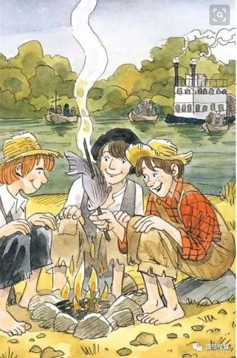
Summarizer
The main content of the story.
One night, Tom and his good friend Huck went to the graveyard to play and witnessed a murder. Afraid of being discovered by the murderer, they knew about it. They fled to a desert island .They Mistakenly let the family think they were dead, but they turned up at their funeral. After thinking, Tom finally stood up bravely and point out the murderer. Soon after, during a picnic, he lost his way with Becky in a cave. Later, they came out and found the treasure buried by the murderer .
Tom Sawyer

Slide 6
Summarizer
Enlightenment.
This story makes me understand that when face difficulties, we should have the courage to try to solve problems and never gave up.
Tom Sawyer

Slide 7
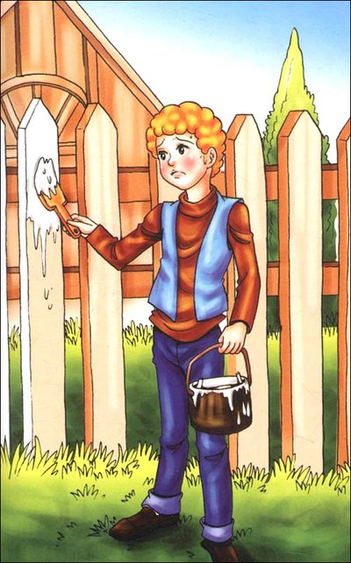
Connector
My experiences.
My PE grades are very poor. However, I dream of getting good grades on PE and keep exercising every day. I believe I will make unremitting efforts to impress others like Tom Sawyer!
Tom Sawyer

Slide 8
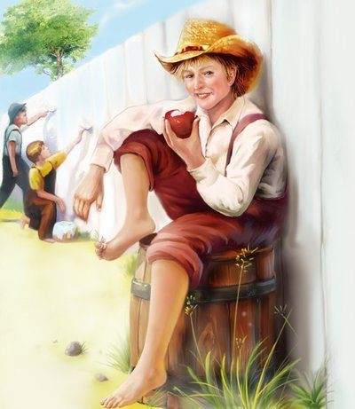
Questions
Do you really read this book carefully?
1. Who was killed by Injun Joe kill? And who did he frame it for?
1. 印江·乔杀了谁？他又嫁祸给了谁？
2. How did Tom and Becky escape from the cave?
2. 汤姆和贝姬是怎样从山洞中逃出来的？
1. Doctor Robinson. Muff Potter.
Tom Sawyer
2. They led the kite string tied to the stone to explore the way, found the exit and walked out of the cave.

Slide 9
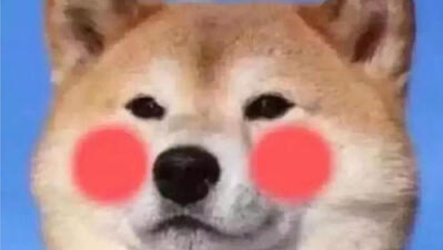
Thanks for listening!
Made by Group 1, Class 27, Grade 9.
Also find us on https://forscript.github.io/self/go/ !

