Slide 1
Introduction to Data Modeling
CS 260

Slide 2
Course Roadmap
SQL queries (4 weeks)
  DML (SELECT)
  DDL (CREATE, ALTER, DROP)
  Action (INSERT, UPDATE, DELETE)
Data modeling and normalization (3 weeks)
Application development (1 week)
Stored DBMS programs (1 week)
Transaction processing (1 week)
DBMS internals and administration (3 weeks)
Other topics: OODBMS, XML (1 week)

Slide 3
Steps in Database
System Development
System definition
  Identify system goals
Analysis
  Specify what the system needs to do
Design
  Specify how the system is going to do
  what it needs to do in order to accomplish its goals
Development
  Create the database
  Create the user and administrative applications
Test and deploy
These tasks
require you
to create a
data model

Slide 4
What is a Data Model?
Precise description of the data content in a system
Levels of data models:
  Conceptual: describes WHAT data the system contains (independent of DBMS)
  Logical: describes HOW the database will be structured (independent of DBMS)
  Physical: describes HOW the system will be implemented using a specific DBMS
    DDLs to create tables

Slide 5
Today's Topics
Introduction to data models
  Definition
  Motivation
Entity-relationship data model components
  Entities
  Attributes
  Relationships

Slide 6
Why do we need to create data models?
To aid in the development of a sound database design that does not allow anomalies or inconsistencies
Goal: to create database tables that do not contain duplicate data values that can become inconsistent
Data anomalies discussion (link in D2L)

Slide 7
Entity-Relationship Data Models
Specify data items and relationships
  Classic, simplest
    Best for deriving a sound table design
  Many extensions/variations exist
  Basis for most other modeling approaches

Slide 8
Today's Topics
Introduction to data models
  Definition
  Motivation
Entity-relationship data models
  Entities
  Attributes
  Relationships

Slide 9
Creating an Entity-Relationship Model
Identify entities
Identify entity attributes and primary keys
Specify relationships

Slide 10
Data Entities
Entity
  A "thing" about which you want to store data in an application
    Corresponds to a database table
  Key: Multiple instances of the entity must exist
    Forces you to think about the system logically
  Goal:
    Store data about each entity in a separate table
  Example entities in CANDY database:
    CUSTOMER, PRODUCT, PURCHASE

Slide 11
ER Model Attributes
Attribute
  A characteristic (data field) of an entity that you want to store in the database
    Examples: CUST_ID, PROD_DESC
    Be careful: is Advisor_ID an attribute of a student or an advisor?
Attribute value
  The value of a particular attribute for a particular entity instance
  Examples: 1, "Nuts Not Nachos"

Slide 12
Class Discussion
For a database for the CS 260 class, identify:
  Entities
  Attributes

Slide 13
Data Entity Instances
Entity instance
  A specific occurrence (identifiable data value) of an entity
  An entity must have multiple entity instances or it is not really an entity!
  Example: (1, "Celestial Cashew Crunch", 5.00, 7.50)

Slide 14
In a database for an Italian restaurant, MENU_ITEM would be an example of a(n):
Entity
Attribute
Entity instance
Relationship

Slide 15
Test Yourself:
In a database for an Italian restaurant, ITEM_PRICE would be an example of a(n):
Entity
Attribute
Entity instance
Relationship

Slide 16
In a database for an Italian restaurant, (1, "Pasta Primavera", 11.95) would be an example of a(n):
Entity
Attribute
Entity instance
Attribute instance

Slide 17
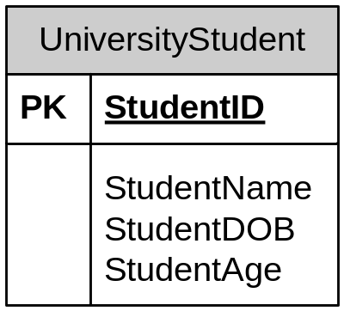
ER Model Notation
Represent entities as rectangles
List attributes within the rectangle
List the PK first and underline/label
Entity
Primary key
Attributes

Slide 18
Aside: Tools for Creating ER Models
Microsoft Visio
  Text and video instructions in D2L Content-Technical Information node
Other open source tools
Drawing tools
  Powerpoint
  Illustrator
DBMS-attached tools
  Oracle Data Modeler
  MySQL Workbench
You need to understand
data modeling and how
to derive normalized
database tables
before you can use these
tools effectively!

Slide 19
Data Model Naming Conventions
Entity names are short, descriptive, compound word nouns
  UWEC_STUDENT, CANDY_PRODUCT,
  Entity names will ultimately correspond to table names
  Why singular?
    Makes more sense when you start talking about relationships

Slide 20
Data Model Naming Conventions
(continued)
Attribute names are descriptive compound words that correspond to the entity name
  Attribute names will ultimately correspond to field names
  Every attribute name within the database should be unique

Slide 21
Specific DBMS Naming Conventions
Oracle, MySQL: words separated by underscores
  EMPLOYEE_NAME, candy_product
  Why? Oracle forces all object names to upper-case letters, MySQL forces all names to lower-case on Windows, so mixed case doesn't work

Slide 22
Attribute Selection Issues
Primary key
Atomic
Composite
Multi-valued
Derived

Slide 23
Selecting Primary Keys
Must be values that are:
  Unique for every possible record
  Do not change
  Best practice: numeric with no blank spaces or formatting characters
Usually you create a surrogate key
  ID value that serves only to identify the object in the database
  Exception: objects with "natural" primary keys
    SKU
    ISBN
    VIN

Slide 24
Which of the following is the best choice for the primary key of the STUDENT entity?
STUDENT_NAME
STUDENT_EMAIL
STUDENT_PHONE_NUMBER
STUDENT_SOC_SECURITY_NUMBER
None of the above are good choices

Slide 25
Atomic and Composite Attributes
Atomic attribute: represents a single data value
  15, "Joline", 12/25/2012
Composite attribute: can be decomposed into atomic attributes
  "James B. Brown"
  "5580 Pinewood Road, Eau Claire, WI 54701"

Slide 26
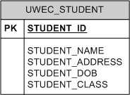
Composite Attributes
In general, always decompose into atomic components for:
    Sorting
    Searching
    Formatting
Student_First_Name
Student_MI
Student_Last_Name
Student_Address_Line_1
Student_Address_Line_2
Student_City
Student_State
Student_Country
Student_Postal_Code

Slide 27
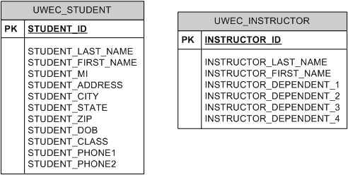
Multi-Valued Attributes
Attribute that might have multiple values for the same entity:

Slide 28
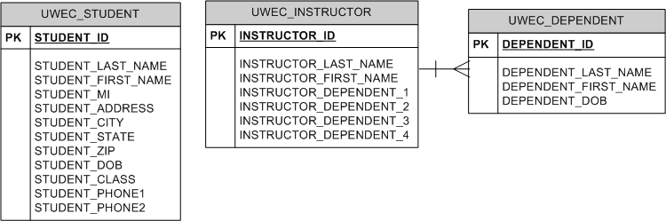
Modeling Multi-Valued Attributes
If it has a definite maximum number, leave as a repeating attribute
If the upper limit is variable, make a new entity and create a relationship

Slide 29
Derived Attributes
Value that can be derived from other attributes
  Student_Age = 25 (DOB = 11/20/1986, current date is 11/13/2012)
  Order_Total = $500 (Item1 cost = $200, Item2 cost = $300)

Slide 30
Modeling Derived Attributes
In general, don't store derived attributes
Instead, create attributes to represent the underlying data values from which you can derive the value
  Examples:
    DOB => Age
    Current_Price and Units_Sold of an item (for a sales order)

Slide 31
Today's Topics
Introduction to data models
  Definition
  Motivation
Entity-relationship data models
  Entities
  Attributes
  Relationships

Slide 32
Data Model Relationships
Specify the number of instances of one entity that can be associated with instances of a related entity
Types:
  1:M
  1:1
  M:M
  “M” denotes some value greater than 1 whose upper bound is undetermined
  This is called relationship cardinality

Slide 33
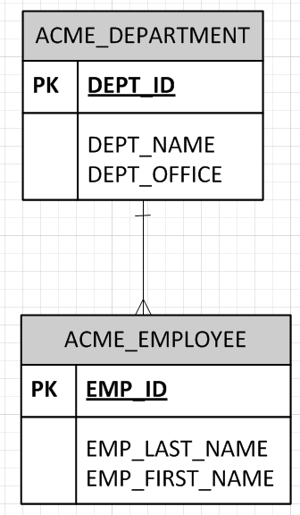
Example 1:M Relationship
DEPT_ID | DEPT_NAME | DEPT_OFFICE
1 | Accounting | NW 130
2 | IT | SW 450
EMP_ID | EMP_LAST_NAME | EMP_FIRST_NAME
1000 | Coyote | Wiley
1001 | Bunny | Bugs
1002 | Bird | Tweety
1003 | Fudd | Elmer

Slide 34
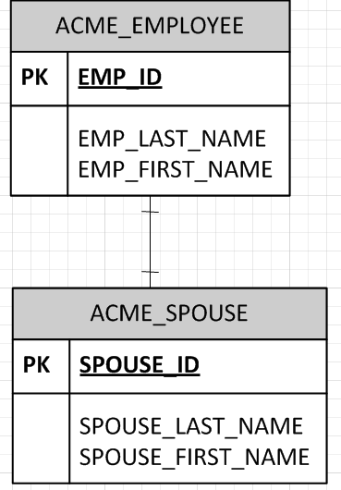
Example 1:1 Relationship
EMP_ID | EMP_LAST_NAME | EMP_FIRST_NAME
1000 | Coyote | Wiley
1001 | Bunny | Bugs
1002 | Runner | Road
1003 | Fudd | Elmer
SPOUSE_ID | SPOUSE_ LAST_NAME | SPOUSE_ FIRST_NAME
1 | Devil | Tas
2 | Fudd | Granny

Slide 35
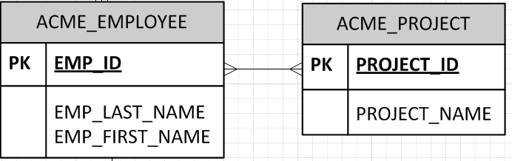
Example M:M Relationship
EMP_ID | EMP_LAST_NAME | EMP_FIRST_NAME
1000 | Coyote | Wiley
1001 | Bunny | Bugs
1002 | Runner | Road
1003 | Fudd | Elmer
PROJECT_ID | PROJECT_NAME
100 | Drop Safe
101 | Go to Albuquerque
102 | Shoot Wabbit
103 | Get Run Over By Train

Slide 36
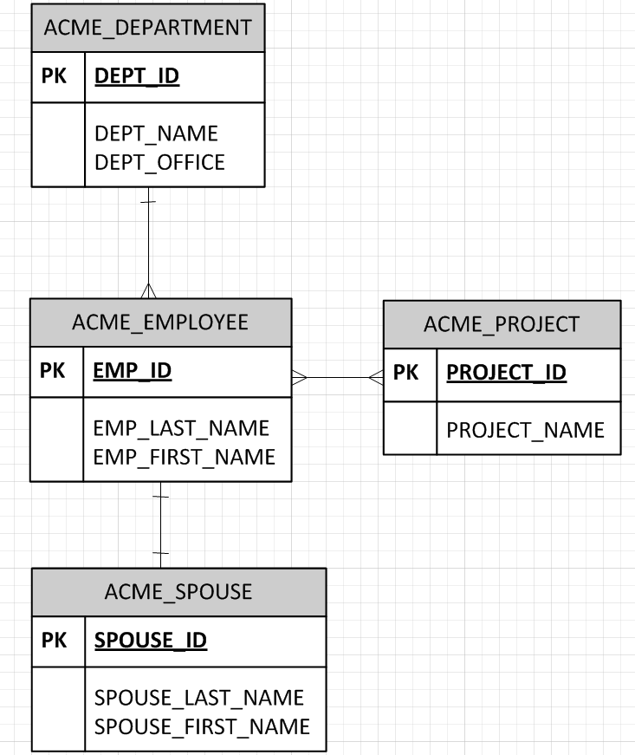
Example ER Model

Slide 37
Summary: The Data Modeling Process
Define entities
Define attributes & primary keys
Define relationships

Slide 38
Class Exercise:
Draw an ER Model for the following system:
Al’s Body Shop keeps data on customers that includes name,
address, phone number, car make, car model, car year, and VIN.
When a customer brings a car in for service, the service manager
completes a work order that contains the date of the service,
the name of each service performed, a description of each service,
and the charge for each service.

Slide 39
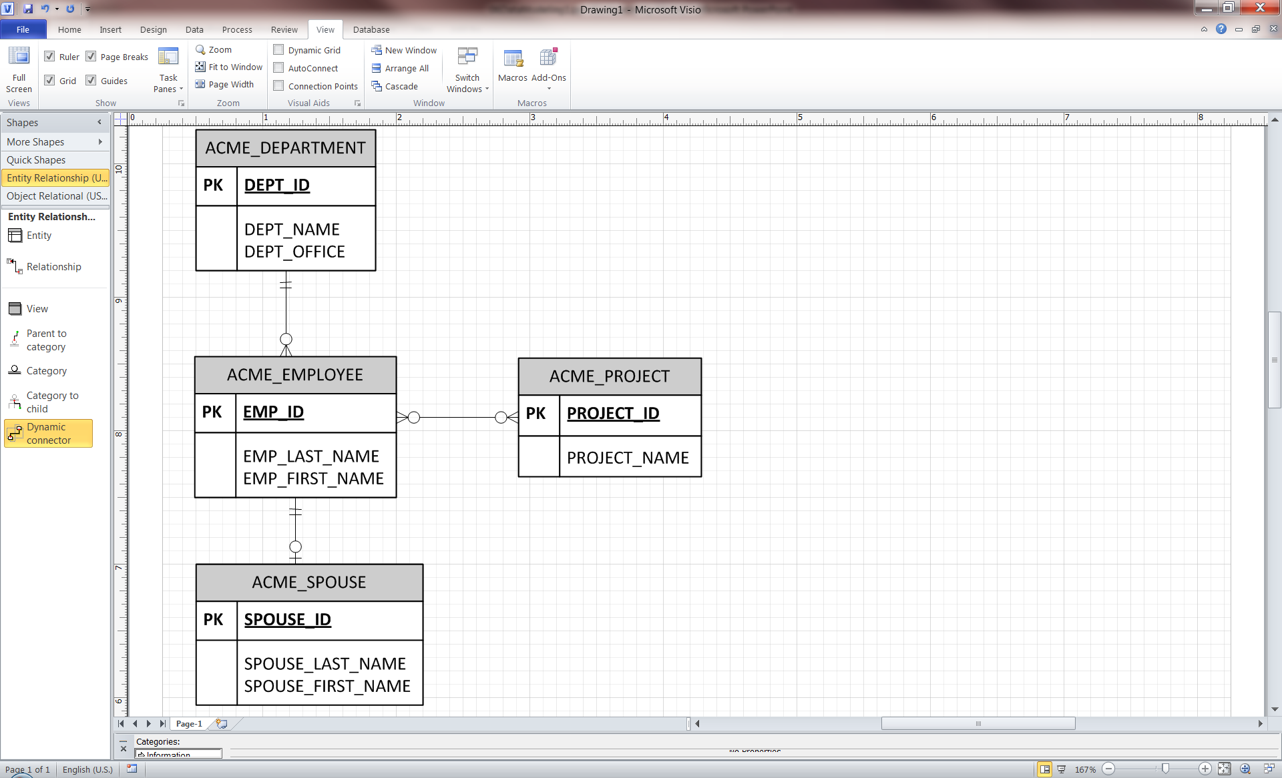
Relationship Lower Bounds
Lower bound: minimum number of related instances in a relationship
  Value is typically 0 or 1
“A department has 0 to many employees”
HAS
“An employee has one and only one department"

Slide 40
More Lower Bound Examples
Implication: Lower bound of 1 creates a dependency
  You have to insert the DEPARTMENT instance before you insert the EMPLOYEE instance
  You have to insert the EMPLOYEE instance before you insert the SPOUSE instance

Slide 41
How Do You Select Upper and Lower Bounds?
Business rules of the organization
Database design decisions
  Example: Auto service center
  Guidelines:
    Make the system as flexible as possible
      Make lower bounds 0 whenever possible
    Make the system as simple as possible
      Avoid M:M relationships if you can
Car
Car_ID
Car_Make
Car_Model
Car_Year
Customer
Customer_ID
Customer_Name
Customer_Address
owns
?
?

Slide 42
Summary: The Data Modeling Process
Define entities
Define attributes
Define relationships
Identify relationship cardinality (1:1, 1:M, M:M, upper AND lower bounds)

Slide 43
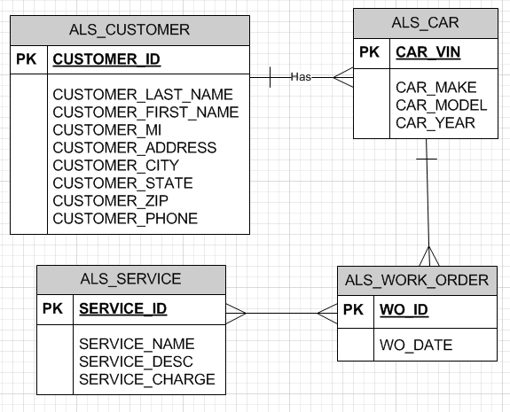
Class Exercise:
Add lower bounds to the relationships for Al's Body Shop

Slide 44
Class Exercise: Create an ER model for the following system
UW- Eau Claire keeps data on students including student ID, student name, campus address and phone number, permanent address and phone number, and email address.
Data is also kept on courses that are offered. This data includes the course call ID (like ‘CS 260’), course name (like ‘Database Systems’), the long course description that appears in the catalog, the semester offered (such as "Fall 2012", section number, day, time, location, and instructor.
Instructor data includes instructor ID, name, title, department, office location, and office phone number. Instructors teach courses, and instructors also advise students. Students enroll in course sections.

