Slide 1
Advanced Data Modeling
CS 260

Slide 2
Topics
Advanced data modeling concepts
  Composite relationships
  Degree of a relationship
  Homonyms and synonyms
  Relationship participation
  Weak and strong entities
  Strategies for identifying entities and attributes

Slide 3
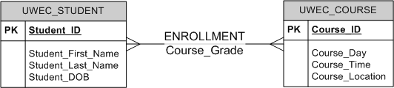
Composite Relationship
Relationship that has attributes
Always has M:M cardinality
Attribute of
the relationship

Slide 4
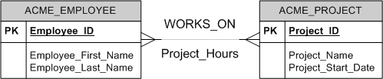
Composite Relationships:
Another Example
Attribute of
the relationship

Slide 5
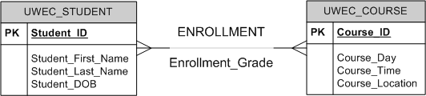
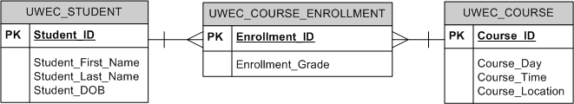
Decomposing a Composite Relationship
Can always be replaced with a new entity that has 1:M relationships with the former entities
Attribute is in the new entity

Slide 6
Today's Topics
Advanced data modeling concepts
  Composite relationships
  Degree of a relationship
  Homonyms and synonyms
  Relationship participation
  Weak and strong entities
  Strategies for identifying entities and attributes

Slide 7
Degree of a Relationship
Specifies the number of entities that participate in a relationship
Up until now, all relationships have been binary (2 entities)

Slide 8
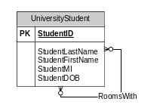
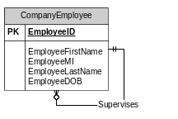
Unary Relationships
Entity has a relationship with itself

Slide 9
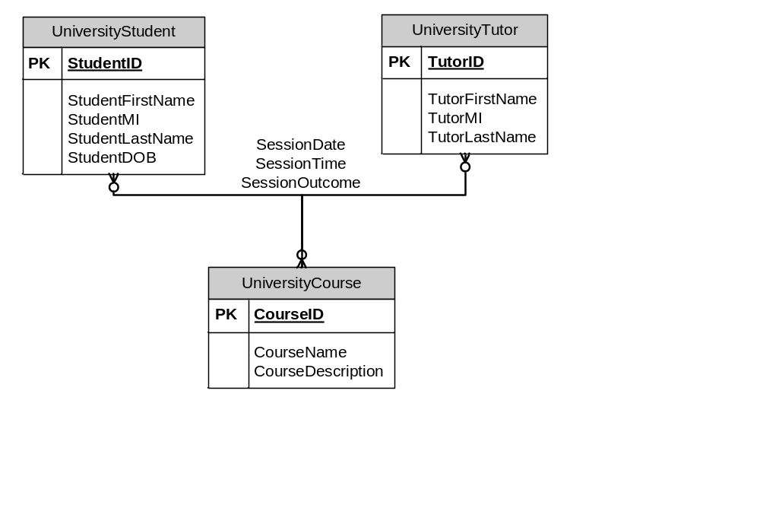
Ternary Relationships
Relationship exists among 3 entities

Slide 10
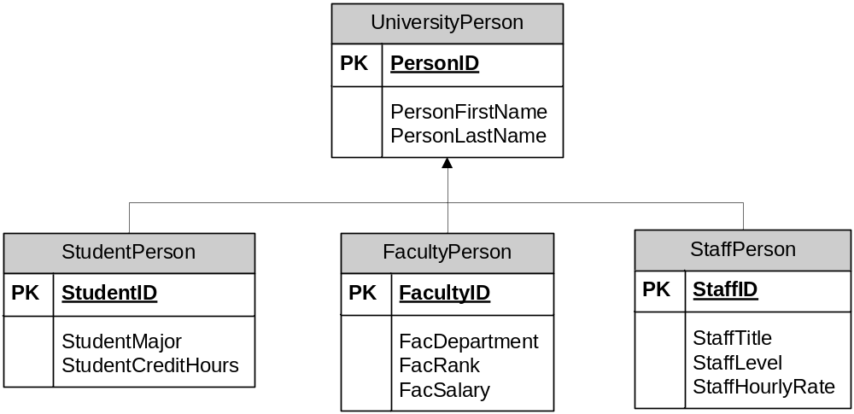
Generalization/Specialization Relationships
Do not show cardinalities
Supertype
Subtypes

Slide 11
How common are these?
Unary
  Rare
Ternary
  More common than you would think
Generalization/Specialization
  You can always avoid them by creating separate entities for the specializations
But: Be aware that they can exist and how you represent them!

Slide 12
A relationship must always involve at least two entities.
True
False
I don't know

Slide 13
A relationship can never involve more than 3 entities.
True
False
I don't know

Slide 14
Today's Topics
Advanced data modeling concepts
  Composite relationships
  Degree of a relationship
  Homonyms and synonyms
  Relationship participation
  Weak and strong entities
  Strategies for identifying entities and attributes

Slide 15
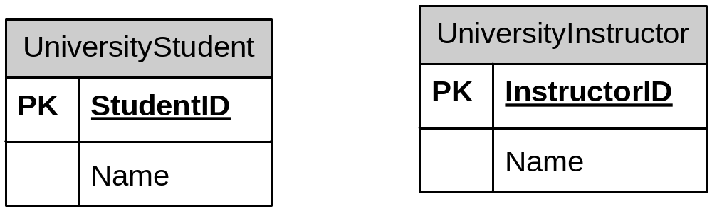
Homonyms
Homonym: different attributes have the same name
  Avoid!
  Attributes should take their name from their entity

Slide 16
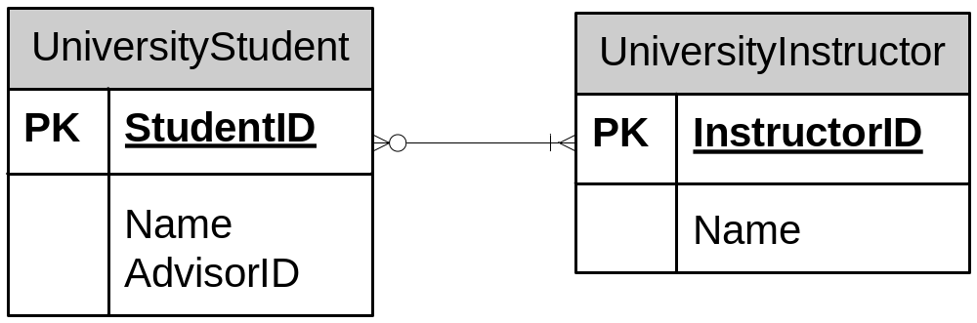
Synonyms
Synonym: same attribute has different names in different tables
  FK field should have same name as PK field, unless another name makes it A LOT more descriptive
  How should you change these entities?
(FK)

Slide 17
Synonyms
  How should you change these entities?
  AdvisorID seems a "lot" more descriptive than InstructorID would – no change!
  Did you notice the relationship cardinalities?
    How can a student have more than one advisor if this also the table design?
    (can't do it as shown)
(FK)

Slide 18
Today's Topics
Advanced data modeling concepts
  Composite relationships
  Degree of a relationship
  Homonyms and synonyms
  Relationship participation
  Weak and strong entities
  Strategies for identifying entities and attributes

Slide 19
Relationship Participation
For an entity, participation in a relationship can be optional or mandatory...

Slide 20
Relationship Participation
Optional (partial participation)
  Participation in the relationship is optional for the entity
  Identified by having 0 as the lower bound in the cardinality
Work_Order
Work_Order_ID
Work_Order_Date
Service
Service_ID
Service_Name
Service_Desc
is performed on

Slide 21
Relationship Participation
Mandatory (total participation)
  Participation in the relationship is required for the entity
  Identified by having a value > 0 as the lower bound in the cardinality
Work_Order
Work_Order_ID
Work_Order_Date
Service
Service_ID
Service_Name
Service_Desc
is performed on

Slide 22
Weak Entities
Entity that is:
  A subordinate of another entity
  Defined by its relationship(s) with other entities
It cannot exist on its own!
  Typically shown with a double outline

Slide 23
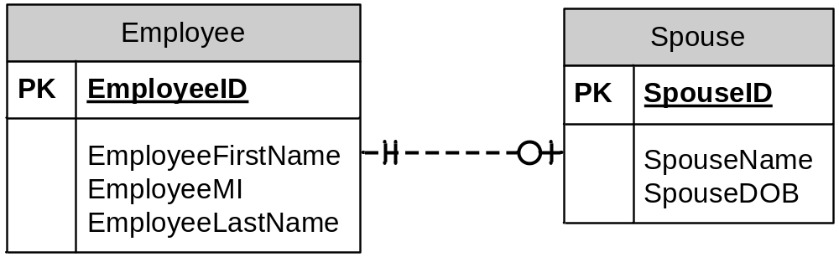
What are the strong entities?
The key is having "1" as
a lower bound.
What are the weak entities?
has
has
Course
CourseID
CourseName
CourseDay
CourseTime
CourseLocation
Student
StudentID
StudentFirstName
StudentLastName
StudentAddress
StudentDOB
StudentClass
Enrollment
EnrollmentID
CourseGrade
Has
Has

Slide 24
Class Discussion:
Why is it necessary to think about participation and weak/strong entities anyway?

Slide 25
Today's Topics
Advanced data modeling concepts
  Composite relationships
  Degree of a relationship
  Homonyms and synonyms
  Relationship participation
  Weak and strong entities
  Strategies for identifying entities and attributes

Slide 26
Strategies for Developing ER Models
How do you decide if an item is an entity or an attribute?
  An item is an entity if:
    Multiple instances exist (or might exist) in the database
    All instances have the same attributes
  An item is an attribute if:
    It is a property of an entity instance
    Each entity instance has a single value for that property

Slide 27
Strategies for Associating an Attribute With the Correct Entity
To which entity does an attribute belong?
  Example: Is AdvisorName an attribute of a UniversityStudent instance?
  Answer: Only if each advisor only advises only one student. Otherwise, you are repeating the name multiple times.
  The ONLY thing that you can repeat in tables is a foreign key value!
Strategy:
  If a non-foreign key attribute value repeats in multiple entities, it is not associated with the correct entity

