Slide 1
Deriving Database Tables from ER Models
CS 260

Slide 2
Today's Topics
Review: levels of data models
Steps for transforming an ER Model to a logical table design

Slide 3
Review: Data Model Levels
  Conceptual: describes WHAT data the system contains (independent of DBMS)
    ER Model
  Logical: describes HOW the database will be structured (independent of DBMS)
    Relational table design
  Physical: describes HOW the system will be implemented using a specific DBMS
    DDLs to create tables

Slide 4
Goal of Logical DB Design:
Database Integrity
Entity integrity
  Every record must have a unique primary key
  The primary key cannot be NULL
    For a composite key, no part of it can be NULL
Referential integrity
  Every foreign key must be the primary key of its parent table
  Every foreign key value must exist in its parent table
No duplicate data values except FKs

Slide 5
Steps for Transforming an ER Model to a Logical Database Design
Create a table to represent every strong entity
  PK of entity is PK of table
  We'll discuss how to handle weak entities later
Represent relationships using foreign keys and/or linking tables

Slide 6
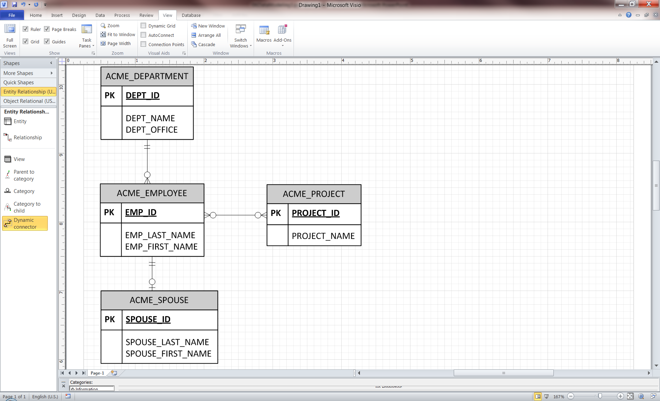
Representing 1:M Relationships
Put the PK of the “1” side into the “M” table
PK of entity is PK of table
ACME_EMPLOYEE(Emp_ID,
Emp_Last_Name, Emp_First_Name,, Dept_ID (FK))
ACME_DEPARTMENT(Dept_ID,
Dept_Name, Dept_Office)
Emp_ ID | Emp_ Last_ Name | Emp_ First_ Name | Dept_ ID (FK)
1000 | Coyote | Wiley | 1
1001 | Bunny | Bugs | 1
1002 | Bird | Tweety | 2
1003 | Fudd | Elmer | 2
Dept_ ID | Dept_Name | Dept_Office
1 | Accounting | NW 130
2 | IT | SW 450
3 | Production | NW 100

Slide 7
Question:
Why can’t you put the PK of the “M” side into the “1” table?
  Approach 1: delimit multiple values using commas
  Approach 2: Repeat "1" side records for each "M" record
Dept_ID | Dept_Name | Dept_ Office | Emp_ID
1 | Accounting | NW 130 | 1001, 1002
2 | IT | SW 450 | 1002, 1003
3 | Production | NW 100
Result: Non-atomic attributes
(cell contains multiple
values)
Dept_ ID | Dept_ Name | Dept_ Office | Emp_ID
1 | Accounting | NW 130 | 1001
1 | Accounting | NW 130 | 1002
2 | IT | SW 450 | 1003
Result: Non-unique PKs, repeating non-FK fields

Slide 8
Specifying Table Structures in Logical Design
Specify the structure of a table using a relation
  Contains: table name, fields names, and PK/FK field identifiers
    Underline PKs
    Label FKs using notation: (FK)
Example relations:
ACME_DEPARTMENT(dept_id, dept_name, dept_office)
ACME_EMPLOYEE(emp_id, emp_last_name, emp_first_name, dept_id (FK))

Slide 9
Representing M:M Relationships
Create a linking table
  Also called a bridge table
  Table name is a compound word made of both parent table names
PK is a composite key comprised of PK’s of both entities
  Both PKs are also FKs

Slide 10
Representing M:M Relationships
EMP_ID | EMP_LAST_NAME | EMP_FIRST_NAME
1000 | Coyote | Wiley
1001 | Bunny | Bugs
1002 | Runner | Road
1003 | Fudd | Elmer
PROJECT_ID | PROJECT_NAME
100 | Drop Safe
101 | Go to Albuquerque
102 | Shoot Wabbit
103 | Get Run Over By Train
EMP_ID (FK) | PROJECT_ID (FK)
1000 | 100
1002 | 100
1001 | 102
1000 | 103
1002 | 103
1003 | 102
composite PK
ACME_EMP_PROJECT
(emp_id (FK),
project_id (FK))

Slide 11
Representing M:M Relationships
If the relationship has an attribute, place the attribute in the linking table
hours
EMP_ID (FK) | PROJECT_ID (FK) | EMP_PROJ_HOURS
1000 | 100 | 14
1002 | 100 | 32
1001 | 102 | 4
1000 | 103 | 7.5
1002 | 103 | 8
1003 | 102 | 0
ACME_EMP_PROJECT
(emp_id (FK),
project_id (FK),
emp_proj_hours)

Slide 12
How many database tables would you create for the following ER model?
Customer
CustomerID
CustomerName
Car
CarVIN
CarMake
CarModel
CarYear
owns
has
WorkOrder
WorkorderID
WorkorderDate
Service
ServiceID
ServiceDesc
ServiceCharge
has
ServiceHours
3
4
5
6
None of the above

Slide 13
Specifying Whether FK values can be NULL
1:M Relationships:
  if the "1" side of the relationship is mandatory (lower bound > 0), the FK cannot be NULL
Department
DID
DName
DOffice
Employee
EID
EName
EOffice
EPhone
EID | EName | EOffice | DID (FK, NN)
100 | Smith | SSS112 | 1
200 | Jones | SSS116 | 1
300 | Brown | SSS107 | 2
Works In

Slide 14
Specifying Whether FK values can be NULL
1:M Relationships:
  If the "1" side of the relationship is optional, the FK can be NULL
  Tends to be rare…
ServiceProject
SPID
SPName
SPDesc
Works On
Student
SID
SName
SAddress
SEmail
SID | SName | ... | SPID (FK, NA)
100 | Smith | ... | 1
200 | Jones | ... | NULL
300 | Brown | ... | 1

Slide 15
Today's Topics
Review: levels of data models
Transforming an ER Model to a logical table design
  1:M and M:M relationships
  NULL foreign key constraints
  1:1 relationships
  Unary/ternary/gen-spec relationships

Slide 16
Deriving Tables for 1:1 Relationships
Depends on:
  Whether one of the entities is weak
  Whether the relationship is mandatory or optional

Slide 17
Deriving Tables for 1:1 Relationships
Case 1: When one entity is weak
  Merge weak entity's attributes into strong entity's table
    Remove weak entity's PK if it is a surrogate key
EMPLOYEE
EMP_ID
EMP_NAME
EMP_OFFICE
SPOUSE
SPOUSE_ID
SPOUSE_NAME
EMPLOYEE
EMP_ID
EMP_NAME
EMP_OFFICE
EMP_SPOUSE_NAME
  Does it ever make sense to keep the weak entity?

Slide 18
Deriving Tables for 1:1 Relationships
Case 2: One side mandatory, one side optional, neither entity is weak
  Create 2 tables
  Put PK of mandatory side in optional table as an FK
Faculty
Faculty_ID
Faculty_Name
Faculty_Rank
Office
Office_ID
Office_Bldg
Office_Room
FACULTY
Faculty_ID
Faculty_NAME
Faculty_Rank
Office_ID (FK, NN)
OFFICE
Office_ID
Office_Bldg
Office_Room

Slide 19
Deriving Tables for 1:1 Relationships
Case 3: Both sides mandatory, neither entity is weak
  Place the FK of one into the other
  But which one?
    Don't do both, this creates a circular dependency!
    Consider the most common query(ies)
For example…

Slide 20
Deriving Tables for 1:1 Relationships
  Most common query is "Who is a department's associate?"
Univ_Department
Dept_ID
Dept_Name
Dept_Office
Univ_Associate
Associate_ID
Associate_Name
UNIV_DEPARTMENT
Dept_ID
Dept_Name
Dept_Office
Chair_Name
Associate_ID (FK, NN)
Univ_Associate
Associate_ID
Associate_Name

Slide 21
Deriving Tables for 1:1 Relationships
  Most common query is "What departments do associates work for?"
Bldg_Office
Office_ID
Office_Location
Office_Phone
Univ_Department
Dept_ID
Dept_Name
Dept_Office
Univ_Associate
Associate_ID
Associate_Name
UNIV_DEPARTMENT
Dept_ID
Dept_Name
Dept_Office
Univ_Associate
Associate_ID
Associate_Name
Dept_ID (NN)

Slide 22
Deriving Tables for 1:1 Relationships
Case 4: Both sides optional, neither entity is weak
  Depends if relationship exists for most instances...
  Consider the question: Are most students likely to be issued laptops?
UnivStudent
Student_ID
Student_Name
Is issued
LaptopComputer
Laptop_ID
Laptop_Brand
Laptop_Processor

Slide 23
Both sides optional, neither entity is weak
If relationship is likely to exist for most entity instances, put the PK of one into the other as an FK
  Save storage space by placing FK in table with fewest instances
UnivStudent
Student_ID
Student_Name
LaptopComputer
Laptop_ID
Laptop_Brand
Laptop_Processor
LaptopComputer
Laptop_ID
Laptop_Brand
Laptop_Processor
Student_ID (FK, NA)
Univ_Student
Student_ID
Student_Name

Slide 24
Both sides optional, neither entity is weak
If relationship is likely to exist for only a few instances, create a linking table
  Less storage space than putting Laptop_ID in UnivStudent as foreign key and having it be NULL most of the time, or putting Student_ID as FK in LaptopComputer and having it be NULL most of the time
UnivStudent
Student_ID
Student_Name
LaptopComputer
Laptop_ID
Laptop_Brand
Laptop_Processor
LaptopComputer
Laptop_ID
Laptop_Brand
Laptop_Processor
UnivStudent
Student_ID
Student_Name
StudentLaptop
Laptop_ID
Student_ID
Checked_Out
Checked_In
Main advantage of linking table is
ability to have other attributes

Slide 25
Summary: Deriving tables for 1:1 relationships
Lots of scenarios
  You need to really think about the data
  Do not create circular relationships!
  If you're not sure:
    No harm is done by making 2 tables and placing PK of one in the other as an FK

Slide 26
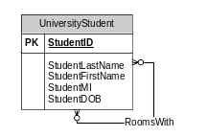
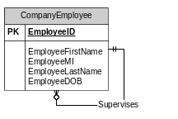
Unary Relationships
Treat just like any other relationship
StudentRoommate
Student1ID (FK, NN)
Student2ID (FK, NN)
Student3ID (FK, NA)
…
StudentNID (FK, NA)
Company_Employee
EmployeeID
EmployeeFirstName
EmployeeMI
EmployeeLastName
EmployeeDOB
SupervisorID (FK, NN)

Slide 27
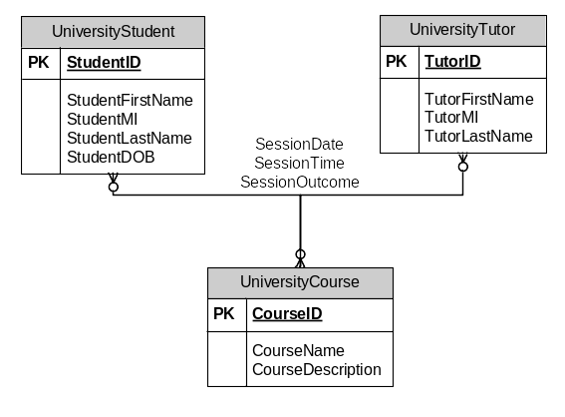
Ternary Relationships
Create a 3-way linking table
StudentTutorSession
StudentID (FK, NN)
TutorID (FK, NN)
CourseID (FK, NN)
SessionDate
SessionTime
SessionOutcome

Slide 28
Generalization/Specialization
Subtype is a weak entity
  Create tables for both supertype and subtype
  Put PK of supertype into subtype table as both a PK and FK

Slide 29
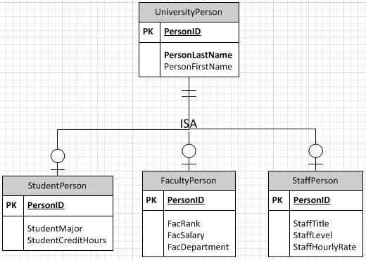
Generalization/Specialization
UniversityPerson
PersonID
PersonFirstName
PersonLastName
I'm showing cardinalities
in this diagram. Is this
a good idea?
StudentPerson
PersonID(FK, NN)
StudentMajor
StudentCreditHours
FacultyPerson
PersonID(FK, NN)
FacDepartment
FacRank
FacSalary
StaffPerson
PersonID(FK, NN)
StaffTitle
StaffLevel
StaffHourlyRate

Slide 30
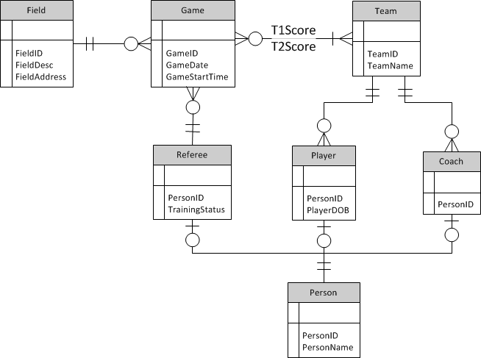
2
Class
Exercise
Derive the relational database tables for this ER Model of a youth soccer league. Label PK's and FK's in all tables, and specify whether FK's can be NULL.

