Slide 1
Data Normalization
CS 260

Slide 2
Topics
What is normalization
Normal forms
  1NF
  2NF
  3NF
Denormalization

Slide 3
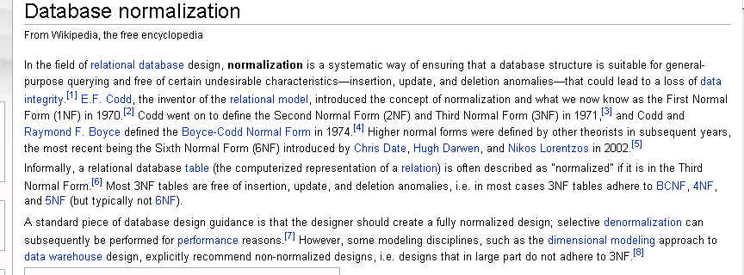
What is normalization?

Slide 4
Why Normalization?
ER model is "top down"
  Identify entities, attributes, then relationships
Normalization is "bottom up"
  Identify system data items and create groupings and dependencies that lead to tables and relationships
  Aids in identifying errors in ER model relationships

Slide 5
Review: Types of "undesirable characteristics"
Anomalies:
  Insertion
  Update
  Deletion

Slide 6
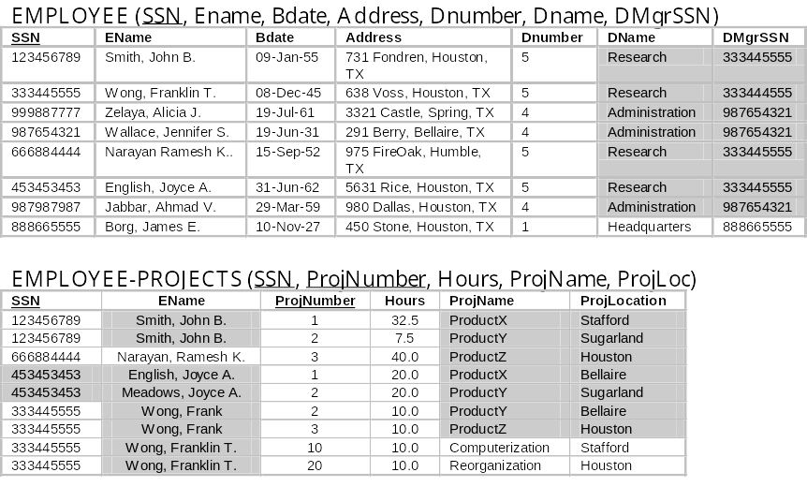
Review: Example of Redundant Data
Admin

Slide 7
Insertion Anomalies
Occur when:
  Inserting a new row causes data to become inconsistent
    DName spelling errors
  You can't insert a new row because its primary key can't be defined
    You want to create a new project but it doesn't yet have any employees

Slide 8
Update Anomalies
Occur when:
  You fail to update all instances of a data value
    Joyce English/Meadows
    Product X locations

Slide 9
Deletion Anomalies
Occur when:
  You delete a row and inadvertently delete other data you don't want to delete
  Example:
    Delete Frank Wong and lose the data for projects that isn't stored anywhere else

Slide 10
Normalization Simplified:
Process of breaking tables into smaller tables to remove redundant data that can lead to data anomalies
Goal: all fields in a relation are 100% determined by the relation's key field(s)

Slide 11
Normal Forms
1NF
2NF
3NF
BCNF
  Boyce-Codd normal form
4NF
5NF
6NF
Adequate for
Practical use
Rarely occurs
Entering the theoretical realm
and usually only discussed
in MS and PhD theses

Slide 12
Topics
What is normalization
Definitions of normal forms
  1NF
  2NF
  3NF
Denormalization

Slide 13
Normal Forms
First Normal Form (1NF):
  No repeating groups within table cells
    Each cell contains only one atomic data value

Slide 14

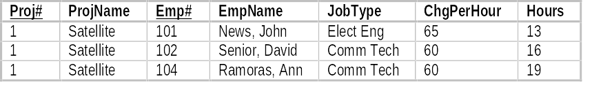
1NF Examples
Non-1NF Table
1NF Table

Slide 15
Dependency Diagram
Used to describe higher (2nd, 3rd, BC) normal forms
Shows functional dependencies
  If R is a entity (or table) and A and B are non-empty sets of attributes (or fields), B is functionally dependent on A if, and only if, each value of A in R has associated with it exactly one value of B in R.
    This is written as A B
  In other words, the value of one data item unambiguously determines the value of a second data item
  Example: PROD_ID PROD_DESC
Dependency diagram
  shows functional dependencies for a single entity or table

Slide 16
Example Dependency Diagrams
EMPLOYEE_FIRST_NAME
EMPLOYEE_LAST_NAME
EMPLOYEE_ID
PROJECT_NAME
PROJECT_DESC
PROJECT_LOCATION
PROJECT_ID
EMPLOYEE_ID
+
PROJECT_ID
EMP_PROJ_HOURS

Slide 17
Candidate Keys
A minimal set of attributes that uniquely identifies a row of data
A table potentially has more than one set of candidate keys
CANDY_PRODUCT:
  Candidate keys: PROD_ID, PROD_DESC (requires descriptions to be unique)
CANDY_CUSTOMER
  Candidate keys: CUST_ID, USERNAME (requires usernames to be unique)

Slide 18
Process for Creating a Dependency Diagram
Each table has an associated dependency diagram
Identify fields that determine the values of other fields
Draw arrows to show dependencies

Slide 19
Dependency Diagram:
PROJ#
+
EMP#
ProjName
Location
}
Hours
EmpName
JobType
ChargePerHour

Slide 20
Second Normal Form (2NF)
A table is in second normal form if:
  It is in 1NF AND
  It contains no partial dependencies
Partial dependency:
  Occurs when primary key consists of two or more fields;
  AND, a non-key field's value can be determined with only part of the key

Slide 21
Partial Dependencies:
PROJ#
+
EMP#
ProjName
Location
}
Hours
EmpName
JobType
ChargePerHour

Slide 22
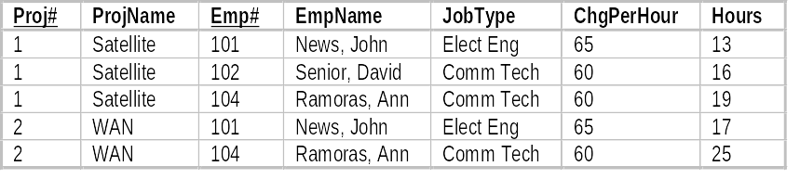
1NF Table & Dependency Diagram
Partial Dependencies

Slide 23
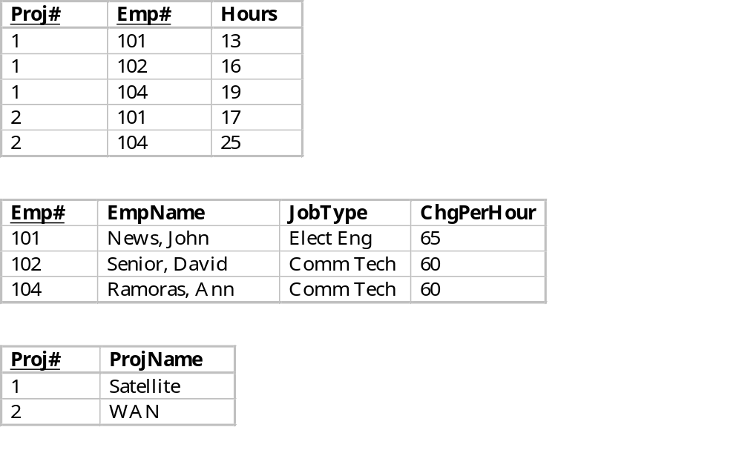
Solution: Remove partial dependencies by creating new tables in which all attributes only depend on the key:
Transitive dependency
still exists in 2NF!

Slide 24
Third Normal Form (3NF)
A table is in 3NF if:
  It is in 2NF AND
  There are no transitive dependencies
    Transitive dependency: non-key field that determines the value of another non-key field
A table is in 3NF if (alternate definition):
  It is in 2NF AND
  all non-key attributes are directly dependent on the table's key

Slide 25
2NF Example Tables
Non-key attributes:
EmpName
JobType
ChgPerHour
Violates 3NF
Transitive dependency
Emp# -> JobType -> ChgPerHour
Non-key ChgPerHour depends on
the non-key JobType attribute

Slide 26
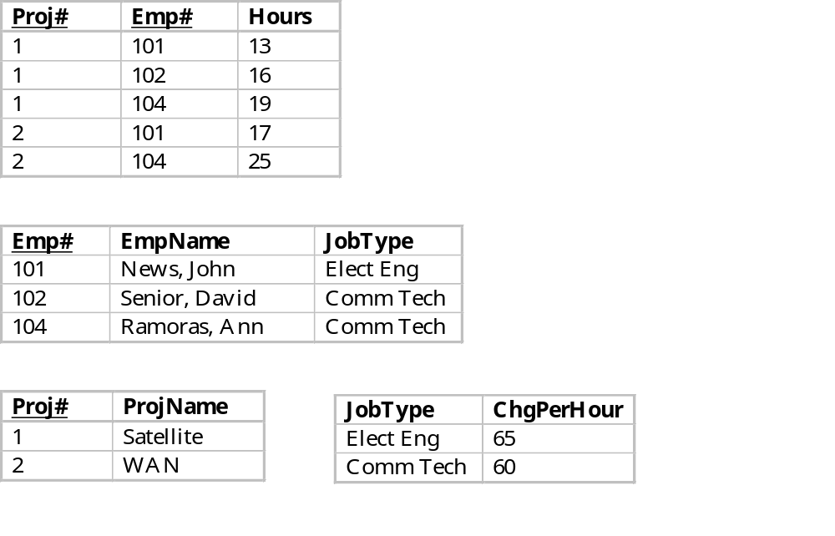
Solution: Remove transitive dependency by creating a new table

Slide 27
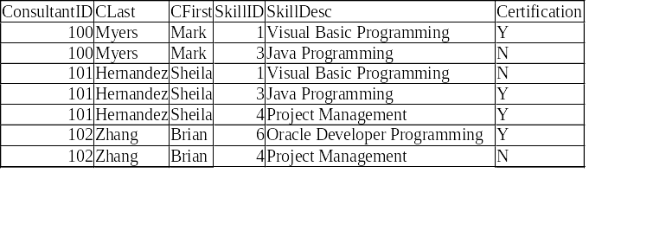
Class Exercise
Draw the dependency diagram and identify the normal form of the following table:

Slide 28
Normalization in Practice
ER Diagrams and associated table derivation rules "usually" result in 3NF tables
Dependency diagrams used to check and revise as needed

Slide 29
Topics
What is normalization
Definitions of normal forms
  1NF
  2NF
  3NF
Denormalization

Slide 30
Denormalization
Normalized database tables add processing complexity
  Increased disk I/O’s for multiple insert, update, delete operations
  More processing for complex join operations
Sometimes a database structure needs to be denormalized (tables combined into fewer tables) to achieve system performance
  Test to determine you have bottlenecks before you denormalize

Slide 31
Summary
Normal Forms
  1NF: tabular
  2NF: 1 NF plus no partial dependencies
  3NF: 2NF plus no transitive dependencies
ER diagrams "usually" result in 3NF tables
Sometimes database designs need to be denormalized to improve query performance

Slide 32
Exercise
Draw an initial dependency diagram for the Henry's Bookstore database (next slide)
Decompose the database so it demonstrates 2NF
Decompose the database again so it demonstrates 3NF
Draw the ER model for the database

Slide 33
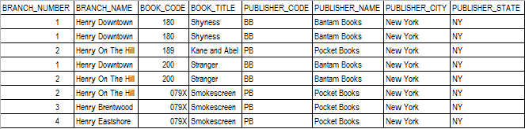
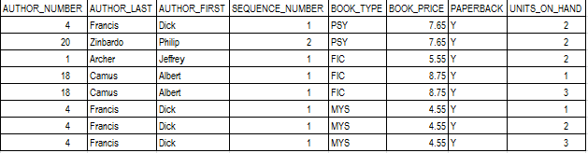
This is
one table!
Indicates whether author is 1st author, 2nd author, etc.

