Slide 1
Creating Stored Database Programs
CS 260

Slide 2
Review: Anonymous Programs
So far, we have looked at anonymous PL/SQL programs
  Write and execute code in an Oracle command-line SQL environment
  Code could be stored as text in a file system
Limitations:
  Programs can't be called by other programs or executed by other users
  Programs can't accept or pass parameter values

Slide 3
Stored PL/SQL Programs
Stored as objects in a database schema
  Persistent
Must have a unique name in the database schema
Are stored in a compiled form
Can be called by other programs and accept input parameters
Can be executed by other users

Slide 4
Stored Program Types
Procedures
Functions
Packages
Triggers

Slide 5
Stored Procedures and Functions
Procedures
  Can receive and pass multiple parameter values
  Can call other program units
Functions
  Similar to procedures except they return a single value

Slide 6
Stored DB Program Parameters
Declared in the procedure header
Parameter values are passed when the procedure is called from the calling program

Slide 7
Parameter Modes
IN
  Incoming values, read-only
  Think: pass by value - Java
OUT
  Outgoing values, write-only
  Acts like an uninitialized variable declaration – must be assigned a value in the procedure
  Nothing comparable in Java (that comes to mind...)
IN OUT
  Readable and writeable
  Think: pass by reference - Java

Slide 8
Creating a Stored Procedure
CREATE OR REPLACE PROCEDURE procedure_name
(parameter1 mode datatype,
parameter2 mode datatype, …
) IS | AS
local variable declarations
BEGIN
program statements
EXCEPTION
exception handlers
END;
/
header
body

Slide 9
Parameter Types
Formal parameters: declared in procedure header
  Don’t specify the maximum size!
Actual parameters: values placed in parameter list when procedure is called
  Values correspond based on order
Procedure Header:
Formal Parameters
PROCEDURE calc_gpa (s_id IN NUMBER, term_id IN NUMBER, gpa OUT NUMBER);
Actual Parameters in procedure call
Procedure Call:
EXECUTE calc_gpa (current_s_id, 4, current_gpa);

Slide 10
Procedure Example
COMMIT; -- make sure session is in stable state
CREATE OR REPLACE PROCEDURE update_delivery_date
(curr_purch_id IN candy_purchase.purch_id%TYPE,
new_delivery_date IN DATE)
IS
curr_purch_date candy_purchase.purch_date%TYPE;
BEGIN
SELECT purch_date INTO curr_purch_date FROM candy_purchase
WHERE purch_id = curr_purch_id;
IF curr_purch_date <= new_delivery_date THEN
UPDATE candy_purchase SET delivery_date = new_delivery_date
WHERE purch_id = curr_purch_id;
DBMS_OUTPUT.PUT_LINE('Delivery date updated');
END IF;
COMMIT;
END;

Slide 11
Calling a Procedure
Can be called:
  From another stored procedure
  Or from an anonymous PL/SQL block
EXECUTE procedure_name(parameter1_value, parameter2_value, …);
EXECUTE update_delivery_date (1, SYSDATE);

Slide 12
Creating a Stored Function
CREATE OR REPLACE FUNCTION function_name
(parameter1 mode datatype,
parameter2 mode datatype, …
)
RETURN function_return_data_type;
local variable declarations
BEGIN
program statements
RETURN return_value;
EXCEPTION
exception handlers
RETURN EXCEPTION_NOTICE;
END;
header
Specifies data type
Of return value
Specifies actual
return value
body
Specifies to display the
exception notice in the
calling program

Slide 13
Calling a Function
Can be called from either a stored program or an anonymous PL/SQL block
Can be called from an SQL query
return_value :=
function_name(param1_value, param2_value, …);

Slide 14
Example Stored Function
CREATE OR REPLACE FUNCTION calc_age (dob IN DATE)
RETURN NUMBER IS age NUMBER;
BEGIN
age := TRUNC(MONTHS_BETWEEN(SYSDATE, dob) / 12);
RETURN age;
END;

Slide 15
Example Stored Function Call
SELECT calc_age
(TO_DATE('11/20/1986', 'MM/DD/YYYY'))
FROM dual;

Slide 16
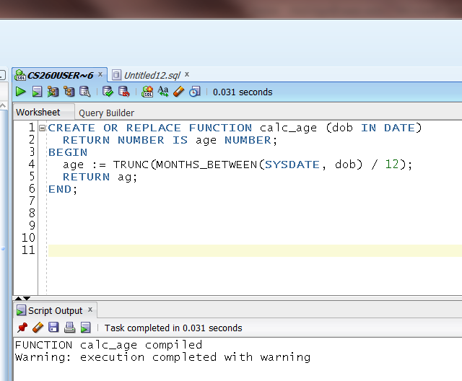
Debugging Stored Programs
SQL Developer does not show error messages for stored programs:

Slide 17
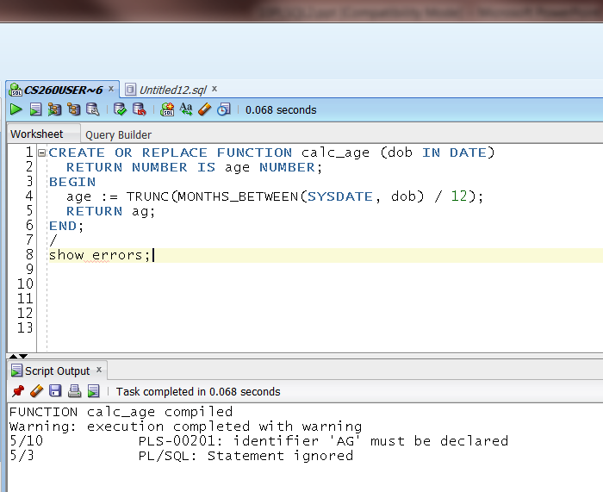
Debugging Stored Programs
Solution: type "/" (executes the previous statement) then "show errors;"

Slide 18
Stored Program Object Privileges
Stored programs exist as objects in a database schema
To allow other users to use your programs, you must grant them EXECUTE privileges:
GRANT EXECUTE ON procedure_name TO username;
GRANT EXECUTE ON calc_age TO PUBLIC;

Slide 19
Using Stored Program Units
That Belong to Other Users
You must have been granted the privilege to use it
You must preface the procedure name with the owner’s schema name
SELECT CS260USER.calc_age(TO_DATE('11/20/1986', 'MM/DD/YYYY'))
FROM dual;

Slide 20
Stored Program Types
Procedures
Functions
Packages
Triggers

Slide 21
Packages
Server-side code libraries
Typically contains a series of related stored database programs that you want to "package up" and share with other users
Advantages:
  Keeps stored programs organized
  Can assign privileges for the entire package

Slide 22
Package Components
Specification
  Used to declare all public components
    Variables, cursors, procedures, functions
  Is visible to other users
Body
  Contains underlying code for procedures and functions
  Not visible to other users
Rationale:
  Specification is visible to users, gives details on how to use
    Input parameters and data types
  Body is not visible, users don’t need to know details

Slide 23
Creating a Package Specification
CREATE OR REPLACE PACKAGE package_name IS
--public variables and cursors
variable_name datatype;
CURSOR cursor_name IS …
…
--procedures & functions
PROCEDURE procedure_name (parameter_list);
FUNCTION function_name (parameter_list)
RETURN data_type;
…
END;
/

Slide 24
Example Package Specification
CREATE OR REPLACE PACKAGE purchase_package IS
--global variable declarations
max_pounds NUMBER := 100;
curr_purch_id candy_purchase.purch_id%TYPE;
--procedure declarations
PROCEDURE update_pounds
(new_pounds IN NUMBER);
PROCEDURE update_delivery_date
(new_delivery_date IN DATE);
FUNCTION calc_age
(dob IN DATE) RETURN NUMBER;
END;

Slide 25
Creating a Package Body
CREATE OR REPLACE PACKAGE BODY package_name
IS
private variable declarations
program unit blocks
END;
/

Slide 26
Example Package Body
If you omit
the parameter
mode
the default
is IN
CREATE OR REPLACE PACKAGE BODY purchase_package IS
PROCEDURE update_delivery_date
(new_delivery_date DATE)
IS
curr_purch_date candy_purchase.purch_date%TYPE;
BEGIN
--retrieve the current purch_date
SELECT purch_date INTO curr_purch_date FROM candy_purchase
WHERE purch_id = curr_purch_id;
--validate that delivery date is same as or after current purch date
--then perform update
IF curr_purch_date <= new_delivery_date THEN
UPDATE candy_purchase SET delivery_date = new_delivery_date
WHERE purch_id = curr_purch_id;
END IF;
COMMIT;
END;
PROCEDURE update_pounds
(new_pounds NUMBER)
IS
BEGIN
--validate that updated pound value is <= global max_pounds value
--then update purchase pounds
IF new_pounds <= max_pounds THEN
UPDATE candy_purchase SET pounds = new_pounds
WHERE purch_id = curr_purch_id;
END IF;
COMMIT;
END;
END;

Slide 27
Using the purchase_package in an anonymous block
BEGIN
--assign the global variable
purchase_package.curr_purch_id := 1;
--call the procedures
purchase_package.update_delivery_date(SYSDATE);
purchase_package.update_pounds(15);
END;
/

Slide 28
Combining blocks in a script
If several anonymous blocks, packages, procedures, and/or functions are in a single script:
  At end of each outer block terminate with a single forward slash /
  Executes the previous block

Slide 29
Combining blocks in script
CREATE OR REPLACE PACKAGE show_message IS
PROCEDURE hello_world;
END;
/
CREATE OR REPLACE PACKAGE BODY show_message IS
PROCEDURE hello_world IS
BEGIN
DBMS_OUTPUT.PUT_LINE('Hello World');
END;
END;
/
SET SERVEROUTPUT ON SIZE 4000;
BEGIN
show_message.hello_world();
END;
/

Slide 30
Calling a Procedure In a Package
(from within an anon block, function, or procedure)
Preface the program unit name with the package name
PACKAGE_NAME.program_unit_name(parameter_list);
Example:
DBMS_OUTPUT.PUT_LINE('Hello World');

Slide 31
Calling a Procedure That Is In a Package
(outside of any block - from a script)
Use: EXEC
EXECUTE PACKAGE_NAME.program_unit_name(parameter_list);
Example (using EXEC abbreviation):
SET SERVEROUTPUT ON SIZE 4000;
EXEC SHOW_MESSAGE.hello_world();

Slide 32




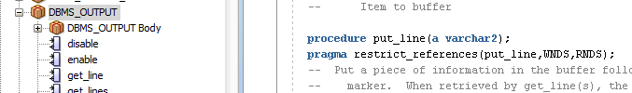
Oracle Built-In Packages
Provide support for basic database functions
Owned by the SYS database schema
To view them
  From SQL Developer
    Open your schema
    Open Other Users
    Open Sys
    Open Packages

Slide 33
Stored Program Types
Procedures
Functions
Packages
Triggers

Slide 34
Database Triggers
Program units that are attached to a specific database table
Execute in response to the following table operations:
  INSERT
  UPDATE
  DELETE

Slide 35
Uses For Database Triggers
Force related operations to always happen
  Sell an item, update QOH
  Enroll in a course section, update current enrollment total
Can be used to create an audit trail
  Record the username and IP address of every user who changes a table
  Example: Record who changed a student grade, when they changed it, and what they changed it from and to

Slide 36
Creating Database Triggers
Code is similar to all PL/SQL stored procedures
  Except –
Database triggers cannot accept parameters

Slide 37
Defining Triggers
To define a trigger, you must specify:
  Statement type that causes trigger to fire
    INSERT, UPDATE, DELETE
  Timing
    BEFORE or AFTER the operation occurs
  Level
    STATEMENT or ROW

Slide 38
Trigger Timing
BEFORE: trigger fires before the statement executes
  Required if you want to record the database state before the action occurs
  Example: for audit trail, records "old" grade value before it is updated
AFTER: trigger fires after statement executes
  Example: update QOH after item is sold

Slide 39
Trigger Levels
ROW: trigger fires once for each row that is affected
  Example: when adding multiple order lines, update multiple inventory QOH values
STATEMENT: trigger fires once, regardless of how many rows are updated
  Example: for audit trail, you just want to record that someone updated a table, but you don’t care how many rows were updated

Slide 40
Creating a Trigger
CREATE OR REPLACE TRIGGER trigger_name
[BEFORE|AFTER] [INSERT|UPDATE|DELETE] ON
table_name
[FOR EACH ROW]
BEGIN
trigger body
END;

Slide 41
Creating a Statement-Level Trigger
--create audit trail table
CREATE TABLE purchase_audit(
date_changed DATE,
user_changing VARCHAR2(30)
);
CREATE OR REPLACE TRIGGER purchase_audit
AFTER INSERT OR UPDATE OR DELETE ON candy_purchase
BEGIN
-- insert record into audit table
INSERT INTO purchase_audit VALUES (SYSDATE, USER);
END;
/
UPDATE candy_purchase SET pounds = 4.5
WHERE purch_id = 1 AND prod_id = 1 AND cust_id = 5;
SELECT * FROM purchase_audit;

Slide 42
Trigger Restrictions
You can create triggers only on tables that you own
You must have the CREATE TRIGGER system privilege
You cannot execute a COMMIT command in a trigger
  COMMIT is handled in the transaction firing the trigger

Slide 43
Row-Level Trigger Syntax
FOR EACH ROW [WHEN (condition)]
  WHEN (condition) optional, specifies to fire only when a row satisfies a certain search condition
Referencing old and new values in the trigger body:
  :OLD.field_name
  :NEW.field_name

Slide 44
Creating a Row-Level Trigger in SQL Developer
DROP TABLE purchase_audit_row; -- start empty for this test
CREATE TABLE purchase_audit_row
(old_pounds NUMBER,
new_pounds NUMBER,
change_date DATE,
change_user VARCHAR2(30));
CREATE OR REPLACE TRIGGER purchase_audit_row
BEFORE UPDATE ON candy_purchase
FOR EACH ROW
BEGIN
-- insert record into audit table
INSERT INTO purchase_audit_row VALUES
(:OLD.pounds, :NEW.pounds, SYSDATE, USER);
END;
/
UPDATE candy_purchase SET pounds = 15 WHERE purch_id = 5;
SELECT * FROM purchase_audit_row;

Slide 45
Disabling and Dropping Triggers
Syntax to drop a trigger:
DROP TRIGGER trigger_name;
Syntax to enable or disable a trigger:
ALTER TRIGGER trigger_name [ENABLE | DISABLE];

Slide 46
Designing Triggers (from Oracle)
Use triggers to guarantee that when a specific operation is performed, related actions are performed
Do not define triggers that duplicate features already built into the Oracle Database. For example, do not define triggers to reject bad data if you can do the same checking through declarative integrity constraints. (NOT NULL – PRIMARY KEY – etc.)
Limit the size of triggers. If the logic for your trigger requires much more than 60 lines of PL/SQL code, it is better to include most of the code in a stored procedure and call the procedure from the trigger. (max trigger code size is 32KB)
Use triggers only for centralized, global operations that should be fired for the triggering statement, regardless of which user or database application issues the statement.
Do not create recursive triggers. For example, creating an AFTER UPDATE statement trigger on the Emp_tab table that itself issues an UPDATE statement on Emp_tab, causes the trigger to fire recursively until it has run out of memory.
Use triggers on DATABASE judiciously. They are executed for every user every time the event occurs on which the trigger is created.

