Slide 1
Scaling Up
CS 260

Slide 2
Database Performance
Database system performance measures
  Response time: when user initially sees a retrieved value that he/she can work with
  Throughput: time elapsed until all records are retrieved
Response time and throughput deteriorate as:
  The number of records that a database stores increases
    More data
  The number of transactions that the database services increases
    More users

Slide 3
Database Performance & Size
Performance also degrades when:
  Tables store large data volumes
    Particularly BLOB data
  "Many" transactions requiring write locks hit the database simultaneously
  Queries involve joining many tables that each contain many records

Slide 4
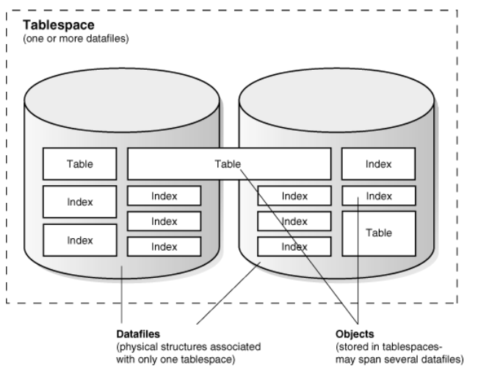
Oracle Datafiles and Tablespaces
A single join might require multiple disk accesses

Slide 5
Oracle Databases, Tablespaces and Datafiles
Oracle database
  Consists of one or more logical storage units ("tablespaces"), which collectively store all of the database's data.
Tablespace
  Consists of one or more files ("datafiles"), which are physical structures that conform to the operating system in which Oracle is running.
Datafiles
  A very simple Oracle database would have one tablespace and one datafile.
  A realistic database will have multiple tablespaces, each of which consists of multiple datafiles
  Usually create a tablespace for each separate application
Think critically: Why have multiple datafiles instead of just having one big one?

Slide 6
Enlarging an Oracle Database
Add a datafile to a tablespace
Add a new tablespace
Increase the size of a datafile

Slide 7
Why Does Performance Deteriorate as the Data Volume Increases?
New table records are stored in first available datafile segment
  Records within the same table are probably stored in different segments throughout the disk(s)
  Parent and child records with foreign key relationships are probably not stored in same physical location
  Records that match a specific search condition are probably not stored in the same physical location
Result:
  Queries require multiple disk accesses (slow)

Slide 8
Why Does Performance Deteriorate as the Number of Transactions Increase?
Locking/blocking for uncommitted queries
All queries are serialized, so you might have to wait

Slide 9
Approaches for Improving System Performance
Indexes
Denormalizing
Distributed databases
Good application design

Slide 10
Oracle Database Indexes
Data in datafiles is not stored in any particular order...
  DBMS places data in next available segment on server hard drive
  If you want to output data in a specific order, you use the ORDER BY clause
Database index:
  Database object that stores data ABOUT data in a data structure that facilitates fast searching (like an index in a book)
  Different implementation approaches
    B-tree (most common)
    Bitmap
    Function based

Slide 11
Database Index Structure
Every record in an Oracle database has a unique ROWID
  Changes if you reorganize or export/import a table
Contains:
  The data object number of the object
  The data block in the datafile in which the row resides
  The position of the row in the data block (first row is 0)
  The datafile in which the row resides (first file is 1). The file number is relative to the tablespace.

Slide 12
Database Index Structure
A database index is a separate table that contains one or more field index values along with the ROWID that identifies the associated record’s actual location
Indexed field values are sorted to facilitate lookup!

Slide 13
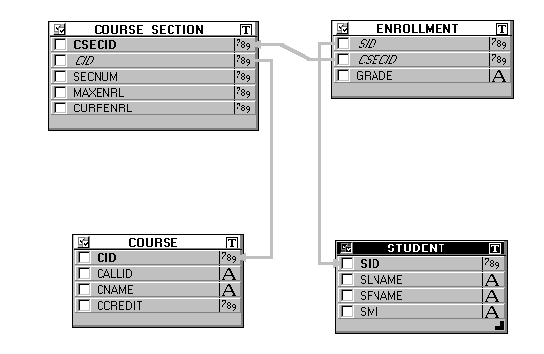
Test Database: username: large_db password: large_db
1,000,001 Records
2,400,000 Records
10,000 Records
600,000 Records

Slide 14
Example query:
SELECT callid, cname
FROM course_section JOIN course
ON course_section.cid = course.cid
WHERE currenrl >= 100;

Slide 15
Structure of a Single-Field Database Index
Index on CURRENRL field
In the COURSE_SECTION table
Sorted CURRENRL Values | ROWID
0 | AAAeKvAAEAAAASkAAA
0 | AAAeKvAAEAAAASkAAB
0 | AAAeKvAAEAAAbSkAAA
5 | AAAeKvAvEAAAASkAAA
10 | AAAeKvAAEAAAASkBBA
12 | AAAeKevAvEAAAASkAAA
12 | AAeeKvAAEAAAASkBBA
17 | .
17 | .
19 | .
19 | .
COURSE_SECTION table on disk:
ROWID | CSECID | SECNUM | MAXENRL
 | 24 | 2 | 50
 | 50 | 4 | 100
 | ...

Slide 16
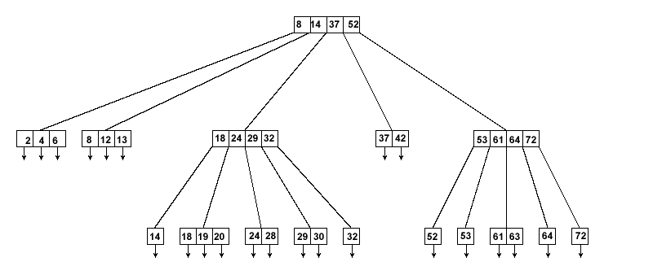
Actual Index Structure
Not a table, but a tree:

Slide 17
How does this index help?
Aids queries that retrieve records based on searches of the indexed field (CURRENL)

Slide 18
Different Types of Indexes
Simple (single-field)
Composite (multiple-field)
Unique
  Requires each indexed field value to be unique
Clustered
  Causes the DBMS to physically store the records in the order they appear in the index

Slide 19
System and User Indexes
System-created
  By default, most DBMSs (Oracle, mySQL, SQL Server) automatically create indexes on primary key fields and fields with a UNIQUE constraint
  That's why searching for a record by PK value is "almost" as fast as searching by ROWID
User-created
  Create an index on non-key fields used as:
    Search conditions
    Foreign keys in join conditions that involve many records

Slide 20
Creating Indexes
If you can, create a table index AFTER table is populated with data
  Indexes make subsequent INSERT, UPDATE, and DELETE operations slower because index must also be maintained
  Clustered indexes make these operations REALLY slow!
Every index must have a unique name
  Naming convention:
  Table_Name_Field_name(s)_IDX

Slide 21
Creating Indexes (2)
SQL command:
CREATE INDEX course_currenrl_IDX
ON course_section (currenrl);
CREATE INDEX student_slname_sfname_IDX
ON student(slname, sfname);

Slide 22
Structure of a Composite (Multiple-field) Database Index
Composite Index on
(SLNAME, SFNAME)
Sorted
SFNAME
Values
Sorted SLNAME values
Associated
ENROLLMENT
Records
Sorted SLNAME Values
Jones
Nelson
Smith
Section Current Enrollment | ROWID
Adrienne
Andrew
Daphne
Jeremy
Kyle
Luke
Robert
…
CSECID | CID
24 | 3201
540 | 15039
Structure index
so first field has a
smaller search space

Slide 23
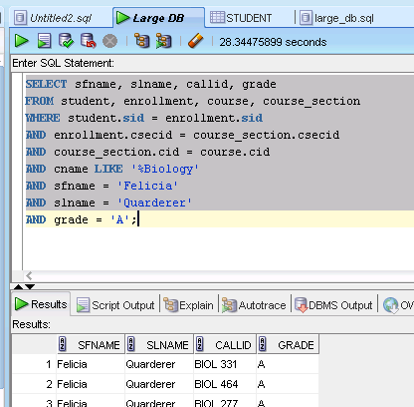
Index Retrieval Demonstration
Query time before creating index:
SELECT sfname, slname, callid, grade
FROM student JOIN enrollment
ON student.sid = enrollment.sid
JOIN course_section
ON enrollment.csecid = course_section.csecid
JOIN course ON course_section.cid = course.cid
WHERE cname LIKE '%Biology'
AND sfname = 'Felicia'
AND slname = 'Quarderer'
AND grade = 'A';
CREATE INDEX student_slname_sfname_IDX
ON student(slname, sfname);

Slide 24
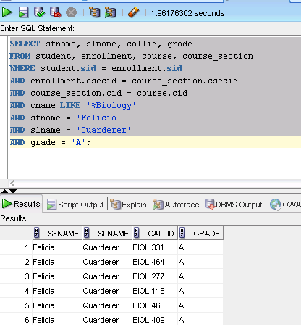
Index Demonstration (continued)
Query time after creating the index:
I could not replicate this performance
increase. I suspect the increase
shown here is a result of caching
rather than indexing.
Running the query
a second time with or without the index
results in sub 1 second times for me.

Slide 25
Benchmarking Queries
Clear the buffer_cache. This is main memory used to store recently used data blocks and redo log information.
  ALTER SYSTEM FLUSH BUFFER_CACHE;
Clear the shared pool. This is main memory used to store compiled versions of recently executed queries.
  ALTER SYSTEM FLUSH SHARED_POOL;
You need admin privileges to do this.

Slide 26
When Should You Create an Index?
Query performance is objectionable
At least one of the tables in the query contains a large number of records
  Rule of thumb: a "large" table contains over 100,000 records
One of the search/join fields contains a wide range of values
  Or, one of the search/join fields contains a large number of NULL values
Most of the time, the query retrieves less than 2% to 4% of the table rows
  Typically, indexes only speed retrievals when <15% of the table records are involved

Slide 27
Dropping an Index
DROP index index_name;
You can't drop a system-created index

Slide 28
Approaches For Improving System Performance
Database indexes
Denormalizing
Distributed databases
Good application design

Slide 29
Denormalization
Normalization: breaking databases into small tables so each field is wholly dependent on the primary key and nothing else
Denormalization: putting normalized database tables back together again to improve system performance (fewer JOIN operations)

Slide 30
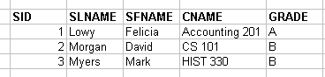
Denormalization Approaches (1)
Create a summary table that replicates the data associated with common queries that join multiple tables
  Create triggers that automatically update summary table when underlying table values change
Denormalized Summary Table

Slide 31
Denormalization Approaches (2)
Create materialized views
  Normal view is just a stored query
  Materialized* view stores the actual retrieved values in a real table, then automatically updates the underlying base tables as needed
Advantages
  Faster: values are physically stored together
  Easier: you don't have to make the triggers
Disadvantages
  Lots of system overhead
  Inserts/updates/deletes take longer
*MySQL also supports Materialized Views

Slide 32
Materialized Views
Makes it read-only
CREATE MATERIALIZED VIEW class_list AS
SELECT slname, sfname, callid, cname, grade
FROM course c JOIN course_section cs ON c.cid = cs.cid
JOIN enrollment e ON e.csecid = cs.csecid
JOIN student s ON s.sid = e.sid;
Makes it updatable
CREATE MATERIALIZED VIEW class_list FOR UPDATE AS
SELECT slname, sfname, callid, cname, grade
FROM course c JOIN course_section cs ON c.cid = cs.cid
JOIN enrollment e ON e.csecid = cs.csecid
JOIN student s ON s.sid = e.sid;

Slide 33
Approaches For Improving System Performance
Database indexes
Denormalizing
Distributed databases
Good application design

Slide 34
Distributed Databases
Networked servers running independent DBMS instances that work together
Fragmentation is transparent to users

Slide 35
Distributed DB Approaches
Full replication
  Every node runs the same DBMS and contains the same data
Homogeneous
  Every node runs the same DBMS
  Nodes contain different data at different physical locations
  Each node has the same schema design
Heterogeneous (also called federated)
  Nodes can run different DBMSs
  Nodes can contain distinct databases with different structures
  Nodes agree to share certain data values

Slide 36
Full Replication Database Components
Publisher
  Contains the master copy of the data
Subscribers
  DB servers that received updated copies from the publisher and deliver it to users
Subscriber
Subscriber
Publisher
Subscriber
Subscriber

Slide 37
Replication Approaches:
Snapshot
Transactional replication
Merged replication

Slide 38
Replication Approaches (1)
Snapshot
  Publisher distributes a snapshot of the entire database to each subscribers

Slide 39
Replication Approaches (2)
Transactional replication
  All changes are made only to the publisher
  Publisher distributes changes to subscribers
    Either immediately or periodically
Merged replication
  Changes are made both to publisher and subscribers
  Changes are merged periodically
    Conflict resolution algorithm manages conflicting transactions
      Approaches: timestamps, priorities

Slide 40
Full Replication Implications
Advantage: If one site fails others can take over
Disadvantage: Time and resource intensive
  Best for databases whose contents don't change very much

Slide 41
Homogeneous Distributed Databases
Each node stores different data
  Rationale: have each node store the data most likely to be used by its local users
Fragmentation: specifies how data is divided among nodes
  Goal: minimize response and throughput time through parallel query processing
  Fragmentation approaches:
    Horizontal
    Vertical

Slide 42
Horizontal Fragmentation
All table fields are included at each location
Appropriate records are distributed to each location
  Usually choose a field value that acts as a distribution filter

Slide 43
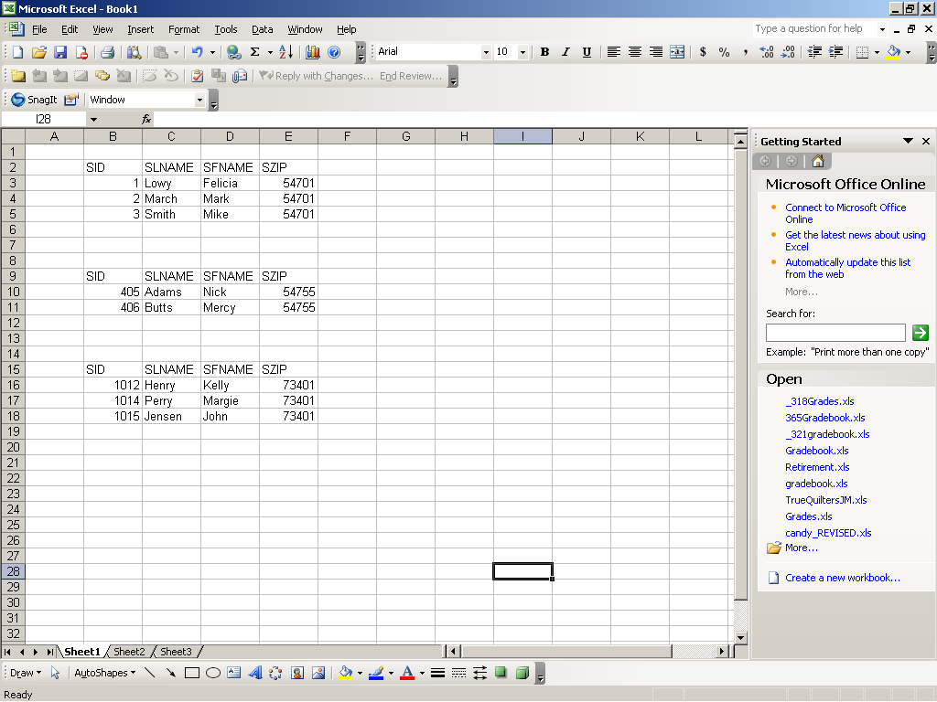
Horizontal Fragmentation Illustrated
Node 1
Node 2
Node 3

Slide 44
Vertical Fragmentation
All table records are included at each location
Appropriate field values are distributed to each location

Slide 45
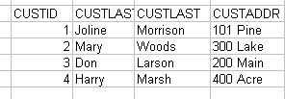
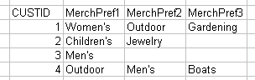
Vertical Fragmentation Illustrated
Node 1
Node 2
Billing
Sales

Slide 46
Federated Databases
Database systems that operate independently ...
  But agree to cooperate and share data.

Slide 47
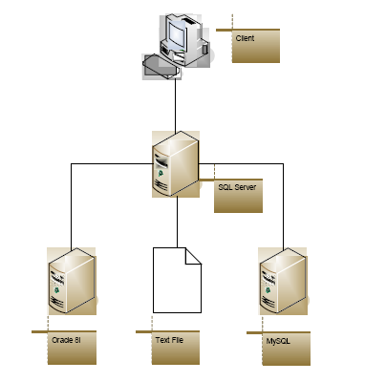
Example Federated Database
Client
Client connects to primary server
Primary server establishes links to other sources
  Different DBMS platforms have different ways to manage this...
SQL Server
Oracle 10g
XML file
mySQL

Slide 48
General Implementation Approach:
Associated unique linked server names with database instances
Instance Name | Domain Name | Linked Server Name
csdev | stef.cs.uwec.edu | csdev_link
sqldev | win.is.uwec.edu | sqldev_link

Slide 49
Creating Distributed Queries
Specify the link name along with the schema, table, and field names
  Syntax when primary server is an Oracle DBMS:
SELECT cust_last, quantity
FROM joline.candy_customer@csdev_link JOIN
joline.candy_purchase@sqldev_link
ON joline.candy_customer.custid@csdev_link =
joline.candy_purchase.cust_id@sqldev_link
WHERE cust_id = 1;
Implementing this would be an interesting collaborative research project…

Slide 50
Approaches For Improving System Performance
Database indexes
Denormalizing
Distributed databases
Good application design

Slide 51
Application Design Strategies To Improve Database Performance
Chances are good that your application is creating the bottleneck rather than the database…
  Create stored procedures whenever possible
  Offload work to the database (sorting, filtering, etc.) whenever possible
Don't retrieve more data than you absolutely need
Use prepared statements to process user inputs
Create asynchronous queries

Slide 52
Asynchronous Queries
Synchronous query
  Requires all query records to be retrieved before control returns to client application
Asynchronous query
  Fetches a subset of query records and displays them to the user
  Continues fetching additional records in the background while allowing user to work in the foreground
    Improves response time
    Anyone recall using threads?

Slide 53
Creating Applications That Use Asynchronous Queries
Must be done at the application level
Approach:
  Create a separate thread to retrieve the data into the application and display it
  Don't freeze the application while the data

Slide 54
When To Use?
Any time a user could potentially retrieve a lot of records and have to wait an unacceptably long time
  Most of the time in real databases!
Alternative:
  Perform a ROWCOUNT query, then warn the user and give him/her a chance to reconsider running the query...

Slide 55
Scaling Up: Summary
What do you do when throughput and/or response time is a problem:
  Test
  Create indexes
  Denormalize
  Modify the application
  Create a distributed database
Easier
Harder
External Improvements: Faster CPU, more RAM, faster Network, faster Hard Drives...

