Slide 1
DBA 101:
Database Storage Management
CS 260

Slide 2
Database Administration
Tasks fall into 2 categories:
  New system development
  Ongoing operational tasks

Slide 3
DBA System Development Tasks
Assisting application developers in designing databases and database applications
Creating database objects (tables, views, indexes, stored procedures, user schemas, etc.)
Designing, creating, and managing database storage structures
Migrating existing data to different platforms
Deploying database applications to users

Slide 4
DBA Operational Tasks
Installing and upgrading the DBMS server and client applications
Creating user accounts and maintaining system security
Controlling and monitoring user access to the database
Monitoring and optimizing the performance of the database
Planning for backup and recovery of database information
Backing up and restoring the database

Slide 5
DBA Operational Tasks
Installing and upgrading the database server and client applications
Creating user accounts and maintaining system security
Controlling and monitoring user access to the database
Monitoring and optimizing the performance of the database
Planning for backup and recovery of database information
Backing up and restoring the database

Slide 6
Database Administration Topics
Database storage structures
User authentication
Security, backup & recovery

Slide 7
Database Storage Structures
Physical data structures
  How the hardware actually stores the data
Logical data structures
  How the database views and manages the physical data files

Slide 8
Primary Database Data Files
In most DBMSs (MySQL, Oracle, SQL Server, DB2):
  Data is stored in datafiles
  Information about uncommitted transactions is stored in log files
  System configuration information is stored in a variety of system files
  Backup information is stored in archive files

Slide 9
Specific Oracle DBMS Files
Datafiles
Redo log files
Archive log files
Parameter files
Control files

Slide 10
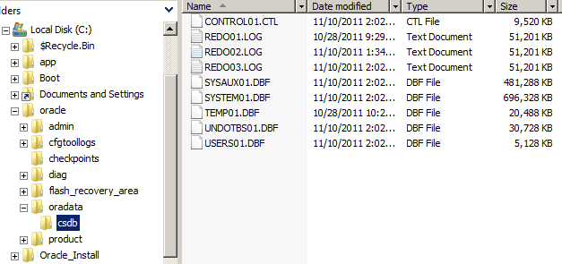
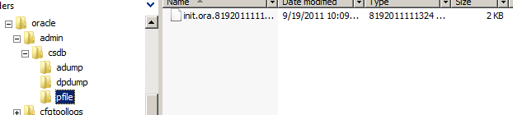
Oracle 11g Example

Slide 11
Datafiles
Contain actual data values
Typically have an .ora or .dbf extension

Slide 12
Redo Log Files
When a user inserts, updates, or deletes a record:
  When the transaction is committed, information about the transaction is written to a redo log file
  The data is not changed in the datafile until a "checkpoint" occurs
In the case of a system crash, the DBMS uses the redo log file contents to recover the database to the point of the failure

Slide 13
Redo Log Files
Typically have a .log extension
What exactly do the redo log files store?
  INSERT: image of the new data
  UPDATE: pre-image and post-image of data values
  DELETE: image of record before it was deleted

Slide 14
Oracle Parameter Files
PFILE (parameter file)
  Text file containing configuration information
  DBMS reads it at startup and configures itself
  If you change it, changes are only applied when server re-started
  Located in the oracle/admin/sid/pfile folder on the server
SPFILE (server parameter file)
  Binary file containing configuration information
  DBMS creates and maintains it
  Allows DBA to change configuration information dynamically

Slide 15
Control
Files
.CTL extension,
  Typically located in the oracle/oradata/sid/ folder
  Binary, only modified by DBMS
All files are mirror images
  Multiple copies are kept for safety
Purposes:
  Maintains overall DB architecture
  Records locations of all other files
  Guides recovery operations
Contains:
  DB name and time of creation
  Paths and filenames of other DB files
  Overall DB structure

Slide 16
Managing Control Files
Keep offline, offsite backups
  File is required for database startup and operation

Slide 17
Summary: Oracle Files
Datafiles: actual data values
Redo log files: recovery information
Parameter files: configuration information
Control files: overall system architecture
Archive files: backups

Slide 18
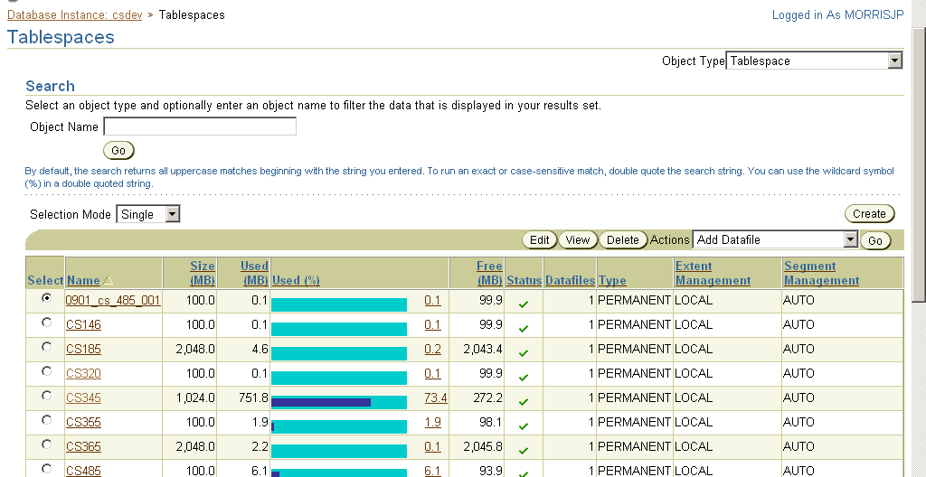
Logical Data Structures
Oracle & MySQL use tablespaces

Slide 19
Tablespaces
Definition: logical data structure to specify how a DBMS stores data
Tablespace design approaches:
  Different tablespaces for different applications
    or
  Different tablespaces for different database tasks
    User data, system data, indexes, temporary data, etc.

Slide 20
Tablespace Rationale
Perform similar maintenance tasks on the data in a single tablespace
  Backup
  Take offline/put online
  Delete

Slide 21
Tablespaces
  A tablespace can be stored in one or more datafiles
Tablespaces
Datafiles
Database
Instance

Slide 22
Think Critically: Tablespace Management
Why should you create multiple datafiles for a tablespace?
How large should datafiles be allowed to grow?

Slide 23
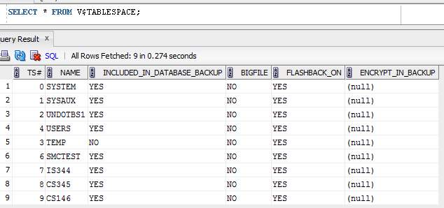
Tablespaces Dario:
This works with student accounts
Above requires DBA privileges

Slide 24
Oracle Logical Data Structures
Database
Instance
Segments
Extents
Data blocks
Tablespaces

Slide 25
Oracle Storage Space Management
  Tablespaces
    Logical database partition
  Segments
    Contains a specific object, like a table or view
  Extents
    Contains a contiguous data object, like a row
  Data Blocks
    Smallest data unit that the DBMS can address
Detail

Slide 26
Segments
Used to store data for a single object
  Table, view, sequence
Each segment stores data in one or more extents
  Extents are allocated and deallocated as needed
Extent
Segment
Extent
. . .

Slide 27
Extents
Each extent is a contiguous physical storage area
Stores data that needs to be retrieved using a single disk I/O
  row
Extent comprised of one or more data blocks
Data Blocks
Extent

Slide 28
Data Blocks
Smallest unit of storage that an Oracle database recognizes
Corresponds to one or more operating system storage units
  UNIX: blocks
  NTFS: clusters
    Actual block size depends on hard drive configuration

Slide 29
Components of an Oracle Data Block
Block header
Table directory
Row directory
Free space (allows block to grow
if user updates current value
with larger value)
Data values

Slide 30
Creating a New Tablespace
Steps
  Create the tablespace
  Create the associated datafile(s)
  Configure the datafile(s)

Slide 31
Configuring Datafiles
When you create a new datafile, it contains:
  Header information
  1 free extent
Datafiles are usually autoextensible
  When the datafile becomes full, it automatically makes itself larger
  When data is deleted, existing extents are marked as unused and become available to store new data

Slide 32
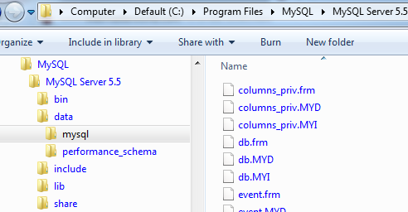
MySQL data files
Stored in /mysql/data/ where mysql is the directory MySQL was installed to.

Slide 33
MySQL data files
.frm table definition files
.myi MyISAM index files
.myd files containing table data

