Slide 1
Database User
Authentication
CS 260

Slide 2
Database Administration
Tasks fall into 2 categories:
  New system development
  Ongoing operational tasks

Slide 3
DBA System Development Tasks
Assisting application developers in designing databases and database applications
Creating database objects (tables, views, indexes, stored procedures, user schemas, etc.)
Designing, creating, and managing database storage structures
Migrating existing data to different platforms
Deploying database applications to users

Slide 4
DBA Operational Tasks
Installing and upgrading the Oracle server and client applications
Creating user accounts and maintaining system security
Controlling and monitoring user access to the database
Monitoring and optimizing the performance of the database
Planning for backup and recovery of database information
Backing up and restoring the database

Slide 5
Database Authentication Goals:
Enable legitimate users to access the data
  and
Keep non-legitimate users out

Slide 6
Oracle Authentication:
User Schema
Users have individual user "accounts" called user schemas
  Identified by a username (database object)
  Authenticated by an authentication method
A user "owns" all objects within his/her schema
  Has unlimited privileges on these objects
  Can grant privileges on these objects to other users

Slide 7
User Authentication Topics
Required information for creating a new user
System & object privileges
Roles

Slide 8
Required Oracle User Specifications:
Username
Authentication approach
Default tablespace
Temporary tablespace
Allowable disk quota in default tablespace

Slide 9
Creating a New User (Oracle)
CREATE USER mojo
IDENTIFIED BY secret
DEFAULT TABLESPACE users
TEMPORARY TABLESPACE temp
QUOTA UNLIMITED ON temp
QUOTA 100M ON users;

Slide 10
Creating a New User
(cs admin used this for my CS 260 Account)
CREATE USER MORRISJP
IDENTIFIED BY *********
DEFAULT TABLESPACE CS260
TEMPORARY TABLESPACE TEMP
PROFILE adv_user;
GRANT DBA to MORRISJP WITH ADMIN OPTION;
GRANT UNLIMITED TABLESPACE TO MORRISJP;
Applies to
ALL tablespaces!

Slide 11
New User Specifications
Username
  Must follow Oracle naming convention for database objects:
  1-30 characters, unique in the database, can't begin with a number, only special characters &, _, #
Profile
  Allows DBA to create profiles to customize properties of user accounts
    Kernel limits (CPU time, maximum concurrent sessions, maximum connect time, etc.)
    Password profiles (maximum number of failed login attempts, time until password expires, function to specify password contents, etc.)

Slide 12
New User Specifications (2)
Authentication approach
  Password (Database)
    Authentication is managed by the Oracle DBMS
    Users can change passwords at any time
    Passwords are stored in an encrypted format
  External (Network OS)
    DB user identity verified by operating system login
  Global
    Users are authenticated using a directory server
      Server that specifies server locations and properties on a network

Slide 13
Storing passwords
Not in PLAIN TEXT!
Store as a hash
Just google password hash
  Lots of easy ways to do this (many libraries written for this purpose)
  Here's one easily read article on the topic:
  http://phpsec.org/articles/2005/password-hashing.html

Slide 14
New User Specifications (3)
Default tablespace
  Tablespace that stores user's objects (if they don't specify an alternate one)
  Also have to specify a disk quota in the tablespace
    Otherwise the user can't create objects
Temporary tablespace
  Tablespace that stores temporary query data (sorts, DISTINCT output, etc.) for user

Slide 15
User Authentication Topics
Required information for creating a new user
System & object privileges
Roles

Slide 16
System Privileges
Users must be granted explicit system privileges to do anything with an Oracle database
  Create specific types of objects
  Perform specific types of operations
  Etc.
Oracle 11g has 173 distinct system privileges...

Slide 17
Types of System Privileges
Schema-specific
  Example: "CREATE object"
  User can perform the action (create the table, view, sequence, etc.) only in his/her user schema
ANY schema
  Example: "CREATE ANY object"
  User can perform the action in any user’s schema

Slide 18
Very Important System Privileges
CREATE SESSION
CREATE TABLE
CREATE VIEW
CREATE PROCEDURE
SYSDBA
SYSOPER
Can't connect to DB without
this privilege
Enables user to start and shut down the database

Slide 19
Admin Option
When you grant a privilege to a user, you specify if s/he has Admin option
  Allows the user who was granted the privilege to grant that privilege to other users
  If privilege is revoked from original user, privileges s/he granted to others are not revoked…
  What are the security implications?

Slide 20
Object Privileges
Associated with a specific object
Enables user to perform operations on that object
  INSERT, UPDATE, DELETE, SELECT from a table or view
  Use a sequence
You can grant an object privilege IF:
  You own the object; or
  You have been granted the privilege with admin option; or
  You have the GRANT ANY OBJECT system privilege

Slide 21
User Authentication Topics
Required information for creating a new user
System & object privileges
Roles

Slide 22
Roles
Collection of system and object privileges that are frequently granted to multiple users
  Allows you to easily grant/revoke privileges to/from multiple users
Existing roles can be granted to new roles
Oracle systems have predefined roles that consist of the most common tasks sets of users perform
  DBAs can also create custom roles

Slide 23
Important Oracle Predefined Roles
CONNECT
  Default role given to new users
  Contains the following system privilege:
    CREATE SESSION
DBA
  Grants all system privileges with admin option

Slide 24
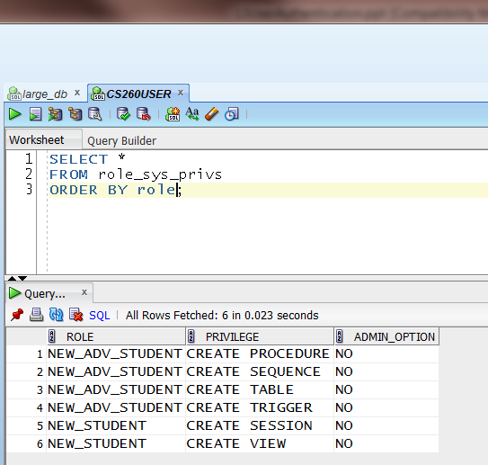
What roles and privileges do you have?

Slide 25
SQL Commands to Grant/Revoke Object Privileges
GRANT privilege ON object TO username|role;
REVOKE privilege ON object FROM username|role;
GRANT SELECT ON JOLINE.CANDY_CUST_ID TO MOJO;
REVOKE UPDATE ON JOLINE.CANDY_PRODUCT FROM MOJO;

Slide 26
Important Default User Accounts in a New Oracle Database Installation
System accounts: reserved for system and administration
  SYSTEM
  SYS
  SYSMAN
Account that contain tables with sample data
  SCOTT/tiger
  Can be a security leak…

Slide 27
Viewing System Information
DBA utility (Enterprise Manager)
  or
Data Dictionary views
  Views maintained by the SYS schema that provide information about the database
  Types of views:
    DBA: information about ALL database objects
    ALL: information about all objects that the current user connection can access
    USER: information about the CURRENT user connection's objects

Slide 28
Oracle Summary
User schema identified by a username and authentication method
Each user schema has associated system privileges
Each user schema owns database objects
A user schema can grant object privileges to other user schemas, provided they have the privileges to do so
A role comprises a set of related system privileges

Slide 29
Oracle/MySQL User Authentication Contrasts
Big-picture concepts are similar
  Users, authentication approaches, privileges, roles
Lots of differences however
  Review the links if you are interested
http://www.softtreetech.com/blog/comments.php?aid=40&cid=4
http://docs.oracle.com/cd/E12151_01/doc.150/e12155/oracle_mysql_compared.htm

