Slide 1
Fantasy Football Application
Zach Forster
Matt Wisby
Isaac Schemm
Cody Kubicek

Slide 2
Introductions
Zach Forster – Web Designer, PHP Developer
Cody Kubicek – Database Admin
Matt Wisby – Database Admin, PHP Developer
Isaac Schemm – PHP Developer

Slide 3
Cody’s Slides

Slide 4
Matt’s Slides

Slide 5
Challenges
Special Feature

Slide 6
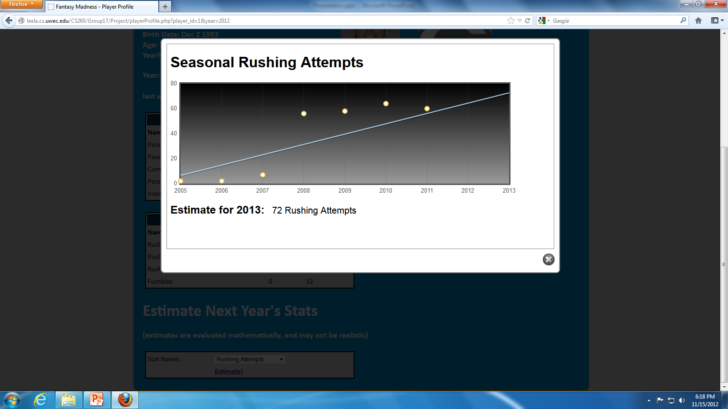
Innovations
Statistic Prediction

Slide 7
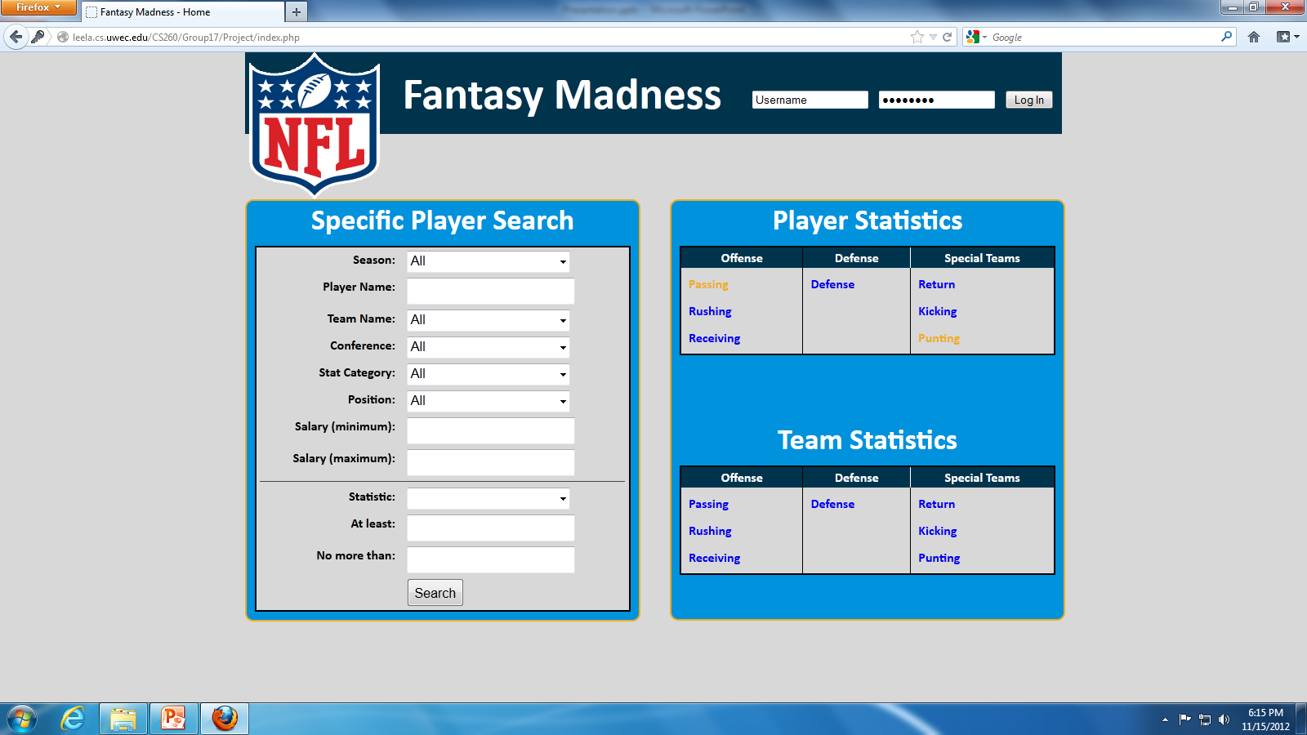
Innovations
Quick Searching

Slide 8
Conclusions
What Could Be Changed:
Session Variables for Login
More Realistic Prediction Algorithm
Passer Rating Calculation
Cleaner Invalid Login Message
What We Learned:
Difficulties of Multiple Browser Support
Capabilities of JQuery, CSS, and PHP
Importance of Design before Functionality

