Slide 1

Happy 60th Birthday, Mom
By: Melanie Lin

Slide 2
Happy Birthday
Dear mom,
Here are some pictures for your birthday. I hope you enjoy it.
Love,
Melanie

Slide 3
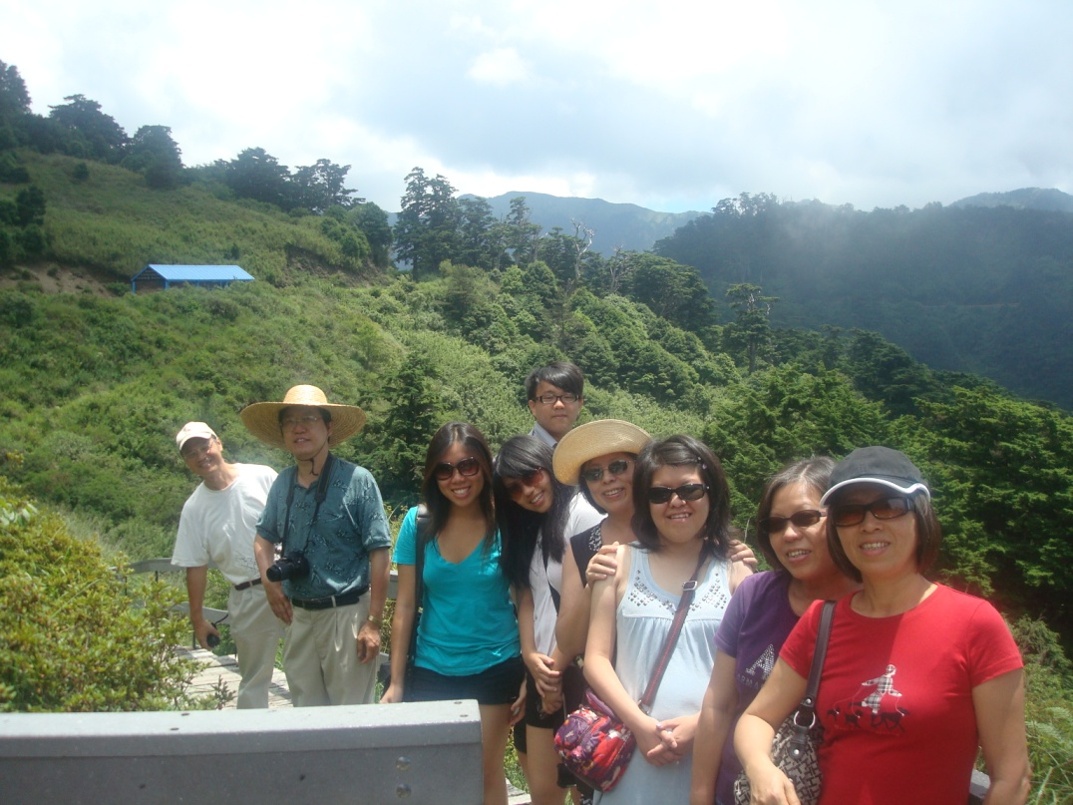
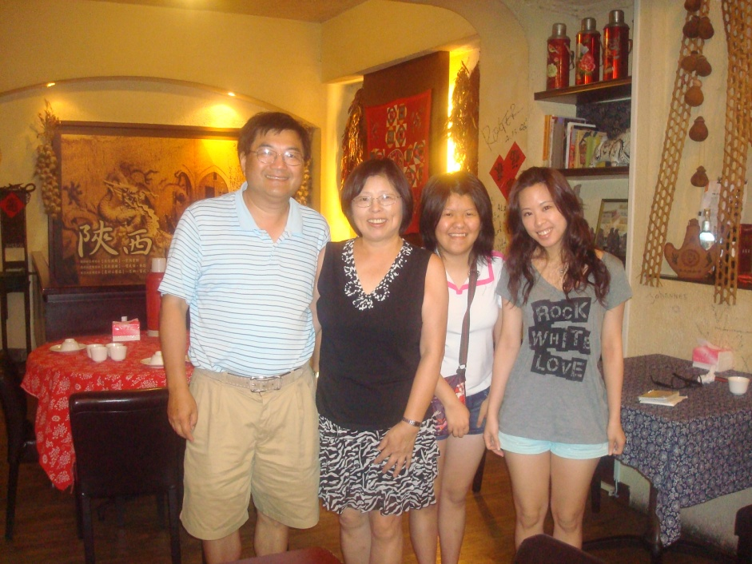
Taiwan Trip

Slide 4
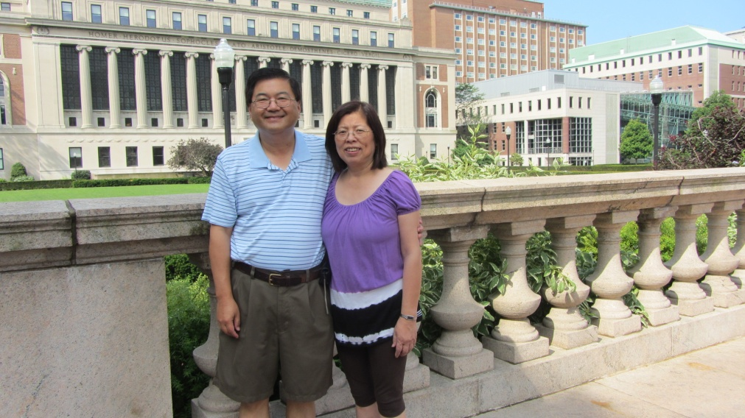
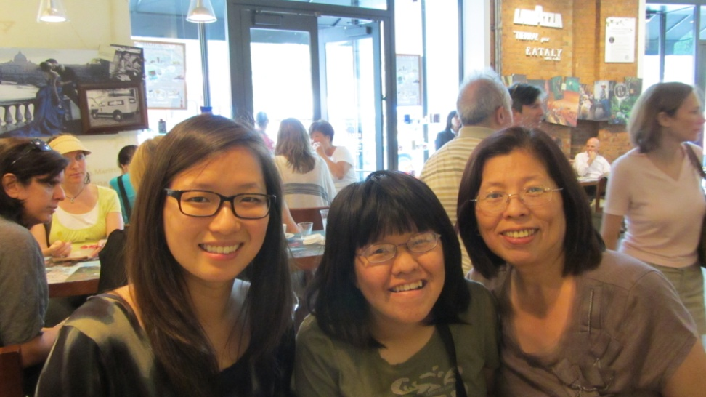

New York Trip

Slide 5
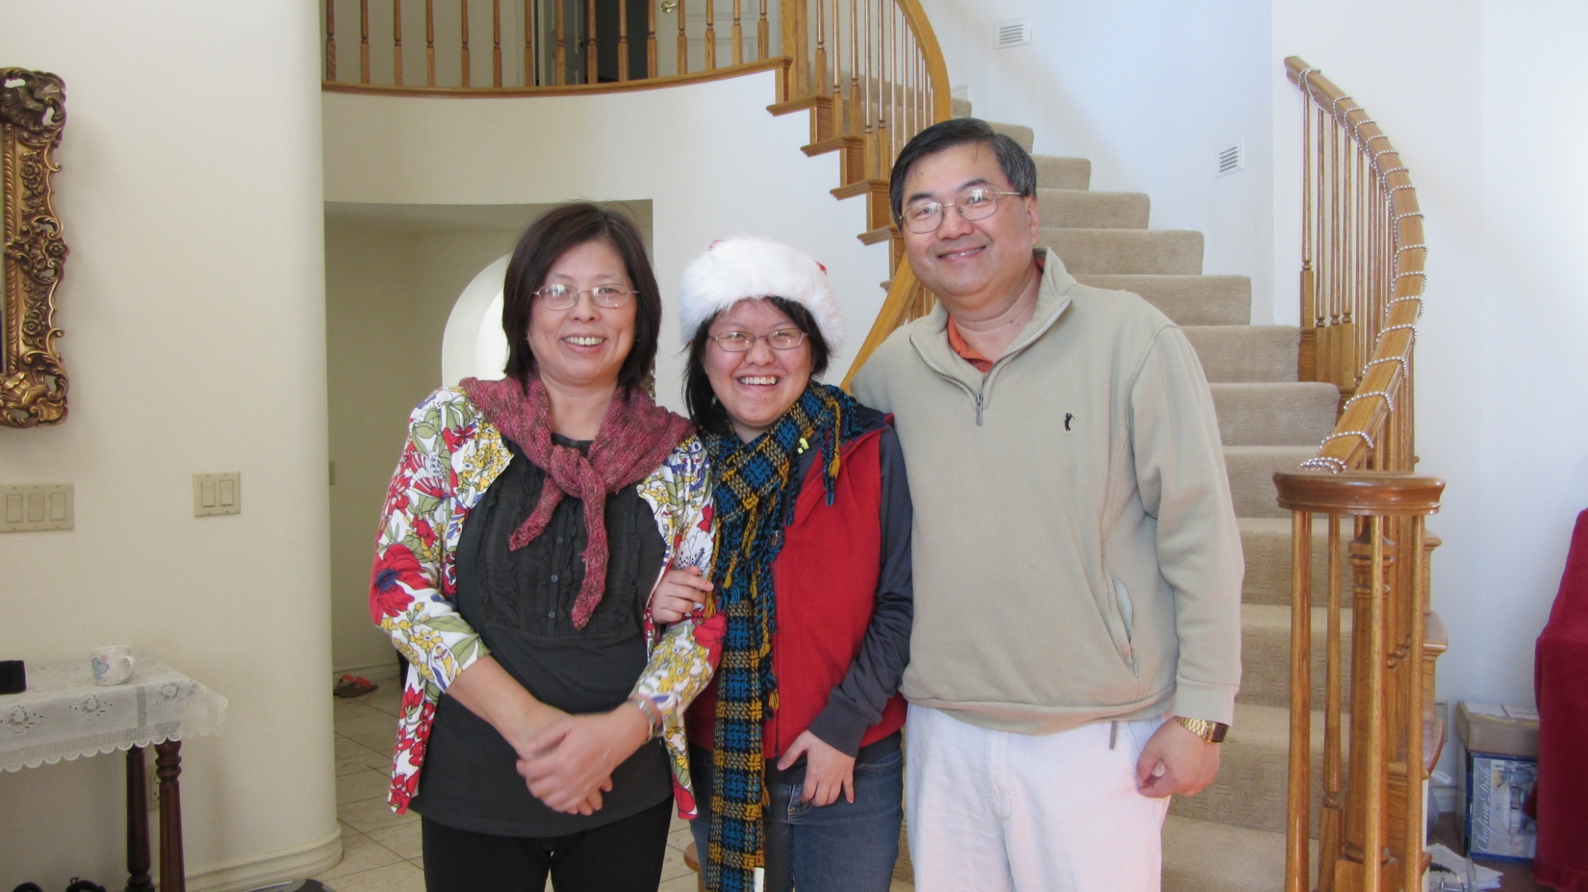
Christmas Day

Slide 6
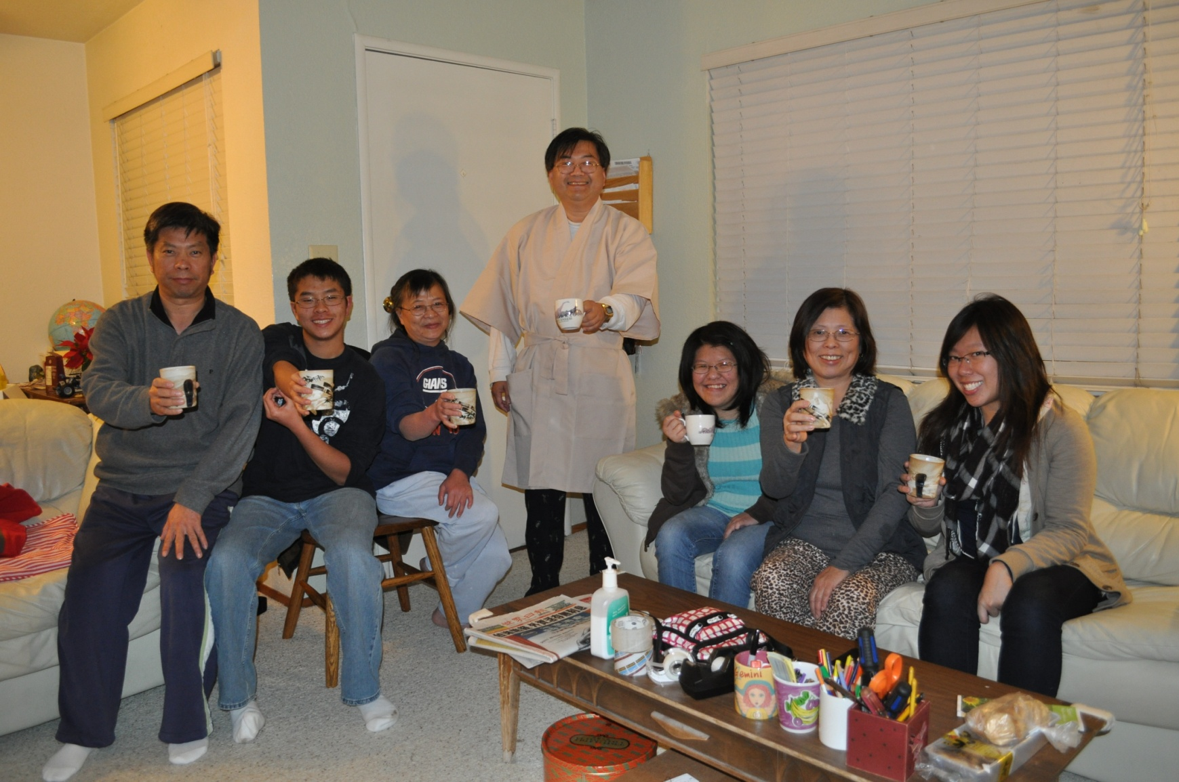
Celebrating New Years

Slide 7
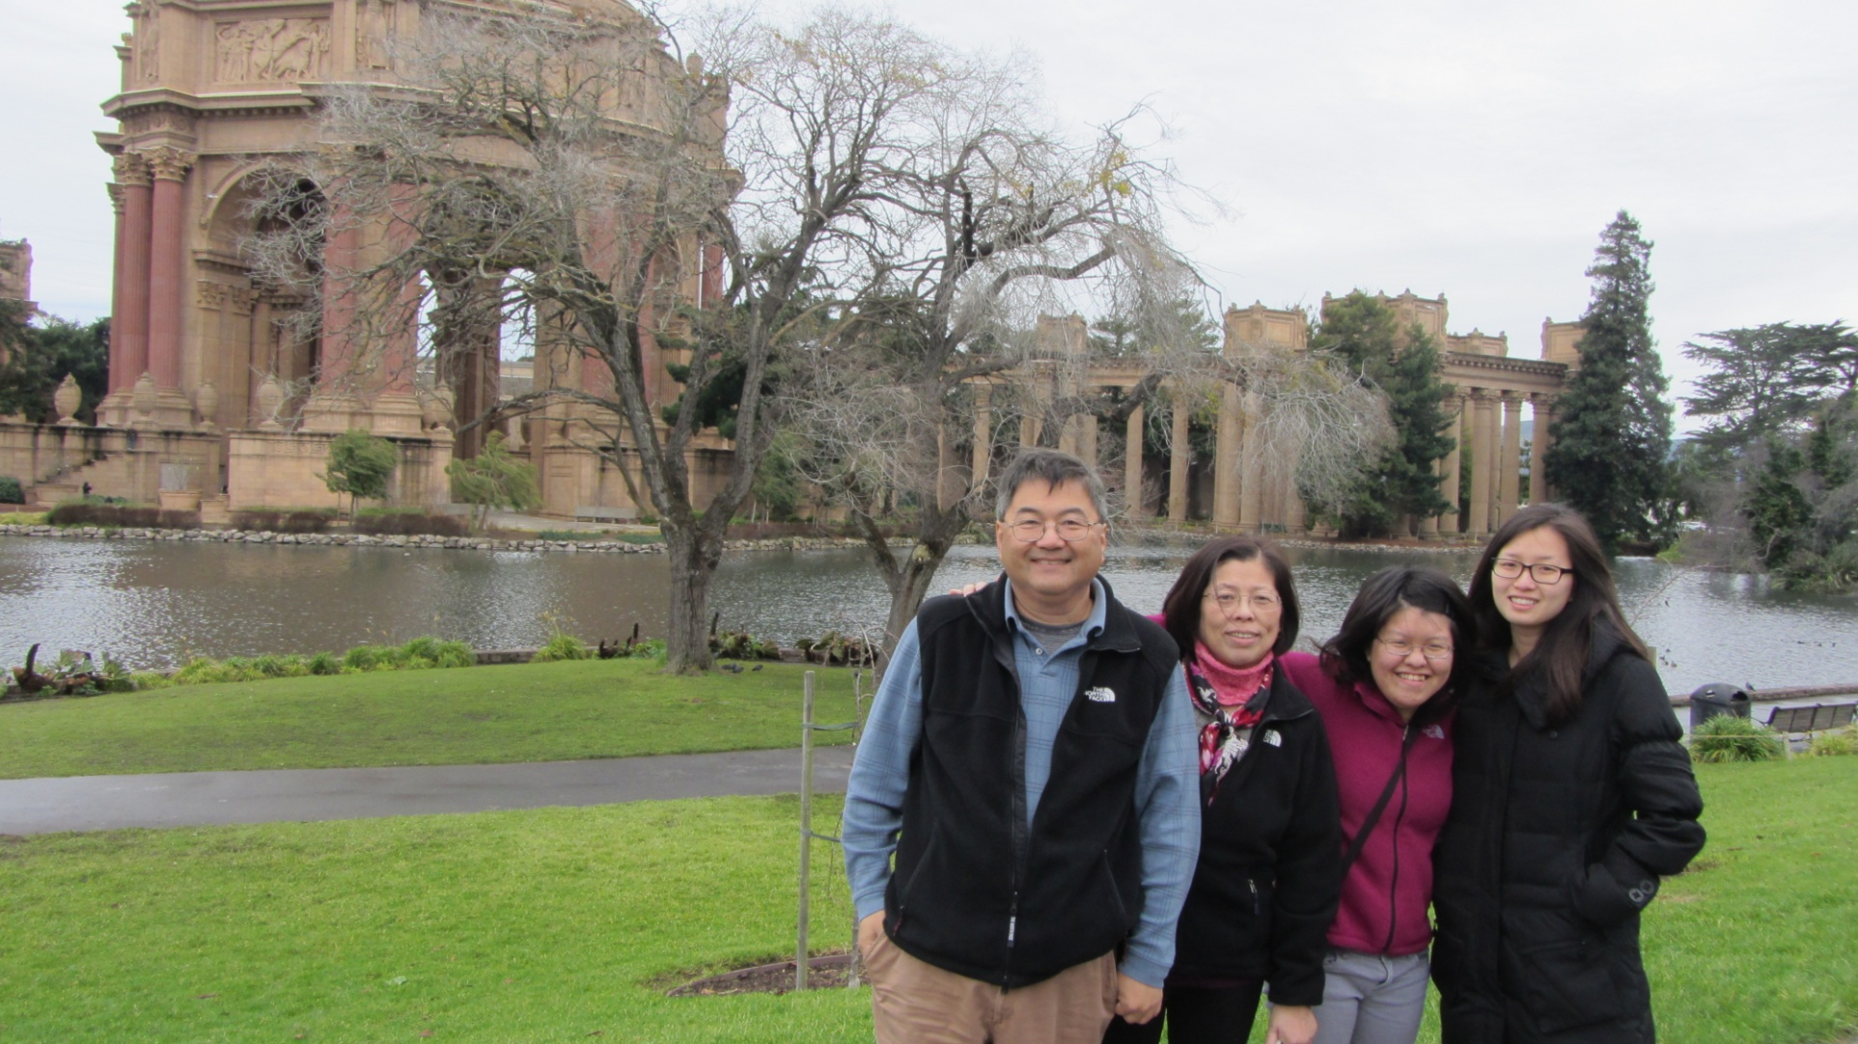
Another Trip With My Family

Slide 8
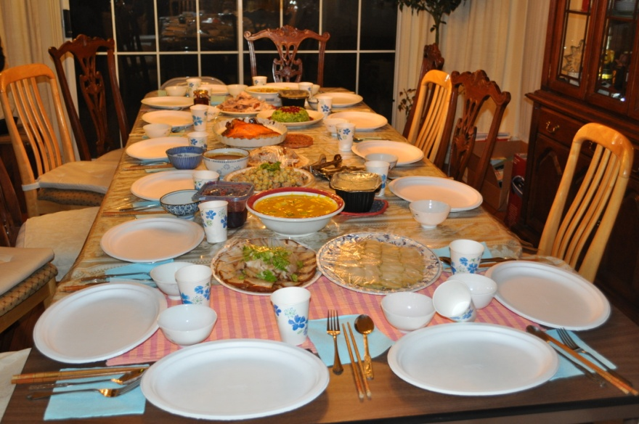
Thanksgiving Day
Here is the last picture that I am thankful for.
I really like spending time with you, mom.
I love you.

