Slide 1
EventFinder

Slide 2
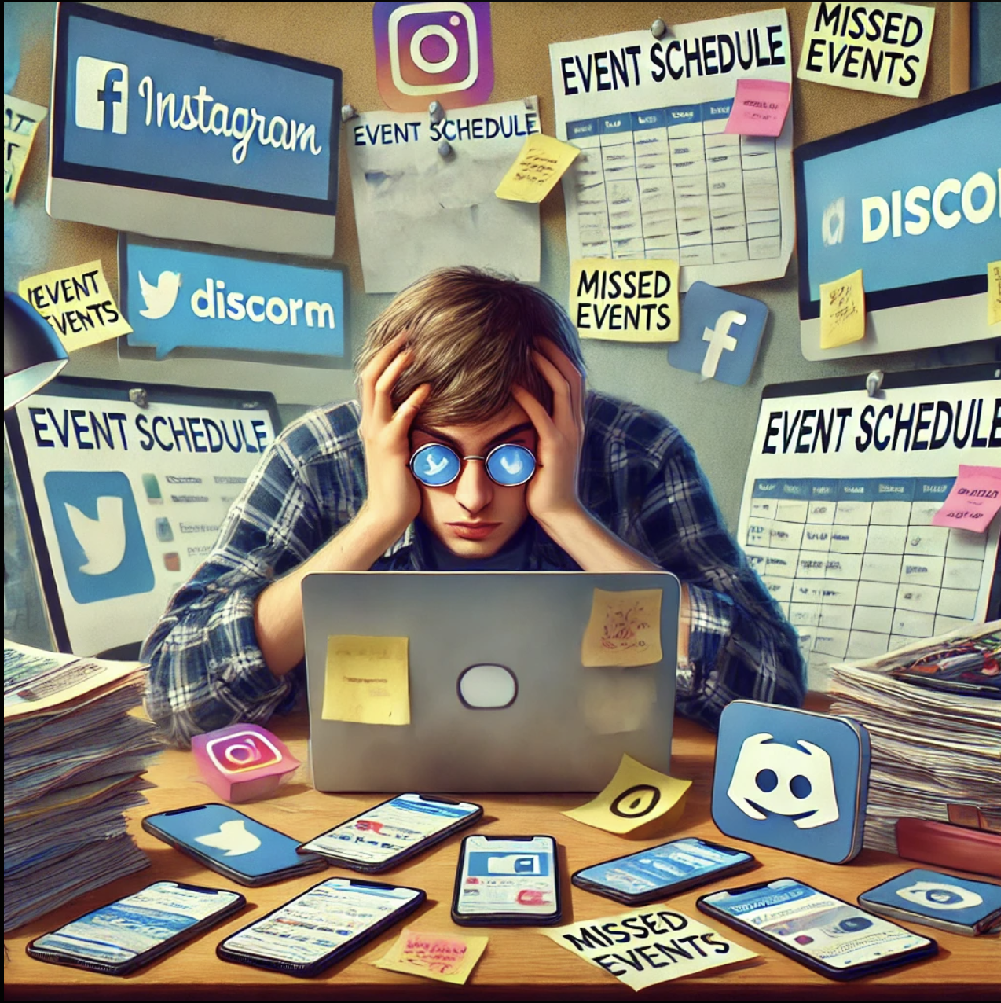
Problem Description
NJIT students miss campus events due to scattered information across platforms.

Slide 3
Research - Users
Interview Participants
Students (Freshman, Seniors, Graduates)
Club Organizers (Gaming, Sanskaar)
And Our Own Experience

Slide 4
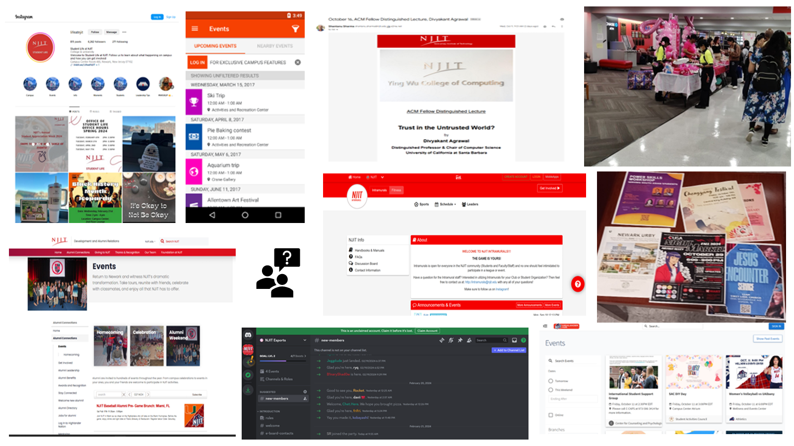
Research – So Many Sources!!!

Slide 5
Research - Key Findings
Organizers' Strategy
Most Difficult For Freshmen
Time Constraints

Slide 6
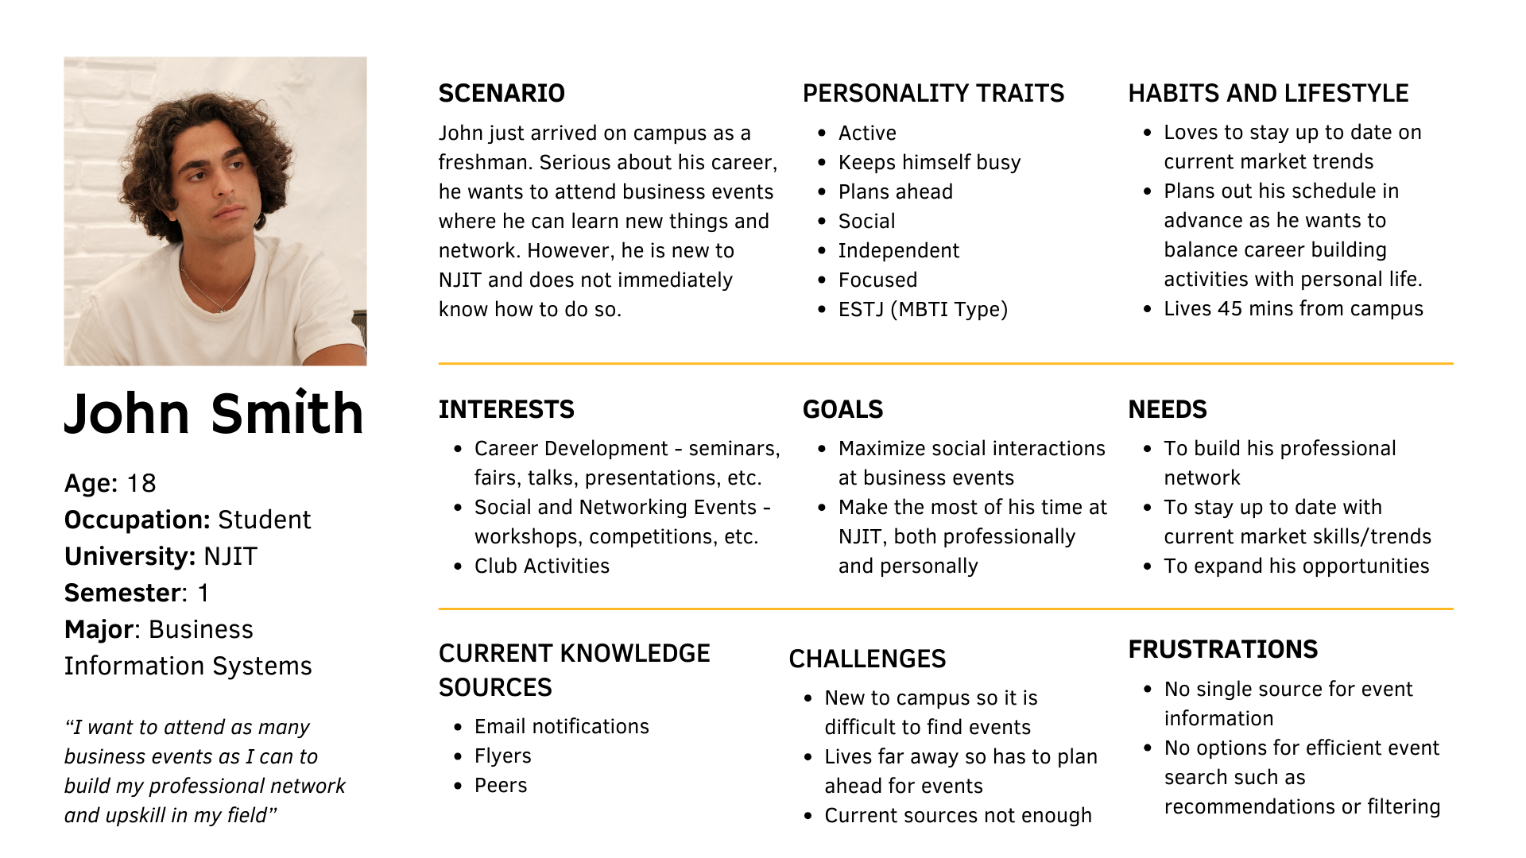

Slide 7
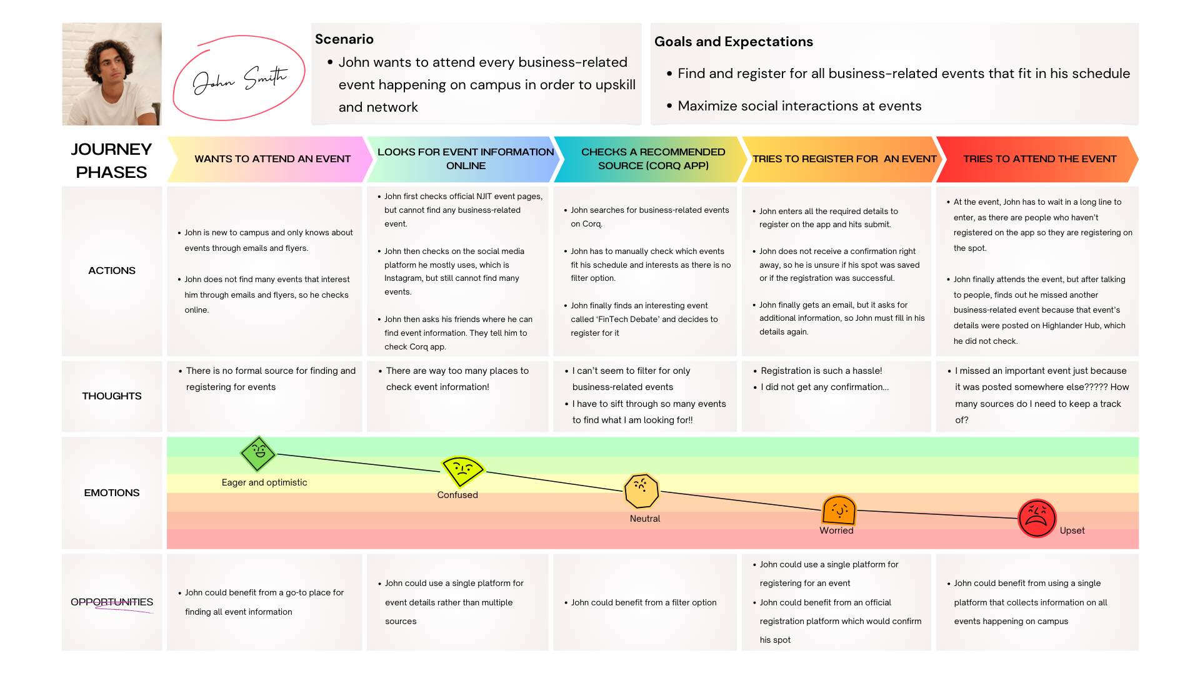

Slide 8
User Testing
Participants
Students and Organizers
Protocol
Think aloud method + Open-ended questions

Slide 9
User Testing – Task Scenarios
Find business-related events using the app’s filters.
Register for a business-related event.
Find ways to interact with other people through the app

Slide 10
User Testing – Insights
Intuitive Design
Visuals
Feedback

Slide 11
Revision – Intuitive UI
Made events eye-catching
Added feedback after registration
Added checkboxes for tags

Slide 12
Reflection
Incredible learning experience
Adopting design thinking
Focusing on the problem before solution
Creating human-centered designs

