Slide 1
Code Security for SAP
Using the OpenText Application Security Portfolio
October 2025

Slide 2

Agenda
SAP Evolution (ERP+)
SAP Extensibility
SAP Development Stack
OpenText solutions for SAP Code Security
Example Scenarios

Slide 3
SAP Evolution (ERP+)

Slide 4
Simplified SAP ERP Generations
SAP R/3
( ~ 1992)
SAP S4/HANA
( ~2015)
SAP BTP (~ 2022)
Evolution of R/3
SAP ECC
( ~ 2004)
Client-Server 3 tier model
Supported till 2040
~1992
PAAS – collection of services in the cloud
Integrated with ECC and S4/HANA – out-of-core customizations
Environments:
On-prem or Cloud
Client-Server or Web based UI (Fiori Launchpad)
SAP GUI
EOL 2027
On-prem
On-prem
EOL 2027
Extended support to 2030
Still Client-Server based
Development Languages:
Customizations:
Customizations:
Customizations:
Cloud Foundry,
ABAP,
Kyma
Cloud ABAP,
Java,
Node.JS,
Python,
Go …
Classic ABAP
Classic ABAP
Java (external)
Classic ABAP,
Cloud ABAP,
Java (external)
JS/TS (Fiori)
Mainframe
Notes:
ECC = ERP Central Component
BTP = Business Technology Platform

Slide 5
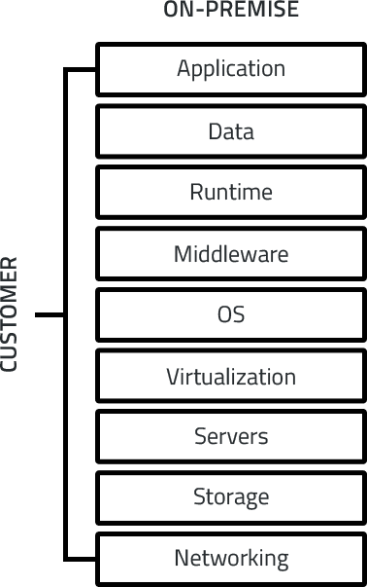
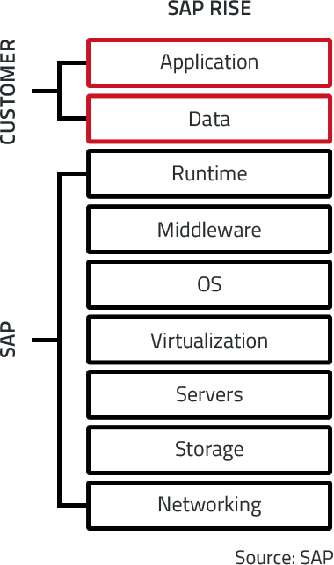
RISE with SAP (migrate on-prem to S/4HANA Cloud)
SAP CVA available for additional cost
See also GROW with SAP –Cloud only based ERP for SMB

Slide 6
SAP Migrations from ECC to S4/HANA
By end of Q4 2024, ~39% of ECC customers had licensed S/4HANA. [The Register]
Only ~28% (or slightly more) had fully migrated / were live as of early 2025. [Datalink Dynamics]
Many are still in transition, planning, or evaluating. [Datalink Dynamics]
It is projected that ~57% will have completed migration end of 2027, ~80% by end of 2030
~17% of SAP ERP customers run in the cloud (30-33% for S/4HANA only)
~55% of SAP customers use BTP (73% of which in context of S/4HANA) [ASUG]

Slide 7
Core Components of RISE with SAP
SAP S/4HANA Cloud
The digital core ERP system, available in public or private cloud editions.
Business Process Intelligence (BPI)
Tools to analyze, improve, and monitor business processes using data-driven insights.
SAP Business Technology Platform (BTP)
A platform for integration, extension, and data management across SAP and third-party systems.
SAP Business Network Starter Pack
Connects businesses with suppliers, logistics providers, and asset operators.
Embedded Tools and Services
Includes lifecycle management, analytics, and support services to ease migration and operations.
Cloud Infrastructure
Delivered via hyperscalers like AWS, Microsoft Azure, Google Cloud, or SAP’s own infrastructure.

Slide 8
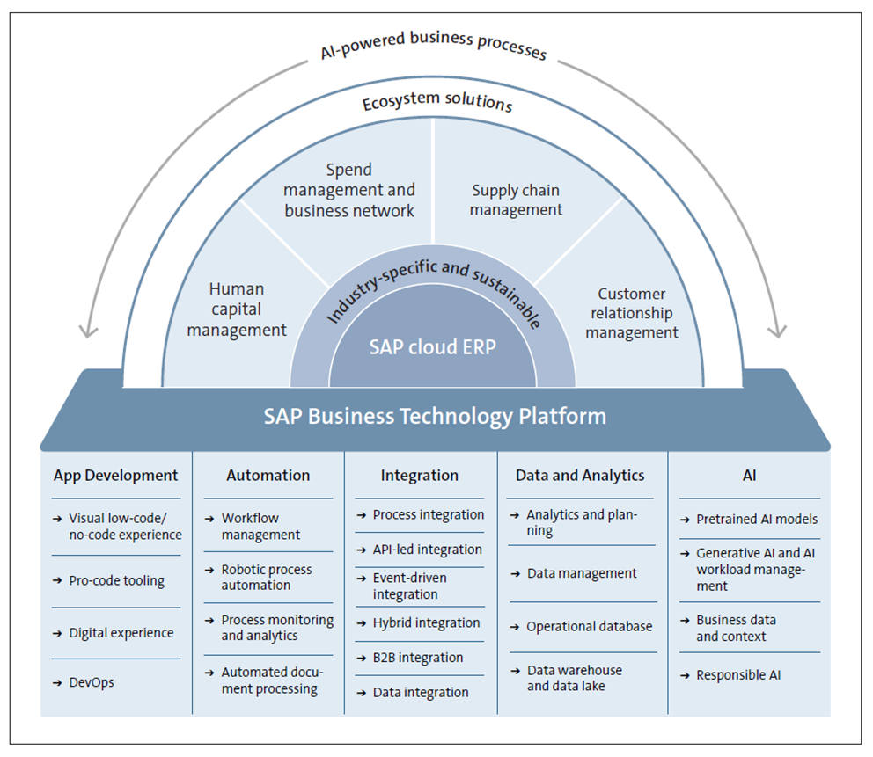
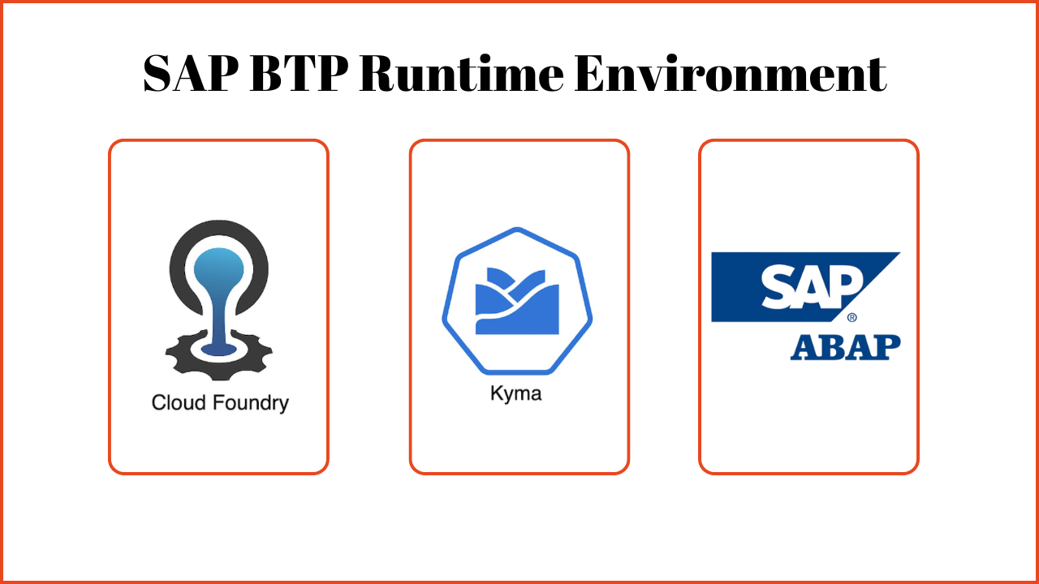
SAP BTP (Business Technology Platform)

Slide 9
SAP Extensibility

Slide 10
SAP Extensibility Approaches
On Stack Extensibility (Fiori/UI5) Custom web apps using HTML5, JavaScript, SAPUI5.
In-App Extensions: Key user tools for quick customizations without coding
Side-by-Side Extensions: External apps on SAP BTP using APIs and events.
On Stack Extensibility (ABAP): Direct enhancements within SAP S/4HANA using ABAP

Slide 11
Example SAP Extensibility Use Cases
Extensibility Options | Role | Use Cases
In-App Extensions | Business Expert/User | Adapting UIs, adding custom fields, adding custom business objects and more.
On Stack Extensibility (ABAP and Fiori/UI5) | ABAP Developer Fiori Web Developer | Custom extensions running in the same Logical Unit of Work (LUW) as SAP applications. Custom applications with frequent or complex SQL access to SAP S/4HANA data. Tailored custom remote APIs or services which serve side-by-side SAP BTP apps. ABAP Cloud add-on products by partners. Dashboards, KPIs, Mobile, Role Specific transactions
Side-by-Side Extensibility (using BTP) | BTP Developer | Custom applications for a separate target group (no ERP users). Custom application workload that shall run separated from ERP. Custom applications needing proximity to intelligent SAP BTP services Solutions integrating with several ERP systems and cloud services. SaaS applications provided by partners.

Slide 12
SAP Extensibility Techniques
Technique | Description | Examples | Availability
Report Enhancements | Custom logic added to SAP standard reports using exits or enhancement points. | Modify standard reports, add custom fields, or integrate external data | On-premise
User Exits | Predefined hooks in SAP standard programs allowing custom code via function modules. | Used in older SAP versions (e.g., R/3, ECC) for adding business logic. | On-premise
Customer Exits | Similar to User Exits but more structured; implemented via function modules. | Enhancing standard SAP functionality during upgrades or custom processes. | On-premise
BADI (Business Add-Ins) | Object-oriented enhancement technique using interfaces and methods. | Preferred in newer SAP versions for flexible and reusable enhancements. | On-Premise
Enhancement Framework (S/4HANA) | Unified framework combining classic and new techniques, including implicit and explicit enhancements. | Used in S/4HANA for clean core and upgrade-safe customizations. | On-Premise Cloud

Slide 13
SAP Development Stack

Slide 14
SAP Development Stack
Core Technologies
SAP Netweaver (legacy)
SAP ABAP Platform
SAP HANA Database
SAP Fiori Elements
OData Services
Core Data Services
SAP Business Technology Platform
SAP Cloud Application Programming Model (CAP)
SAP Integration Suite
SAP Extension Suite
SAP Identity Authentication & Authorization
SAP Analytics Cloud (SAC)
SAP AI Core & AI Launchpad
…
APIs & SDKs
SAP API Business Hub
SAP Mobile Services SDKs
SAP Graph
SAP Event Mesh
…
Development Tools
SAP UI (SE80)
Visual Studio Code with SAP Fiori Tools
Eclipse with ABAP Development Tools (ADT)
SAP Business Application Studio (Cloud)
DevOps and CI/CD Tools
Git Integration (abapGit)
Jenkins/Project “Piper”/GitHub Actions
SAP Continuous Integration and Delivery (BTP)
Transport Management System/gCTS

Slide 15
ABAP Development
Development Environments:
SAP GUI with ABAP Workbench (SE80)
Eclipse with ABAP Development Tools (ADT)
Key Objects:
Reports, Function Modules, Classes & Methods
Data Dictionary (Tables, Views, Domains)
SmartForms, Enhancements & User Exits
Development Process:
Requirement Gathering → Technical Design → Coding → Testing → Transport
Types of Programs:
Classical Reports, ALV Reports
Dialog Programming, Web Dynpro ABAP
OData Services for SAP Fiori

Slide 16
ABAP Evolution
ABAP (Advanced Business Application Programming), SAP’s proprietary programming language, has undergone significant evolution since its inception in the 1980s.
Procedural Roots (1980s-1990s)
Initially designed for developing reports and interfaces in SAP R/2 and later R/3
Purely procedural, similar to COBOL
No object-oriented features, limited modularity
Object Oriented (2000s)
ABAP Objects introduced with SAP R/3 4.6c
Enabled encapsulation, inheritance and polymorphism
Class-based exception handling (replaced older MESSAGE-based error handling)
Integration with Web (2010s)
ABAP in the Cloud (Late 2010s-2020s)
Web Dynpro ABAP: UI framework for building web-based applications
SAP NetWeaver: ABAP a core part of NetWeaver stack, supporting web services and RFCs
REST & OData: ABAP gained capabilities to expose services via Odata, enabling Fiori and mobile apps
ABAP for SAP S/4HANA: Optimized for HANA database with features like Core Data Services (CDS) AMDP and better performance
ABAP RESTful Application Programming Model (RAP)
Steampunk (ABAP Environment in SAP BTP)
Notes:
ABAP (Advanced Business Application Programming), SAP’s proprietary programming language, has undergone significant evolution since its inception in the 1980s. Here's a breakdown of how ABAP has developed over the years:
1. Early Days (1980s–1990s): Procedural Roots
Purpose: Initially designed for developing reports and interfaces in SAP R/2 and later SAP R/3.
Style: Purely procedural, similar to COBOL.
Limitations: No object-oriented features, limited modularity.
2. Rise of Object-Oriented ABAP (2000s)
ABAP Objects (ABAP OO) introduced with SAP R/3 4.6C.
Enabled encapsulation, inheritance, and polymorphism, aligning ABAP with modern programming paradigms.
Class-based exception handling replaced older MESSAGE-based error handling.
3. Integration with Web Technologies (2010s)
Web Dynpro ABAP: A UI framework for building web-based applications.
SAP NetWeaver: ABAP became a core part of the NetWeaver stack, supporting web services and RFCs.
REST & OData: ABAP gained capabilities to expose services via OData, enabling Fiori and mobile apps.
4. ABAP in the Cloud Era (Late 2010s–2020s)
ABAP for SAP S/4HANA: Optimized for HANA database with features like Core Data Services (CDS), AMDP (ABAP Managed Database Procedures), and better performance.
ABAP RESTful Application Programming Model (RAP):
Introduced to build cloud-ready, service-oriented applications.
Emphasizes metadata-driven development, reusability, and separation of concerns.
Steampunk (ABAP Environment in SAP BTP):
ABAP in the cloud, decoupled from SAP S/4HANA.
Encourages clean core and side-by-side extensions.
5. Modern ABAP Features
Syntax Enhancements: Inline declarations (DATA(...)), new loop constructs, and expressions.
Testability: Support for unit testing via ABAP Unit.
Security & APIs: Improved support for OAuth, JWT, and secure APIs.
Developer Experience: ABAP Development Tools (ADT) in Eclipse replaced SE80 for modern development.

Slide 17
ABAP Language Versions
Language Version | Meaning | Latest Release | Fortify Support
Standard ABAP | This version of ABAP is an unrestricted ABAP language version for classic ABAP. It covers the entire language scope of ABAP that can be used in Unicode systems and apart from the static package concept, access to all other repository objects is allowed. The syntax check for Standard ABAP is performed as Unicode check, which is the minimum requirement for a Unicode system. The documentation of this version describes all ABAP language elements. | ABAP Platform 2023 (ABAP 7.58) | 6.x, 7.x
ABAP for Cloud Development | This version of ABAP is a restricted ABAP language version for ABAP Cloud. The general rules for Standard ABAP apply but only a very restricted set of language elements is supported and access to repository objects is restricted as described here. Furthermore, most developments can be implemented in methods only, where the stricter syntax rules of classes automatically apply. Almost no obsolete language elements are allowed. For ABAP SQL, the most strict syntax check mode currently available is applied. Client isolation is enforced. The documentation for ABAP for Cloud Development is a restricted version of the full documentation. | Restricted version of above | ?
ABAP for Key Users | This version of ABAP is intended for the secure implementation of enhancements by key users within the scope of enhancement options provided by SAP. ABAP for Key Users is a restricted ABAP language version where the general rules for Standard ABAP apply but only a very restricted set of language elements is supported and access to repository objects is restricted as described here. Furthermore, enhancements can be implemented in methods only, where the stricter syntax rules for classes automatically apply and no obsolete language elements are allowed. ABAP for Key Users is not supported by the ABAP keyword documentation. Only ABAP syntax diagrams with a short explanation are shown. For more information, see Key User Extensibility. | Restricted language elements of above | ?

Slide 18
Classic ABAP vs ABAP Cloud (Steampunk)
Aspect | Classic ABAP | ABAP Cloud (Steampunk)
Runtime platform | SAP ECC / S/4HANA (on‑prem or private cloud) | SAP BTP – ABAP Environment
Architecture style | Monolithic, system‑centric | Cloud‑native, side‑by‑side
Programming model | Procedural + OO mix | RAP only
State handling | Stateful | Stateless
Database access | Direct SELECT on SAP tables | API / CDS‑only access
CDS usage | Optional | Mandatory
Extensibility | Modifications & enhancements | Released APIs only (clean core)
Legacy ABAP | Allowed | Not allowed
Integration | RFC, BAPI, IDoc | OData V4, HTTP, events
UI technology | SAP GUI, Dynpro, Web Dynpro | SAP Fiori (Elements / freestyle)
Security & auth | PFCG, AUTHORITY‑CHECK | Platform‑managed (OAuth / IAM)
Tooling | SAP GUI (SE80, SE11) | ADT (Eclipse) only
Transports | CTS | Cloud TMS / gCTS
Upgrade impact | Custom code can break upgrades | Upgrade‑safe by design
Target use cases | Core system development | Side‑by‑side extensions & services
Future Direction | Maintenance Focus | Strategic, cloud-first

Slide 19
ABAP Specific Migration Challenges
Classic ABAP Development
Maintaining existing on-premise systems
ABAP Cloud Development
Migrating to S4/HANA - the cloud and/or clean core
Customizations are tightly coupled with SAP ABAP Netweaver Stack
Customizations are more loosely coupled
Business logic, data logic and UI are often implemented in the same layer - SAP GUI based UI, Direct Database access etc
Mostly procedural programming using function modules, reports and includes
Layered implementation - RESTful ABAP Programming model (RAP), Fiori UI, Database access via CDS Views
Object Oriented (Classes, Interfaces, Inheritance etc) and Declarative (CDS Views, Data Dictionary, Annotations etc)
A large amount of this code cannot be kept when moving from ECC to S4/HANA and/or Cloud
Restricted language scope and restricted access to released APIs

Slide 20
Fiori Development
Development Environments:
SAP Business Application Studio (part of BTP)
Key Objects:
Annotations, Manifest.json, Component.j
Development Process:
Requirement Gathering → Technical Design → Coding → Testing → Transport
Types of Programs:
Web or Mobile
SAP Web IDE (deprecated)
Visual Studio Code
Models, Views (XML, JSON, HTML),
Fragments, Controllers
FLP Configuration
Transactional Apps
Analytical Apps,
Dashboards, Overviews, Worklists

Slide 21
Example SAP Development Stages and Tools
Plan Jira, SAP Solution Manager
Code ADT (ABAP), VsCode, Business Application Studio (UI5/CAP)
Scan ABAP Test Cockpit (ATC), SonarQube, Fortify
Build Jenkins, SAP CI/CD Service
Test ABAP Unit, JUnit, Mocha
Package abapGit, MTA Builder
Deploy gCTS, TMS, BTP CLI
Monitor SAP Cloud ALM, Solution Manager

Slide 22

Adoption Trends: abapGit and SAP CI/CD Tools
abapGit is widely adopted for version control of ABAP code in SAP on-premise and BTP environments.
Used by SAP partners and developers for code transport, auditing, and CI integration.
SAP CI/CD Service is gaining traction for managing pipelines in SAP BTP (Fiori, CAP, ABAP).
Project 'Piper' is SAP’s open-source Jenkins-based framework for CI/CD automation.
Jenkins is commonly used with ABAP CI plugin for ATC checks and transports.
GitHub Actions and GitLab CI are popular in hybrid SAP landscapes for CAP and UI5 apps.
SAP provides Docker images and templates for CI/CD integration via Project Piper.

Slide 23
Recommended SAP Application Security Practices
ABAP Code Scanning Use ATC (ABAP Test Cockpit) and SCI (Code Inspector) to detect vulnerabilities.
Authorization Checks: Implement AUTHORITY-CHECK and manage roles via SU24 and PFCG.
Secure Connectivity Use SAP Cloud Connector and HTTPS/TLS for secure data transmission.
Identity & Access Management Apply OAuth 2.0, SAML, and SAP IAS for user authentication.
Audit & Monitoring Enable SAP Security Audit Log, Cloud ALM, and Solution Manager for compliance.
DAST Scanning SAP internal: FioriDAST/odfuzz ODATA Fuzzing, Webmacros

Slide 24
Common ABAP Security Vulnerabilities
SQL Injection Even though ABAP Cloud encourages the use of CDS views and safe query APIs, developers might still use dynamic SQL in legacy code or custom logic. If user input is concatenated into SQL strings without proper sanitization, it can lead to injection.
XML External Entity (XXE) Injection If an ABAP Cloud app parses XML from external sources using insecure parsers, it might allow XXE attacks.
Cross-Site Scripting (XSS) ABAP Cloud applications expose UI elements via SAP Fiori or custom HTML and fail to sanitize user input, malicious scripts could be injected.
Cross-Site Request Forgery (CSRF) ABAP Cloud apps using RESTful services must implement CSRF protection headers. If missing, attackers could trick users into performing unwanted actions.
Improper Authorization Checks In ABAP Cloud, authorization is often handled via Business Catalogs and IAM roles. If developers bypass or forget to implement AUTHORITY-CHECK or equivalent mechanisms, sensitive operations may be exposed.
Insecure API Exposure APIs exposed via RAP (RESTful ABAP Programming Model) must be properly scoped. If metadata or internal services are exposed without authentication, it can lead to data leaks.
Hardcoded Secrets or Credentials Embedding credentials in ABAP code or configuration files (e.g., destination settings) without secure storage (like SAP BTP's secure store) is a common vulnerability.
Improper Input Validation Failing to validate input types, lengths, or formats can lead to buffer overflows, logic errors, or injection attacks.

Slide 25









OpenText Application Security (DevSecOps)
OpenText Application Security Platform
Governance
DevOps
IDE
ITSM
CICD
SAST
SCA
DAST/MAST
Posture Mgmt
Source Control
Supply Chain
Defect Mgmt
Open Source Select
Compliance
Cloud
Fortify Aviator
OSPO
Secure Development Training
Public Cloud
Private Cloud
Off Cloud
Premium Support and Services
Notes:
IDE = Integrated development environment
CICD = Continuous integration/continuous deployment
ITSM = IT service management (ServiceNow, etc)
OSPO = Open source policy office
DevOps inputs go into our platform and the governance “strategic actions” that come out, all underlined by our basic products of SCA, SAST, DAST etc.

Slide 26
OpenText Application Security for SAP
SAST
DAST
SCA
Aviator
Full language support
Scan ABAP, SAPUI5 (JavaScript) and other BTP languages
Scan Fiori/SAPUI5 Web Apps (Webmacros)
Scan npm packages and packages from other BTP languages
Audit Assistance and Code Remediation
Scan OData Services (Postman collections)

Slide 27
Use Cases
Classic ABAP
Use Fortify SAP Extractor to download specific packages/programs and referenced code to perform ABAP scan locally or via ScanCentral/FoD.
ABAP for Cloud
Use abapGit to “synchronise” code with Git repository, download and scan ABAP code just like any other language. No referenced code but ABAP for Cloud is written against released APIs.
SAP Fiori (UI5)
SAP Fiori applications written in Javascript/Typescript code
SAP CDS
BTP Applications written in JavaScript/TypeScript or Java using SAP CDS
SAP Mobile Services
SAP Mobile Development Kit and/or SAP BTP SDK for iOS/Android

Slide 28
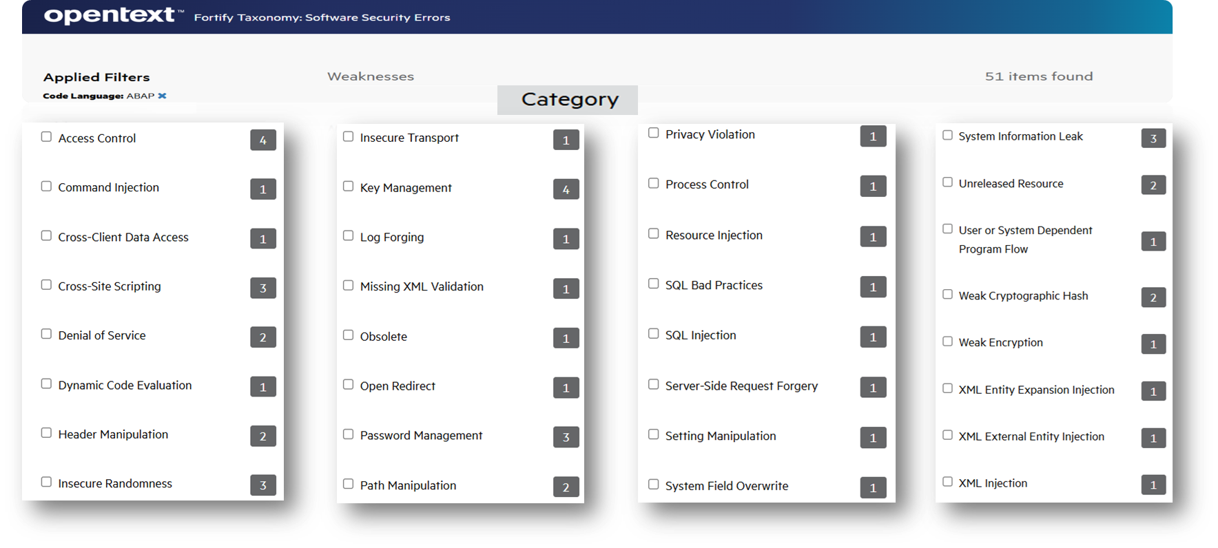
Fortify Scan ABAP – Coverage
Fortify has a comprehensive set of rules for finding vulnerabilities in SAP ABAP Code (see https://vulncat.fortify.com/en/weakness?codelang=ABAP for some examples).
Notes:
https://www.microfocus.com/en-us/assets/cyberres/magic-quadrant-for-application-security-testing

Slide 29
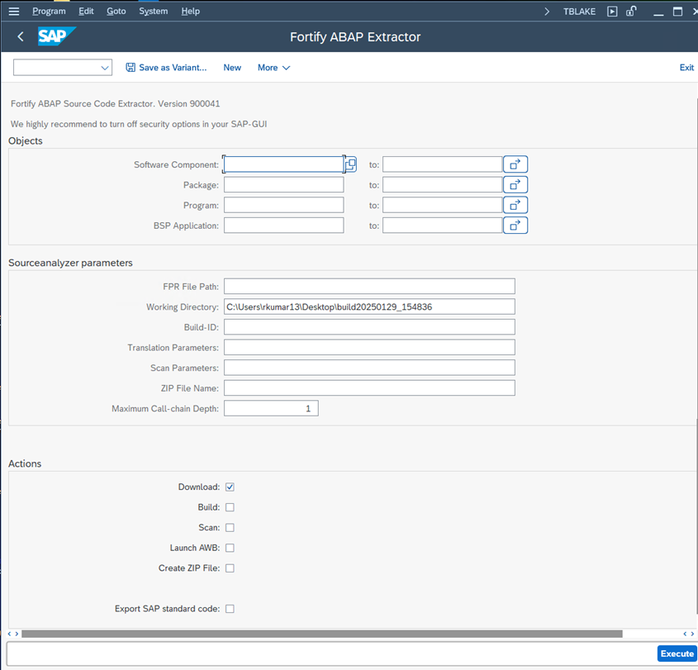
Fortify Scan ABAP –Extractor
The Fortify ABAP Extractor automates the process of extracting SAP ABAP Program code and scanning for vulnerabilities.
ABAP Extractor – Various Options
https://www.microfocus.com/documentation/fortify-static-code-analyzer-and-tools/2440/SCA_Help_24.4.0/index.htm#abap/RunABAPExtractor.htm?Highlight=ABAP
Notes:
https://www.microfocus.com/en-us/assets/cyberres/magic-quadrant-for-application-security-testing

Slide 30
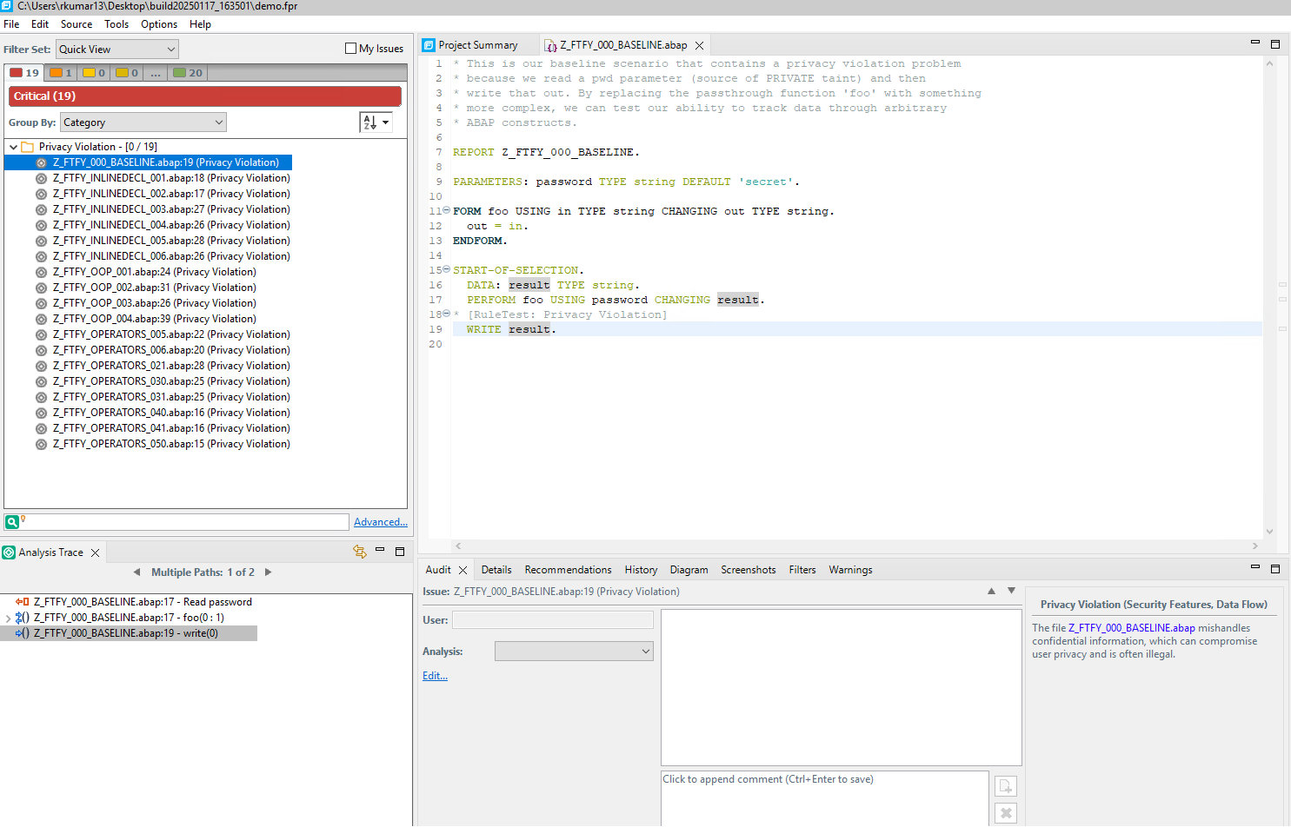
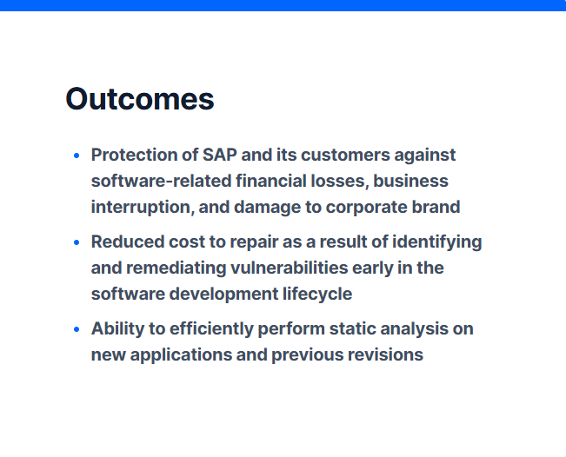
Fortify Scan ABAP – Scan Results
Notes:
https://www.microfocus.com/en-us/assets/cyberres/magic-quadrant-for-application-security-testing

