Slide 1
Kickoff Meeting
Application Security Overview
Defining your goals, objectives and deliverables for
WebInspect and WebInspect Enterprise.

Slide 2
Application Security - Overview
Software Security Assurance (SSA) is the process of ensuring that software is designed to operate at a level of security that is consistent with the potential harm that could result from the loss, inaccuracy, alteration, unavailability, or misuse of the data and resources that it uses, controls, and protects.

Slide 3
Application Security - Overview
The primary goal of Application Security is to reduce your business risk by eliminating vulnerabilities in your source code. For that reason, we are going to need a process that repairs the code.

Slide 4

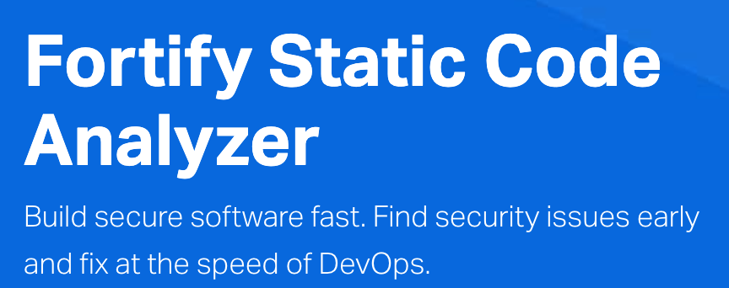
Application Security – Automated Types
Dynamic Testing (DAST)
This testing requires the application to be completed and deployed. Lower ROI then static testing since you pay developers twice.
Static Testing (SAST)
This testing is performed as the developer writes the code. This allows fixes to be made before deployment.
NOTE: The ideal is to perform both DAST and SAST.

Slide 5
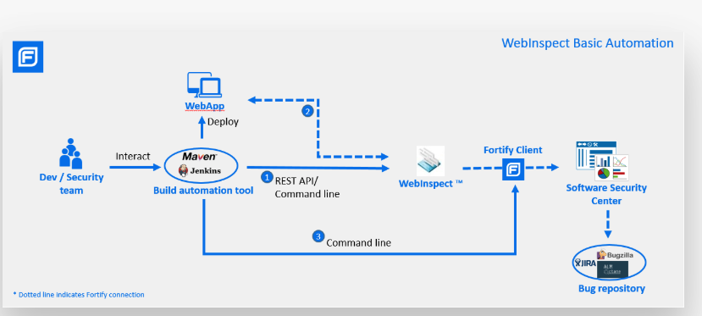

Slide 6
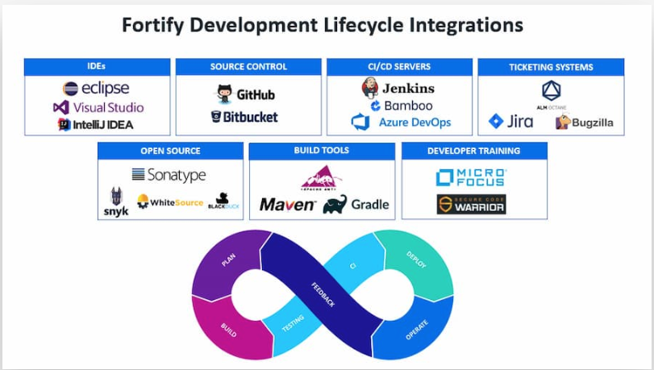

Slide 7

Application Security - Overview
Tools do NOT fix problems, People do !
Tools can support people in finding problems and provide guidance for the human to fix.

Slide 8
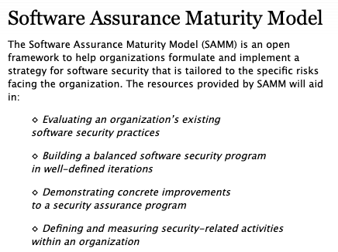
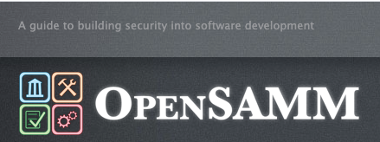
https://www.opensamm.org/

Slide 9
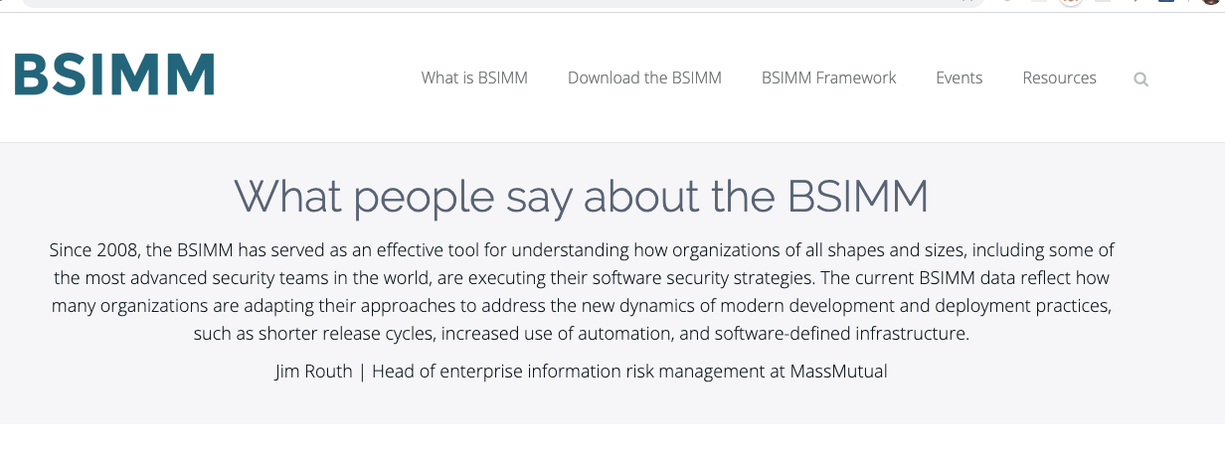

Slide 10
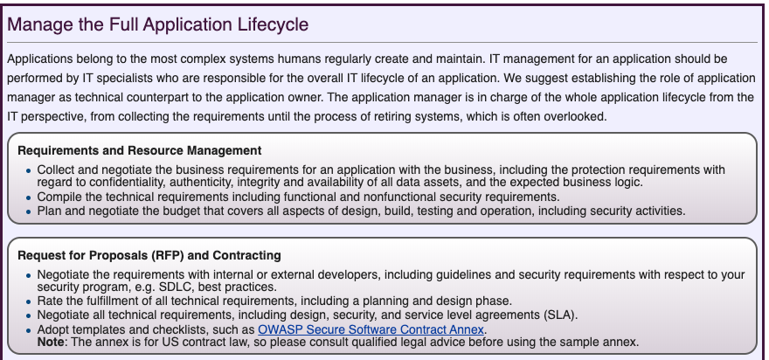
Application Security – Process - 1 https://www.owasp.org/index.php/Top_10-2017_What%27s_Next_for_Application_Managers

Slide 11
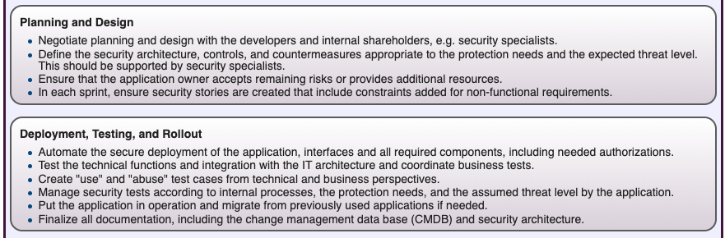
Application Security – Process - 2 https://www.owasp.org/index.php/Top_10-2017_What%27s_Next_for_Application_Managers

Slide 12
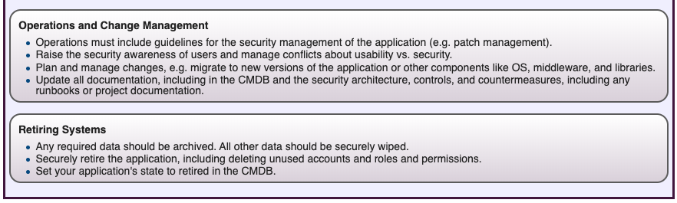
Application Security – Process - 3 https://www.owasp.org/index.php/Top_10-2017_What%27s_Next_for_Application_Managers

Slide 13
Application Security Overview
Key Concepts

Slide 14
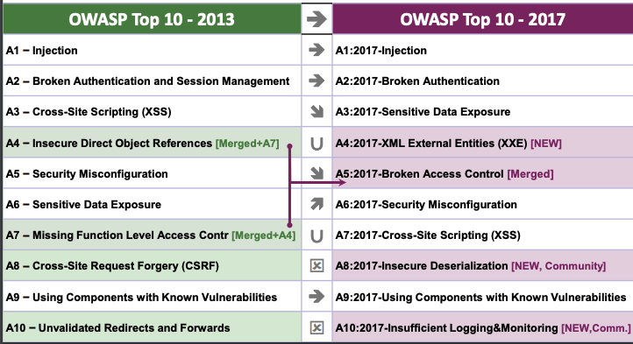
Application Security – Overview https://www.owasp.org/images/7/72/OWASP_Top_10-2017_%28en%29.pdf.pdf

Slide 15











Cyber attackers are targeting applications
Over 80% of breaches occur through software applications
Applications
Hardware
Networks
Security Measures
Switch/Router security
Firewalls
NIPS/NIDS
VPN
Net-Forensics
Anti-Virus/Anti-Spam
DLP
Host FW
Host IPS/IDS
Vuln. Assessment tools
Intellectual Property
Customer Data
Business Processes
Trade Secrets
Notes:
In today’s information-centric world, Hackers are after data and business logic, which they can manipulate and control. You’re talking about stealing your Intellectual Property, your Customer Data (credit card, SSN, address, etc.), Business Processes and Trade Secrets.
With software, protecting one point in the system is not sufficient. The whole pathway to the data must be secure. If there is any vulnerability along that path, then the entire system is vulnerable. Hackers are ingenious in discovering new pathways. Years ago, they started at the network and hardware levels, but we have been successful in handling the problem (grayed out area), now they are going right to the app layer.
This can be useful in explaining things like why encryption is not going to help you with app sec.
15

Slide 16
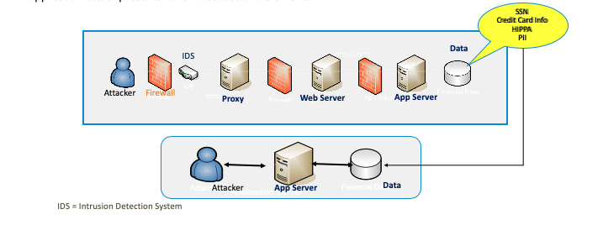
Application Vulnerabilities
It is important to clarify that adversaries have fewer obstacles when performing an attack on code
For example, an infrastructure attack presents all the following obstacles and elements
An application attack presents fewer obstacles and elements

Slide 17
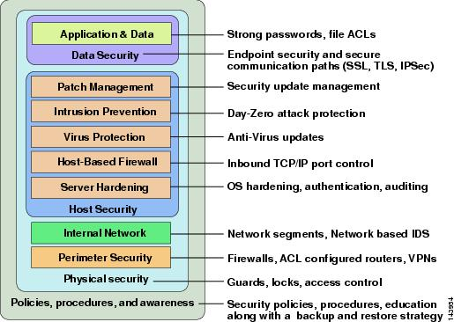
Defense in Depth
Application
and Data
Weak Link

Slide 18
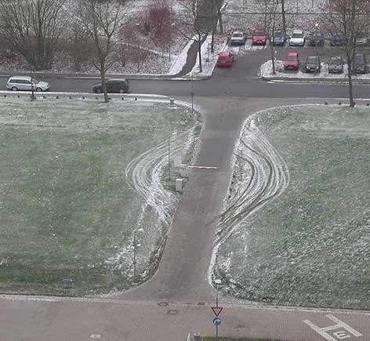
Vulnerability –Example - What are you protecting ?

Slide 19
Do you create detailed threat models for your critical apps ?
https://www.owasp.org/index.php/Testing_Guide_Introduction#Threat_Modeling
To develop a threat model, we recommend taking a simple approach that follows the NIST 800-30 [11] standard for risk assessment. This approach involves:
Decomposing the application – use a process of manual inspection to understand how the application works, its assets, functionality, and connectivity.
Defining and classifying the assets – classify the assets into tangible and intangible assets and rank them according to business importance.
Exploring potential vulnerabilities - whether technical, operational, or management.
Exploring potential threats – develop a realistic view of potential attack vectors from an attacker’s perspective, by using threat scenarios or attack trees.
Creating mitigation strategies – develop mitigating controls for each of the threats deemed to be realistic.

Slide 20
Application Security - Overview
Tools do NOT fix problems, People do !
Tools can support people in finding problems and provide guidance for the human to fix.

Slide 21
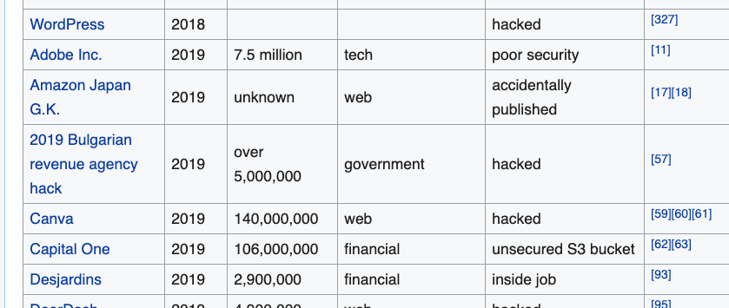
Examples of AppSec Breaches
https://en.wikipedia.org/wiki/List_of_data_breaches
Wikipedia contributors. (2019, December 23). List of data breaches. In Wikipedia, The Free Encyclopedia. Retrieved 01:01, December 30, 2019, from https://en.wikipedia.org/w/index.php?title=List_of_data_breaches&oldid=932101229

Slide 22
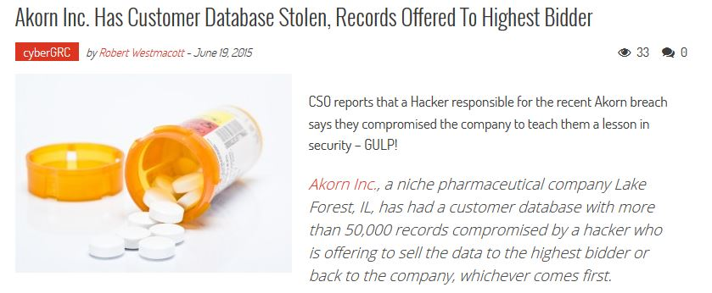
SQL Injection is Still and issue

Slide 23
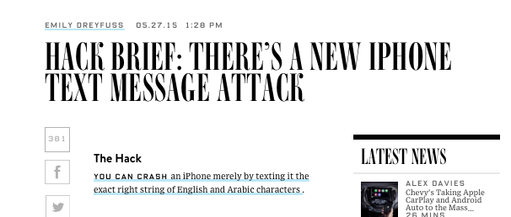
Recent Security Incidents
Availability
http://www.wired.com/2015/05/hack-brief-theres-new-iphone-text-message-attack/
Notes:
What does your business or organization have of value that it needs to protect ?

Slide 24
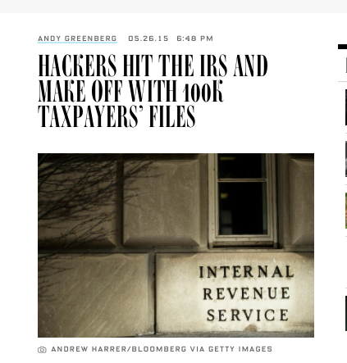
Recent Security Incidents
http://www.wired.com/2015/05/hackers-hit-irs-access-100000-taxpayers-files/
Confidentiality
&
Integrity
Notes:
What does your business or organization have of value that it needs to protect ?

Slide 25

Data breach results in $4.8 million HIPAA
April 2014
settlemen
http://www.hhs.gov/news/press/2014pres/05/20140507b.html
Two health care organizations have agreed to settle charges that they potentially violated the Health Insurance Portability and Accountability Act of 1996 (HIPAA) Privacy and Security Rules by failing to secure thousands of patients’ electronic protected health information (ePHI) held on their network. The monetary payments of $4,800,000 include the largest HIPAA settlement to date.

Slide 26

Cross Site Scripting Famous Example
PayPal, circa 2004 - 2006
Steal credit card numbers
  Users access URL on genuine PayPal site
  Page modified via XSS attack to silently redirect user to external server
  Fake PayPal Member log-in page
  User supplies login credentials to fake site
Exploitable for two years
26
Notes:
References:
PayPal Security Flaw allows Identity Theft
Advisory, Netcraft, 16 June 2006
PayPal XSS Exploit available for two years?
News Story, Netcraft, 20 July 2006
PayPal fixes phishing hole
News Story, News.com, 16 June 2006
Responsible Disclosure? - Paypal vulnerable for two years
Blog Entry, Computer World, 20 July 2006
26

Slide 27

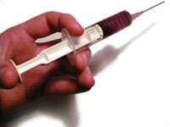
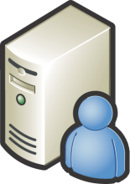



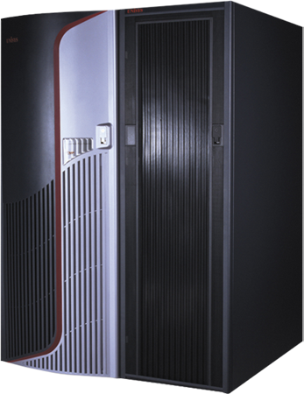
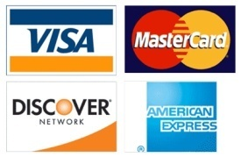
Injection Attack Costly Example
Heartland Payment Systems – Jan, 2009
Jan. 2009
94M records stolen
$130M +
SQL Injection
HR
MAC III
(cmd_proc
Enabled)
Payment
Processing
MAC I
Notes:
Civilian example of a SQL Injection – placing attack code in a running application – on an administrative system (Mission Assurance Category III in Gov’t language). Once the attacker takes control of the HR system, they retrieve authorized access to the payment processing network and subsequently steal 94 million records – costing over $130M.

Slide 28
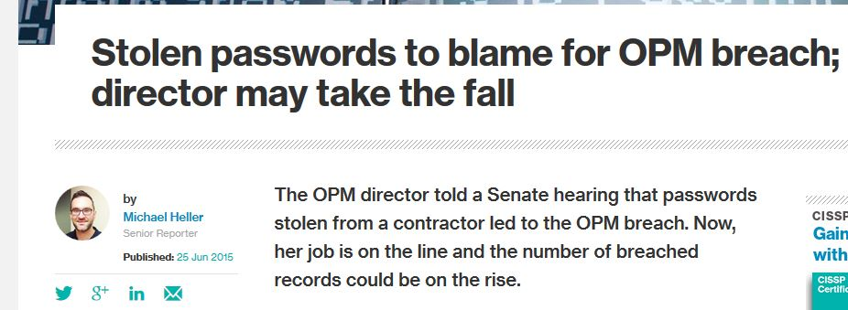
Authentication Design Flaws

Slide 29
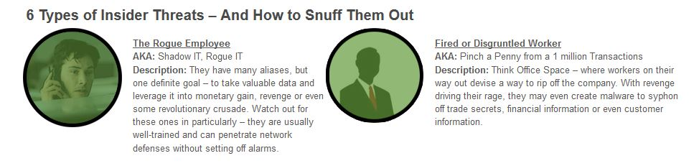
Insider Threats

Slide 30



House
Exercise:
List the Potential Attacks/SafeGuards
Attack (or exploit). An action taken to harm an asset.
Threat
Which is easier to protect ?
Why/When/Cost ?
Family
Internal Threat
Storms
Thief
External
Threat
Repairman
Internal
Threat
House is like a
Desktop Computer
Apartment is like a
VM/Cloud/Shared
Computing
Assets

Slide 31
Application Security – Overview
Key Security Concepts
Confidentiality
  Prevent the disclosure of information to unauthorized individuals or systems.
Integrity
  Prevent data modifications that are untraceable.
Availability
  Ensure the information is available when it is needed

Slide 32
Application Security – Overview https://www.owasp.org/index.php/OWASP_Risk_Rating_Methodology
Technical Impact Factors
Technical impact can be broken down into factors aligned with the traditional security areas of concern: confidentiality, integrity, availability, and accountability. The goal is to estimate the magnitude of the impact on the system if the vulnerability were to be exploited.
Loss of confidentiality
How much data could be disclosed and how sensitive is it? Minimal non-sensitive data disclosed (2), minimal critical data disclosed (6), extensive non-sensitive data disclosed (6), extensive critical data disclosed (7), all data disclosed (9)
Loss of integrity
How much data could be corrupted and how damaged is it? Minimal slightly corrupt data (1), minimal seriously corrupt data (3), extensive slightly corrupt data (5), extensive seriously corrupt data (7), all data totally corrupt (9)
Loss of availability
How much service could be lost and how vital is it? Minimal secondary services interrupted (1), minimal primary services interrupted (5), extensive secondary services interrupted (5), extensive primary services interrupted (7), all services completely lost (9)
Loss of accountability
Are the threat agents' actions traceable to an individual? Fully traceable (1), possibly traceable (7), completely anonymous (9)

Slide 33
Application Security - Overview
Application security encompasses measures taken to improve the security of an application often by finding, fixing and preventing security vulnerabilities.
Key Terms
Asset. Resource of value such as the data in a database, money in an account, file on the filesystem or any system resource.
Vulnerability. A weakness or gap in security program that can be exploited by threats to gain unauthorized access to an asset.
Attack (or exploit). An action taken to harm an asset.
Threat. Anything that can exploit a vulnerability and obtain, damage, or destroy an asset.
Wikipedia contributors. (2019, September 12). Application security. In Wikipedia, The Free Encyclopedia. Retrieved 23:32, December 29, 2019, from https://en.wikipedia.org/w/index.php?title=Application_security&oldid=915255773

Slide 34
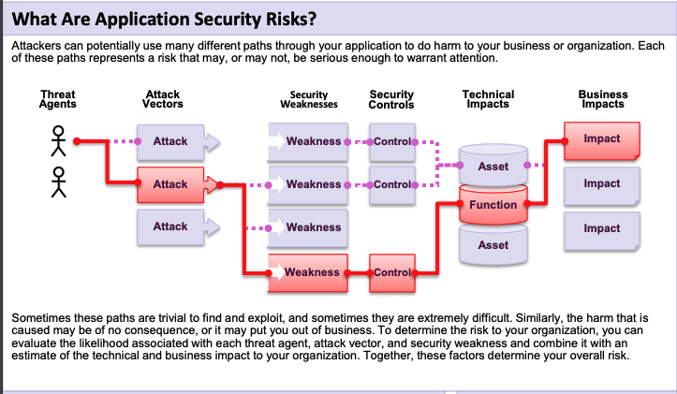
Application Security – Overview https://www.owasp.org/images/7/72/OWASP_Top_10-2017_%28en%29.pdf.pdf

Slide 35
Dynamic Web Site Testing
A dynamic application security testing (DAST) tool is a program which communicates with a web application through the web front-end in order to identify potential security vulnerabilities in the web application and architectural weaknesses.
Wikipedia contributors. (2019, December 2). Dynamic application security testing. In Wikipedia, The Free Encyclopedia. Retrieved 23:31, December 29, 2019, from https://en.wikipedia.org/w/index.php?title=Dynamic_application_security_testing&oldid=928924351
Fortify WebInspect is a DAST tool.

Slide 36
Dynamic Web Site Testing Phases
Baseline/Initial Scans
This is the scan that is the initial Web ScanS performed to see the current state.
NOTE: a comprehensive baseline scan may include many scan versions and is an iterative process until all potential threat paths have been addressed:
  Scan without Login Macro
  Scan with Login Macro
  Scan with Login Macro and Business Workflow Macro
Remediation/After Fixes/Code Changes Scan
This is the scan that is performed at various checkpoints after code changes for the web application have been performed and deployed to testing area.

Slide 37
WebInspect Use Case – DAST Baseline Scans
The goals of a DAST baseline scan is to set a starting point for fixing security issues found by a web security test.
This is usually the first phase after you have defined your Application Security Program and Processes using BSIMM and OpenSAMM as a guide or reference.
NOTE: This requires that you select the key applications and setup a schedule for the baseline scan.

Slide 38
WebInspect Use Case – DAST Remediation Scans
The goals of a DAST remediation scan is to verify that fixes have been made to an application.
This is usually the performed after a review of the baseline scan and assignment of issues via a bug tracking system. This issue should have been fixed and marked in the bug tracking system.

Slide 40
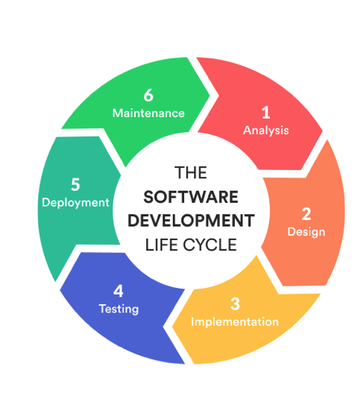
Initial Discussion Questions.
Key Discussion Questions:
NOTE: Please provide details on the critical business applications and development processes, based on these questions.
Describe the software development lifecycle used and the tools that support this ? List all tools also.
How do you perform change management for your critical business applications applications today ?
Do you create threat models and data classification for your critical business applications ? How detailed and when is it done ? Do you use or plan to use OpenSAMM, BSIMM or some other security framework?
How do you find security issues in your applications today ? What tools or services do you use ?
How do you plan to use WebInspect in your current SDLC ? Are you planning to define a new process ?

