Slide 1
(DAST) Dynamic Application Security Testing with WebInspect
Best Practices for Reducing Risks with WebInspect DAST tools

Slide 2
Application Security - Overview
Software Security Assurance (SSA) is the process of ensuring that software is designed to operate at a level of security that is consistent with the potential harm that could result from the loss, inaccuracy, alteration, unavailability, or misuse of the data and resources that it uses, controls, and protects.

Slide 3
Application Security - Overview
The primary goal of Application Security is to reduce your business risk by eliminating vulnerabilities in your source code. For that reason, we are going to need a process that repairs the code.

Slide 4

Application Security - Overview
Tools do NOT fix problems, People do !
Tools can support people in finding problems and provide guidance for the human to fix.

Slide 5











Cyber attackers are targeting applications
Over 80% of breaches occur through software applications
Applications
Hardware
Networks
Security Measures
Switch/Router security
Firewalls
NIPS/NIDS
VPN
Net-Forensics
Anti-Virus/Anti-Spam
DLP
Host FW
Host IPS/IDS
Vuln. Assessment tools
Intellectual Property
Customer Data
Business Processes
Trade Secrets
Notes:
In today’s information-centric world, Hackers are after data and business logic, which they can manipulate and control. You’re talking about stealing your Intellectual Property, your Customer Data (credit card, SSN, address, etc.), Business Processes and Trade Secrets.
With software, protecting one point in the system is not sufficient. The whole pathway to the data must be secure. If there is any vulnerability along that path, then the entire system is vulnerable. Hackers are ingenious in discovering new pathways. Years ago, they started at the network and hardware levels, but we have been successful in handling the problem (grayed out area), now they are going right to the app layer.
This can be useful in explaining things like why encryption is not going to help you with app sec.
5

Slide 6
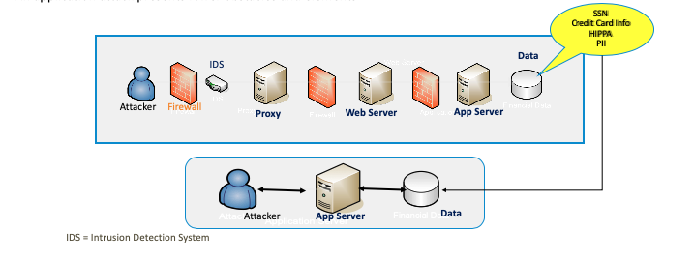
Application Vulnerabilities
It is important to clarify that adversaries have fewer obstacles when performing an attack on code
For example, an infrastructure attack presents all the following obstacles and elements
An application attack presents fewer obstacles and elements

Slide 7
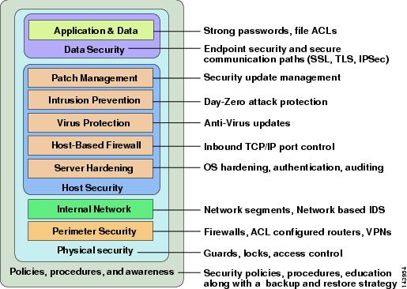
Defense in Depth
Application
and Data
Weak Link

Slide 8

Vulnerability –Example - What are you protecting ?

Slide 9

Application Development Life Cycle
Product Design
Development
Testing
Deployment
Production
Security requirements
SAST
RASP or WAF
DAST/IAST
Pen Tests

Slide 10

DAST Pros and Cons
Key concerns:
Should add SAST to reduces risks further.
Cannot detect non-reflective attacks
Might miss minor or less visited areas of the app
Requires full compilation upon every code change
Not fitting for agile methodology
No Remediation location indication
No need for source code
Analysis on Client and Server side
Exposes Vulnerabilities manifested in real-time
Can expose 3rd party vulnerabilities
NOTE: You pay Coder Twice once to write bad code and again to fix it. SAST Answer.
Notes:
Exposes vulnerabilities that manifest themselves only in real-time. For example, it can present production mis-congurations or vulnerabilities that are based on dynamic reection. Integration with 3rd party code. Many times an app is based on an external compiled package or library. A magnifying glass into the source code of the app to “read” its behavior is impossible in these cases. However, testing the app’s functionalities based on varying input allows the user to gain an understanding of what the app does and how it does it.
Limited vulnerability coverage. The DAST tool analyzes only requests and responses. As a result, DAST cannot surface hidden vulnerabilities such as design issues, or vulnerabilities that do not generate feedback when triggered (aka non-reective attacks). Limited app coverage. The DAST crawls the application in order to dene its points of entry. However, some DAST tools are known to miss smaller or less visited pages and thus the security of these pages are not tested. Every code change requires a new scan. The point is that DAST runs on the executable – the complete Web app. Consequently, if the app changes it needs to be re-packaged as an application in order to perform a dynamic scan. In an environment with constant new releases, no security program has the privilege to delay a release to follow the DAST cycle: packaging an app for scanning, returning the app to development for xing, and once again re-packaging to re-scan.

Slide 11
Do you create detailed threat models for your critical apps ?
https://www.owasp.org/index.php/Testing_Guide_Introduction#Threat_Modeling
To develop a threat model, we recommend taking a simple approach that follows the NIST 800-30 [11] standard for risk assessment. This approach involves:
Decomposing the application – use a process of manual inspection to understand how the application works, its assets, functionality, and connectivity.
Defining and classifying the assets – classify the assets into tangible and intangible assets and rank them according to business importance.
Exploring potential vulnerabilities - whether technical, operational, or management.
Exploring potential threats – develop a realistic view of potential attack vectors from an attacker’s perspective, by using threat scenarios or attack trees.
Creating mitigation strategies – develop mitigating controls for each of the threats deemed to be realistic.

Slide 12
DAST Best Practice Phases
The following phased approached ensures you identify the risk that need to be mitigated first, first ! After that, then move to more complicated scenarios with user role logins and workflows. The goal is to create two final scan templates for a quick scan and full check scan. Scan templates allow you to resuse settings that are tailor to a website.
Phase #1: Baseline Scans
Crawl First Level Only: The is a scan without login of the first level of pages. You will see if any vulnerabilities need to be fixed that any average user would find. This should be fixed first, because they require no effort other than visiting the home page. This scan should be the fastest to perform and will find the issues that needed to be fixed yesterday.
Crawl Full Site Only: The is a scan without login of full website. You will see if any vulnerabilities that need to be fixed that any average user would find. These vulnerabilities should be fixed first, because they require no effort other than visiting website. With this scan you should identify any other hosts that are used with this Website, (i.e. Microservices) that should be included in the allow host for the full scan in the next phase.
Crawl/Audit with basic user Login Macro: This scan requires that you create a login macro with valid credentials for the website. This scan should include settings and allowed hosts from the analysis of the prior crawl only scans.
Crawl/Audit with basic user Login Macro and Workflow Macros: This is the scan that includes the action from the full scan with login and creates workflow macros for all user form scenarios.

Slide 13
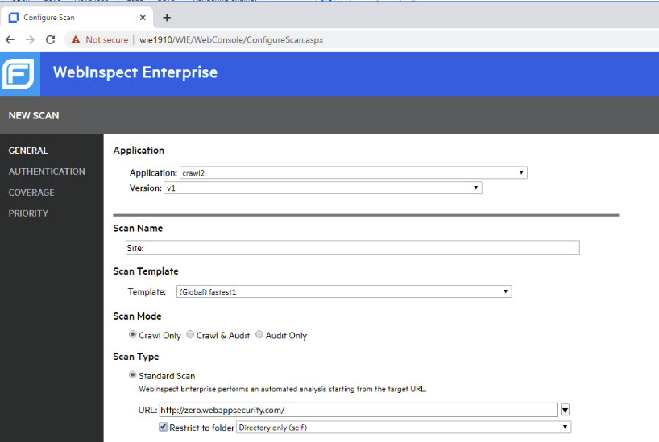
Example Crawl Only First Level Scan:

Slide 14
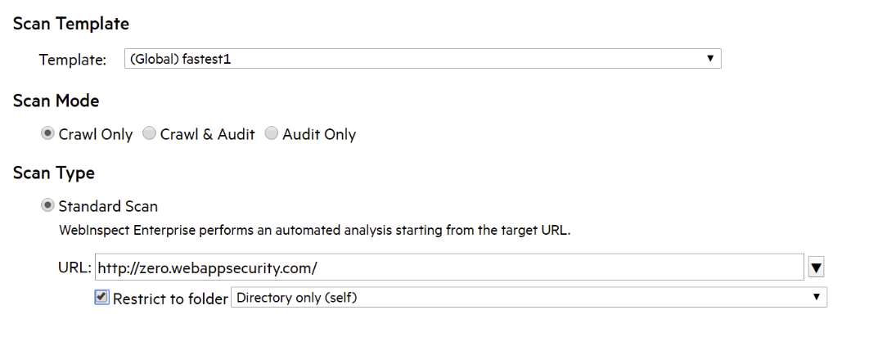
Example Crawl Only First Level Scan:
NOTE: This scan used a scan template with special settings to just look for things easy to find and restricted to only the first level pages. We will discuss scan templates, later in the advance configuration settings section.

Slide 15
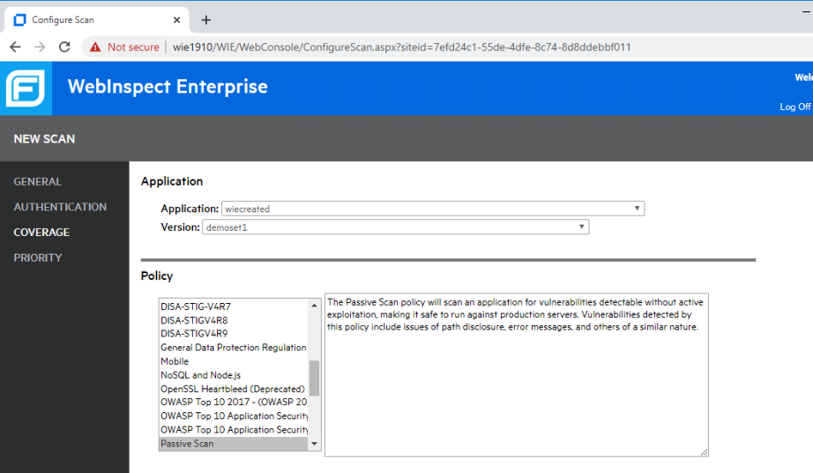
Example Crawl Only First Level Scan: Passive only

Slide 16
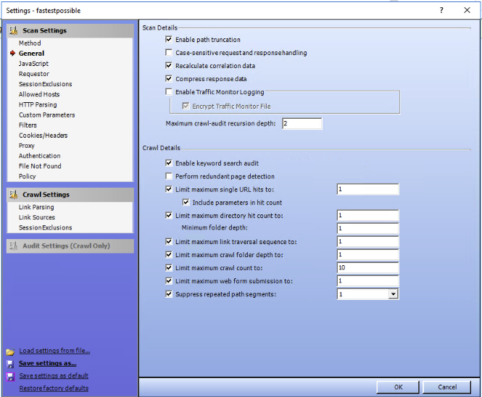
Example Crawl Only First Level Scan Example Quick Settings:

Slide 17
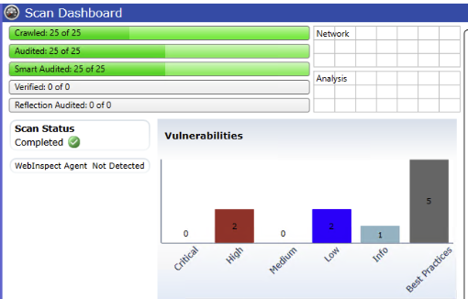
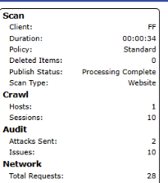
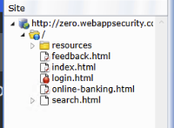
Example Crawl Only First Level Scan Example Quick Settings:

Slide 18
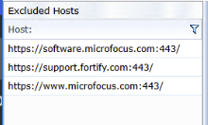
Example Crawl Only First Level Scan Example Quick Settings:

Slide 19



The Goal of a Crawl Only Scan on First Level is to get the most critical low hanging fruit , if any. This should be fixed yesterday !
The scan will be fast and hopefully does not return any critical issues or highs.
Hacker person starts with low hanging fruit. They may never need to try the more complex attacks.
Regular person can find low hanging fruit.

Slide 20

Questions

Slide 21



Slide 22
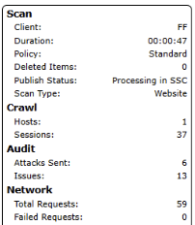
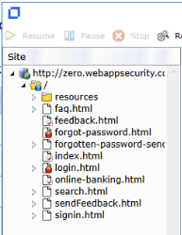
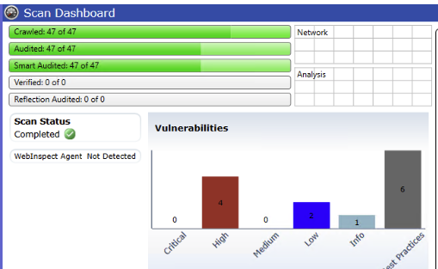
Example Crawl Only Full Site Scan:

Slide 23
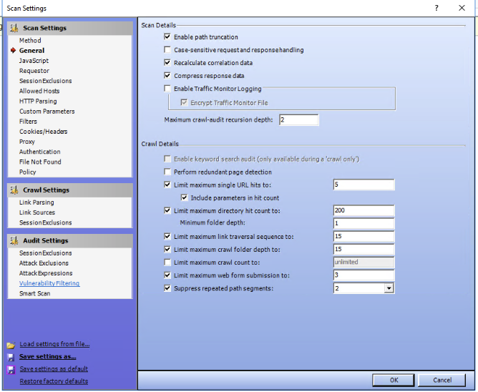
Example Crawl Only First Level Scan Example Default Settings:

Slide 24
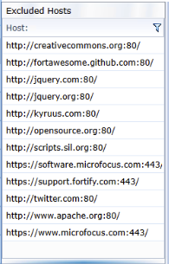
Example Crawl Only Full Site Scan:

Slide 25

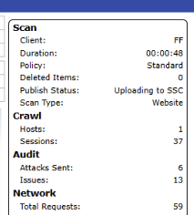
Example Crawl Only Quick speed compare to Full Site Scan:
Increase in time.
NOTE: This is one example on a small scale.
There are many factors that affect scan time.
NOTE: We will discuss scan performance tuning in a later section.

Slide 26
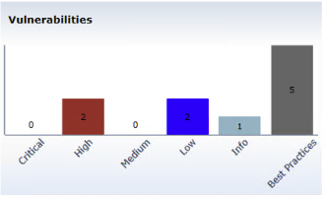
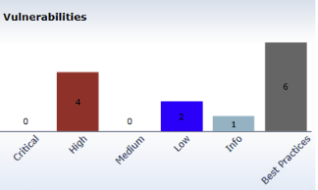


Example Crawl Only Quick speed compare to Full Site Scan:
50% Increase in High issues.
NOTE: This is one example on a small scale.
There are many factors that affect issues
NOTE: We will discuss how WebInspect detect issues in a later section.

Slide 27
Questions

