Slide 1
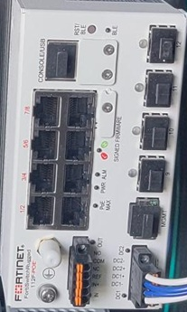
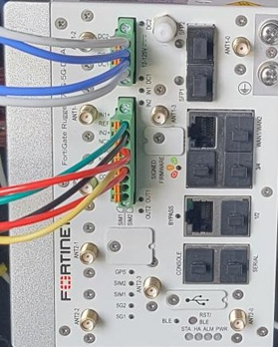

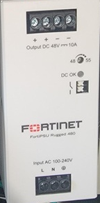
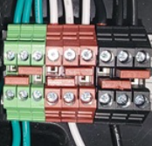
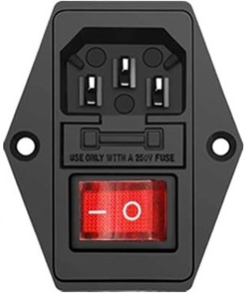
–PS2
+PS2
+PS1
-PS1
-PS1 +PS1 –PS2 +PS2
–PS2
+PS2
+PS1
-PS1
-PS1 +PS1 –PS2 +PS2
-PS1 +PS1 –PS2 +PS2
-PS1 +PS1 –PS2 +PS2
G1
+PS1 +PS1 -PS1 -PS1
+PS2 +PS2 -PS2 -PS2
G2
N1
N2
L1
L2
Note: Jumpers
Ground / Green
Neutral / White
Line / Black
L1 N1 G1
L2 N2 G2

Slide 2
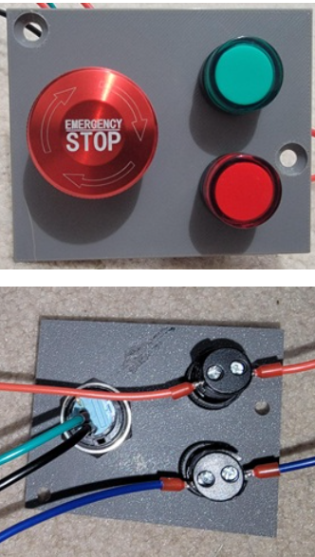
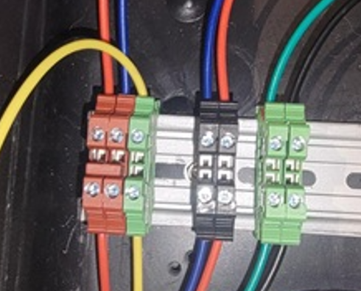
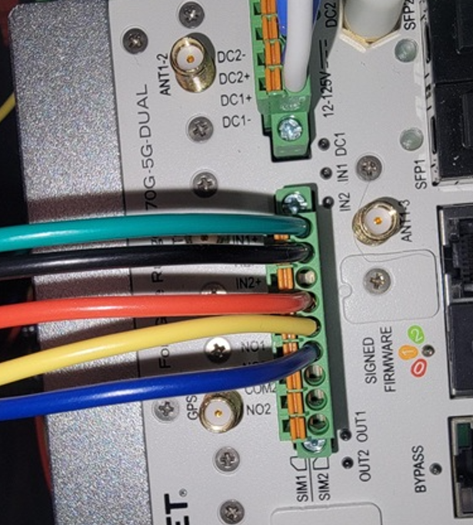
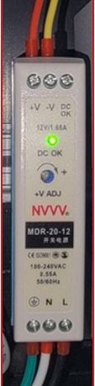
Green Light
Green Light
Red Light
Red Light
eStop
-V
Red Light
eStop
Red Light
Green Light
Note: Jumper
Green Light
To Terminal Block
To Terminal Block
+V
To FGR
To FGR
To FGR
To FGR
To FGR
To Terminal Block
G3
+V -V
N3
L3
Note: Jumpers
Ground / Green
Neutral / White
Line / Black
G3 N3 L3

